Slide 1
Dephasing Mechanisms
Г_{g}: ground state lifetime (> 20 s) -> neglect
Г_{e}: excited state lifetime (~ 5 s) -> neglect
Angle: (< 5 mrad): sample is 2 µK => 140 Hz (k*angle*v/2/pi)
Г∆ : Detuning, at a central pixel (~5.5 µM): ~ 100 Hz
Г_{L}: Laser linewidth ~ 200 Hz
Collisional effects: Г_{ee,} Г_{ge} (?), Г_{dep} (?) (dephasing due to elastic collisions)
Lattice intensity fluctuations

Slide 2
Collisional effects Г_{ee}
OD of a central pixel: ~ 0.4
Atom number in the center pixel: 115 atoms
Number of tubes per pix: 140 lattice sites
=> <N> = 0.8 atoms per site
=> 45 % 0 atom
=> 36 % 1 atom
=> 14 % 2 atoms
=> 4 % 3 atoms
=> 0.8 % 4 atoms
Peak density of a single atom in tube: ~1e13
Г_{ee} = NSite*Kee Density

Slide 3
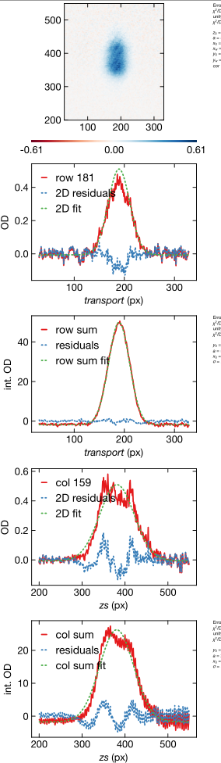
(side note): Collisional effects Г_{ee}
<N> = 0.8 atoms per site
From the fit-> <N>~2

Slide 4
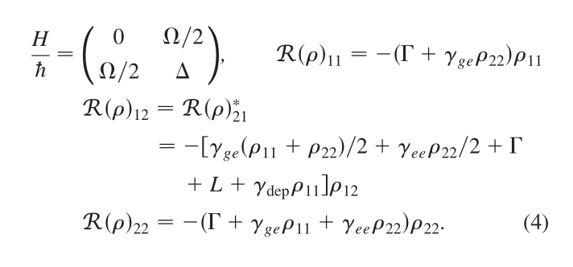
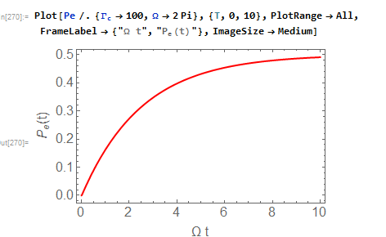
Detuning and Laser linewidth (Approach 1)

Slide 5
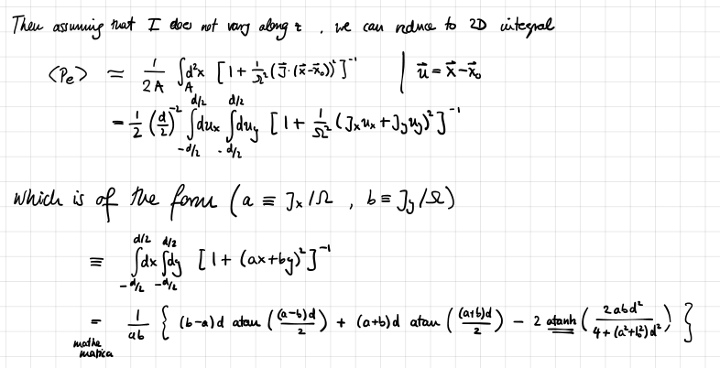
Detuning and Laser linewidth (Approach 2)

Slide 6
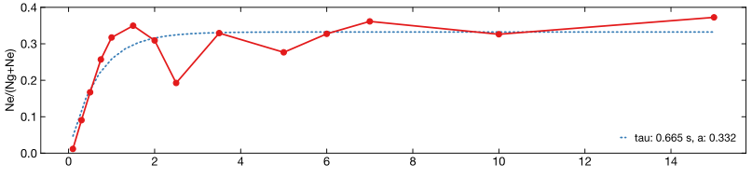
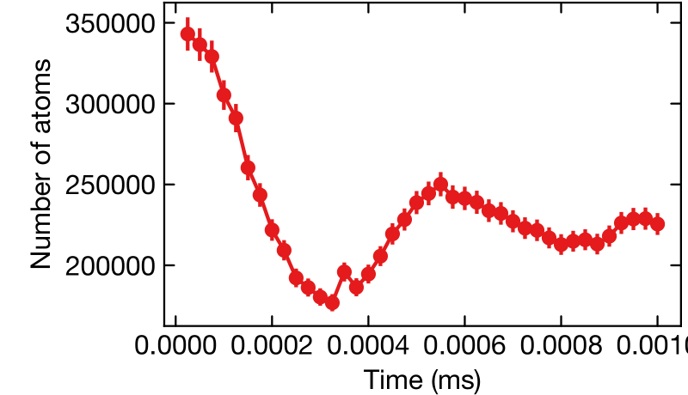
Rabi in the SC
Rabi in the MC

