Slide 1
Dephasing Mechanisms
Г_{g}: ground state lifetime (> 20 s) -> neglect
Г_{e}: excited state lifetime (~ 5 s) -> neglect
Angle: (< 5 mrad): sample is 2 µK => 140 Hz (k*angle*v/2/pi)
Clock laser intensity & field fluctuations,
Г∆ : Detuning, at a central pixel (~5.5 µM): ~ 100 Hz
Lattice intensity fluctuations => total AC stark shift 400 kHz
=> 400 Hz for dI/I0=1e-3
Laser linewidth: ~ 200 Hz
Collisional effects: Г_{ee,} Г_{ge} (?), Г_{dep} (?) (dephasing due to elastic collisions)
*inhomogeneities in Ω
*inhomogeneities in ∆
*inhomogeneities in Ω & ∆

Slide 2
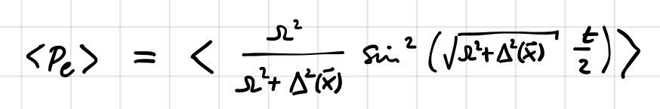
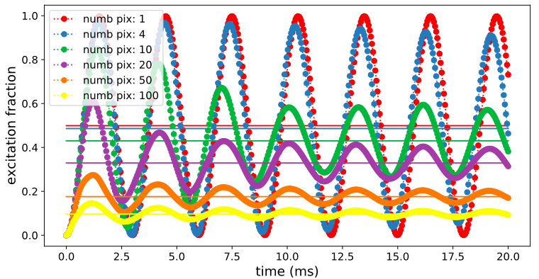
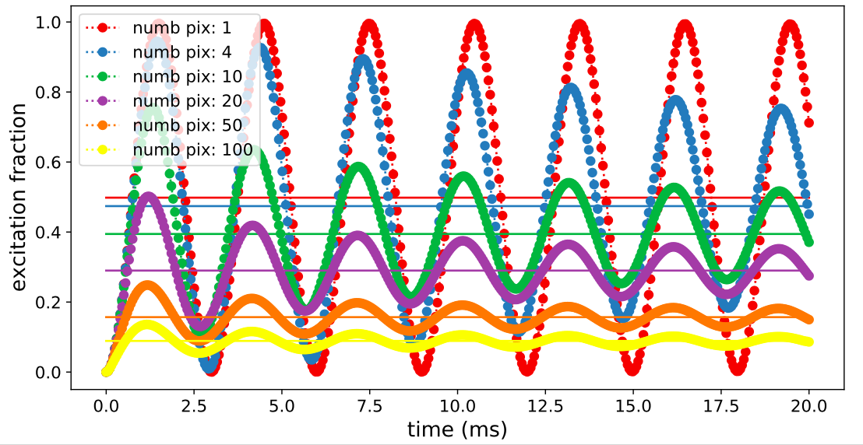
Inhomogeneities in ∆ (numerics)
Analytic solution for a steady state for
linear detuning (s.b.’s write-up)
->
∆
1D
Slope: 50 Hz/ 1 pix => 1 pix => 5.5 µm
x
0
2D

Slide 3
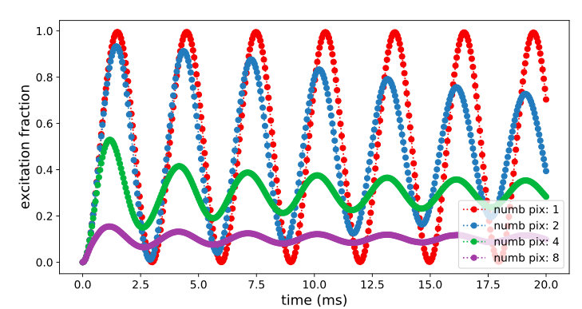
Inhomogeneities in ∆ (numerical & analytic soln )
Detuning: from the potential -> additions of two gaussian
->
∆
0
x
Single pixel => detuning contribution very small
Pe_steady_state as a function of numb pix averaged goes down more
rapidly than actual data (need further investigation)

Slide 4
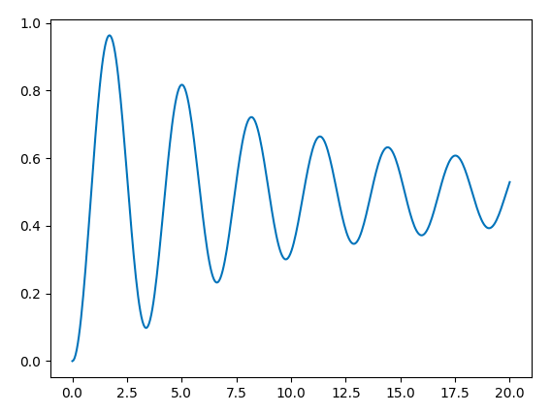
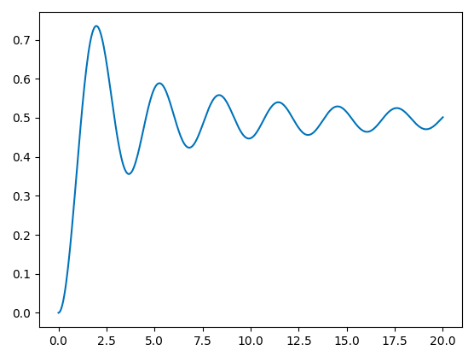
Inhomogeneities in Ω due to angle
5 mrad angle, 200 Hz and 2 uK
10 mrad angle, 200 Hz and 2 uK
Notes:
Mode angle

Slide 5
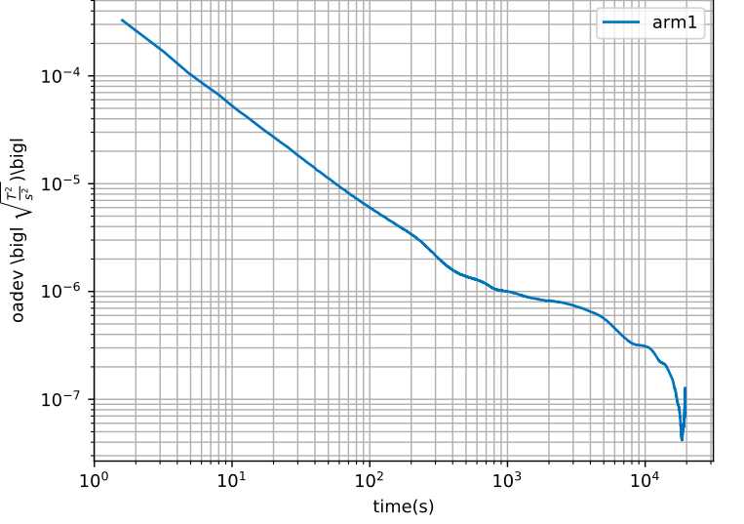
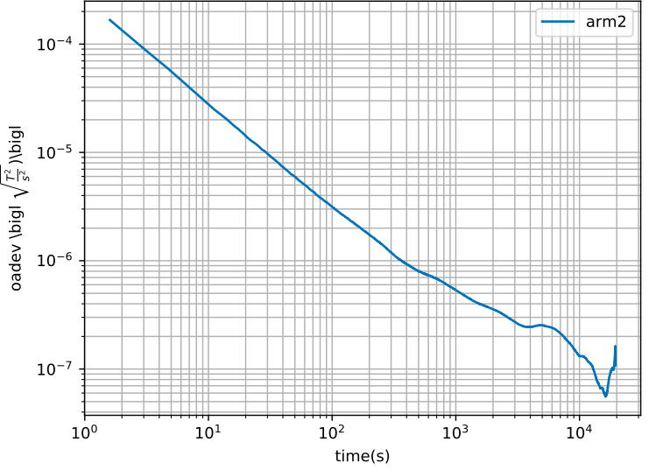
Intensity noise

Slide 6
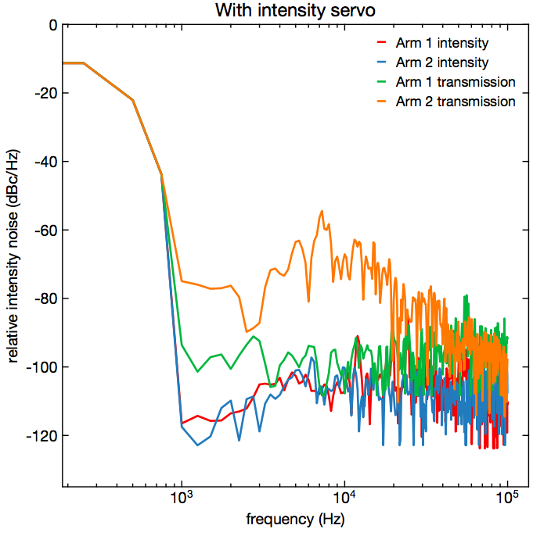

Slide 7
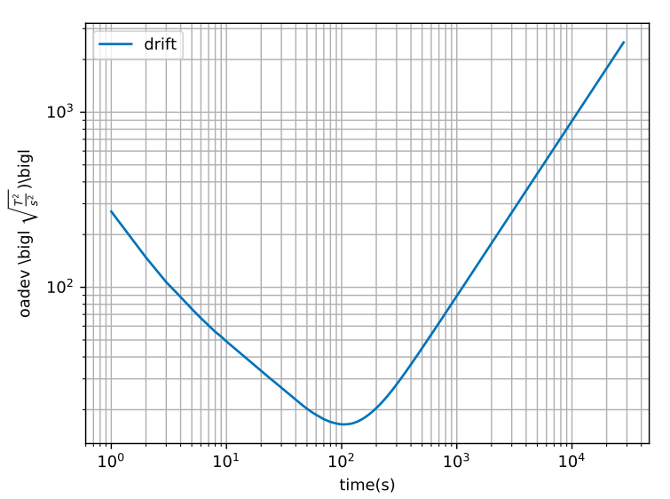
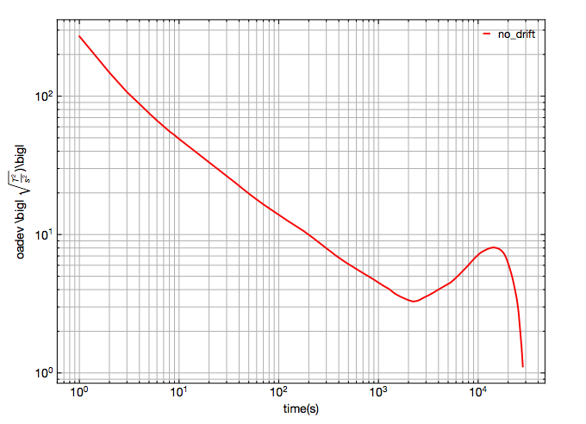

Slide 8
Dephasing Mechanisms
Г_{g}: ground state lifetime (> 20 s) -> neglect
Г_{e}: excited state lifetime (~ 5 s) -> neglect
Angle: (< 5 mrad): sample is 2 µK => 140 Hz (k*angle*v/2/pi)
Clock laser intensity & field fluctuations,
Г∆ : Detuning, at a central pixel (~5.5 µM): ~ 100 Hz
Lattice intensity fluctuations => total AC stark shift 400 kHz
=> 400 Hz for dI/I0=1e-3
Laser linewidth: ~ 200 Hz
Collisional effects: Г_{ee,} Г_{ge} (?), Г_{dep} (?) (dephasing due to elastic collisions)
*inhomogeneities in Ω
*inhomogeneities in ∆
*inhomogeneities in Ω & ∆

Slide 9
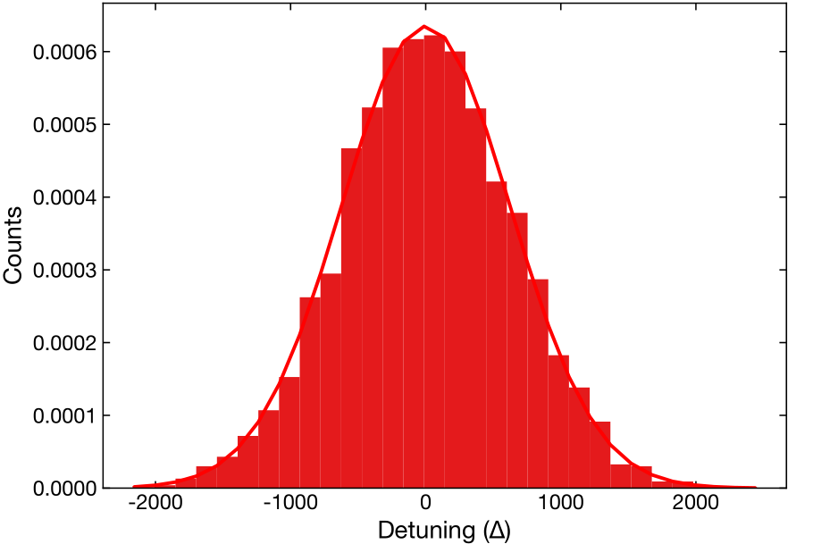
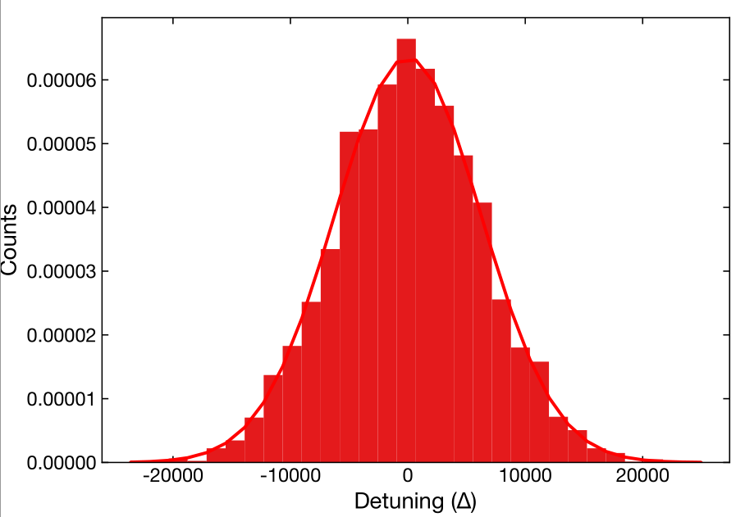
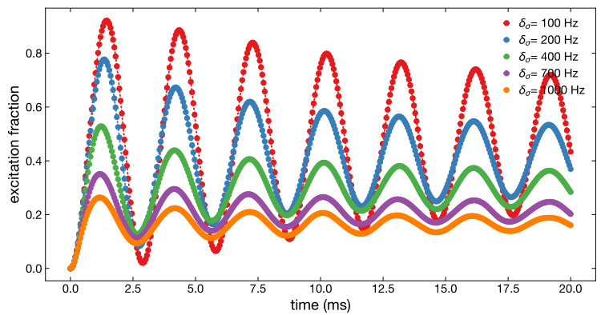
Inhomogeneities in ∆
Nsample=5000
∆_{σ} =2*pi*100 Hz
∆_{σ} =2*pi*1 kHz

Slide 10
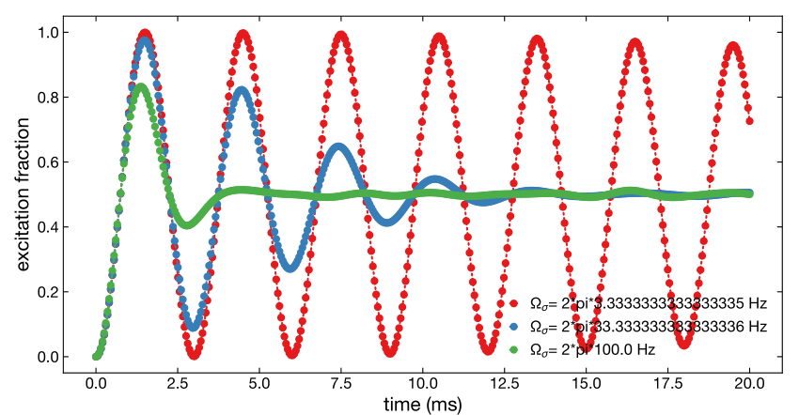
Inhomogeneities in Ω
Angle: (< 5 mrad): sample is 2 µK => 140 Hz (k*angle*v/2/pi)
Clock laser intensity & field fluctuations,
=> both effects probably negligible! (also the probe beam intensity inhomogeneity, since we are looking at a single pix)

Slide 11
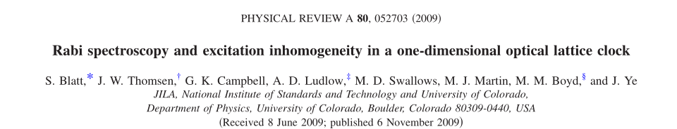
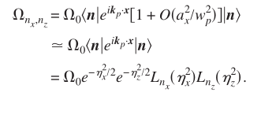
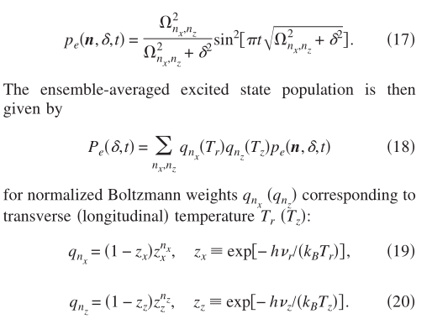

Slide 12
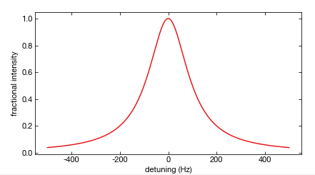
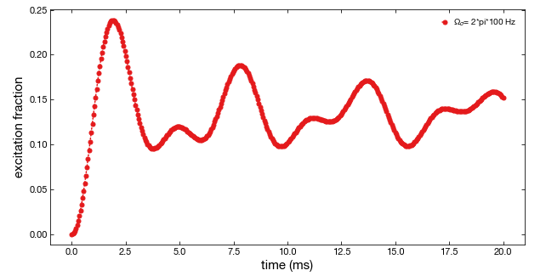
Laser Noise
Ωi, ∆i
100 Hz

Slide 13
Collisional effects Г_{ee}
OD of a central pixel: ~ 0.4
Atom number in the center pixel: 115 atoms
Number of tubes per pix: 140 lattice sites
=> <N> = 0.8 atoms per site
=> 45 % 0 atom
=> 36 % 1 atom
=> 14 % 2 atoms
=> 4 % 3 atoms
=> 0.8 % 4 atoms
Peak density of a single atom in tube: ~1e13
Г_{ee} = NSite*Kee Density

Slide 14
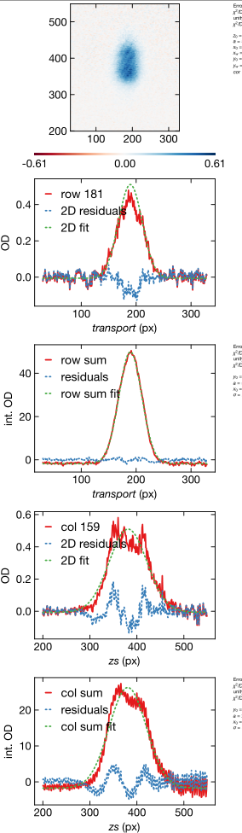
(side note): Collisional effects Г_{ee}
<N> = 0.8 atoms per site
From the fit-> <N>~2

Slide 15
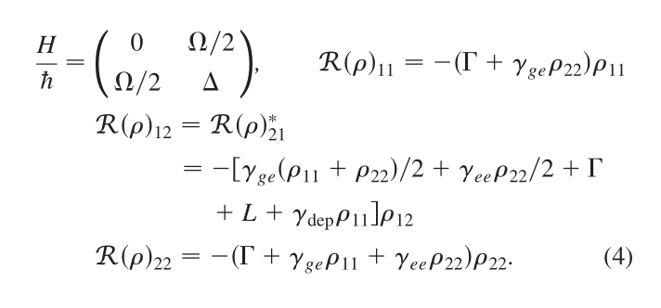
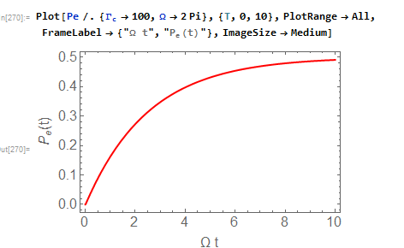
Detuning and Laser linewidth (Approach 1)

Slide 16
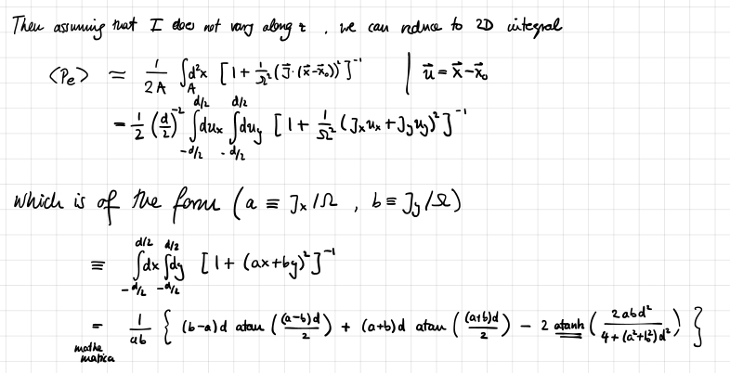
Detuning and Laser linewidth (Approach 2)

Slide 17
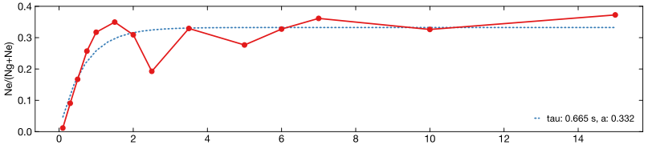
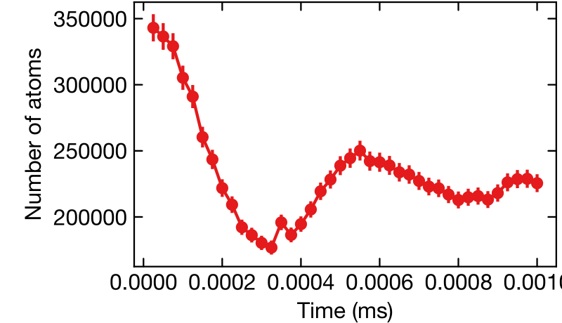
Rabi in the SC
Rabi in the MC

