Slide 1

Introduction to Mathematical Oncology Classical ODE Models of Tumor Growth
Hyunah Lim
Postdoctoral Associate
Institute for Health Computing

Slide 2
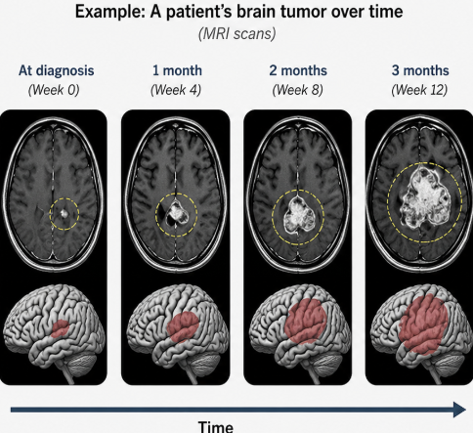
Motivation
Questions doctors face every day
How fast will this tumor grow?
What treatment schedule should we choose?
Which treatment is most effective?
How will this patient’s tumor respond?
Notes:
Last lecture we learned what cancer is and how tumors develop. One of the biggest challenges in cancer treatment is that doctors don't know exactly what a tumor will do in the future. Will it grow quickly? Slowly? How well will treatment work?
These questions are difficult because every patient's tumor behaves differently.
Today we'll see how mathematicians try to answer these questions by building mathematical models.

Slide 3
Classical Models of Tumor Growth
Exponential Model
Logistic Model
Gompertz Model
von Bertalanffy Model
Early tumor growth models describe how the size (or volume)
of a tumor changes over time using mathematics.

Slide 4
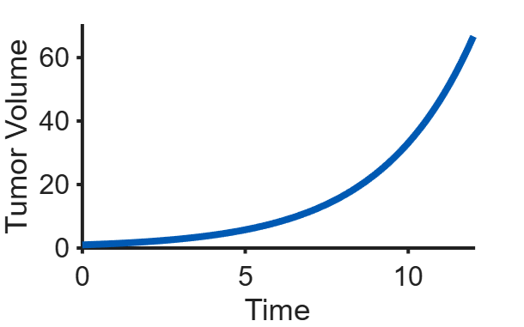
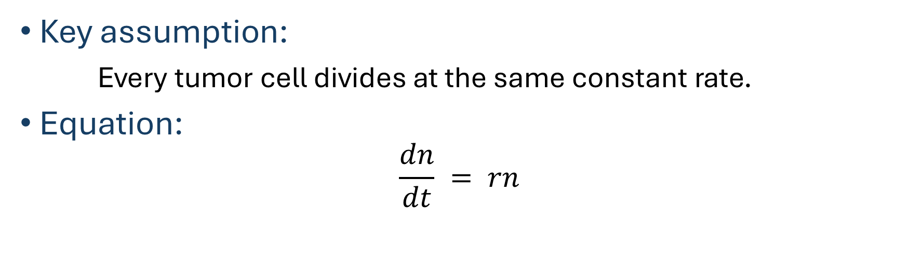
Exponential Growth Model
Key assumption:
Every tumor cell divides at the same constant rate.
Equation:
$$\frac{dn}{dt} = rn$$
Growth rate becomes larger
as the tumor gets larger.

Slide 5
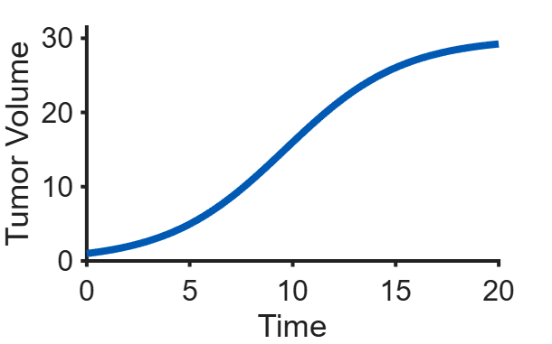

Logistic Growth Model
Key assumption:
Tumor growth slows down as resources become limited.
Equation:
$$\frac{dn}{dt} = n\left(1−\frac{n}{K}\right)$$
Growth rate slows and eventually
Approaches zero as the tumor
nears its carrying capacity.

Slide 6
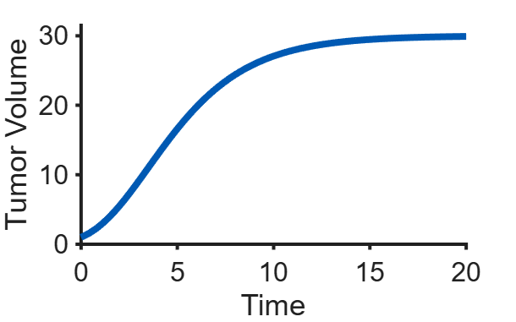

Gompertz Growth Model
Key assumption:
Growth slows gradually as the tumor becomes larger.
Equation:
$$\frac{dn}{dt} = rn ln\left(\frac{n}{K}\right)$$
Growth rate decreases gradually
throughout growth.

Slide 7
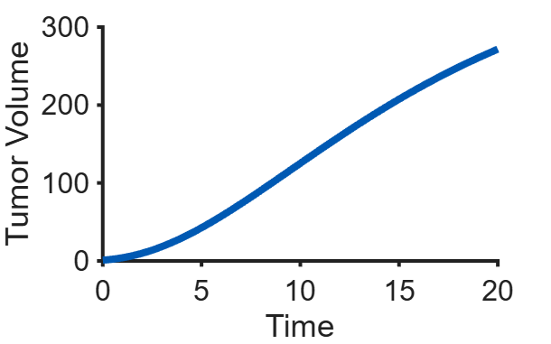
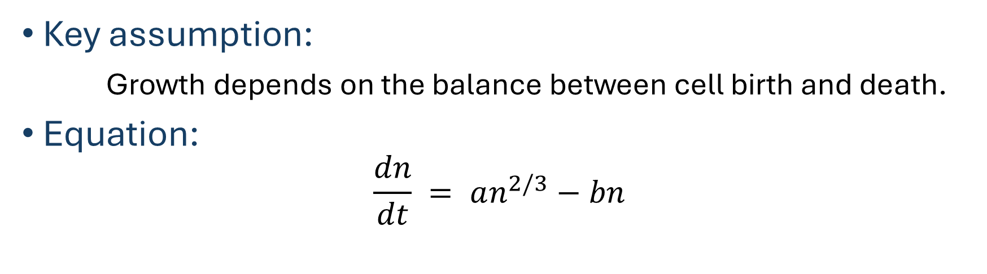
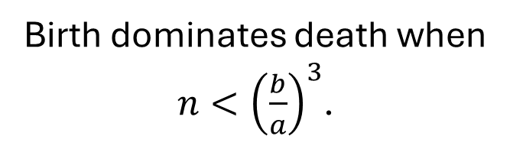
von Bertalanffy Growth Model
Key assumption:
Growth depends on the balance between cell birth and death.
Equation:
$$\frac{dn}{dt} = an^{2/3}−bn$$
Birth dominates death when
$n<{\left(\frac{b}{a}\right)}^{3}$.

Slide 8
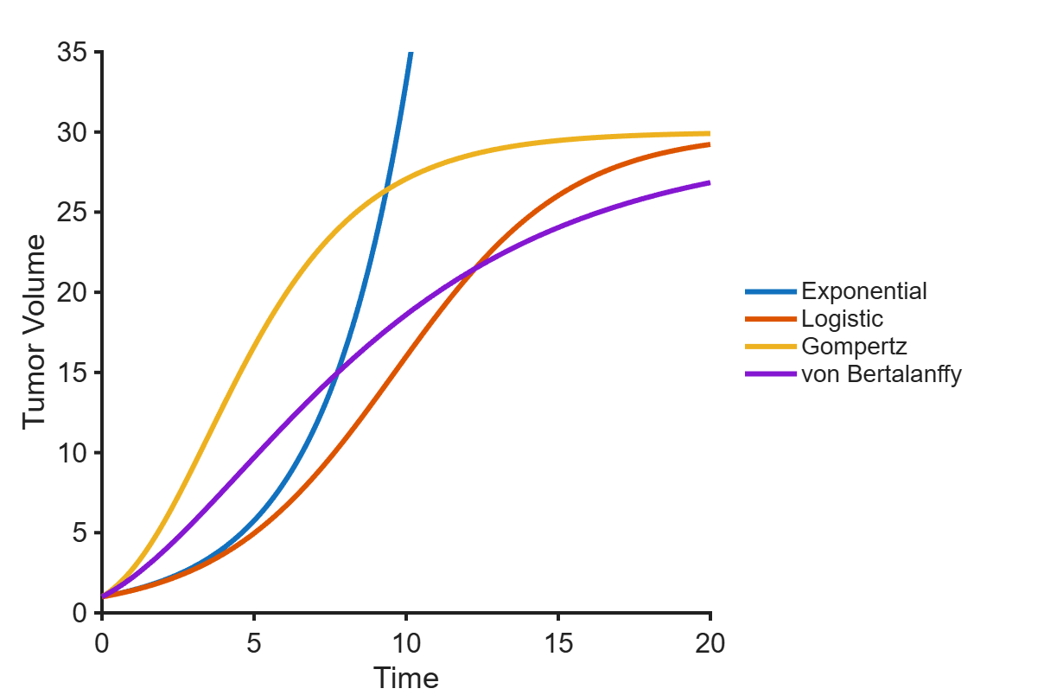
Comparing Classical Tumor Growth Models
Model | Main Idea
Exponential | Unlimited growth
Logistic | Resource limitation
Gompertz | Gradually slowing growth
von Bertalanffy | Cell birth vs. Cell loss

Slide 9
Limitations and Uses
Every model has limits.
Classical models help us
capture tumor volume change
provide a starting point for cancer modelling
However, many other interesting questions remain:
Tumor cells in different locations grow differently
Incorporating spatial variation in tissue environment
Overcoming treatment delivery issues

Slide 10
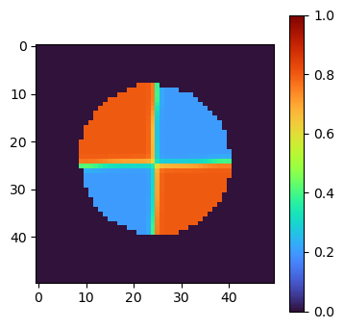
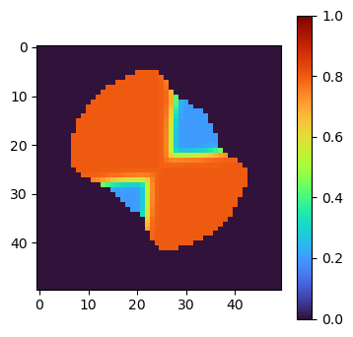
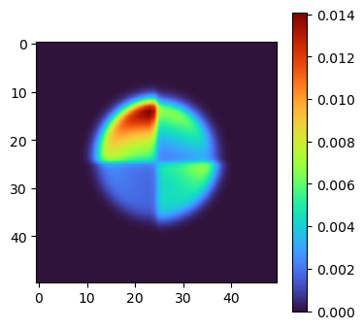
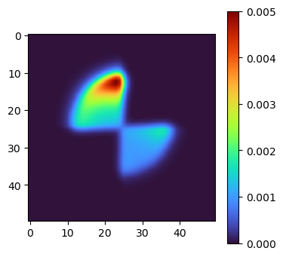

Extensions of the Classical Models
Adding space:
e.g. $\frac{∂n}{∂t}=DΔn+n\left(1−\frac{n}{K}\right)$
Adding therapy:
Drug resistance evolution
Spatial population change

Slide 11
Choosing the Right Model
Q. What model should we choose?
Research Questions:
Capturing tumor volume growth in its early stage
when tumor grows without resource limitation
Growth saturation / Long-term tumor volume change
Tumor regrowth after radiation therapy at the boundary of the irradiated region
A good model should be as simple as possible
while capturing the key mechanisms needed to explore the research question.

Slide 12
Q&A

