Slide 1
210323

Slide 2
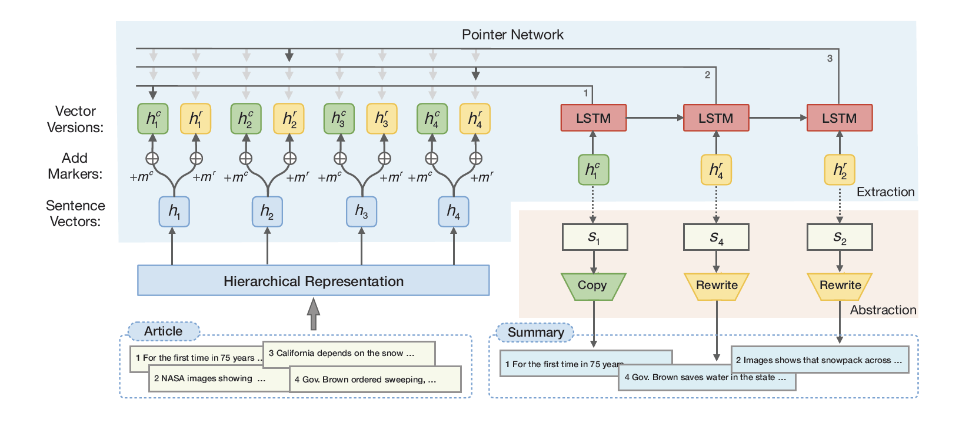
Copy or Rewrite: Hybrid Summarization with Hierarchical Reinforcement Learning(AAAI-20)

Slide 3
