Slide 1
210511

Slide 2
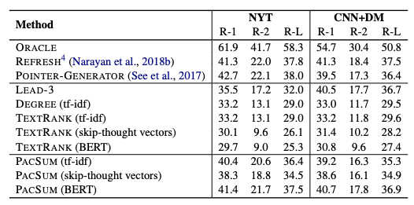
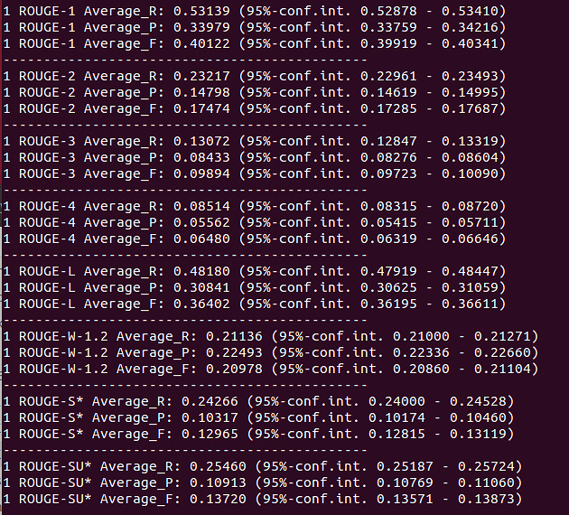
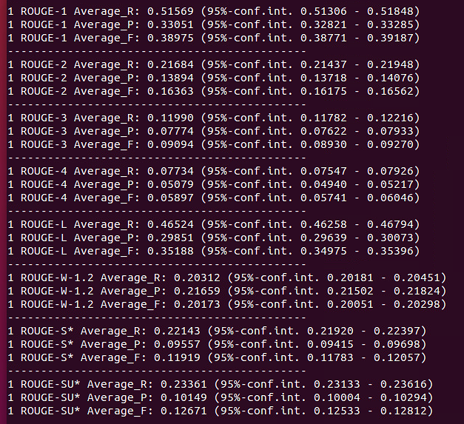
PacSum(2019)
Graph-based ranking algorithm: Textrank
여기에 두가지 측면에서 centrality를 향상시켜보자
문장간 유사도를 BERT를 이용해 계산
directed graph로 만들어서 문장 랭킹
BERT
tf-idf
Notes:
지금까지는 classification 모델 구현
마지막 레이어가 classifier 역할을 하는 softmax
마지막 부분 수정해보기
아직 segment를 사용하는 것에 대한 실험 조차 해보지 못함
그래서 이건 조금 두고, 그동안 진행했던 segment를 가지고 일단 unsupervised 요약을 사용해 실험 진행해보자

Slide 3
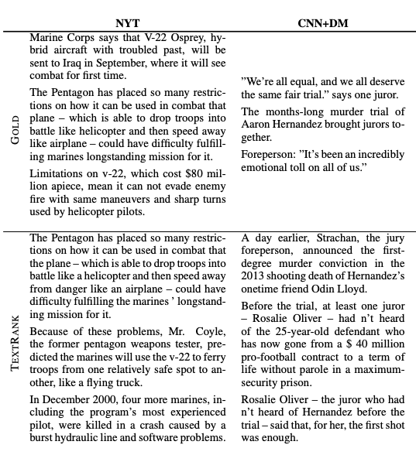
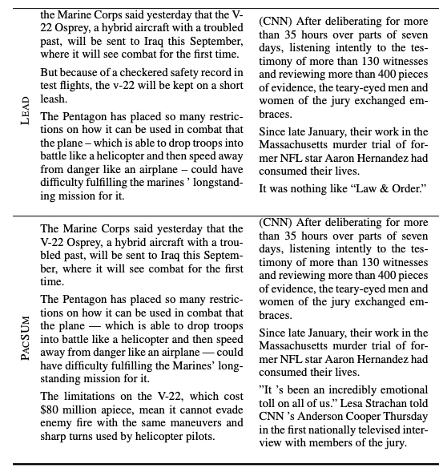

Slide 4
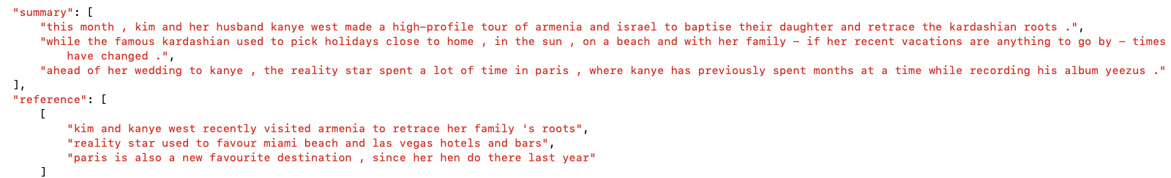
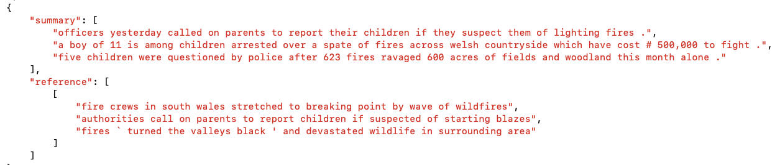
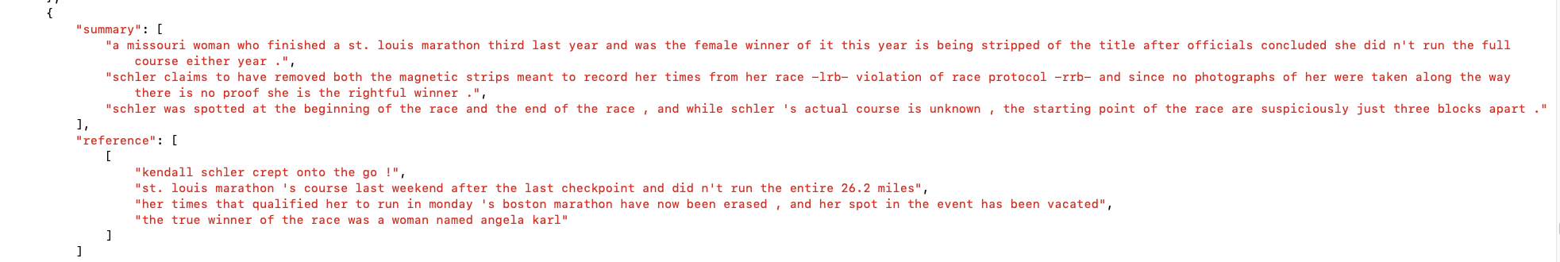
{'rouge_1_recall': 0.52776, 'rouge_1_precision': 0.31016, 'rouge_1_f_score': 0.37836, 'rouge_2_recall': 0.21638, 'rouge_2_precision': 0.12747, 'rouge_2_f_score': 0.15513,
'rouge_l_recall': 0.47526, 'rouge_l_precision': 0.27969, 'rouge_l_f_score': 0.34101}

Slide 5
{'article': ["an improving economy is concealing serious problems in the city 's budget that can only be solved through permanent spending cuts or increases in revenue , like higher taxes , a state fiscal monitor warned yesterday .", "the new york state financial control board said it had reviewed mayor michael r . bloomberg 's proposed $ 46.9 billion budget for the fiscal year that begins july 1 , and found a `` deterioration in the city 's fiscal condition that was temporarily masked `` by a growing surplus in this year 's budget .", "the board , which can take control of the city 's finances if the city ends the fiscal year with a deficit , said the city is relying too heavily on temporary increases to the personal income and sales taxes that are due to expire over the next two years .", 'it said the projected surplus of about $ 1.5 billion this year would have been even larger if medicaid costs , employee pensions and labor agreements had not increased .', "`` on the surface , '' the board said in a report , `` a surplus of this size suggests that the city is in sound fiscal health .", "unfortunately , the fact is the city 's finances remain structurally unbalanced . ``", "the control board 's report is the latest in a series of warnings from budget watchers that the city 's fiscal condition could be weaker than the numbers make it appear .", "last week , the state comptroller , alan g . hevesi , said he was `` increasingly concerned that rising interest rates and large federal deficits will put a damper on economic activity '' and squeeze new york city 's budget .", 'and the federal reserve bank of new york reported in april that the city is too dependent for its tax revenue on volatile wall street markets .', "mr. bloomberg has also warned that the city faces large deficits beginning in the 2006 fiscal year , and he has repeatedly stressed the problem of rising costs , some of which are beyond the city 's control .", "but since he proposed spending $ 250 million to give a $ 400 property tax rebate to homeowners , the mayor has also sought to characterize the city 's finances as improving enough to make the rebate fiscally responsible .", "the control board 's report painted a starkly different picture .", "citing the mayor 's own estimate of a $ 3.8 billion deficit in 2006 , the board suggested that the current surplus is little more than a fleeting break from the harsh reality of entrenched fiscal problems .", 'the city , it said , is benefiting from a number of temporary measures , like $ 1 billion in soon-to-expire tax increases , $ 1.5 billion it borrowed to help recover from the sept . 11 attacks , and a booming real estate market that since january has yielded $ 600 million more than expected from taxes on property transactions .', "the board urged the city to begin taking stronger `` recurring actions '' -- a euphemism for permanent spending cuts or revenue increases -- to close future gaps .", "jeffrey l . sommer , the acting executive director of the control board , said in an interview that even though the mayor 's proposed budget for next year was balanced , he should start `` building up a surplus to use in 2006 , because that is the troubled year . ''", "the board , created in 1975 when the city was on the verge of bankruptcy , does not take a position on local policy initiatives , and so it would not publicly criticize the mayor 's rebate plan or an alternative tax cut proposal by the city council that could cost about $ 300 million .", "asked yesterday to comment on the board 's report , jordan barowitz , a spokesman for the mayor , sought to blame any budget problems on the city council .", 'mr. barowitz pointed to a series of employee pension enhancements , discussed at a council committee hearing yesterday , which he said would cost millions of dollars .', 'david k . chai , a spokesman for gifford miller , the council speaker , said some of the pension changes were intended to benefit families of emergency services workers who died sept . 11 .'], 'abstract': ["new york state financial control board warns that improving economy is concealing serious problems in new york city 's budget that can only be solved through permanent spending cuts or revenue increases .", "review of mayor michael bloomberg 's proposed $ 46.9-billion budget for next fiscal year finds ` deterioration ' in underlying situation ."], 'oracle_sens': [0, 1], 'oracle_rouge': 1.65033985543, 'sentence_rouges': [1.49667996453, 1.14291612689, 0.503526338827, 0.192548854943, 0.357644661949, 0.245112028715, 0.587457578172, 0.466949418195, 0.451265790437, 0.47351827621, 0.330478198521, 0.249866718634, 0.472803505927, 0.323203469978, 0.617670129194, 0.660773233158, 0.39567077957, 0.332395240237, 0.0994642571224, 0.121590880812]}

Slide 6
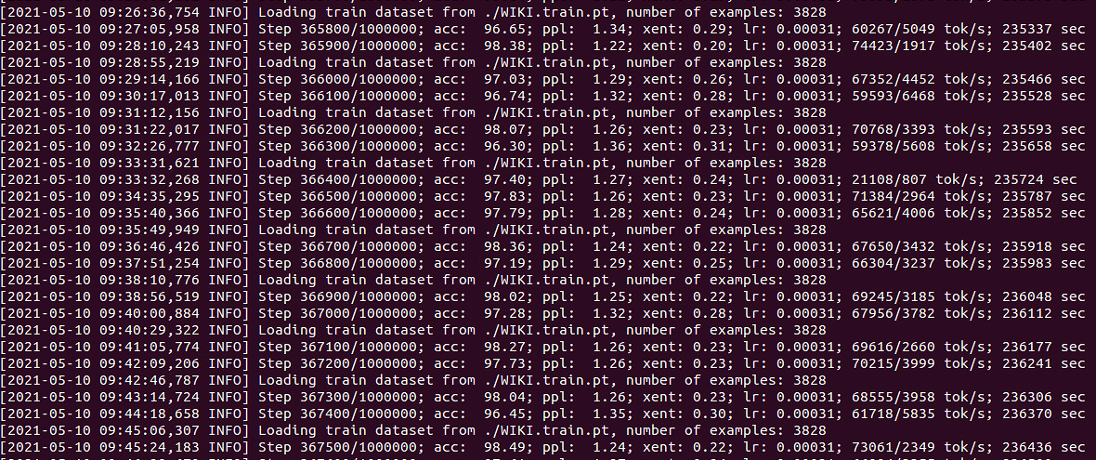
hiersum

