Slide 2
Competition
Text Analysis Conference(TAC)
https://tac.nist.gov//
요약은 2008, 2009, 2010, 2011, 2014에 열림
TAC2014: https://tac.nist.gov//2014/BiomedSumm/
biomedical 분야의 논문 요약
CL-SciSumm의 Pilot Task
데이터셋 포맷 오류로 평가 진행되지 않음(http://ceur-ws.org/Vol-1610/paper11.pdf)
Document Understanding Conference(DUC)
2001 ~ 2007
DocEng’2020 Competition on Extractive Text Summarization
https://dl.acm.org/doi/pdf/10.1145/3395027.3419579
CL-SciSumm 2020(EMNLP20)
2014년부터 열리기 시작
https://ornlcda.github.io/SDProc/sharedtasks.html
Notes:
https://dl.acm.org/doi/pdf/10.1145/3395027.3419579

Slide 3
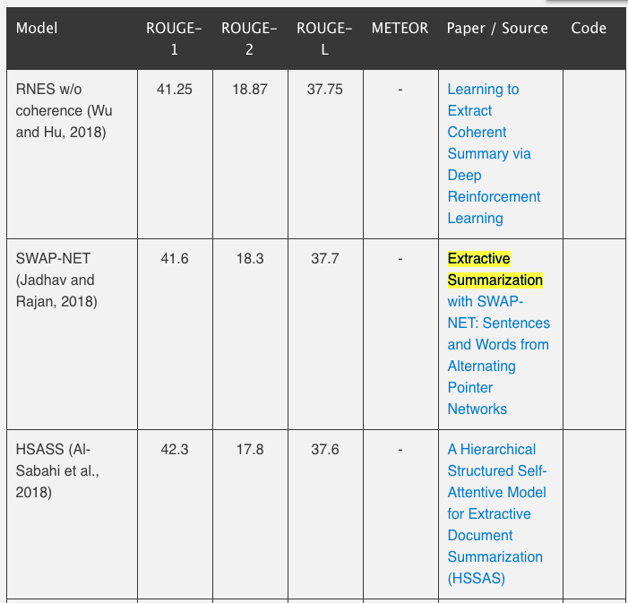
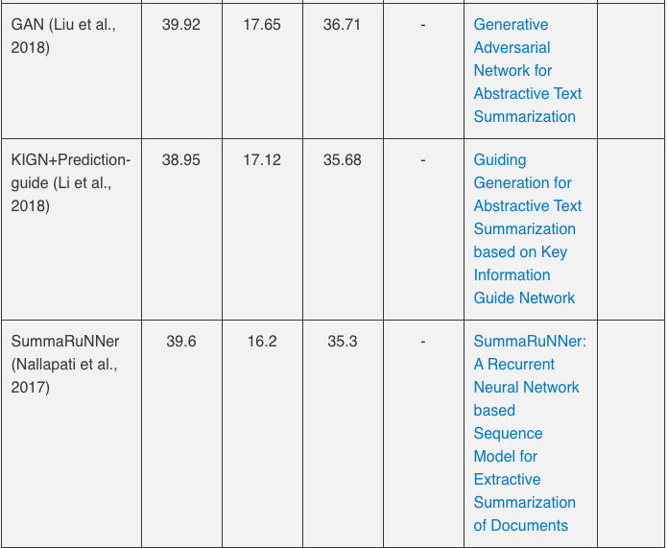
CNN/Mail(익명화 된 버전)
Nallapati et al. (2016)
온라인 뉴스기사(평균 781토큰) & 2개 이상의 문장으로 이뤄진 요약문(평균 3.75개의 문장, 56개의 토큰)
287,226 training pairs, 13,368 validation pairs and 11,490 test pairs.
full-length F1-scores of ROUGE-1, ROUGE-2, ROUGE-L, and METEOR (optional).
https://arxiv.org/abs/1804.07036
https://www.aclweb.org/anthology/P18-1014.pdf
https://github.com/aishj10/swap-net/tree/master/swap-net-summer
https://github.com/hpzhao/SummaRuNNer
https://arxiv.org/pdf/1805.07799.pdf
https://github.com/koren88i/NLP-ExtractiveTextSummarization
Notes:
http://nlpprogress.com/english/summarization.html

Slide 4
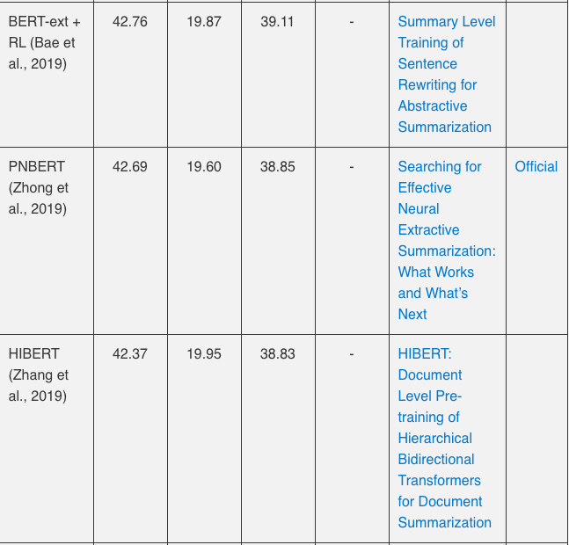
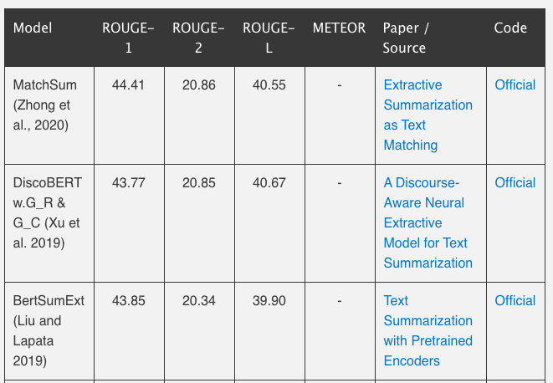
CNN/Mail(익명화 X 버전): Extractive
https://www.aclweb.org/anthology/P17-1099/
https://arxiv.org/abs/1909.08752
https://arxiv.org/pdf/2004.08795v1.pdf
https://github.com/maszhongming/MatchSum
https://arxiv.org/abs/1907.03491
https://github.com/maszhongming/Effective_Extractive_Summarization
https://arxiv.org/pdf/1910.14142.pdf
https://github.com/jiacheng-xu/DiscoBERT
https://arxiv.org/abs/1905.06566
https://arxiv.org/abs/1908.08345
https://github.com/nlpyang/PreSumm

Slide 5
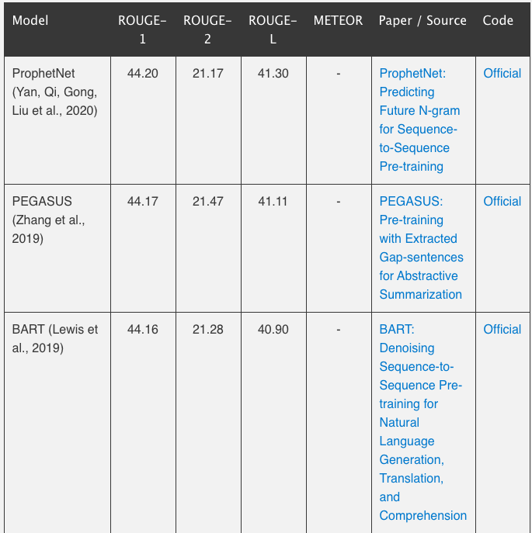
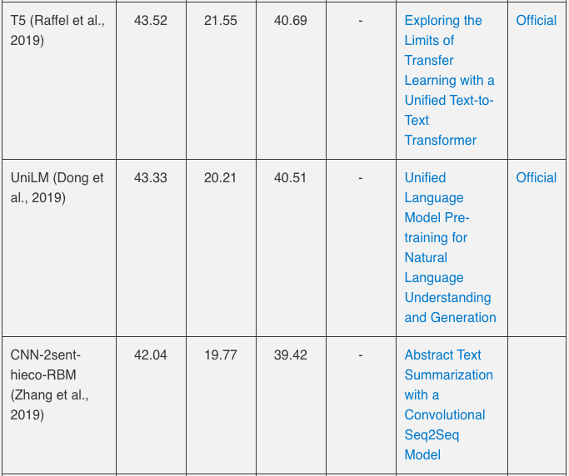
CNN/Mail(익명화 X 버전): Abstractive & Mixed
https://arxiv.org/pdf/1910.10683.pdf
https://arxiv.org/pdf/2001.04063.pdf
https://github.com/microsoft/ProphetNet
https://github.com/google-research/text-to-text-transfer-transformer
https://arxiv.org/pdf/1912.08777.pdf
https://github.com/google-research/pegasus
https://arxiv.org/pdf/1905.03197.pdf
https://github.com/microsoft/unilm
https://arxiv.org/pdf/1910.13461.pdf
https://github.com/pytorch/fairseq/tree/master/examples/bart
https://www.mdpi.com/2076-3417/9/8/1665/pdf

Slide 6
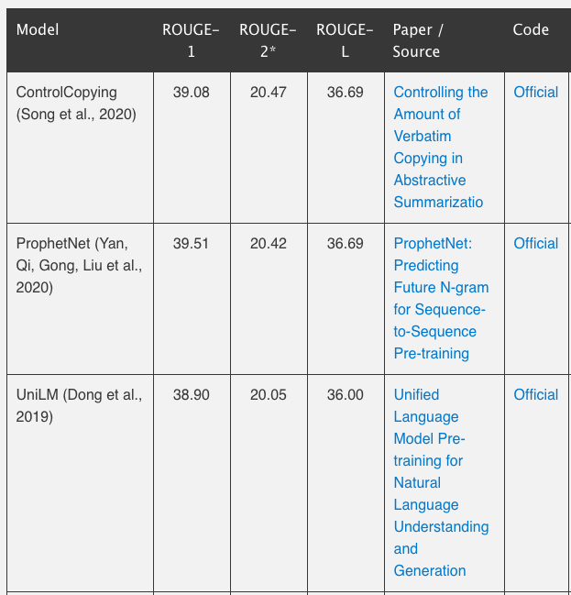
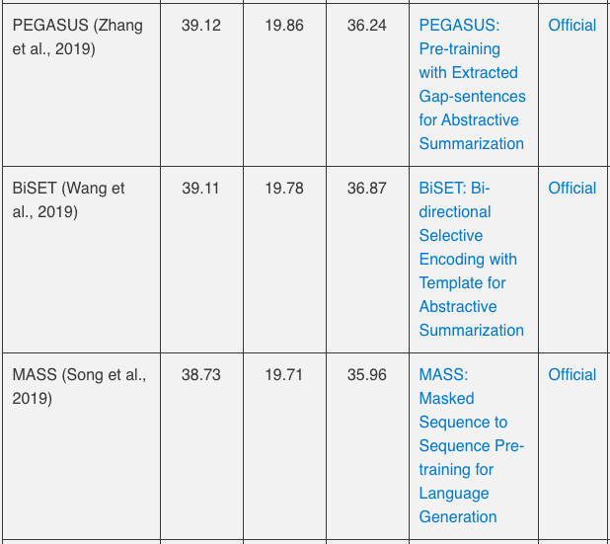
Gigaword
Rush et al., 2015
a sentence summarization / headline generation task with very short input documents (31.4 tokens) and summaries (8.3 tokens).
https://arxiv.org/pdf/1911.10390.pdf
https://github.com/ucfnlp/control-over-copying
https://www.aclweb.org/anthology/P19-1207.pdf
https://github.com/InitialBug/BiSET
https://arxiv.org/pdf/1905.02450v5.pdf
https://github.com/microsoft/MASS

Slide 7
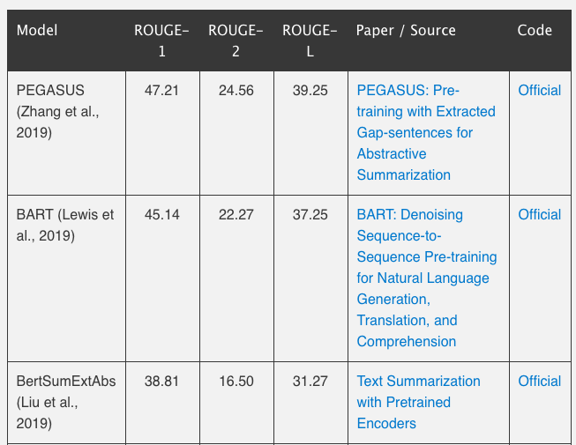
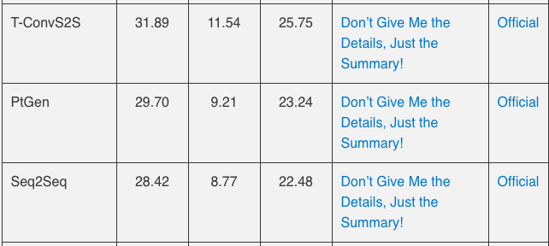
X-Sum(Extreme Summarization)
Narayan et al., 2018
dataset for abstractive modeling approach
하나의 문장으로 이뤄진 뉴스 요약 만들기
BBC 온라인 뉴스에서 수집된 뉴스 기사
204,045 samples for the training set
11,332 for the validation set
11,334 for the test set.
평균 기사 길이: 431 words (~20 sentences)
평균 요약문 길이: 23 words.
https://arxiv.org/pdf/1808.08745.pdf
https://github.com/EdinburghNLP/XSum

Slide 8
한국어 데이터셋
한국어: https://aihub.or.kr/aidata/8054/download
scientific papers: https://cs.stanford.edu/~myasu/projects/scisumm_net/

Slide 9
Huggingface_pipeline(Bart)
CNN / Daily Mail dataset으로 학습된 모델
전체 기사의 첫 3-5문장을 원문으로
1: 정치 뉴스
원문:
President Donald Trump picked up more Latino voters in several key battleground states than he won in 2016, according to preliminary results of a nationwide CNN exit poll. The President captured more than 2 in 5 votes among the group, up from 35% in 2016. Former Vice President Joe Biden earned just over half of the Latino vote in the state, compared to 62% who supported Democratic nominee Hillary Clinton four years ago. Biden also lost support among Latino voters in Georgia and Ohio, important states to capturing the White House. The former vice president was up only about 25 percentage points in Georgia and about 24 points in Ohio, compared to Clinton's margin of 40 percentage points and 41 points in Georgia and Ohio, respectively. But more voters under age 30 have flocked to the former vice president in several important Midwestern states.
요약문:
"Former Vice President Joe Biden earned just over half of the Latino vote. That's compared to 62% who supported Hillary Clinton four years ago. Biden also lost support among Latino voters in Georgia and Ohio.”
분석
원문에서 “vice president”에 대한 내용이 더 많았기 때문에 vice president와 관련된 내용으로 요약문
고유명사와 수치가 많기 때문에 extractive한 방식으로 요약문 만들어진 것 같음.

Slide 10
Huggingface_pipeline(Bart)
CNN / Daily Mail dataset으로 학습된 모델
2: 날씨 뉴스
원문:
At least 17 people are dead and more than two million impacted after Typhoon Goni, the world's strongest typhoon this year, swept across the Philippines Sunday, according to the country's emergency agencies. The typhoon, known locally as Typhoon Rolly, passed over the south of the country's main island Luzon, causing heavy rainfall, flooding and landslides, before weakening as it skirted the edges of the capital of Manila.m Office of Civil Defense Division Chief Jessar Adornado said that most of the deaths had been either from people who were swept away in flood waters or buried in landslides. In some parts of the country, nearly 90% of homes had been destroyed by the storm, according to the International Federation of Red Cross and Red Crescent Societies (IFRC.)
요약문:
"Typhoon Goni, the world's strongest typhoon this year, swept across the Philippines Sunday. At least 17 people are dead and more than two million impacted by the storm."
분석
extractive한 방식으로 요약문 생성되었지만, 문장 순서 바뀜 + typhoon goni를 storm으로 변경

Slide 11
Huggingface_pipeline(Bart)
CNN / Daily Mail dataset으로 학습된 모델
3: 블로그 글(topic: technology)
원문:
In the previous post, we looked at Attention – a ubiquitous method in modern deep learning models. Attention is a concept that helped improve the performance of neural machine translation applications. In this post, we will look at The Transformer – a model that uses attention to boost the speed with which these models can be trained. The Transformers outperforms the Google Neural Machine Translation model in specific tasks. The biggest benefit, however, comes from how The Transformer lends itself to parallelization. It is in fact Google Cloud’s recommendation to use The Transformer as a reference model to use their Cloud TPU offering. So let’s try to break the model apart and look at how it functions. The Transformer was proposed in the paper Attention is All You Need. A TensorFlow implementation of it is available as a part of the Tensor2Tensor package. Harvard’s NLP group created a guide annotating the paper with PyTorch implementation. In this post, we will attempt to oversimplify things a bit and introduce the concepts one by one to hopefully make it easier to understand to people without in-depth knowledge of the subject matter.
요약문:
'The Transformer is a model that uses attention to boost the speed with which these models can be trained. The Transformers outperforms the Google Neural Machine Translation model in specific tasks. The biggest benefit, however, comes from how The Transformer lends itself to parallelization.’
분석
extractive한 방식으로 요약문 생성

Slide 12
Huggingface_pipeline(Bart)
CNN / Daily Mail dataset으로 학습된 모델
4: Technology 뉴스
원문:
Amazon's latest effort to speed up shopping trips lets you pay with the palm of your hand at some of its stores. On Tuesday, the company introduced Amazon One, which connects your palm print to a stored credit card so you can place your hand above a sensor to enter and buy items at checkout-free Amazon (AMZN) Go stores. (Typically, visitors use a code on their smartphone to open electronic gates inside these stores.) Initially, the feature will be available at two Amazon Go stores in Seattle, and the company plans in upcoming months to add it to more Amazon Go stores, which are spread across Seattle, San Francisco, New York, and Chicago. Amazon plans to bring it to other retailers — and perhaps places like offices and stadiums — in the future.
요약문:
'Amazon One lets you pay with the palm of your hand at some of its stores. The feature will be available at two Amazon Go stores in Seattle. Amazon plans to bring it to other retailers in the future.’
분석
span을 extractive하게 추출해서 요약, 배치
전반적으로 굉장히 잘 요약.

Slide 13
Huggingface_pipeline(Bart)
CNN / Daily Mail dataset으로 학습된 모델
5: 연예 뉴스
원문:
Acclaimed actor Jeff Bridges announced Monday on Twitter that he has been diagnosed with lymphoma. "Although it is a serious disease, I feel fortunate that I have a great team of doctors and the prognosis is good," Bridges tweeted. "I'm starting treatment and will keep you posted on my recovery." Lymphoma is a form of cancer that affects the lymph system, or "tissues and organs that produce, store, and carry white blood cells that fight infections," according to the US Centers for Disease Control and Prevention. The two main types of lymphoma are Hodgkin, which spreads in an orderly manner through lymph nodes, and Non-Hodgkin, which spreads in a non-orderly fashion, according to the CDC. Bridges' Hollywood career stretches over six decades and has starred in over 70 films including "True Grit," "Seabiscuit," "The Big Lebowski" and "King Kong."
요약문:
“Lymphoma is a form of cancer that affects the lymph system. The two main types of lymphoma are Hodgkin and Non-Hodgkin. Bridges' Hollywood career stretches over six decades."
분석
Lymphoma라는 병명이 자주 등장했기 때문에 이를 키워드로 선정한 것 같음

Slide 14
Huggingface_pipeline(Bart)
CNN / Daily Mail dataset으로 학습된 모델
6: 사회 뉴스
원문:
A North Korean man was taken into custody after crossing into South Korea via the eastern border, the Joint Chiefs of Staff (JCS) said Wednesday, amid a possibility that he could have sought to defect to the South. The man, whose identity was withheld, was captured about 10 hours after he crossed the border in the eastern county of Goseong late Tuesday. His crossing was detected on the South's surveillance equipment, prompting the military to launch extensive search operations. "Our military safely captured the man at around 9:50 a.m. In coordination with related authorities, we will carry out investigation into the man, including how he crossed the border and if he has the intention to defect to the South," the JCS said in a statement. "No unusual moves by the North Korean military have been detected," the military added. It is not immediately known if he is a soldier or a civilian, though officials said he did not wear a military uniform. For the search operations, troops were placed on the "Jindogae" alert, which is issued to cope with a possible intrusion of armed guerrillas from North Korea, officials said, adding that the alert would be lifted later after analyzing the situation in front-line areas further.
요약문:
The man was captured about 10 hours after he crossed the border. His crossing was detected on the South's surveillance equipment. It is not immediately known if he is a soldier or a civilian, though officials said he did not wear a military uniform.
분석
전반적으로는 잘 요약하고 있지만 핵심(north Korean man => the man)은 찾지 못함

Slide 15
Huggingface_pipeline(Bart)
CNN / Daily Mail dataset으로 학습된 모델
7: 연예 뉴스2
원문:
K-pop superstar BTS ranked No. 12 on the Billboard's main singles chart this week with its mega-hit single "Dynamite" while also keeping three of its albums on the main albums chart. "Dynamite" dropped five notches to come in 12th on the Hot 100 chart for the week ending this Saturday, snapping its nine-week streak in the chart's top 10, according to the lately refreshed Billboard chart. The Hot 100 blends all-genre U.S. streaming, radio airplay and sales data. The septet's first English song lost its No. 1 position on the Digital Song Sales chart to place third this week. But its radio airplay performance still remained strong this week, with "Dynamite" finishing 18th on the Radio Songs chart and ninth on the Pop Songs radio chart, which is the highest-ever ranking achieved by a K-pop act.
요약문:
'"Dynamite" dropped five notches to come in 12th on the Hot 100 chart for the week ending this Saturday. The song lost its No. 1 position on the Digital Song Sales chart to place third. But its radio airplay performance still remained strong this week.'
분석
마찬가지로 전반적으로는 잘 요약하고 있지만 핵심(BTS)은 찾지 못함

Slide 16
Huggingface_pipeline(Bart)
CNN / Daily Mail dataset으로 학습된 모델
8: 사회 뉴스
원문:
Lee Chun-jae, the suspect in one of the nation's most notorious serial killings, admitted in court Monday that he murdered 14 women and girls three decades earlier, including a 13-year-old girl in 1988, while attending the retrial of a man who was allegedly wrongly convicted and served 20 years in prison in the case. Lee, 57, was identified in September last year as a suspect in at least three of the 10 killings that took place in Hwaseong, south of Seoul, between 1986 and 1991. He later confessed to all the cases, including one in which another man, identified by his surname Yoon, was charged and sentenced to life imprisonment in 1989. Yoon, who was released on parole in 2009, filed for a retrial at a district court in Suwon, south of Seoul, in November last year. Lee attended the hearing as a witness and admitted that he committed 14 murders and about 30 sexual crimes.
요약문:
Lee Chun-jae admitted to killing 14 women and girls between 1986 and 1991. He was sentenced to life in prison in 1989, but was released on parole in 2009.
분석
extractive하지 않고 거의 abstractive하게 요약
하지만 사실 관계가 맞지 않음
He was sentenced to life in prison in 1989, but was released on parole in 2009.
이 부분은 이춘재가 아닌 Yoon에 해당하는 부분.

Slide 17
Huggingface_pipeline(Bart)
CNN / Daily Mail dataset으로 학습된 모델
9: 스포츠 뉴스
원문:
South Korean big league pitcher Ryu Hyun-jin has earned his second straight Cy Young Award nomination ― this time, in a different league. Ryu, the Toronto Blue Jays ace, was announced as one of three finalists for the American League (AL) Cy Young Award by the Baseball Writers' Association of American (BBWAA) on Monday (U.S. local time). The winner will be announced Nov. 11. The voting was completed at the end of the regular season in late September, and being a finalist means Ryu, who finished fourth in the AL with a 2.69 ERA, ranked in the top three in the voting. While pitching for the Los Angeles Dodgers last year, Ryu finished second to Jacob deGrom of the New York Mets for the National League Cy Young Award. Ryu was the first South Korean pitcher to even be nominated for the top annual pitching prize. As a free agent, Ryu signed a four-year, US$80 million deal with the Blue Jays in December to become the highest-paid pitcher in franchise history.
요약문:
'Ryu Hyun-jin is one of three finalists for the American League (AL) Cy Young Award. The Toronto Blue Jays ace finished fourth in the AL with a 2.69 ERA last year. Ryu was the first South Korean pitcher to even be nominated for the award.’
분석
전반적으로는 잘 요약하고 있지만 핵심은 찾지 못하고 있음
“류현진이 싸이영 상에 2번째로 노미네이트 되었다.”
Notes:
[{'summary_text': "U.S. futures rose and Asia markets were mostly higher on Wednesday. Many investors took forecasts of a so-called ''blue wave'' of Democratic Party wins as a signal that the economy might soon get a big, fresh infusion of help. But with the race too close to call, analysts said they might be reassured by the prospect for a continuation of Trump's pro-market stance."}]

Slide 18
Huggingface_pipeline(Bart)
CNN / Daily Mail dataset으로 학습된 모델
10: 경제 뉴스
원문:
U.S. futures rose and Asia markets were mostly higher on Wednesday as investors worldwide awaited the results from the U.S. presidential election. Just after 10 p.m. Eastern time, President Donald Trump and Democratic challenger Joe Biden were locked in tight races in battleground states. Most polls have predicted a Biden victory. Many investors took forecasts of a so-called ''blue wave'' of Democratic Party wins as a signal that the U.S. economy might soon get a big, fresh infusion of help. But with the race too close to call, analysts said they also might be reassured by the prospect for a continuation of Trump's pro-market stance. ''Markets seem to be pricing in better chances for Trump, or at least a smaller chance of a blue wave,'' Stephen Innes of Axi said in a commentary. ''On the one hand with the fiscal implications of a Biden win/blue wave that's a bit of a surprise ― on the other Trump is widely considered more market-friendly, so one can see how it nets out a small positive,'' Innes said. As of midnight Eastern time, Dow futures were up 0.8% and the SP 500 futures rose 1.6%. Both initially fell as election returns began coming in. The Nasdaq futures fell back, losing 0.2% after earlier gaining 3.5%. The gains in the futures follow a strong performance in regular trading Tuesday on Wall Street.
요약문:
"U.S. futures rose and Asia markets were mostly higher on Wednesday. Many investors took forecasts of a so-called ''blue wave'' of Democratic Party wins as a signal that the economy might soon get a big, fresh infusion of help. But with the race too close to call, analysts said they might be reassured by the prospect for a continuation of Trump's pro-market stance."
분석
extractive 방식으로 요약문 생성

Slide 19
Huggingface_pipeline(Bart)
CNN / Daily Mail dataset으로 학습된 모델
소설
원문:
"Alice was beginning to get very tired of sitting by her sister on the bank, and of having nothing to do: once or twice she had peeped into the book her sister was reading, but it had no pictures or conversations in it, “and what is the use of a book,” thought Alice “without pictures or conversations?” So she was considering in her own mind (as well as she could, for the hot day made her feel very sleepy and stupid), whether the pleasure of making a daisy-chain would be worth the trouble of getting up and picking the daisies, when suddenly a White Rabbit with pink eyes ran close by her.”
요약문:
Alice was beginning to get very tired of sitting by her sister on the bank, and of having nothing to do. She was considering in her own mind whether the pleasure of making a daisy-chain would be worth the trouble of getting up and picking the daisies. Suddenly a White Rabbit with pink eyes ran close by her.
분석
extractive 방식으로 요약문 생성

Slide 20
Huggingface_pipeline(Bart)
bert-extractive-summarizer 이용해 3000개 문장 추려냄
그 문장들을 가지고 pipeline 적용
소설
원문: Jane Austin ‘이성과 감성’
요약문(전체에서 15문장 가져오기 => abstractive):
The family of Dashwood had long been settled in Sussex but the indelicacy of her conduct was so much the greater . The sudden termination of Colonel Brandons visit at the park with his steadiness in concealing its cause filled the mind and raised the wonder of Mrs Jennings for two or three days she was a great wonderer as every one must be .
분석
내용이 매끄럽게 이어지지 못하고 내용이 끊김
소설 전체를 요약 X
Notes:
single-modal한 토픽
multi-modal한 토픽
어떻게 고려하는지
소설 -> multi modal 염두에 두고 요약해야
한글에 대해서 접근
긴 문장에 대해 접근

Slide 21
Huggingface_pipeline(Bart)
소설
원문: Jane Austin ‘오만과 편견’
Chapter1만 요약
내용: 베넷씨와 베넷부인이 네더필드 파크에 새로 이사 올 남자(빙리)에 대해 대화를 나누고 있음. 베넷부인은 그 남자와 자신의 딸들 중 한명을 결혼시켜야 한다고 하면서 베넷씨에게 빙리한테 인사를 가야 한다고 말하는 장면
Extractive
It is a truth universally acknowledged, that a single man in possession of a good fortune, must be in want of a wife. Why, my dear, you must know, Mrs. Long says that Netherfield is taken by a young man of large fortune from the north of England; that he came down on Monday in a chaise and four to see the place, and was so much delighted with it, that he agreed with Mr. Morris immediately; that he is to take possession before Michaelmas, and some of his servants are to be in the house by the end of next week.” “ A single man of large fortune; four or five thousand a year. Lizzy is not a bit better than the others; and I am sure she is not half so handsome as Jane, nor half so good-humoured as Lydia. Mr. Bennet, how can you abuse your own children in such a way? But I hope you will get over it, and live to see many young men of four thousand a year come into the neighbourhood.” “ She was a woman of mean understanding, little information, and uncertain temper.
Abstractive
Mrs. Long(이웃주민) says Netherfield is taken by a young man of large fortune from the north of England . Lizzy is not a bit better than the others; and I am sure she is not half so handsome as Jane, nor half so good-humoured as Lydia . Mr. Bennet, how can you abuse your own children in such a way?
대화체로 구성된 챕터. 요약문의 내용은 true이지만 약간 어색 + 문장 형식이 어색함
Notes:
single-modal한 토픽
multi-modal한 토픽
어떻게 고려하는지
소설 -> multi modal 염두에 두고 요약해야
한글에 대해서 접근
긴 문장에 대해 접근

Slide 23
python3 main.py --train_input ./arxiv/inputs/train --train_label ./arxiv/labels/train --val_input ./arxiv/inputs/val --val_label ./arxiv/labels/val --refpath ./arxiv/human-abstracts/val --gloveDir ./glove.6B.100d.txt --length_limit 200 --dataset arxiv --model attentive_context
python3 main.py --train_input example-input.json --train_label example-label.json --val_input example-input.json --val_label example-label.json --refpath example-abstract.txt --gloveDir glove.6B.300d.txt --length_limit 200 --dataset arxiv --device 2 --model attentive_context

