Slide 1
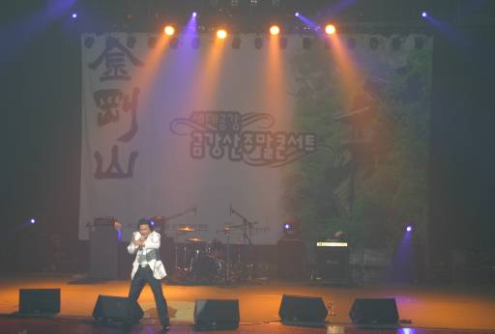
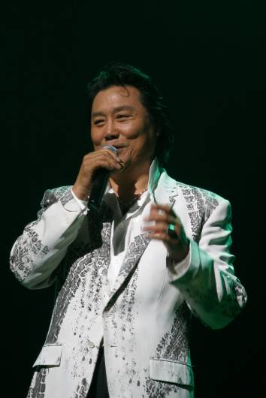
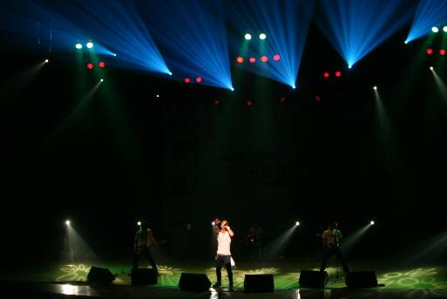
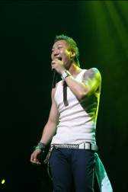

Hyundai Asan’s news letter (June)
Mt. Kumgang tour
Hot News
1. Generation sympathy weekend concert held at Mt. Kumgang
- Singer ‘Nam, Jin’ and music band ‘No-Brain’ performed
- Plans to give regular concerts every week or every other week starting in August
Two different kinds of music representing both old and young generations met at
the world famous Mt Kumgang.
Weekend concert for generation sympathy was held at Kumgang Culture Center on June 9th, with performances by Nam Jin, No Brain, and other singers.
Nam, Jin, top star of the 70’s with many big hit songs and new generation band, “No Brain” has made their name well-known since being in the soundtrack of the movie “Radio Star.”
Like water and oil, this ill-matching two musicians came into unison at Mt. Kumgang. Because of their differences, people were curious with the two musicians playing together as with the same curiosity they had with the two Koreas meeting with one another for the first time. Surprisingly, an audience of around 600 filled the concert hall, where the crowd became one in the middle of a thunderous round of heartfelt applause, giving us a message of sweet-filled harmony.
This ‘Weekend concert in Mt. Kumgang’ is expected to go on regular event after taking measures in some parts which are not perfect.
So far, Open Concert by KBS and performances of singers like Jang, Sa-Ik, Ahn, Chi Hwan and Jang, Yoon Jung have performed here at Mt. Kumgang.
For the attraction of the younger generation as well as the old, changes will continue to be made so that both the generations can be well accommodated and their experiences at Mt. Kumgang will be at their greatest pleasure.

Slide 2
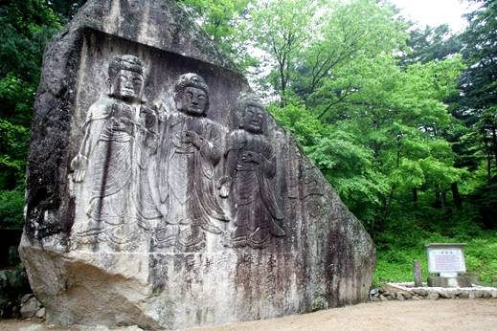
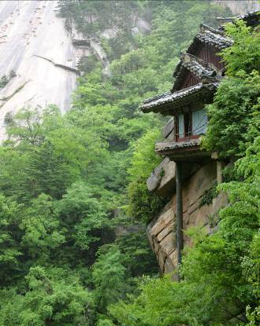
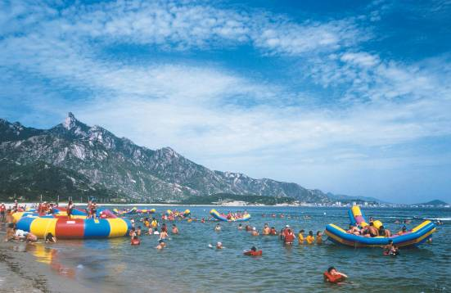
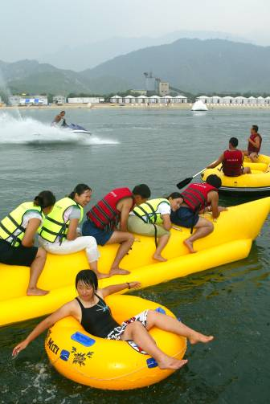
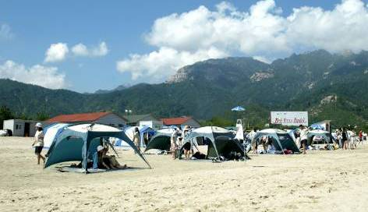
Hyundai Asan’s news letter (June)
Mt. Kumgang tour
Hot News
2. Buddhist monk Ji-Kwon from Jogye Order and others visit Inner Mt. Kumgang
- Buddhist ceremony in Shinge temple, pilgrimage of NaeKumgang, Munpilbong etc.
- 2007.6,21(Thur) ~ 23(Sat), 2 nights and 3 days
For the first time after the division of the Korean peninsula, a group of pilgrimage for Buddhism relics which consisted of about 160 people including the executive chief of the Korean Buddhist Jogye Order , Buddhist monk Ji-Kwon, followers from South and the press visited temples and sites of Buddhism relics in inner Kumgang. They started their journey from June 21st and stayed for 2 nights and 3 days.
They toured various temples,
1st day: Buddhist ceremony in Shinge temple
2nd day: NaeKumgang (inner Kumgang) pilgrimage (Poheun temple, Boduk temple etc)
3rd day: Munpilbong and site of Beukgi temple etc.
Buddhist monk Ji-Kwon grieved over the fact that the precious historic Buddhism relics had been ruined in the war. He also insisted that he should not be in a position to mention a definite timetable but it was natural for ruined Buddhism relics in Inner Mt. Kumgang to be restored.
Buddhist monk Jae-Jung dispatched by Jogye Order who is in charge of the project of restoring a temple of Shinge temple said, “Since we keep safe the elaborate layout drawing of Jang-Ahn temple drawn by the Japanese during Japan’s colonial rule of Korea, we can bring the perfect picture of the temple of the old days back.”
3. Camping site and Beach will open in Mt. Kumgang (July 10th ~ August 25th)
Seated at the lower edges of the mountain, the sandy beach stretches about 1.2 kilometers along the East Coast.
At Mt. Kumgang Beach, you can enjoy various daytime water activities such as motorboat, jet-skiing, rock climbing and snorkeling. You can use clean shower booths, camp sites and convenience stores.
In addition, you can quietly enjoy swimming in the sea because it is not crowded. Because there are facilities like washrooms, changing rooms, shower booths and 10 quarters for 20 people, 8 quarters for 5 people and a camping site to accommodate 30 tents, it is good for families and groups that come from schools and companies. Mt. Kumgang Beach is open for 45 days from July 10 to August 25.
▶ Beach Fees
① Individual - adult : $5, student: $3, infant : free
② Group (over 30) - adult : $3, student : $2, campers: free
※ For more information : 02-3669-3000, www.mtkumgang.com

Slide 3
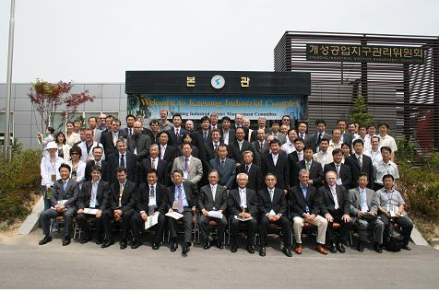
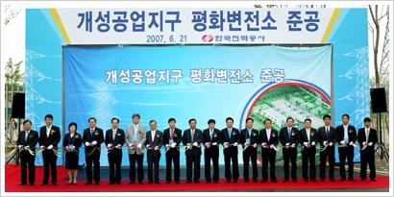
Hyundai Asan’s news letter (June)
Kaesong Industrial Complex
Hot News
1. IR for foreign companies holds in the KIC
Hyundai Asan and KOTRA held an Investor Relations for the CEOs of foreign companies considering to move-in Kaesong Industrial Complex (KIC) on June 20th.
About 120 guests attended the KIC, including 39 foreign CEOs, 42 Korean CEOs, people from KOTRA and the press.
By making direct introductions of attractive investment environments to foreign investors with interest, and to lead investor’s potential minds to an actual investment, there were various events like observation of the 800 acres and visits to waste water disposal plants and companies working at the KIC.
2. Completion ceremony of ‘Pyeonghwa substation’ in the KIC
On June 21st, Hyundai Asan CEO, Yoon, Man-Joon together with Kim, Young-Ju, Minister of MOCIE (Ministry of Commerce, Industry and Energy) and Lee, Won-gul, CEO of KEPCO (Korea Energy and Power Corp) participated in the completion ceremony of Pyeonghwa (its meaning of peace in Korean) substation which would supply electricity to the first phase development (800 acres) of KIC. The substation will provide 100,000 kilowatts of electricity to 300 South Korean companies supposedly moving into the first phase development, once the first phase of construction is completed late this year.
The amount of electricity is not small considering the maximum electricity demand (500,000 kilowatts) of Island JeJu.

Slide 4
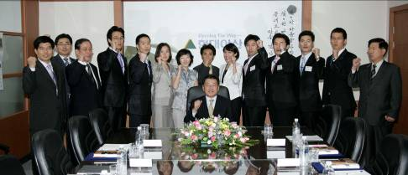
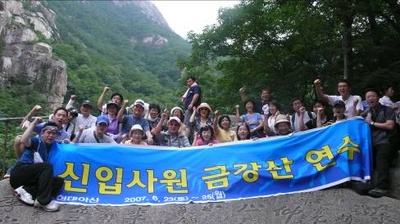
Hyundai Asan’s news letter (June)
Company related
1. Open recruitment of new employees and job training
On June 15th, Hyundai Asan CEO, Yoon, Man-Joon, presided over an informal gathering with the new employees and conferred written appointments, asking them to be faithful throughout their career life.
After training at Mt. Kumgang with their parents, a visit of the Kaesong Industrial Complex and a direct experience to bid farewell to tourists for Mt. Kumgang, they will be placed in their positions early July. In the meantime, competitive rate of open recruitment for new employees ended on June 11th, with leads of 400 to 1.

