Slide 1
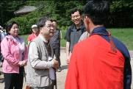
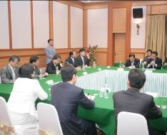
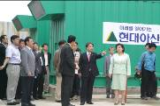
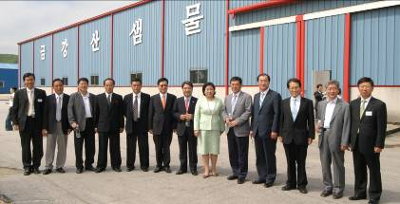
[Hyundai Asan] July 2007 Newsletter
Tourism
Hot News
Unification Minister Lee Jae Jung Visits Mt. Kumgang
<7/16/2007 (Mon) ~ 7/18/2007 (Wed)>
On the 16th of July, Unification Minister Lee, Jae-Jung visited Mt. Kumgang for three days.
Minister Lee’s visit was accompanied by Hyundai Group Chairwoman Hyun, Jung- Eun, Hyundai Asan CEO Yoon, Man-Joon and members of the Unification Ministry.
This visit was conducted with the memorable object of understanding the status quo, meaning of Mt. Kumgang business and reflecting on duties of the government, the corporation to bring about a bright future to the tourism business and the reconciliation between the South and the North.
At an informal talk with Chairwoman Hyun and CEO Yoon, Minister Lee mentions, “In order to pull up our inter-Korean cooperative business to a higher stage, we must come up with more strategic and systematic plans that receive strong support from the whole nation. To do so, it is urgent to construct transportation infra-structures, improve immigration process, complete building family reunion center at Mt. Kumgang and to provide relief actions to North Korean people, who live in Mt. Kumgang area.”
Minister Lee looked over all major tour facilities at Mt. Kumgang resort including the recently-opened Nae-Kumgang. He remarked, “I thank Hyundai Asan’s hard work in carrying on this Mt. Kumgang tourism business despite all the troubles and I hope it continues to open it’s way to bring peace and reconciliation between the Koreas.”

Slide 2
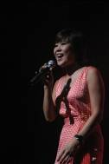
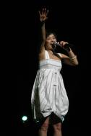
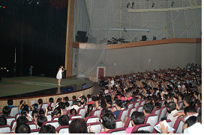
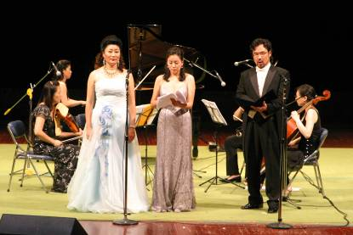
[Hyundai Asan] July 2007 Newsletter
Tourism
Hot News
2. The Third Mt. Kumgang “San-wool-lim” Musical Concert <7/21/2007 (Sat)>
- MC Lee Hong Ryeol
- Performances by Singers Shin Hyo Beom and Hyun Sook,
Sopranos Kim, Mee Sung and Yoon Sun Kyung, and Baritone Byun Seung Wook
In the evening of the 21st, the third Mt. Kumgang “San-wool-lim” Concert was held at Mt. Kumgang Cultural Center.
This event was hosted by Lee, Hong Ryeol, a popular comedian-MC. Sopranos Kim, Mee Sung and Yoon, Sun Kyung and Baritone Byun, Seung Wook sang along a string quintet, which was followed by the performances of popular singers Shin, Hyo Beom and Hyun Sook.
The audience was touched by Baritone Kim’s ‘I once had two sons,’ a piece conveying the grief of the Korean War and the divided Koreas, and then by Shin, Hyo Beom’s powerful voice and Hyun Sook’s songs with vigor.
This year’s San-wool-lim concert—first concert held in 2005—was a heated stage with 670 seats filled. Hyundai Asan plans to hold the event every year as its custom.
So far, Mt. Kumgang has hosted Mt. Kumgang concert including performances by Jang, Sa Ik, Ahn, Chi Hwan, and Jang, Yoon Jung’s Filial Piety Concert, Nam, Jin together, with the band No-Brain’s generation sympathy Concert, and The Magic Show.
In addition, Hyundai Asan paid tribute and presented an appreciation plaque to Sejong Art and Music Association’s President Jung, Chi-Gun who has donated the ‘Open Concert Hall’ to Mt. Kumgang and sponsored the San-wool-lim concerts for the past three years.

Slide 3
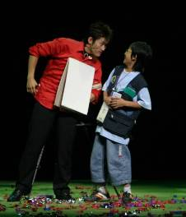
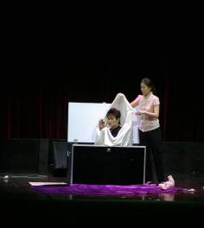
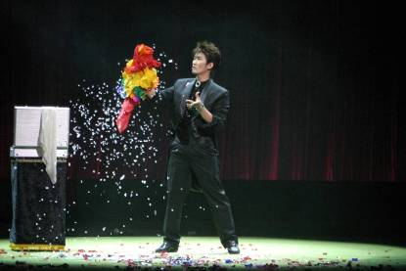
[Hyundai Asan] July 2007 Newsletter
Tourism
Hot News
3. Mt. Kumgang Magic Show <7/25/2007 (Wed)>
- Cultural performances being held regularly
At Mt. Kumgang Cultural Center, a magic show by Magician Han, Sang Min was held on the 25th(Wed).
Magician Han presented brilliant magic tricks using fire, canes, candles and a scarf. He also presented a magic with a plot called “Palar Magic” and a “Stage Magic” including a dove, rose and a ball.
Moreover, he prepared programs with the participation of the audience, making the show a memorable time for families and friends.
The magic show gave tourists an opportunity to enjoy and made lasting impressions in children’s hearts to give them hope and dreams to grow on.
The Mt. Kumgang Magic Show will be held on a regular basis.

Slide 4
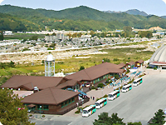
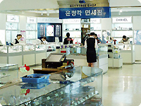
[Hyundai Asan] July 2007 Newsletter
Tourism
Information
4. Grand opening of shopping center at ‘West On-jung-gak House’
after renovation
West On-jung-gak House shopping center opens after a six-week-long renovation construction in July.
The shopping center’s ideal location affords a magnificent view of Mt. Kumgang, and its wooden building exhibits natural beauty.
The Family Mart and Beer House on the terrace are newly added to the facility with an existing mountain-climbing equipment store, Mt. Kumgang Tour and North Korea souvenir shop and etc.
Through the renovation, the West On-jung-gak House has formed into a new department store.

Slide 5
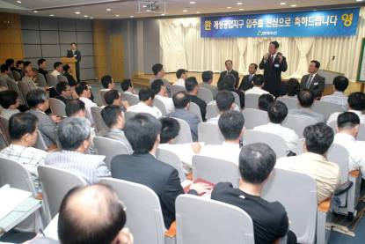
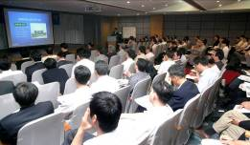
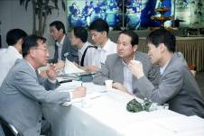
[Hyundai Asan] July 2007 Newsletter
KIC
Hot News
1. Kaesong Industrial Complex
Plant construction explanatory meeting <2007.7.19 (Thurs)>
Hyundai Asan held a briefing session of new plant construction in the KIC for the selected expectant tenant companies from the second lot sale.
Around 200 participants from approximately 100 tenant enterprises attended the session and showed high interest in the plant construction.
The event commenced with the presentation of Kaesong Industrial Complex Development Plan PR video which was followed by the briefing of the KIC plant construction plans, question and answer session and individualized consultation.
Expectant tenants voiced interest in construction cost per unit area, KIC construction infra-structures, construction approval procedures, strength and weaknesses of various construction structures. (* iron reinforcing bar, steel frame, and etc.)
After the explanatory session, participants had the opportunity to privately consult with Hyundai Asan staffs about various matters concerning successful move-in to the KIC, such as in the area of development, construction design, CIQ, distribution and etc.
For further information on plant construction in the KIC please visit our website at www.hdasan.com or contact Construction Department (+822-3669-3949, Mr. Shim, General Manager of construction of tenant companies)

Slide 6
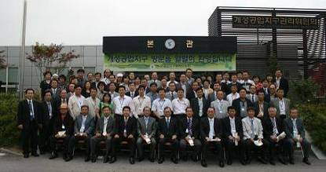
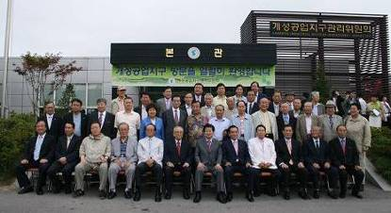
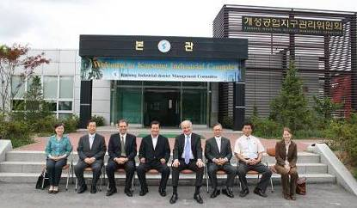
[Hyundai Asan] July 2007 Newsletter
KIC
Hot News
1. Notable visitors to Kaesong Industrial Complex
South Korean entrepreneurs for investment in the KIC
<2007.07.26 (Thurs)>
Former Unification Minister Jung, Dong Young, the National Assembly Vice-Speaker Lee, Yong Hee, and former/incumbent members of the National Assembly including Jung, Chung Rae <2007.07.20(Fri)>
German Ambassador <2007.07.03 (Wed)>

Slide 7
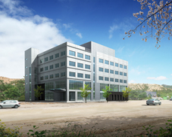
[Hyundai Asan] July 2007 Newsletter
KIC
Hot News
Bids invited for ‘Kaesong convenient center’ in the KIC
Hyundai Asan is inviting investors and renters for convenience facilities in ‘Kaesong convenient center’.
Recently, 2nd lot sales in the 1st phase industrial zone of the KIC was successfully completed attracting 156 tenant companies through the 2.3 : 1 competitive ratio in June. Selected companies are on the process of moving into the KIC in the near future.
Especially, Kaesong convenient center is the first multipurpose commercial facility that will target large number of customers comprised of the developers, administrators, workers from the residing companies and construction companies (approximately 3,500 people by the end of 2008) and various parties and organizations visiting the KIC (currently, 400 people per day).
Bidding Schedule
◦ 2007.8. 7(Tues)
- Bid briefing session (14:00 Hyundai’s conference center in Seoul)
◦ 2007.8.13(Mon)~16(Thurs)
- Potential bidders application submission
◦ 2007.8.21(Tue) : Notification of qualified bidders
◦ 2007.8.24(Fri) : An open tender
◦ 2007.8.31(Fri) : Lease contract
2. Profile of Kaesong convenient center
◦ Total Area: 6,507.04㎡(exclusive use rate 73%), 5 stories above-ground
◦ Major Facilities:
- Floor 1: Household Necessities, souvenirs, Café/Bar, Karaoke,
Beauty Salon/Massage, Pool Room, Screen Golf
- Floor 2: Korean Restaurant, Chinese Restaurant, Japanese Restaurant
- Floors 3~5: Lodging Facilities (including long-term stays)
For further information, please visit Hyundai Asan Website at: www.hdasan.com or contact Construction Department (+822-3669-3881, Mr. Song, General Manager of Sales)

