Slide 1
2. Tutorial:
Bioinformatics analysis for proteomics
Hyung-Wook Choi, AI Informatics Team

Slide 2


Overview
Quick Poll & Materials
Answer three questions and open the materials
Quick Poll
Materials
3 questions · 1 min
bit.ly/4ic39tS
Live results
github.com/hyungwookc07/msdata-workshop
Data · Colab notebook · slides

Slide 3
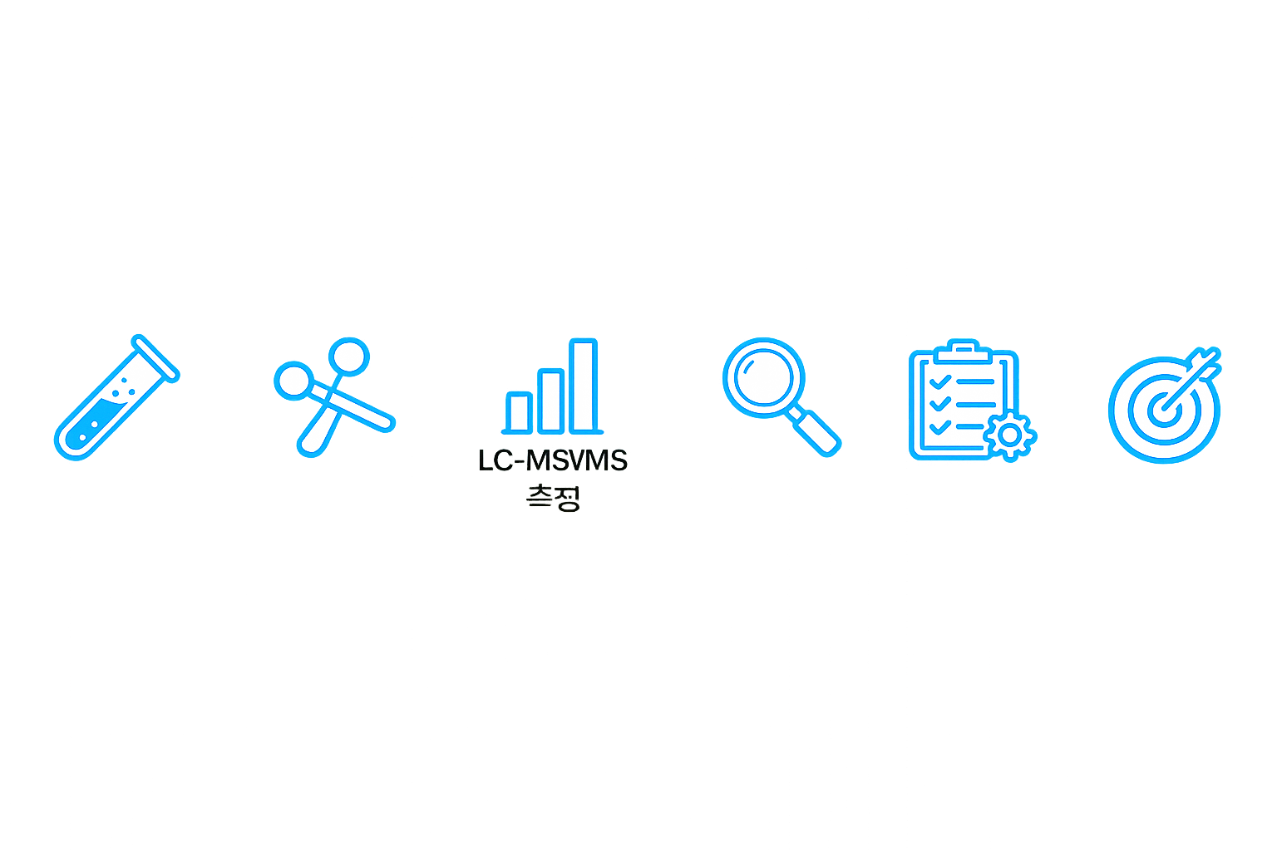
Overview
Proteomics Workflow
Today's tutorial: from spectra to biological insight
Sample
preparation
Digestion
LC-MS/MS
Search
Quantification
Interpretation
Protein
Extraction
Trypsin
Digestion (peptide)
Mass analysis
Peptide identification
Protein inference
Differential &
pathway analysis
Reduction of
Sample complexity
Generation of
Peptide
Generation of
Spectrum
“Which peptide?”
“How much?”
“What changed?”
Introduction
Sample preparation to spectra
Part 01
LC-MS Data
Part 02
Preprocessing
Part 03 · 04
Downstream · Hands-on

Slide 4
Overview
Agenda
LC-MS proteomics data: structure, workflow, and key tools
01
LC-MS Data
02
Preprocessing
03
Downstream
04
Hands-on
Raw data structure
Acquisition · PSM
Peptide → protein
Tools for each step
Filtering · normalization
Imputation (if needed)
Quality control
DE: t-test vs. limma
ORA vs. GSEA
PPI network (STRING)
Mouse liver data by diet
Web · Colab notebook
Enrichment · STRING

Slide 5
Part 01
LC-MS Data
Raw data structure and reading MS2 sequences
Acquisition · quantification, PSM
Peptide → protein inference

Slide 6
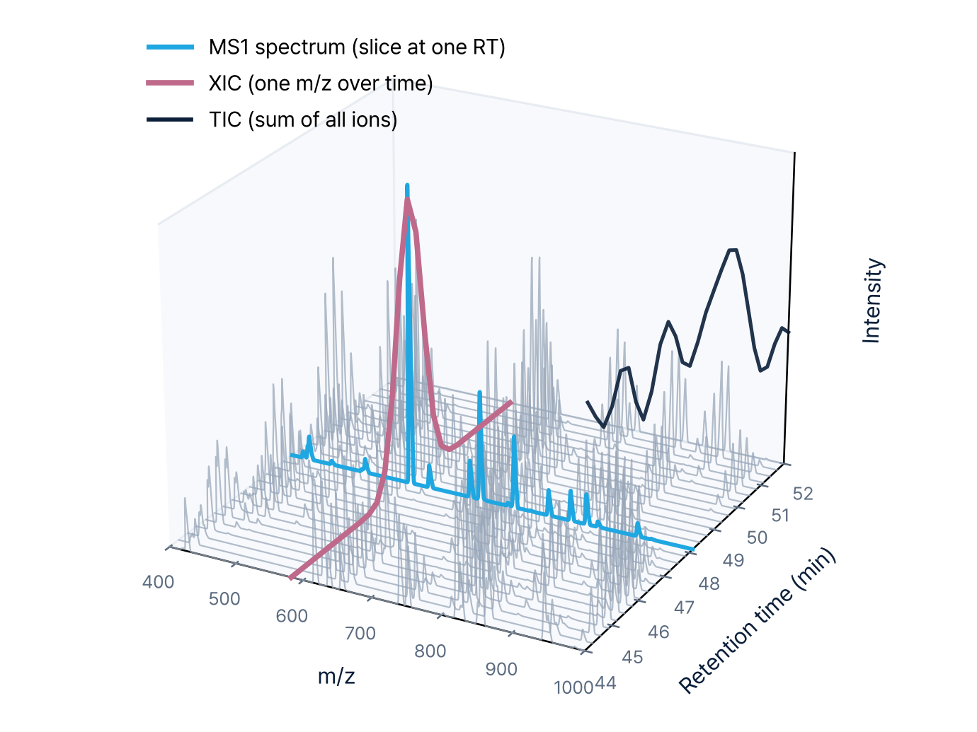
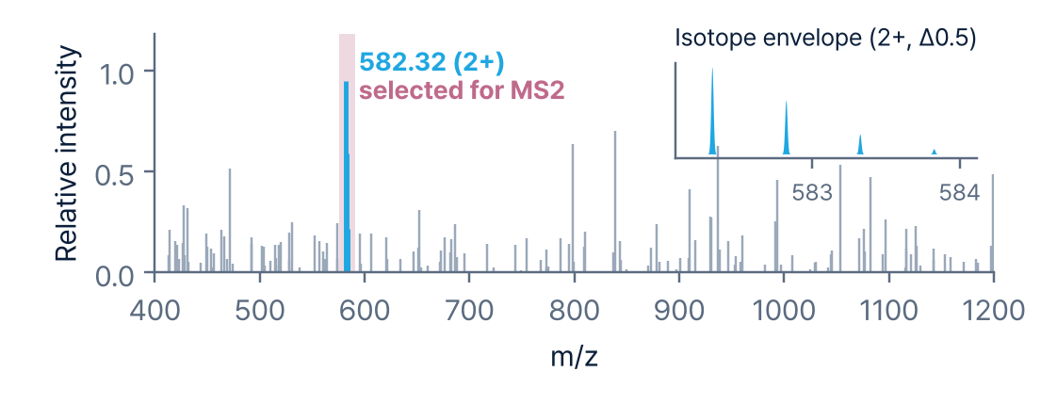
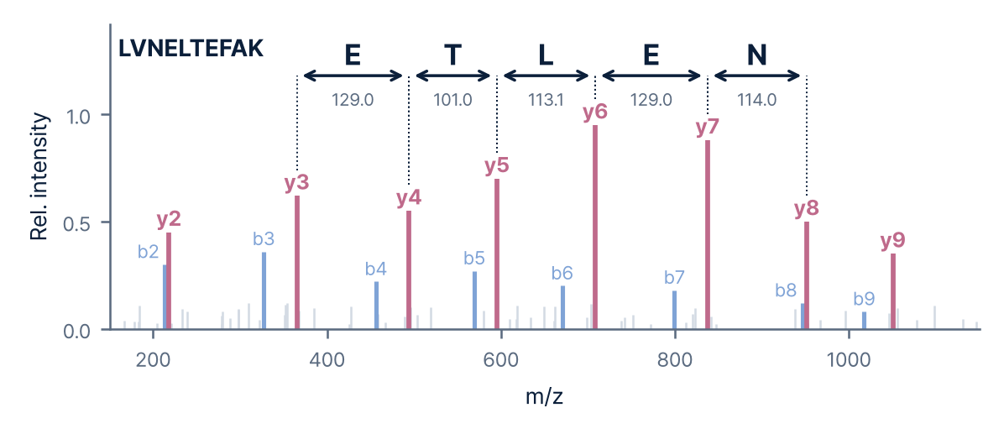
01
Part 01 · Overview
What the Raw Data Looks Like
LC-MS data = retention time × m/z × intensity
LC-MS data: retention time × m/z × intensity
MS1 · Precursor spectrum Slice at a single RT
isolate & fragment
MS2 · Fragment spectrum of 582.32
Figure: simulated data for illustration (LVNELTEFAK masses calculated)

Slide 7
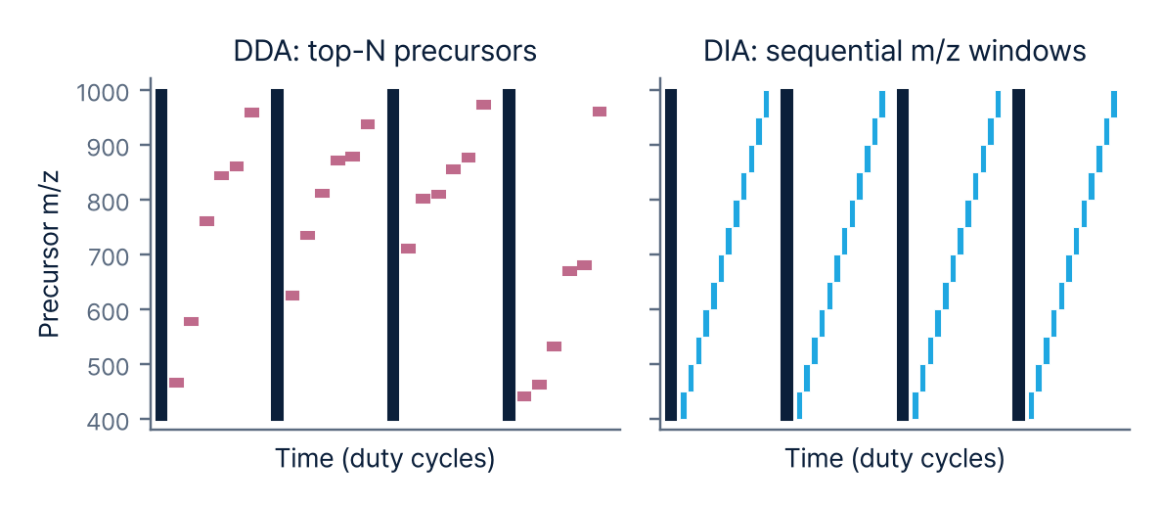
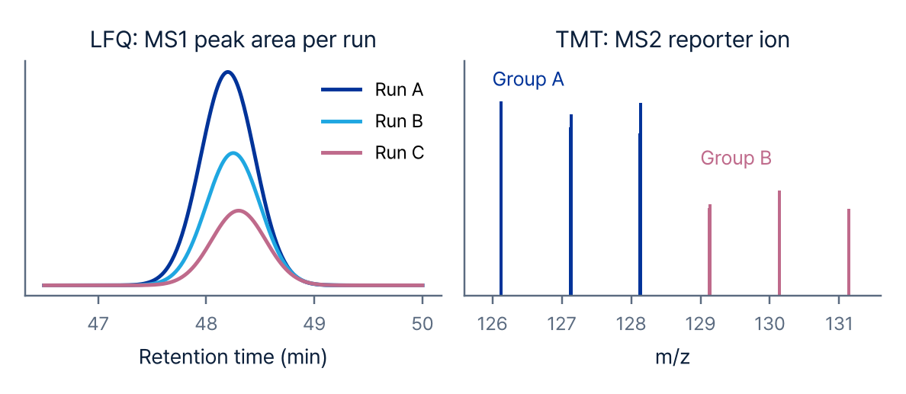
01
Part 01 · Overview
Acquisition & Quantification
Acquisition and quantification methods determine missing-value patterns and tools
Acquisition: DDA vs DIA
Quantification: Label-free vs TMT
DDA
Selects only top-intensity precursors; many missing values across samples
LFQ
Compares MS1 peak areas across runs; no limit on sample number (hands-on data)
DIA
Fragments all precursors in m/z windows; high reproducibility
TMT
Isobaric tags measure multiple samples in one run
Tools: MaxQuant, FragPipe (DDA) · DIA-NN, Spectronaut (DIA) · Proteome Discoverer (TMT)

Slide 8
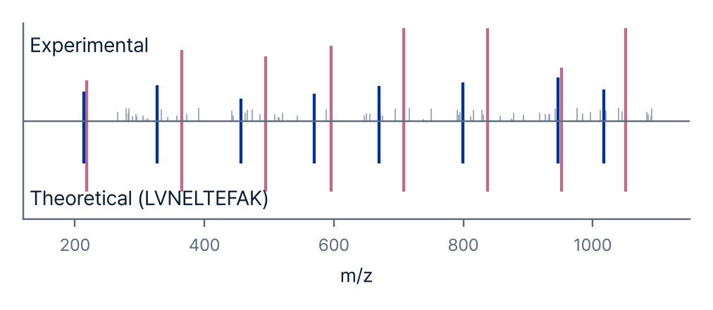
01
Part 01 · Overview
From Spectra to Peptides
PSM identification and FDR control yield peptide-level quantities
Experimental (top) vs. theoretical (bottom) spectrum
Peptide-level table (log2 intensity, example)
Peptide | z | q-value | S1 | S2 | S3
LVNELTEFAK | 2 | 0.0001 | 24.8 | 25.1 | 24.6
YLYEIAR | 2 | 0.0003 | 22.3 | NA | 22.0
AEFVEVTK | 2 | 0.0008 | 23.5 | 23.9 | 23.2
HLVDEPQNLIK | 3 | 0.0021 | 21.1 | NA | NA
… | … | … | … | … | …
PSM: match measured spectra to theoretical spectra from a sequence DB
FDR: keep error rate ≤ 1% with target-decoy
Done automatically by search software (MaxQuant, DIA-NN, etc.)
Row: peptide (precursor), column: sample
Not protein values yet; grouped into proteins at the next step (protein inference)
NA: not measured in some samples

Slide 9
01
Part 01 · Overview
Peptide to Protein Inference
Peptides are measured; protein values are inferred from peptides
Peptide → protein mapping
Protein A quantity (example)
Peptide | HFD_1 | HFD_2 | ND_1
p1 | 8.1e6 | 7.6e6 | 3.9e6
p2 | 2.4e6 | 2.6e6 | 1.1e6
p3 (razor) | 5.0e6 | 4.7e6 | 2.3e6
Protein A
p1
p2
p3
Identified (2 unique)
Protein B
p3
p4
Identified (1 unique)
Protein C
p5
p6
Indistinguishable
protein group
Protein C′
p5
p6
Protein | HFD_1 | HFD_2 | ND_1
Protein A | 1.55e7 | 1.49e7 | 7.3e6
Unique peptide
Shared peptide
Peptides shared by isoforms
Razor peptide Shared peptide (p3) assigned to the protein with more evidence (A)
Protein group Reported together as C;C′ in the result table
Protein value from summed peptide signals or MaxLFQ (example above: simple sum)
Repeated for all proteins: protein × sample matrix (input to preprocessing)

Slide 10
Part 02
Preprocessing
Representative tools for each step
Filtering · normalization · imputation
Quality control

Slide 11
02
Part 02 · Preprocessing
Analysis Pipeline & Tools
Representative tools for each step
1 Search · Quant
›
2 Preprocessing · QC
›
3 DE analysis
›
4 Enrichment
›
5 PPI network
MaxQuant
Perseus
Perseus
g:Profiler
STRING
FragPipe
R: MSstats
R: limma
Enrichr
Cytoscape
DIA-NN
Python: pandas
Python: scipy
DAVID
R: STRINGdb
Spectronaut
R: clusterProfiler
Proteome Discoverer
Python: gseapy
Output: Protein matrix
Output: Normalized matrix
Output: DE table · volcano
Output: Enriched terms
Output: Network · modules
Desktop (GUI)
Web
Code (R / Python)

Slide 12
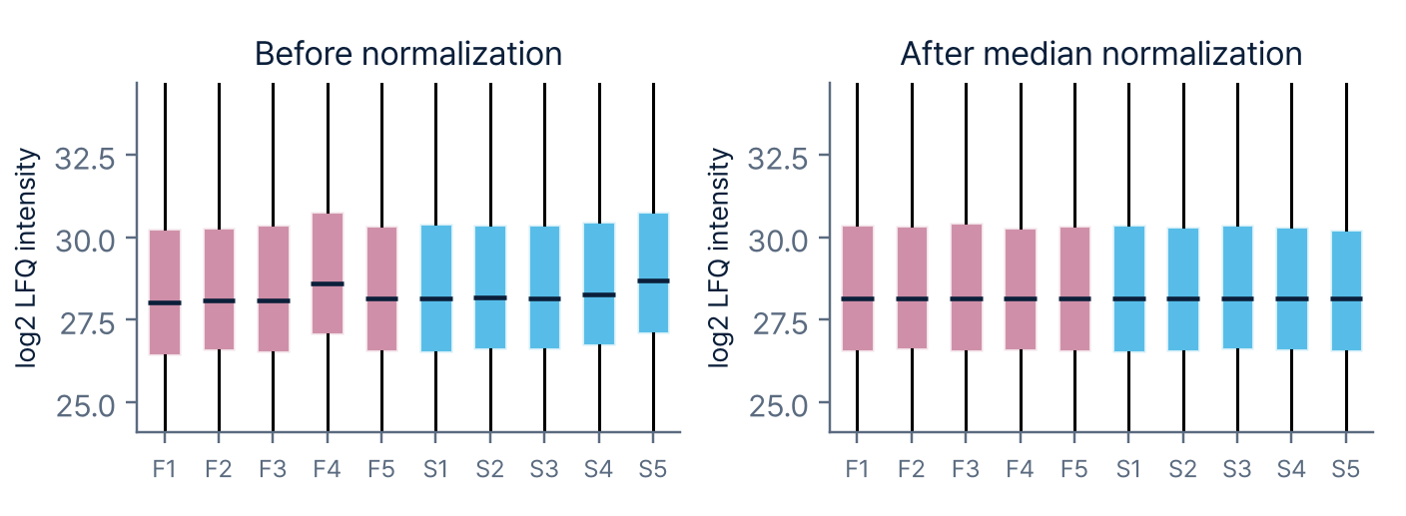
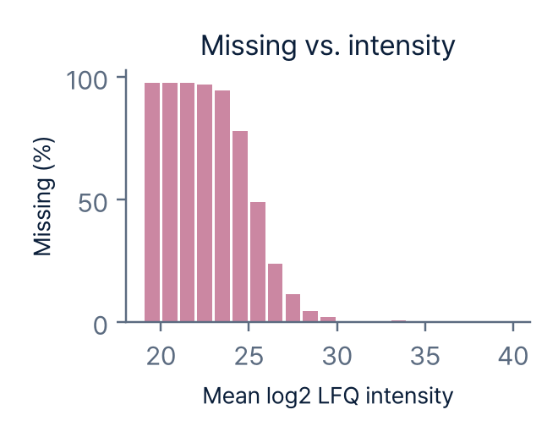
02
Part 02 · Preprocessing
Preprocessing
Data preprocessing before statistical analysis
1
Filtering
›
2
Log2 transform
›
3
Normalization
Imputation
If needed
Remove contaminants · decoys; filter by valid-value ratio
Make the intensity distribution near-symmetric
Correct sample loading differences (e.g., median centering)
Consider only with many missing values; often skipped
Options for missing values
Analyze as is: with few missing values, analyze directly (limma allows NA)
Impute: low values for MNAR (MinProb), kNN etc. for MCAR
Imputed values can create false differences; compare before and after
Figure: hands-on data (Small et al., 2024, 4 weeks)

Slide 13
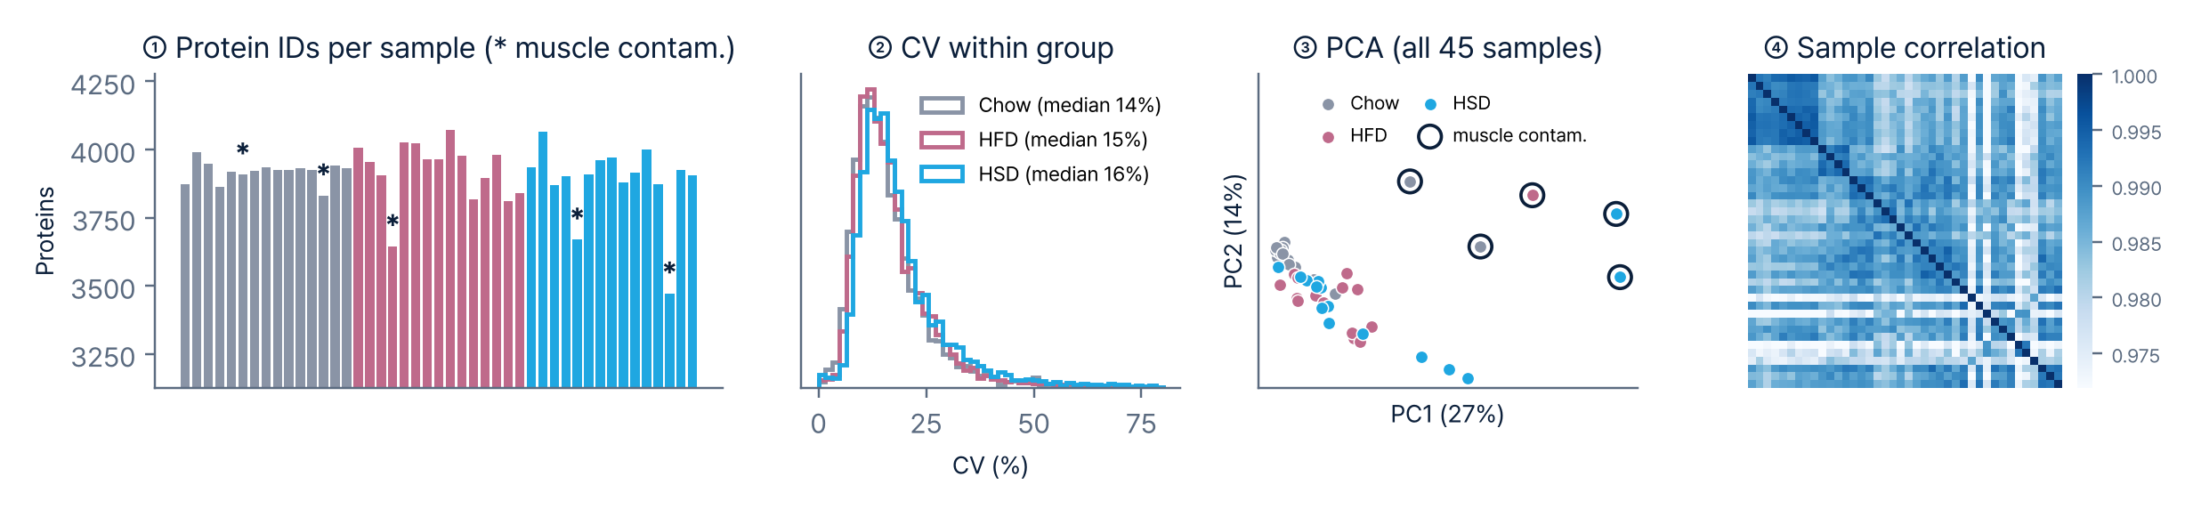
02
Part 02 · Preprocessing
Quality Control
Key QC metrics to check before statistics
Muscle-contaminated samples (*) have fewer IDs
Median within-group CV 14–16%
5 muscle-contaminated samples stand apart
Most sample correlations ≥ 0.97
Figure: hands-on data (Small et al., 2024, 4 weeks, 45 samples)

Slide 14
Part 03
Downstream Analysis
Differential expression: t-test vs. limma
Functional enrichment: ORA vs. GSEA
PPI network: STRING

Slide 15
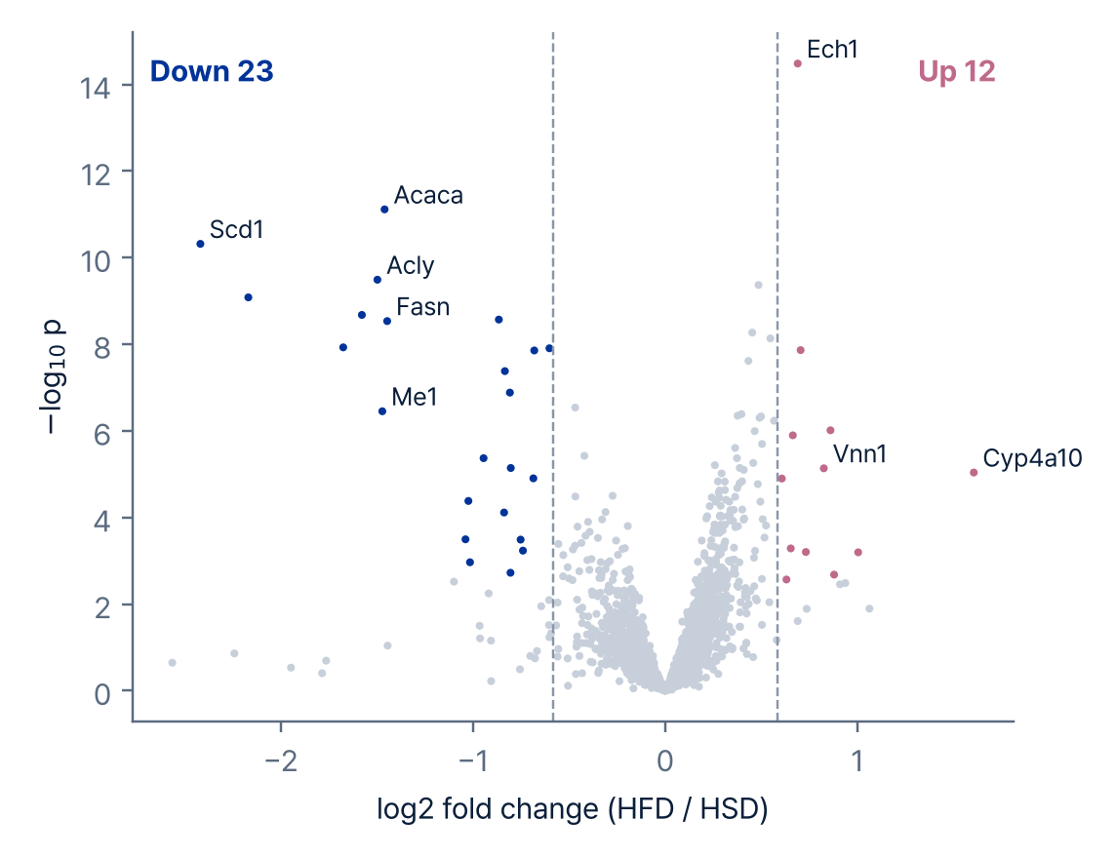
03
Part 03 · Downstream
Differential Expression (DE)
Select differentially expressed proteins by fold change and FDR
Effect size
log2 fold change (1 = 2-fold up, −1 = half)
1
Statistical test
t-test or limma (next slide); BH multiple-testing correction
2
Cutoff
e.g., |log2FC| ≥ 1, adj. p < 0.05
3
Hands-on data: HFD vs HSD (FDR < 0.05, 1.5-fold)
Tools: limma (R), Perseus, MetaboAnalyst (web)

Slide 16
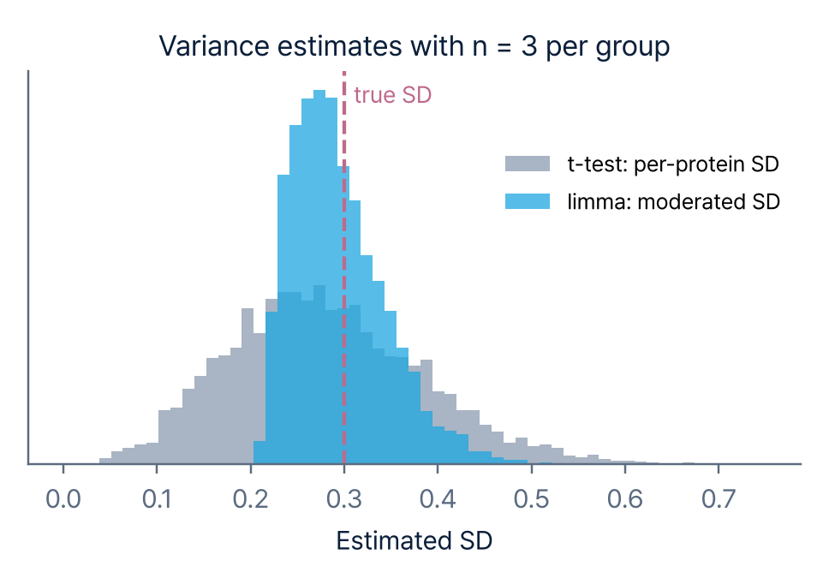
03
Part 03 · Downstream
t-test vs. limma
Choosing a test by sample size and design
 | t-test (Welch) | limma (moderated t)
Variance | That protein only | Shrunk with all proteins (empirical Bayes)
Strength | Simple, easy to explain | Stable at small n, more power
Design | Two groups | Paired, covariates (batch, sex), 3+ groups
Caveat | More false positives/negatives at small n | Filter proteins with many missing values first
Use when | Simple comparison with enough samples per group | Small n (e.g., 3–5 per group) or covariates
With small n, per-protein variance is unstable; limma borrows information across proteins to stabilize it
Both: thousands of proteins tested at once, so BH-FDR is required. Hands-on starts from limma results

Slide 17
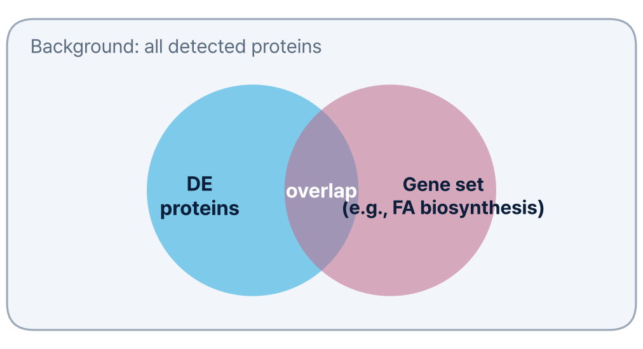
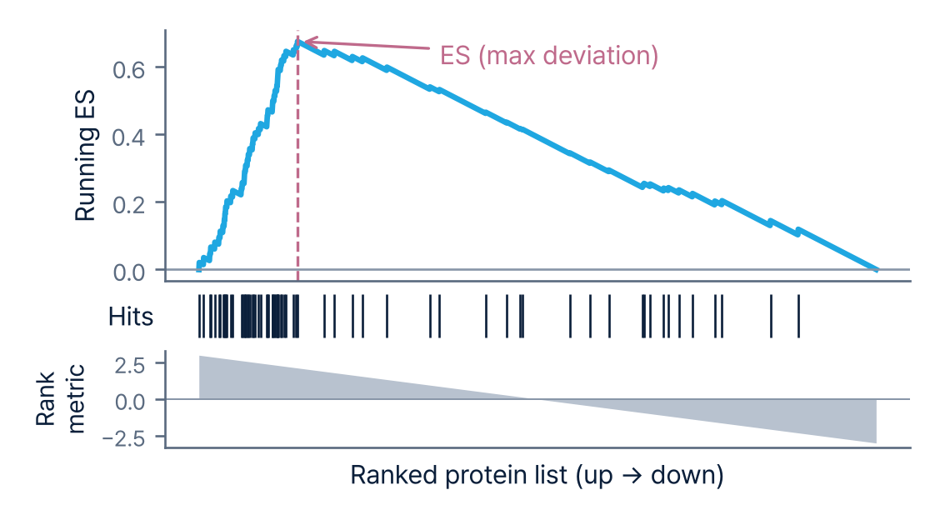
03
Part 03 · Downstream
Functional Enrichment: ORA & GSEA
Two ways to interpret DE results at the function and pathway level
ORA (Over-Representation Analysis)
GSEA (Gene Set Enrichment Analysis)
Tests overlap between DE proteins and a gene set (hypergeometric test)
Background = all proteins detected in the experiment
Ranks all proteins by a metric and tests whether a gene set is skewed to one end
Uses the whole distribution, no cutoff
g:Profiler
Enrichr
clusterProfiler
WebGestalt
GSEA
fgsea · gseapy
Gene set DB: GO, KEGG, Reactome, MSigDB Hallmark

Slide 18
03
Part 03 · Downstream
ORA vs. GSEA
Choosing a method by your DE results and question
 | ORA | GSEA
Question | What are my significant proteins? | Which pathways shift as a whole?
Input | DE protein list + background | All proteins + ranking metric (t, log2FC, etc.)
Statistics | Hypergeometric / Fisher's exact test | Running enrichment score + permutation
Strength | Intuitive, fast, many web tools | No cutoff; detects small consistent shifts; gives direction
Limitation | Results depend on cutoff and background | Low gene-set coverage when few proteins are quantified
Use when | Many clear DE proteins; interpreting a specific list (e.g., a cluster) | Few DE proteins or subtle changes; direction of pathway changes
In practice, run both and start from the terms they share

Slide 19
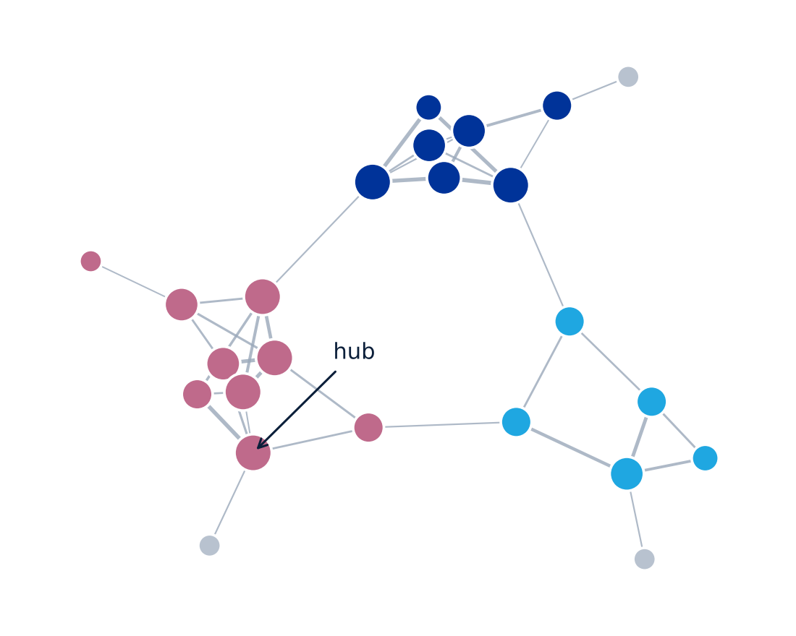
03
Part 03 · Downstream
Protein Network: STRING
Known interactions among DE proteins as a network
Input DE protein list (gene symbols)
Output PPI network, functional enrichment
Read Clusters (functional modules) and hub proteins
Tools STRING (web), Cytoscape stringApp
Example network (color: cluster, size: degree)
STRING interactions are database evidence, not proof of physical binding in your samples

Slide 20
Part 04
Hands-on
Dataset: high-fat vs high-starch diet, mouse liver
Choose a track: web tools or Colab notebook
DE results, enrichment, STRING

Slide 21
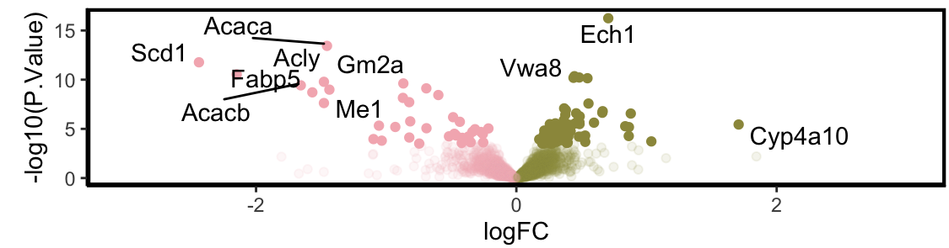
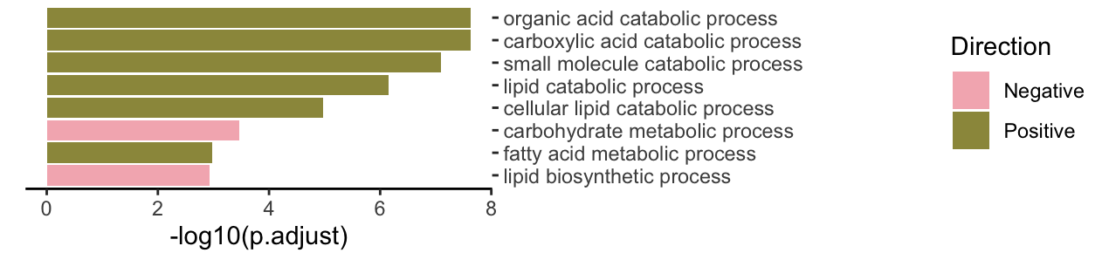
04
Part 04 · Hands-on
Hands-on Dataset
Mouse liver proteome: high-fat (HFD) vs high-starch (HSD) diet
Study
Small et al., J Lipid Res 2024 (PXD054323)
Published result: Fig. 4A
Key changes (in HFD)
↓
Lipogenic enzymes
Acaca, Acacb, Acly, Scd1, Fabp5, Me1
Design
C57BL/6J male, 4 weeks, HFD 14 vs HSD 13 (after QC)
Platform
Label-free DDA (MaxLFQ), MaxQuant
GSEA: biosynthesis · carbohydrate
lipid biosynthetic, carbohydrate metabolic process
↓
Data
proteinGroups.txt from the authors' GitHub
↑
GSEA: catabolic processes
organic acid · small molecule · lipid catabolic process (Ech1, Cyp4a10)
Provided
Protein × sample matrix, sample sheet, DE results
Pink: HSD↑ · Olive: HFD↑ (from the authors' R report)
1 DE results
Table · volcano
2 ORA
g:Profiler
3 GSEA
WebGestalt
4 STRING
Network

Slide 22
04
Part 04 · Hands-on
Choose Your Track
Pick web tools or the Colab notebook
Materials
bit.ly/4ic39tS
github.com/hyungwookc07/msdata-workshop
Data · Colab notebook · README
Step | Web | Code (Colab notebook)
Setup | Web browser only | Browser + Google account (no install)
DE | Provided DE results (limma) | Provided DE results (limma)
ORA | g:Profiler | g:Profiler (same server)
GSEA | WebGestalt (GSEA mode) | gseapy prerank
STRING | string-db.org, Cytoscape | STRING API
Web For ORA, also upload the background (all detected proteins)
Code Run cells top to bottom with Shift+Enter; no coding
R users Same workflow provided as R Markdown with limma code

Slide 23
04
Part 04 · Hands-on
Step 1 · DE Results
Find up- and down-regulated proteins in the limma results
Web
Colab notebook
1
Open de_results_limma.csv in Excel or Google Sheets
Run section 0. Setup → 1. DE results
Install packages, load results, set cutoffs, volcano plot
Open in Colab
2
Sort by adj.P.Val and check the top proteins
3
Locate up/down proteins on the provided volcano plot
Check
Cutoff (FDR < 0.05, 1.5-fold): 12 up · 23 down
Fasn, Acly, Acaca, Scd1 on the left of the volcano
How the counts change with the cutoff
4
Have down_genes.txt, up_genes.txt, background.txt ready

Slide 24
04
Part 04 · Hands-on
Step 2 · ORA (g:Profiler)
Functions over-represented among down-regulated proteins
Web
Colab notebook
1
Open g:Profiler (biit.cs.ut.ee/gprofiler)
Run section 2. ORA
Same analysis on the same g:Profiler server, dot plot
Open in Colab
2
Paste down_genes.txt into the query box
3
Organism: Mus musculus
Check
Fatty acid synthesis and pyruvate metabolism terms
Results with the up list (up_genes.txt)
How results change with a different background
4
Advanced options → Statistical domain scope: Custom, paste background.txt
5
Run query → check the Manhattan plot and Detailed results

Slide 25
04
Part 04 · Hands-on
Step 3 · GSEA (WebGestalt)
Pathways concentrated at one end of the full ranking
Web
Colab notebook
1
Open WebGestalt (webgestalt.org)
Run section 3. GSEA
gseapy prerank with the same score (limma t) and GO-BP; running ES plot
Open in Colab
2
Organism: Mus musculus, Method: GSEA
3
Functional database: geneontology → Biological Process
Check
NES > 0 (HFD↑): small molecule · lipid catabolic process
NES < 0 (HSD↑): lipid biosynthetic · carbohydrate metabolic process
Whether the weak up side in ORA shows up in GSEA
4
Gene ID type: Gene symbol; upload ranked_list.rnk (two columns: gene, score)
5
Advanced parameters → gene set size min 100, max 500 (as in the paper)
6
Submit → check the NES bar chart and top terms

Slide 26
04
Part 04 · Hands-on
Step 4 · Network (STRING)
Interactions and hubs among down-regulated proteins
Web
Colab notebook
1
Open STRING (string-db.org) → Multiple proteins
Run section 4. STRING network
Network via STRING API, hubs by degree
Open in Colab
2
Paste down_genes.txt, Organism: Mus musculus
3
Settings → minimum interaction score: high (0.700) → Update
Check
Whether Acaca, Acly, Fasn, Scd1 form one module
Whether modules agree with ORA and GSEA
How the network changes with the score cutoff
4
Clusters tab → MCL clustering for modules
5
Analysis tab → functional enrichment

Slide 27
Contact
Seongjun Park
Head of PASS Center, Bertis
seongjun.park@bertis.com

