Slide 1
Ploby
We draw the line an AI purchasing agent
spends inside, and we record every stop.
Client-funded project expenses · Monad testnet
GWDC 2026 · Challenge B / [Team name]
Notes:
Rebuilt from the supplied English PDF, preserving its main product claim and technical narrative. Ploby bounds AI-assisted purchase requests under bilateral project terms and records each outcome. TestKRW demonstration; no real funds. Team details are replaceable on the final slide. Repository: https://github.com/hyunhomon/ploby .

Slide 2
Problem and initial customer hypothesis
Shared spending decisions
A project expense, end to end
01 Agree on vendors and a spending cap
02 Reserve an allowed purchase
03 Submit and review the receipt
04 Settle and export the evidence
Agencies buy domains, hosting and design tools. The client needs an agreed spending scope and evidence for reimbursement.
Ploby applies the agreement to each request and keeps a record that explains each payment.
Ploby / Challenge B
02
Notes:
Initial customer hypothesis, not validated traction: small web/design agencies that buy domains, hosting, software and image licenses for client projects. The sample Cafe Ondam project illustrates this workflow; it is not a customer claim. No market-size estimate or customer revenue is asserted.

Slide 3
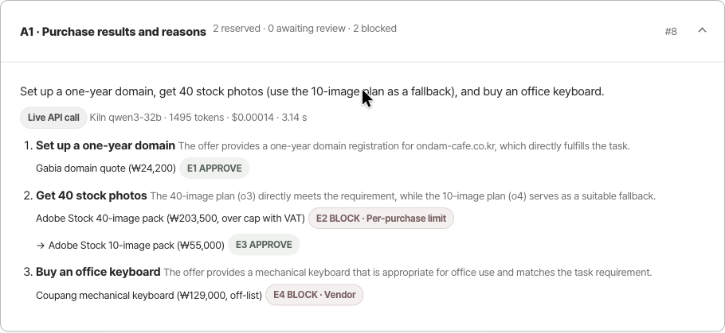
The agent adapts to a policy result
40 images: ₩203,500
BLOCK
The total exceeds the
₩200,000 purchase cap.
10 images: ₩55,000
APPROVE
The agent tries its next
planned offer and reserves it.
Ploby / Challenge B
03
Notes:
Recorded project pd4466e964c56. Live Kiln qwen3-32b planning call: 1,495 tokens, $0.00014 displayed rounded, 3.14 s. The quote readers replayed previously recorded responses. The model proposed an ordered plan. The deterministic engine blocked the 40-image offer at KRW 203,500 including VAT; the agent then tried and reserved the 10-image offer at KRW 55,000. An off-list keyboard vendor was also blocked. Full plan, generation ID, usage and requests are in evidence/projects/pd4466e964c56/log.jsonl. Screenshot is from the actual application, not a mockup.

Slide 4
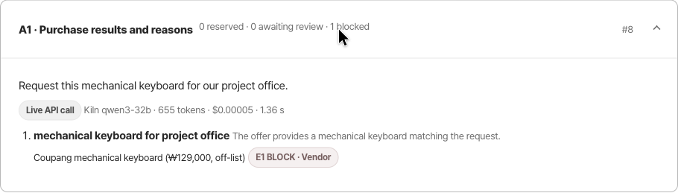
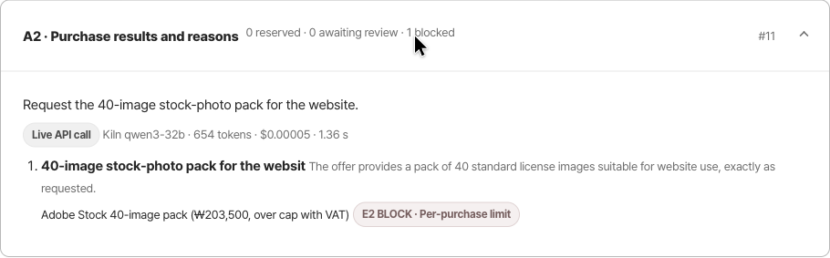
Two separate runs, two recorded stops
Run A1 / Vendor outside the agreed list
Run A2 / Total exceeds the ₩200,000 cap
Ploby / Challenge B
04
Notes:
Fresh project p7ccf1ec48ac6 with the same vendor list and spending caps as the workflow project. Live Kiln plans: A1 keyboard, A2 40-image pack. Quote readings are cached and labeled separately in the logs. A1 requests E1 at log #9: BLOCK vendor; transaction 0x87f2d29aecb42a7501058382d7fa7e71e1d5c3d431bc255659ceb8d86c3705d4. A2 requests E2 at #12: BLOCK per_purchase; transaction 0xfed139854ff621adce522456a9a94f04c8e826787fd8b4995aa92197dfe56f1a. Neither request reserves or pays funds. 14 log entries, 2 original documents and 6 matching chain calls. See evidence/boundaries-audit.json and docs/submission.md.

Slide 5
Control boundaries and wallet approvals
Layer | Responsibility
Kiln · qwen3-32b | Plans offers and extracts document fields. No private key or payee field in the model output.
Policy engine | Applies 15 checks to each request. Keeps the same inputs for independent replay.
Monad escrow | Enforces funded balances, reservations, fixed payee and pausing of new commitments.
Optional wallet mode
EIP-712 binds approval to the exact action and log head.
The engine verifies it; the deployed contract still trusts its operator.
Ploby / Challenge B
05
Notes:
Implementation: escrow/agent.py, escrow/ai.py, escrow/expenses.py, escrow/wallet.py, escrow/core.py, src/PlobyEscrow.sol. EIP-712 mode is optional when all three party addresses are configured. It verifies user-wallet proofs in the off-chain engine and independent replay, binding project, role, operation, policy hash, budgets, parameters, previous log head, chain ID, escrow and expiry. Uses eth-account, not custom ECDSA. Contract currently trusts an operator for business-rule decisions; it does not verify these EIP-712 proofs or all 15 off-chain rules. Chain transactions in the demo use test relayer/funding keys. EIP-712 specification: https://eips.ethereum.org/EIPS/eip-712

Slide 6
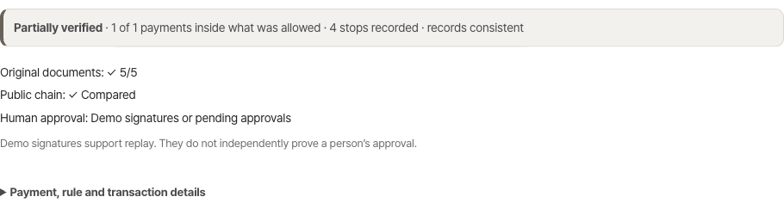
A payment reconstructed from the records
₩24,200
TestKRW settled after receipt approval
31 log entries
5 original documents
13 matching chain calls
Recorded demo: documents and chain match. Human approval uses demo signatures,
so the verifier reports partial verification. Wallet mode verifies real EIP-712 proofs.
Ploby / Challenge B
06
Notes:
Evidence snapshot: evidence/submission-audit.json and evidence/projects/pd4466e964c56/log.jsonl. Independent run executed verify.py from an exported ZIP using public RPC, outside the Ploby API. 31 lines replay, 5 original hashes match, 13 contract calls match their expected events, 1 completed expense payment for KRW 24,200, 4 stopped requests. Settle transaction: https://testnet.monadvision.com/tx/0x25209465868c777c2d9a74d99ed9e5b17158a2f8959480d58b85c44484bf3e9d . Ledger: funded 4,500,000; reserved 4,055,000; paid 24,200; available 420,800. Uses TestKRW units. Overall verifier result is incomplete (demo_authorization), not fully verified. Demo HMAC keys cannot prove a person approved. Uploaded E1 document hashes establish retained content, not vendor authenticity. Live chain balances can change after snapshot. Demo engine clock was advanced by three days; chain timestamps use the real testnet clock.

Slide 7
Checks for decisions, state and money
Verification | Coverage | Observed result
Business rules | Budgets, holds, deadlines, settlement | 64 checks passed
New regressions | Evidence export, audit verdict, wallet proofs, stopped-agent rerun | 8 checks passed
Randomized engine runs | Conservation of funds and state | 200 scenarios passed
Solidity contracts | Current escrow + legacy contract | 12 + 15 tests passed
Live boundary runs
Over-cap offer blocked · unlisted vendor blocked · paused task stops after one request
Ploby / Challenge B
07
Notes:
Commands: python3 harness/check.py; .venv/bin/python -m unittest harness.test_submission -v; python3 harness/fuzz.py; /Users/sunwoo/.foundry/bin/forge test; npm run build in frontend. 64 offline business checks, 8 added regression checks, 200 randomized Python engine scenarios, 12 current PlobyEscrow and 15 legacy ExpenseEscrow Solidity tests. This is bounded regression evidence, not a full security audit or a proof about all documents. Paused duplicate-document rerun now stops after its first blocked request even when allocation is the primary failed rule. Existing adversarial sample results are not presented as evidence of general resistance.

Slide 8
Measured inference efficiency
Eight matched documents | First read | Exact cache replay
Expected policy outcomes | 8 / 8 | 8 / 8
Inference API requests | 8 | 0
Prompt / completion tokens | 5,067 / 986 | 0 / 0 newly sent
Reported inference cost | $0.000525 | $0
Median document-read time | 2.299 s | 0.0014 s
Energy estimate: 0.092–1.679 Wh for the first reads
Accelerator assumptions, not measured Kiln power. Cache figures describe repeated
requests on these fixtures; they do not establish accuracy on unseen documents.
Ploby / Challenge B
08
Notes:
Source: evidence/benchmark.json, generated by harness/benchmark_submission.py. Eight declared demo documents, a fresh project for each, the same fixed policy/date. Cold means no local response cache; provider prefix caching may still apply. Warm immediately replays identical requests. All eight expected APPROVE/BLOCK/HOLD results match in each arm, false approvals 0/8. Cold totals: 5,067 prompt tokens, 986 completion tokens, $0.00052472 billed, median 2.298916 s. Warm: zero inference API requests, zero newly sent tokens/cost, median 0.00135698 s. This is an application regression corpus, not held-out accuracy or an end-to-end speed benchmark. Accelerator-only energy estimate 0.09247–1.67890 Wh for cold requests, based on explicit 4-card RNGD Qwen3 assumptions in docs/efficiency.md; no Kiln power telemetry. Warm has zero incremental remote inference, not zero total system energy.

Slide 9
Commercial focus and alternatives
Existing infrastructure | Documented strength
Stripe shared payment tokens | Seller, amount and time-limited payment credentials
Coinbase Agentic Wallet | Agent wallet tools and spending limits
Safe smart accounts | Treasury permissions and programmable policies
Ploby’s product focus
Bilateral project terms, receipt settlement and a portable record of why each payment passed.
Validation plan: 3 agencies / 10 projects. Pricing hypothesis: $49 per workspace per month.
Measure approval time and reconciliation exceptions before making revenue claims.
Ploby / Challenge B
09
Notes:
Market positioning is an analysis of documented capabilities, not an exhaustive superiority claim. Primary sources accessed 2026-09-30: Stripe agentic commerce primer https://stripe.com/guides/agentic-commerce-primer (SPTs restrict seller, amount and time window); Coinbase Agentic Wallet https://docs.cdp.coinbase.com/agentic-wallet/mcp/mcp-tools/show-wallet-app (per-call and per-session spending limits); Safe https://docs.safe.global/home/ai-agent-quickstarts/agent-with-spending-limit and https://safe.global/teams (spending limits, roles and programmable policies). These products overlap with Ploby controls and can also become infrastructure partners. Initial customer and pricing are hypotheses, not validated traction. Proposed pilot: 3 agencies, 10 real projects, measure administrative time and reconciliation exceptions before testing $49 per active workspace/month. No TAM or revenue forecast is claimed.

Slide 10
Roadmap toward production control
Now
Demonstrable controls
Testnet settlement, optional wallet approvals, evidence export and reproducible checks.
Next
Reduce trusted operator powers
Verify approvals and tighter policy limits on chain.
Exit: independent review plus key-recovery and failure tests.
Pilot
Connect evidence to real operations
Vendor-authenticated receipts and agency pilots.
Exit: measured customer value and a reviewed path to real-money use.
Ploby / Challenge B
10
Notes:
Roadmap stages and exit criteria are proposals, not delivery commitments. The current prototype is not production custody infrastructure. Scope per phase follows identified trust gaps: direct human wallet execution and contract signature verification; reducing operator discretion; authenticated vendor evidence; independent security review, operational monitoring and failure recovery. Long-term vision is a reusable approval and evidence layer for project work across payment rails. Regulatory requirements and payment-provider arrangements must be evaluated before real-money launch; no compliance approval is claimed.

Slide 11
[Team name]
Team introduction
[Member name] · [Role]
[Relevant experience or contribution]
[Member name] · [Role]
[Relevant experience or contribution]
Demonstrated scope
Product UI · Kiln agent · policy replay · Solidity escrow · portable evidence
Ploby / Challenge B
11
Notes:
User requested a replaceable team introduction. All name, role and background fields on this slide are editable native text. Replace these slots with the actual team; remove or add members to match reality. No names, credentials, work history or customer claims have been invented. The demonstrated implementation scope is supported by the repository, but ownership must be assigned by the team.

