Slide 1
Idea & hypothesis
Find a common genes which are physically linked both OSA and dementia associate genes.
Physical link between genes were found in PCNet
Hypothesis: The multiplicative epistasis of both SNPs causes transcriptional changes of the some of common genes, and these genes probably cause both OSA and dementia
Criteria of the common genes
We believe these are novel and had not been reported.
They have to link of both OSA and dementia genes (inferred by SNPs)
The link has to be specific, not broad

Slide 2
Methods (We may need to have a good name of the method)
Starting with 14 dementia related and 3 of OSA related DisGeNET IDs (Curated by Arvind)
Initially got 1,108 dementia associated genes and 23 OSA associated genes
Found 3,610 genes has connections for both dementia and OSA genes.
Perform a permutation test and filtered some genes by Benjamini-Hochberg correction (FDR < 0.05)
Found 42 novel genes

Slide 3
The permutation test (1/2)
Let’s assume you’ve found a list of genes from the method.
If you randomly pick two diseases and run the same thing (i.e. do the exact things with the random input) and if there are overlaps between the random list and your finding, the overlapped genes may be found by a random chance.
But your finding even can be found by the random trial, but it doesn’t mean your finding was random. It’s a case of many possibility.
One possible option would be try to enumerate every pair of disease, but it will take a long time.

Slide 4
The permutation test (2/2)
Instead testing all, we perform the following procedure:
Let’s sample A number of DisGeNET IDs where A is the number of IDs of the diseaseA (used in the method)
Let’s sample B number of DisGeNET IDs where B is the number of IDs of the diseaseB (used in the method)
Find common genes of the both sampled ID sets.
For increment the count of every common genes.
Perform Step 1-4 for 100 * N times where N is the number of the common genes were found by your input (which was not a random choice)
For each of your common genes, calculate p-value by x / 100 * N, where x the counts for the gene by step 1-5.
Correct the p-value using Benjamini-Hochberg correction.

Slide 5
node | a | b | rank | pvalue
TMEM181 | {'SH3RF1'} | {'NRG1'} | 1 | 1.36.E-04
TSPAN19 | {'TSPAN16'} | {'TSPAN18'} | 3 | 8.31.E-06
CSTL1 | {'AHSG', 'PRKN'} | {'NRG1'} | 5 | 4.93.E-04
RNF121 | {'ITGB2'} | {'LPAR1'} | 6 | 2.60.E-04
AL121594.3 | {'RNF4'} | {'NRG1'} | 6 | 5.04.E-04
OR4E2 | {'MC1R'} | {'ARRB1'} | 8 | 5.15.E-04
FAM241A | {'PLP1', 'LINGO1'} | {'LPAR1', 'SGCD'} | 10 | 2.35.E-04
FITM2 | {'CCRL2', 'HTR2C'} | {'LPAR1', 'TSPAN18'} | 10 | 2.74.E-04
OR2L13 | {'ZP3'} | {'ARRB1'} | 15 | 2.02.E-04
OR11H4 | {'PTAFR'} | {'ARRB1'} | 17 | 2.13.E-04
CST11 | {'CST3', 'AHSG'} | {'NRG1'} | 19 | 3.43.E-04
OR4C6 | {'HEATR4'} | {'ARRB1'} | 20 | 2.71.E-04
TMEM120A | {'VKORC1'} | {'TSPAN18'} | 21 | 2.47.E-04
OR2AE1 | {'PTAFR', 'GPR65'} | {'ARRB1'} | 24 | 4.74.E-04
OR7C1 | {'CHRM1'} | {'ARRB1'} | 26 | 3.63.E-04
TMEM87B | {'SLC30A7'} | {'LPAR1'} | 26 | 1.91.E-04
OR8D1 | {'CBLL2', 'ADAD1'} | {'ARRB1'} | 29 | 2.88.E-04
OR4S2 | {'ADAM10'} | {'ARRB1'} | 30 | 3.57.E-04
OR2J2 | {'PCDH11X'} | {'ARRB1'} | 36 | 5.26.E-04
TMED8 | {'TMED9'} | {'PTGER3'} | 39 | 1.22.E-04
OR2C3 | {'CBLL2', 'ADAD1', 'CCDC62'} | {'ARRB1'} | 58 | 4.16.E-04
node | a | b | rank | pvalue
TMCO5A | {'DKKL1', 'TEX33', 'ADAD1', 'CCDC62', 'CBLL2'} | {'TSPAN18'} | 116 | 3.38.E-04
HSPA7 | {'UBXN11'} | {'ARRB1'} | 262 | 2.27.E-04
ZSWIM9 | {'ESR2', 'ZNF292'} | {'AHDC1'} | 331 | 5.15.E-04
FABP9 | {'FABP2'} | {'FABP4'} | 332 | 6.09.E-05
GTSF1 | {'HSPB1'} | {'MPHOSPH6'} | 336 | 1.47.E-04
TMEM151A | {'CAMK2A', 'SNCB'} | {'LPAR1'} | 350 | 5.60.E-04
TMEM218 | {'NARS2'} | {'TSPAN18'} | 363 | 3.99.E-04
MGAT5B | {'FAM171A2', 'MGAT5'} | {'PTGER3'} | 435 | 2.44.E-04
OR6F1 | {'PTAFR'} | {'ARRB1'} | 1408 | 2.13.E-04
ZNF385D | {'ZNF804A'} | {'PTGER3'} | 1414 | 4.71.E-05
TMEM161B | {'RPS6KB1'} | {'LPAR1'} | 1415 | 1.63.E-04
LARGE2 | {'DKKL1'} | {'NRG1'} | 1463 | 4.13.E-04
SCFD2 | {'SCFD1', 'STXBP2', 'UBE2Z', 'SIRT2'} | {'NBAS'} | 1469 | 2.83.E-04
RAVER2 | {'CNKSR3'} | {'NRG1'} | 1474 | 2.94.E-04
CPNE8 | {'TRPM1', 'VAMP8', 'NDUFS1', 'SOAT1'} | {'ARRB1'} | 1493 | 5.29.E-04
ARRDC2 | {'RXRA', 'PDE4D'} | {'ARRB1'} | 1520 | 4.68.E-04
OLFM2 | {'TUBB1'} | {'NBAS'} | 1531 | 3.55.E-04
ENOX1 | {'NOX4', 'SETD1A', 'RBMS3'} | {'LPAR1'} | 1555 | 5.76.E-04
TMEM120B | {'RNF5', 'SIGMAR1'} | {'LPAR1'} | 1573 | 4.32.E-04
BLOC1S3 | {'DTNBP1', 'DNAJC6'} | {'ARRB1'} | 1577 | 2.63.E-04
CFAP45 | {'SPTAN1', 'PACRG'} | {'ARRB1'} | 1739 | 4.13.E-04

Slide 6
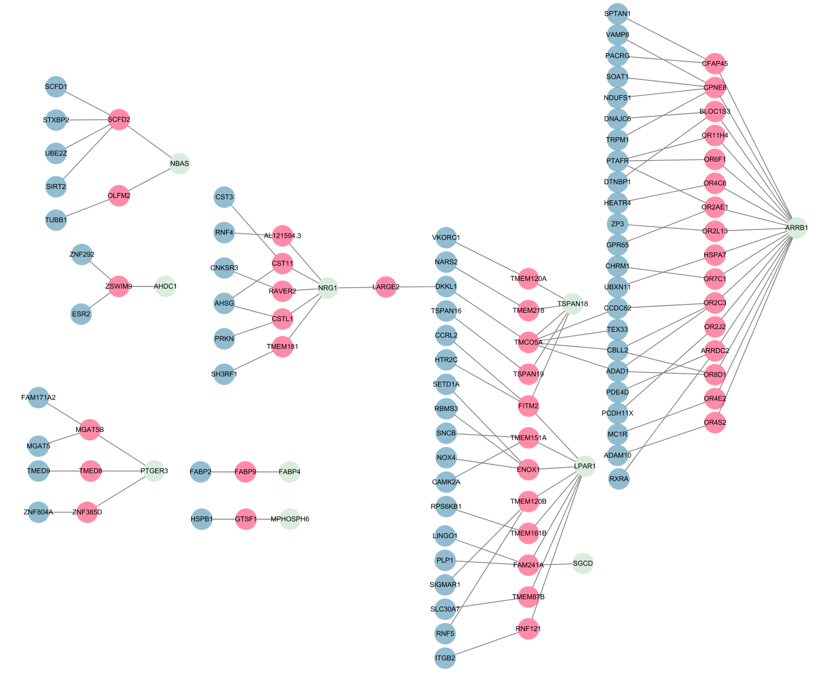
microtubule (SIRT2, TUBB1)
Cysteine-type endopeptidase inhibitor activity
(CST11, CSTL1)
Membrane
Olfactory transduction
Signaling by GPCR
Mitochondrion
(RPS6KB1,CAMK2A,NARS2)

