Slide 1



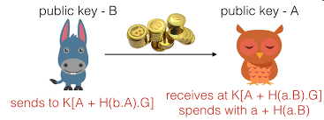
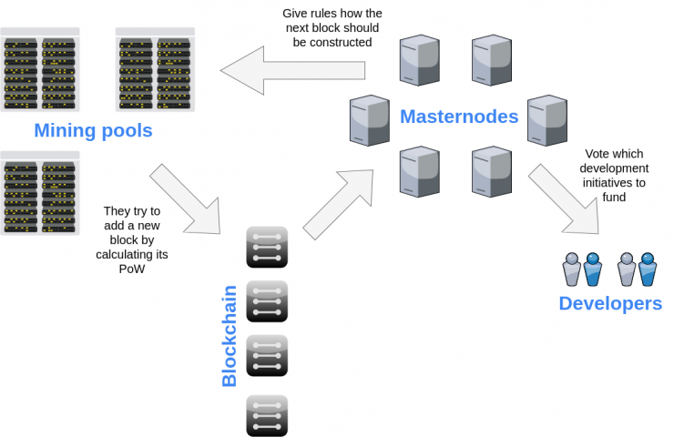
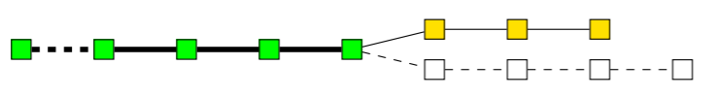

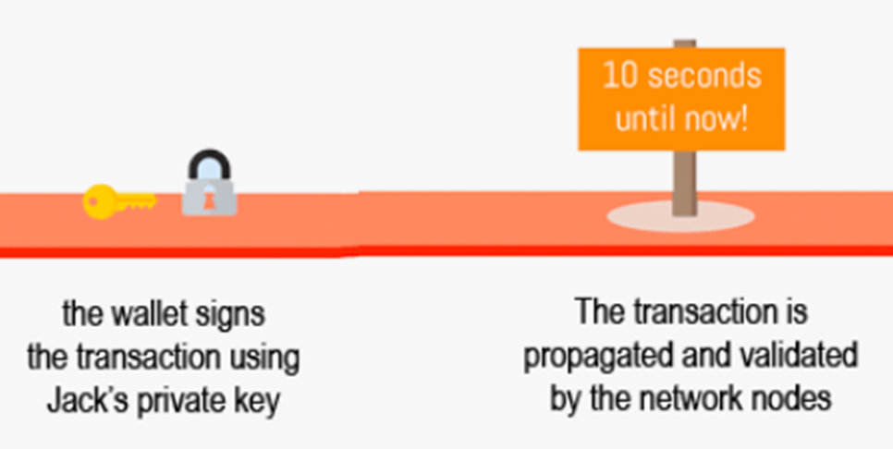
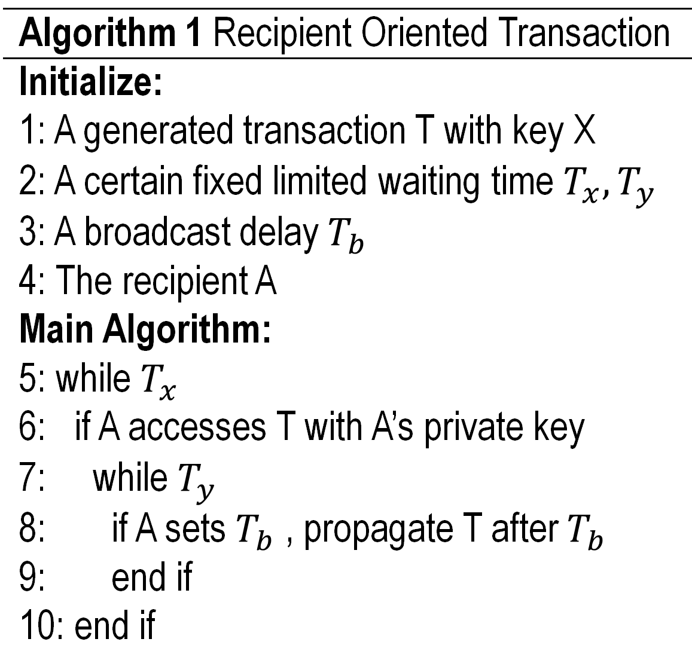


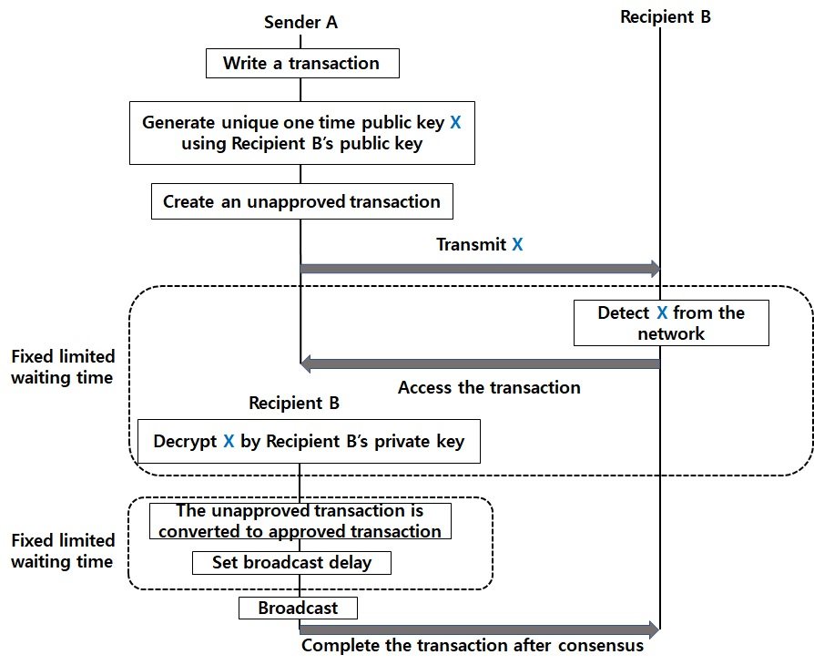
Poster: Recipient Oriented Transaction for Preventing Double-Spending Attacks in Private Blockchain
Hyunjae Lee, MyungJae Shin, Kyeong Seon Kim, Yeongeun Kang, and Joongheon Kim (Chung-Ang University, Korea) E-mail: joongheon@cau.ac.kr
Introduction and Backgrounds
Introduction
Backgrounds
Double Spend Attack → There is still a technique that can be used to deceive someone about the state of a transaction, called double-spend attack
Valid chain (filled as green)
Honest nodes (filled as yellow)
The fraudulent branch by the attacker (shallow)
How to perform
1) Initial state of the blockchain in which all transactions are considered as valid.
2) Honest nodes continue extending the valid chain by putting yellow blocks, while the attacker secretly start mining a fraudulent branch.
3) The attacker succeeds in making the fraudulent branch longer than the honest one.
4) The attacker’s branch is published, it is now considered the valid one
In reality,
→ It requires a tremendous computational power and it is very likely to fail, it may be profitable.
Stealth Address
Masternode
This concept uses unique disposable public key .
All transactions make automatically its own stealth address.
Then, the recipient can detect the information using private key of the recipient.
A successful double-spend attack
We use this concept to devise a recipient-oriented method that allows recipients to perform verification on transactions.
System Modeling and Algorithm
System Modeling and Method Description
System Modeling
System Modeling
Algorithm
Remarkable Features
Adapting Stealth Address and Masternode
All participants can see the unique disposable public key but can’t get what data it has.
The recipient only can access the transaction with the recipient’s private key,
Approve and Delay
Propagation of transaction is not initiated from the sender but from the recipient.
Transaction verification time is hidden thus it is difficult for cooperative malicious node to send double-payment transactions as soon as normal node approves transaction
At the point, there is a possibility that the transaction can be invalidated after an attack using a structure in which a longer blockchain is recognized as a main validated chain even if the receiver confirmed that the transaction is recorded in ledger.
Workflow and Concluding Remarks
Workflow
Concluding Remarks
Workflow
Concluding Remarks
→ The recipient determines the broadcast delay time but the sender can not recognize the time which actually propagates the transaction to the network.
→ It is possible to prevent double spending attacks using the verification time of the recipient and blocking time of the transaction.
Future Work
→ Comparing performance between Bitcoin system and Bitcoin system with Recipient Oriented Transaction, using Bitcoin Simulator which is an open-source Bitcoin simulator build on ns3.
Acknowledgement
→ This work was supported by the National Research Foundation of Korea (2017R1A4A1015675). J. Kim is a corresponding author of this paper.
IEEE International Conference on Sensing, Communication and Networking (SECON)
11 – 13 June 2018
Hong Kong

