Slide 1


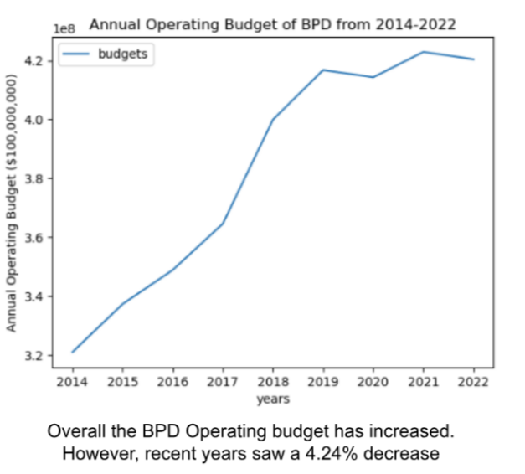
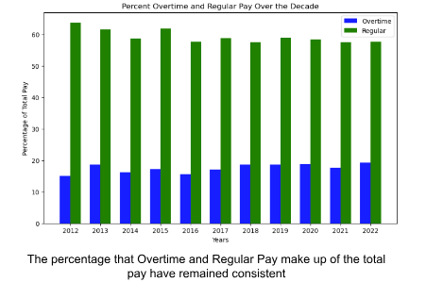
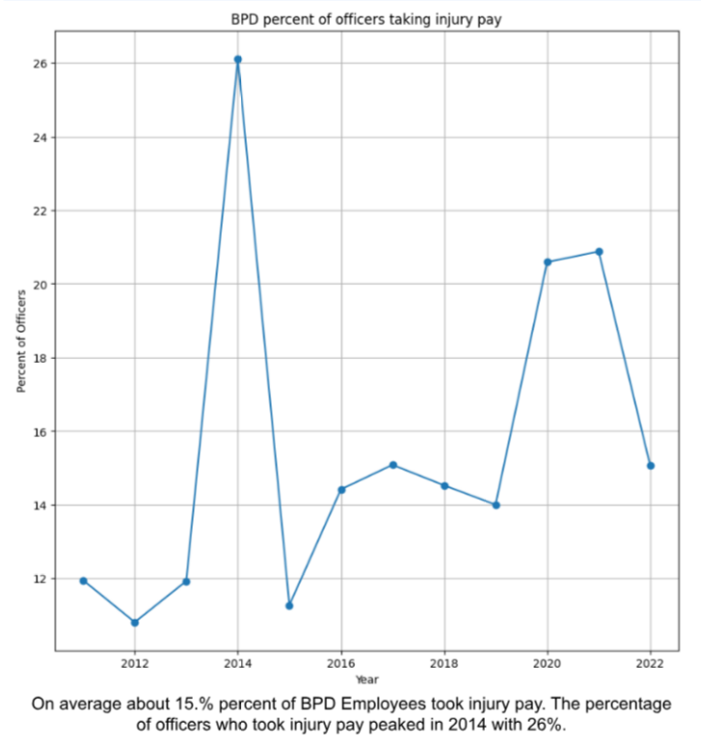

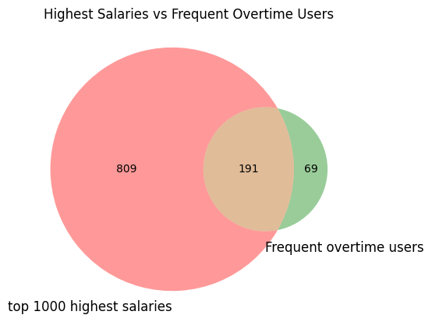
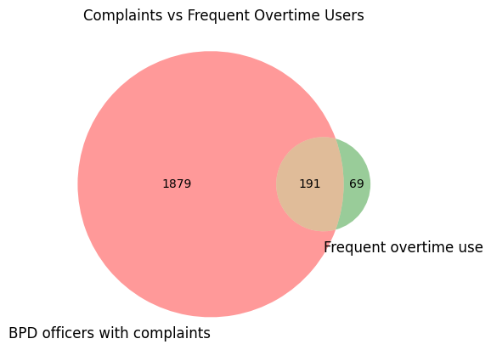
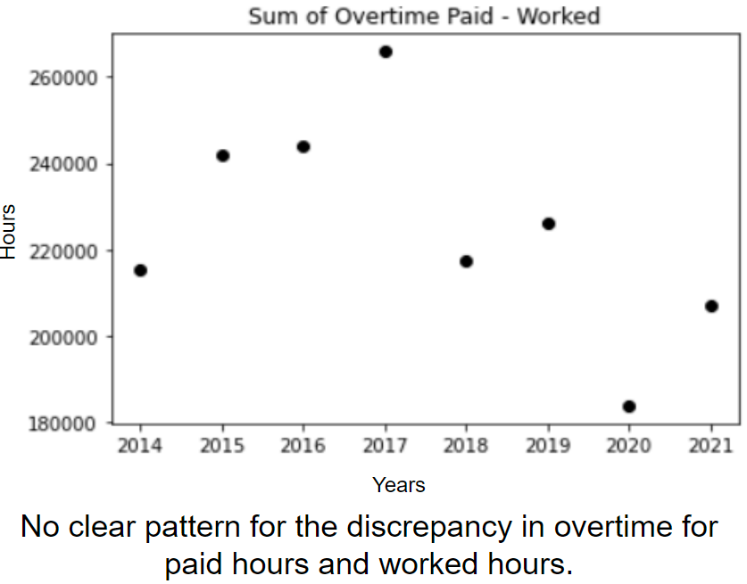
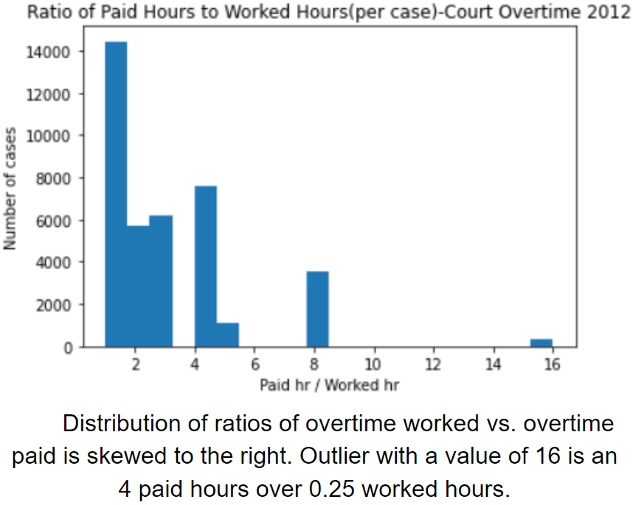
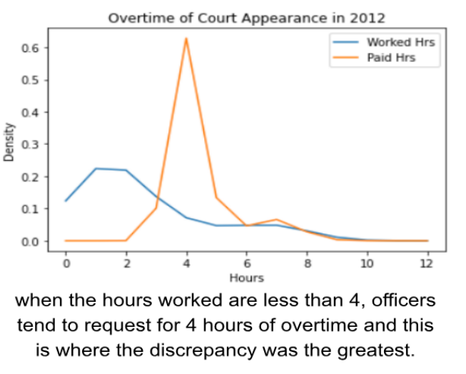
Data Science – Police Overtime
Ahmad Sadiq, 2025, David White, 2024, Ashton Fox, 2024, Seunghwan Hyun, 2024, Emily Opresnick, 2024
Summary
The goal of this project is to analyze the Boston Police Department’s budget and more specifically their overtime usage over the past decade to determine how it is utilized. By doing this we are able to help the ACLU to find cases of police budget excess.
Identifying instances of financial excess in BPD spending
Clients and Mentors
Clients: ACLU
PM: Matthew Batacan
Partners: BU Spark!
Tech Stack/Processes
Language: Python/Jupyter Notebook
Libraries: Matplotlib, Pandas, USZipcode, Time, Numpy, Sklearn, Matplotlib_venn
Reflections:
We found it difficult or unreasonable to try to answer some of the questions due to a lack of available data(demographics of BPD members). Different structures of datasets across the years led to difficulties in trying to compile or analyze these sets. However, we constructed a response to many of the key questions, and while not conclusive of any root factor or cause of the questions they respond to, our findings create generalizations and insights that open many further questions to be explored.
The overall budget had increased since 2014 but recent years saw a 4.24% decrease. The largest category has remained personnel services.
Categories such as quinn, other, and injury pay had increased whereas detail and retro have decreased. Overtime and regular pay have remained consistent.
Injury pay has increased overall. For the decade, BPD employees claimed 15.9% of Injury pay on average.
Using data to fill in narratives around misconduct by individual BPD officers
We compared ‘the top 10% of overtime users’ with ‘officers who are the highest paid’, ‘investigated by the Suffolk DA’, ‘with complaints’, and ‘have previously been disciplined’. We found significant overlap between frequent overtime users and officers with complaints against them or were highly paid. Only one officer appeared on all 5.
Characterizing wasteful BPD overtime practices
Notes:
Beautiful!!!!

Slide 2
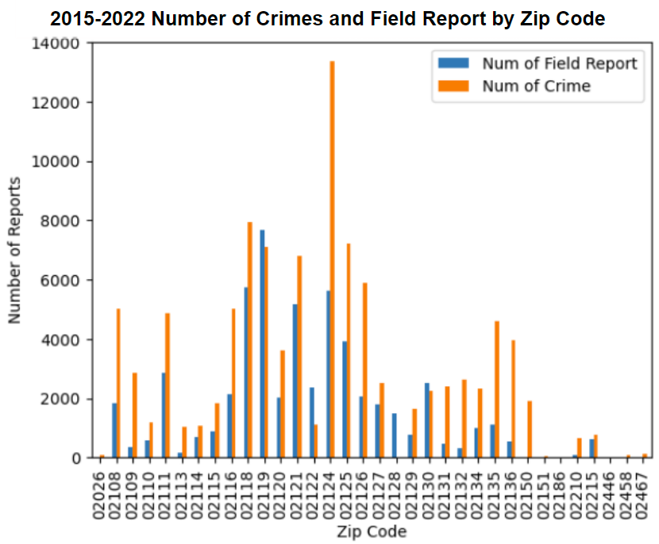
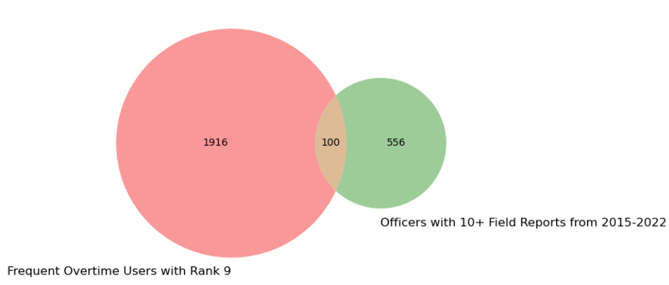
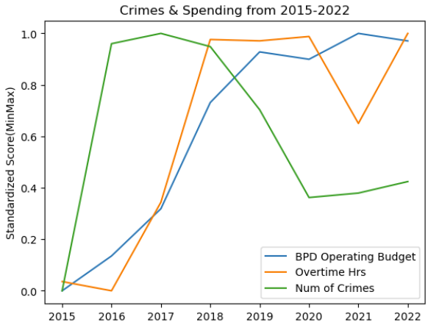


Data Science – Police Overtime
Ahmad Sadiq, 2025, David White, 2024, Ashton Fox, 2024, Seunghwan Hyun, 2024, Emily Opresnick, 2024
Extension Project Questions
Are the crime rates lower in areas with higher police presence?
Is there any relationship between police spending and improvements in community safety?
To determine if police presence impacted crime rates we look at crime reports and field reports.
The number of police reports made per zip code was often considerably less than the amount of reported crime for that area between 2015-2022. We do not have an explanation for zip codes where there were more field reports than actual reported crime.
From this we can conclude that police presence did not impact crime rates.
Extension Project Goal
To explore the impact of the Boston Police Department spending on Community Safety. Given the significant budget allocation to the BPD, it’s important to understand how police presence and activities can correlate with safety. This analysis can reveal insights into the effectiveness of police spending and strategies, and whether they align with community needs.
We looked into if officers with more overtime were in places with higher or lower crime rates to determine if these extra hours worked had an impact on community safety. We found that there is not a large overlap between frequent overtime BPD Employees with rank 9 and officers with more than 10 field reports from 2015-2022.
There was no clear relationship between crime rates and overtime hours or crime rates and BPD operating budget. This shows that there was no strong relationship between BPD spending and community safety.

