Slide 1
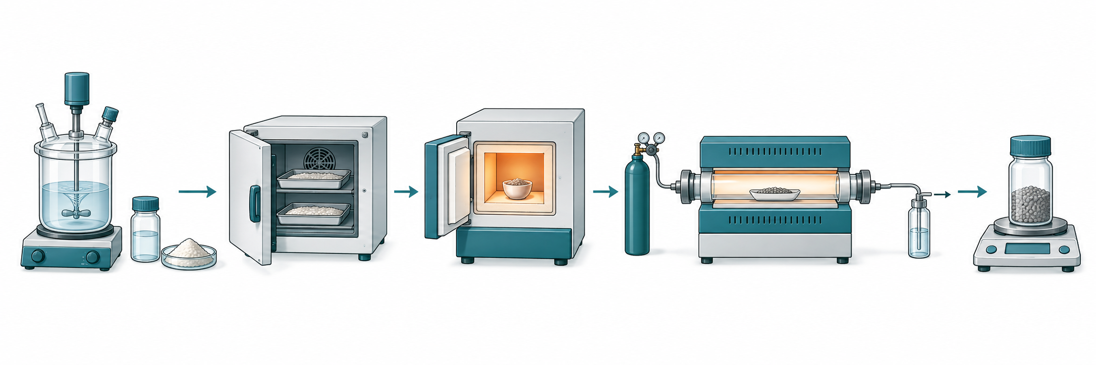
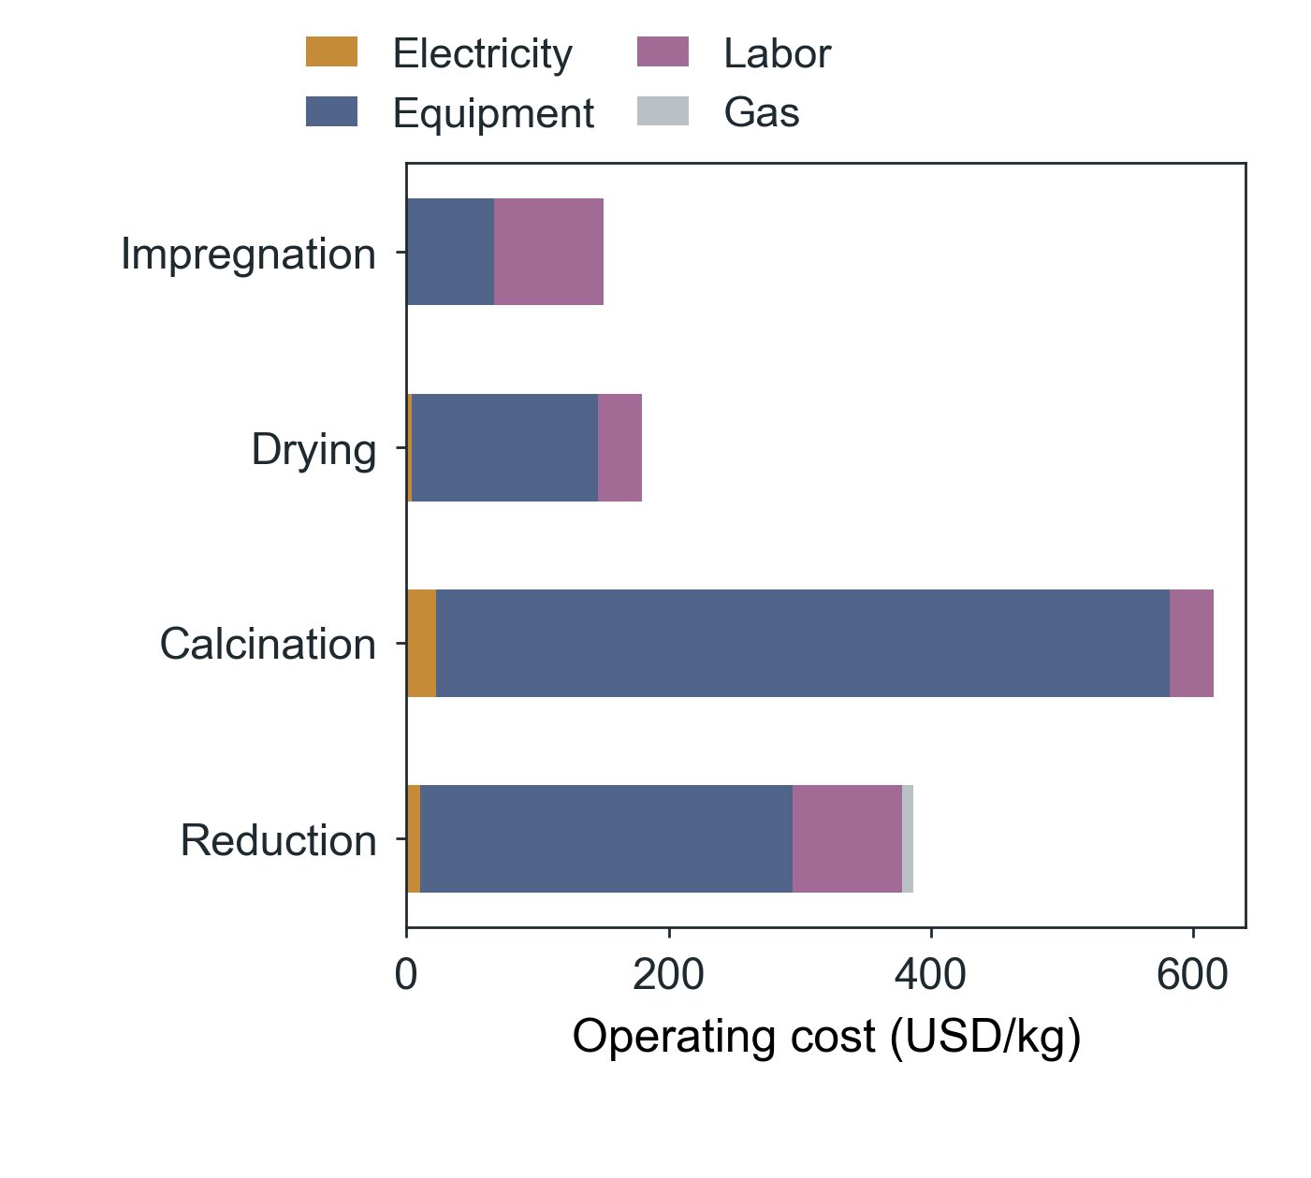
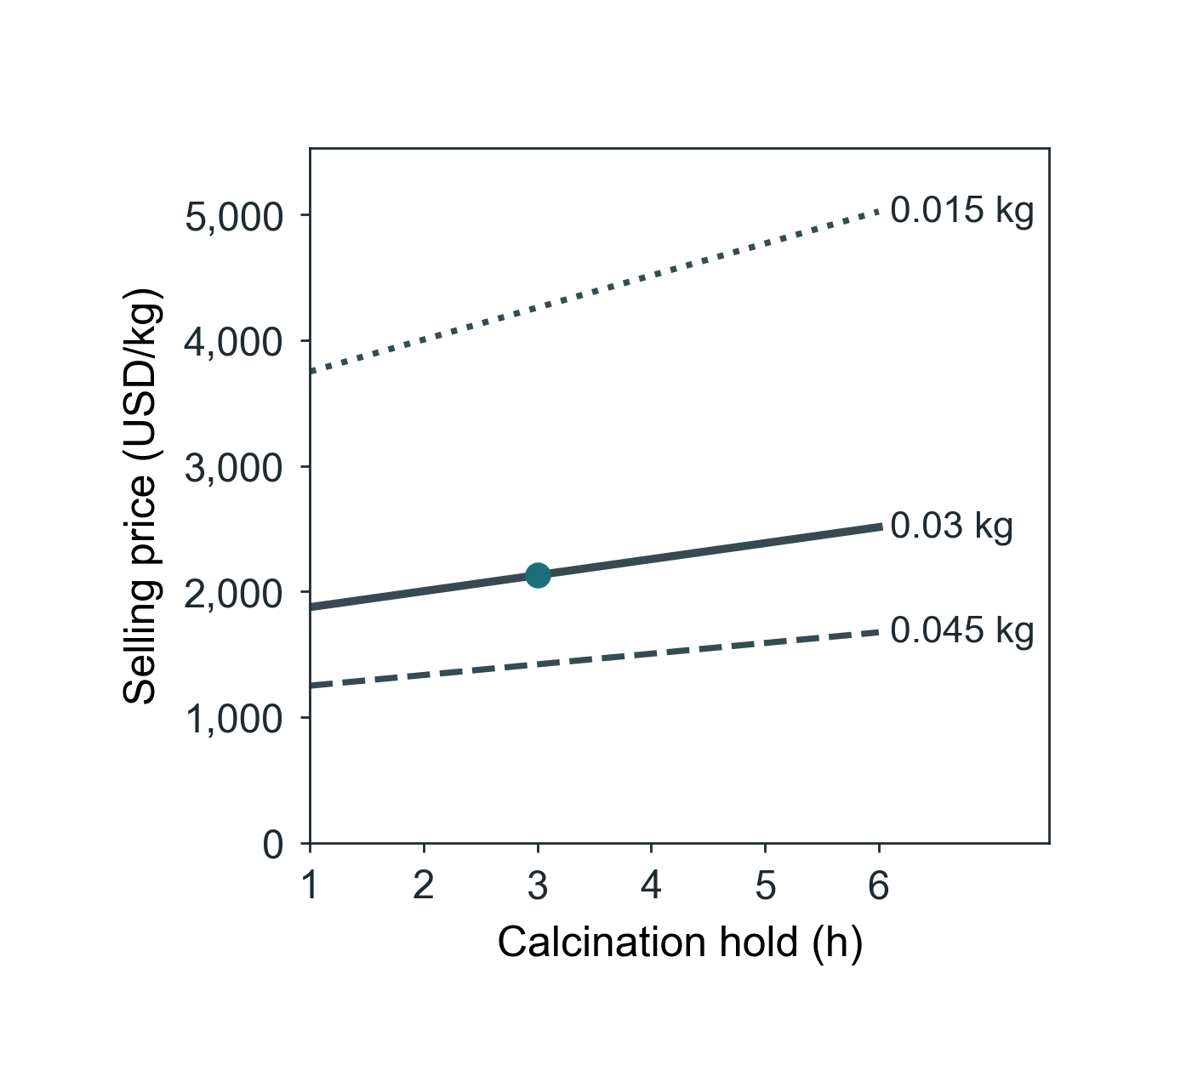
(a)
Impregnation
Drying
Calcination
Reduction
Dry output
Time
Time / energy
Time / energy
Time / gas
Mass
(b)
(c)
Notes:
Editable COMET figure deck, 2026-09-16. Numeric panels are matplotlib renders of the frozen COMET analysis files (see panels/panels.json); they are not editable data. Conceptual artwork is identified in artwork-provenance.json. Labels and panel letters are native slide objects.

Slide 2
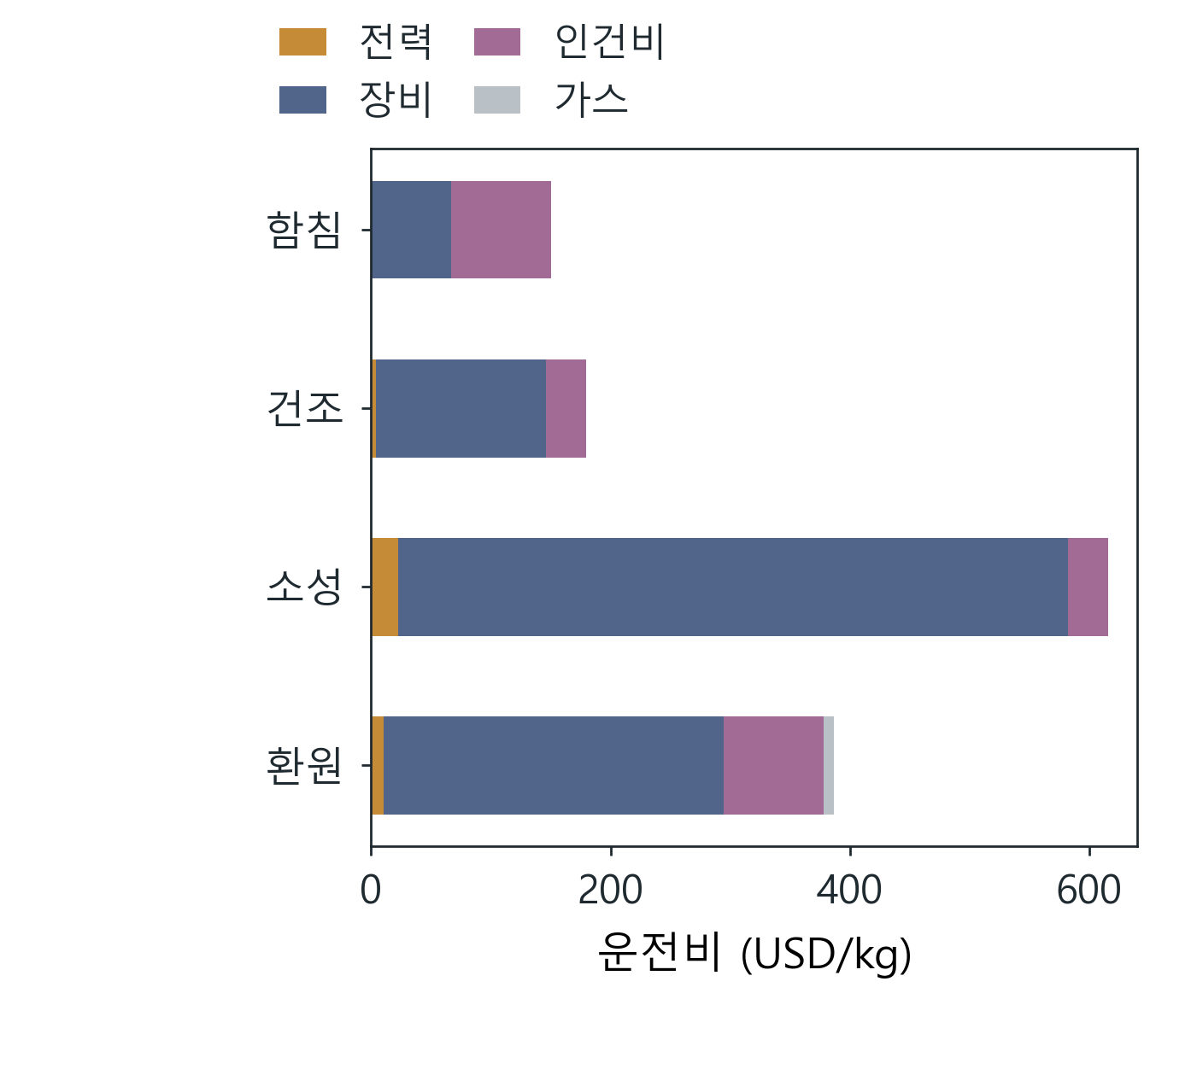
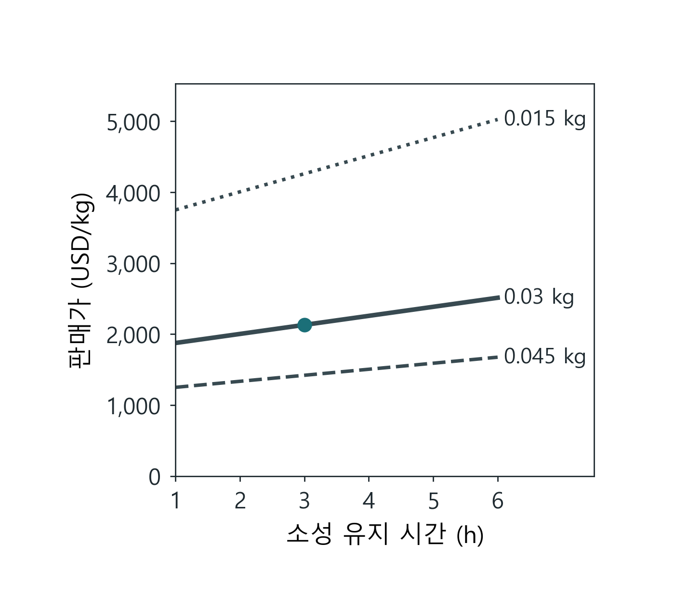
(a)
함침
건조
소성
환원
건조 수득량
시간
시간 / 에너지
시간 / 에너지
시간 / 가스
질량
(b)
(c)
Notes:
Editable COMET figure deck, 2026-09-16. Numeric panels are matplotlib renders of the frozen COMET analysis files (see panels/panels.json); they are not editable data. Conceptual artwork is identified in artwork-provenance.json. Labels and panel letters are native slide objects.

