Slide 1
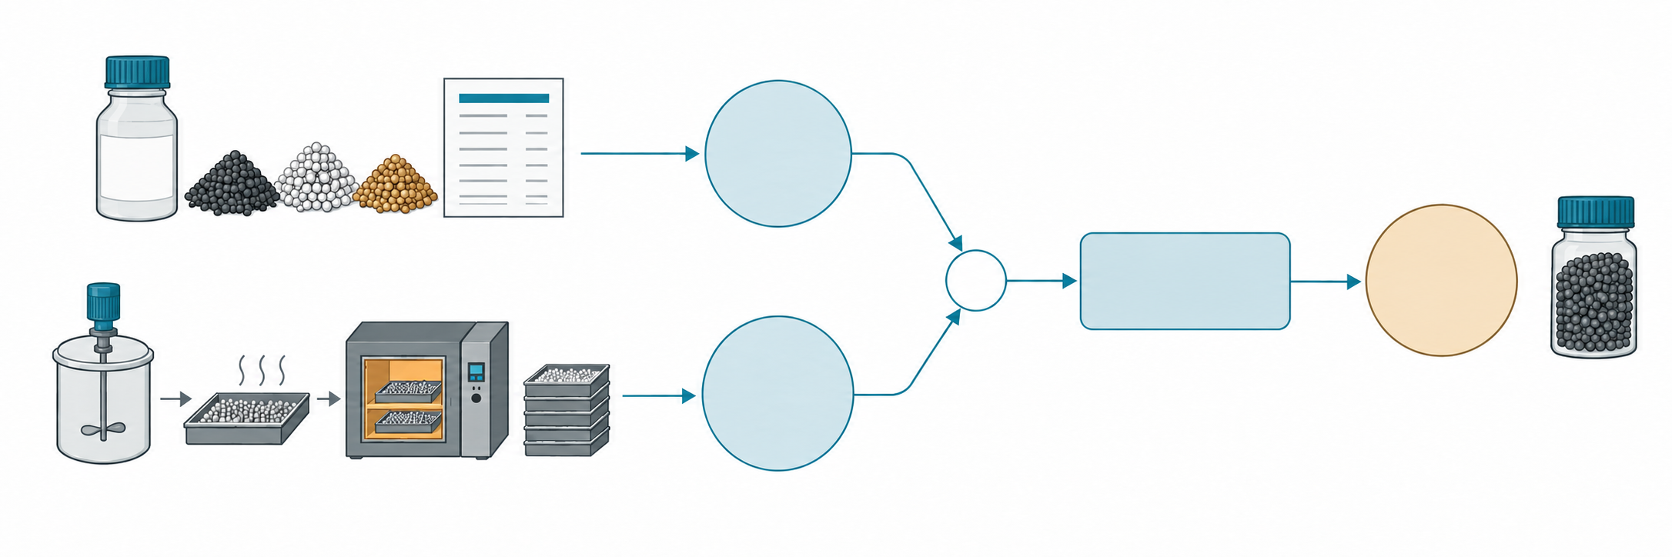
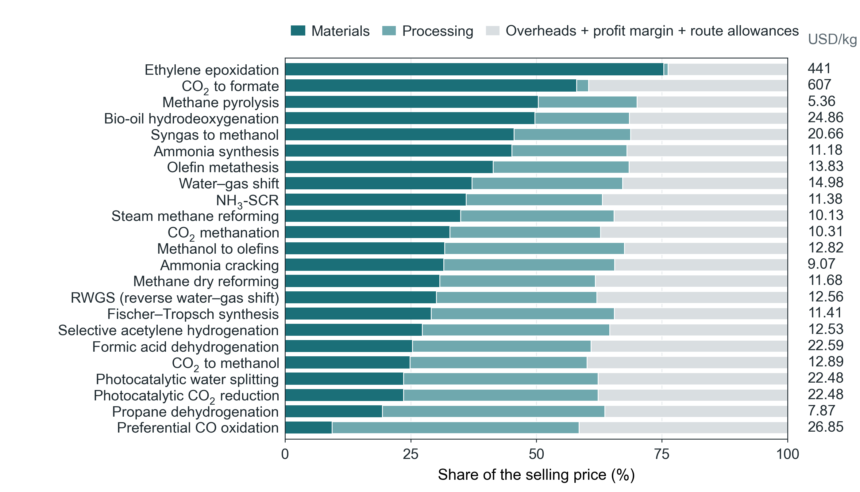
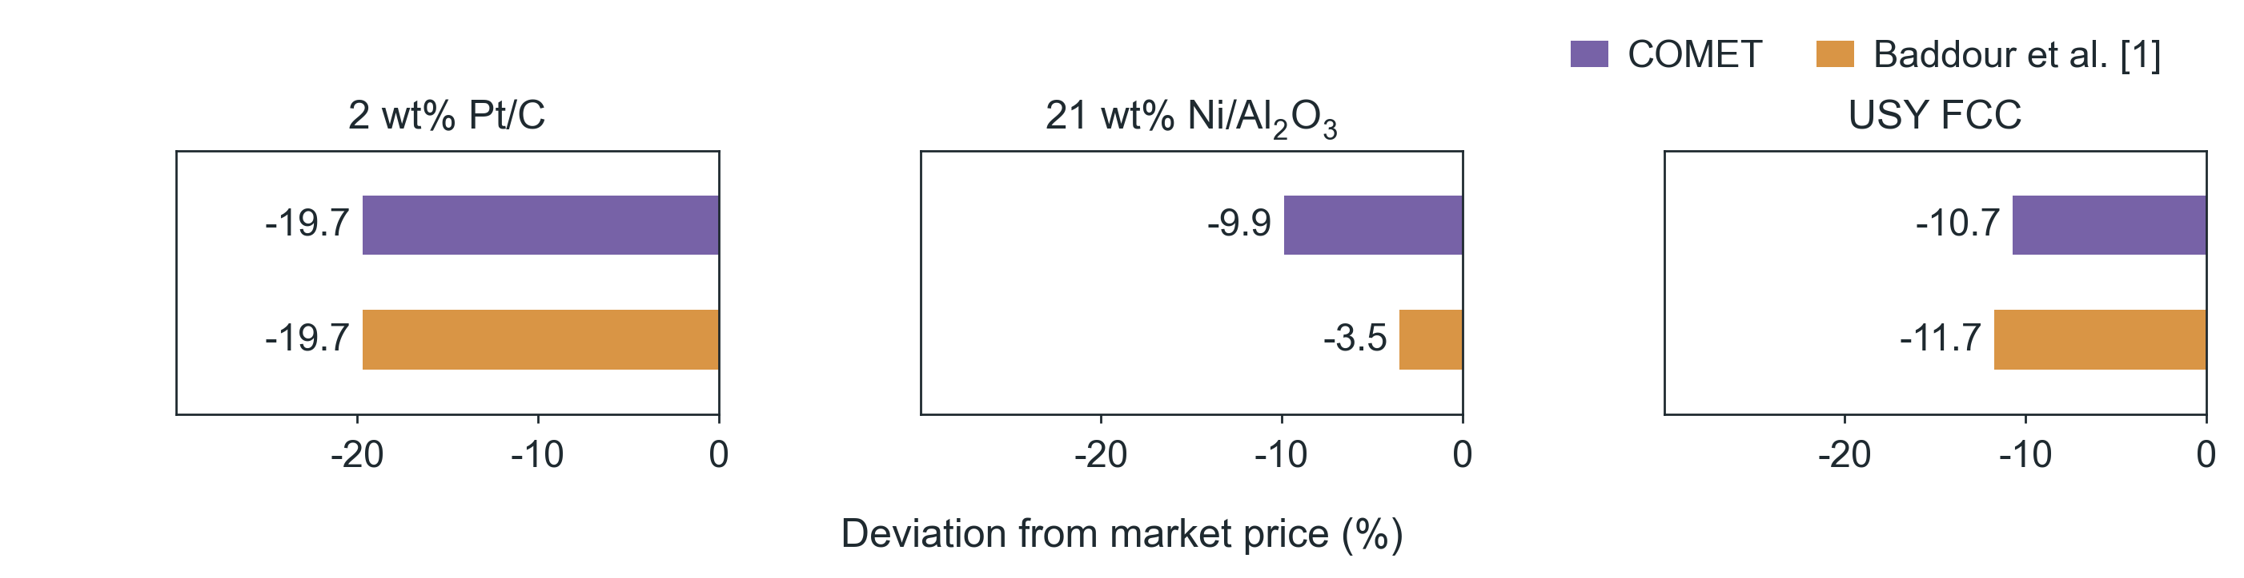
(a)
Materials
C_{m}
Formulation and prices
+
Overheads
Selling
and margin
price
P
Processing
C_{p}
Route and order size
(b)
(c)
Notes:
Editable COMET figure deck, 2026-09-16. Numeric panels are matplotlib renders of the frozen COMET analysis files (see panels/panels.json); they are not editable data. Conceptual artwork is identified in artwork-provenance.json. Labels and panel letters are native slide objects.

Slide 2
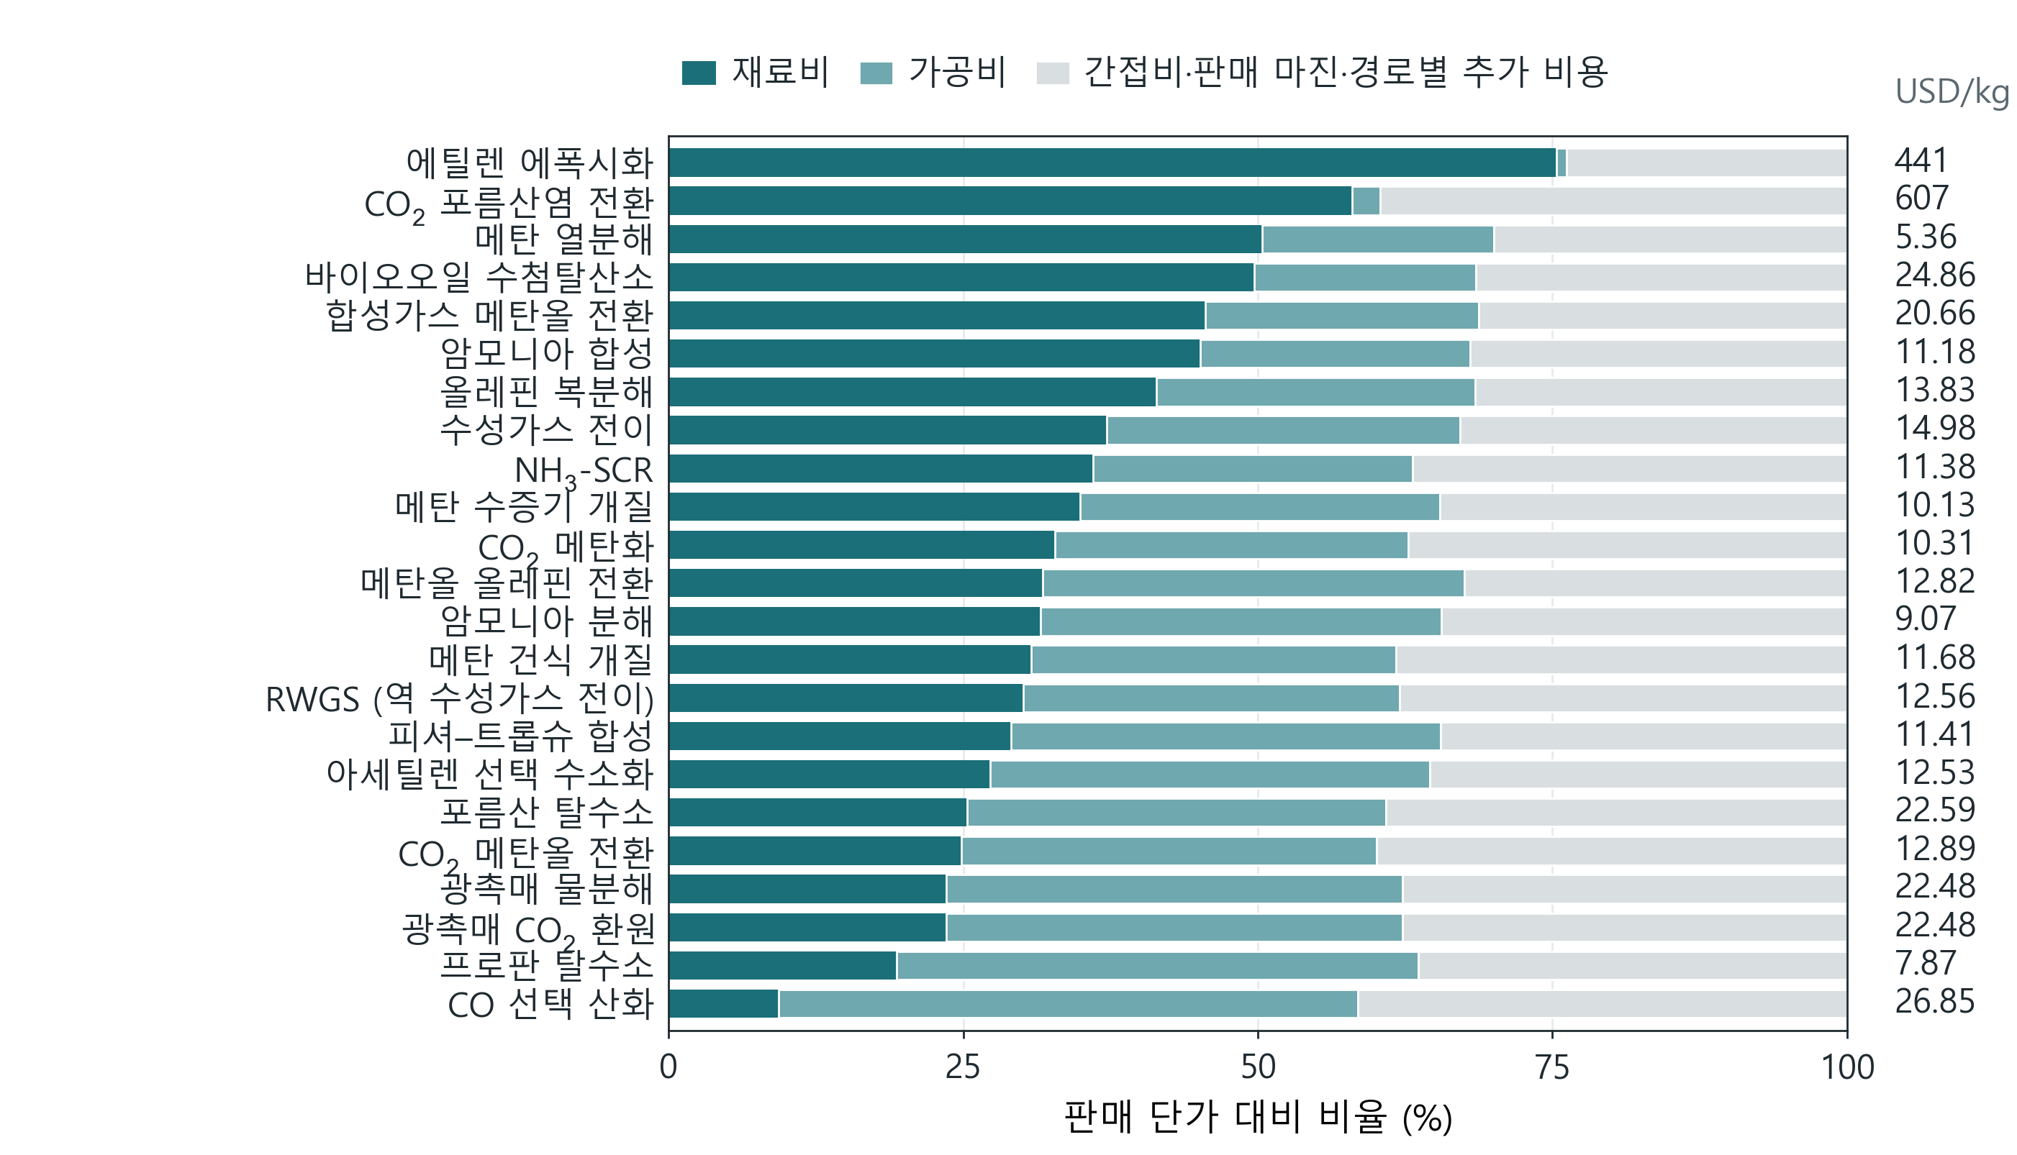
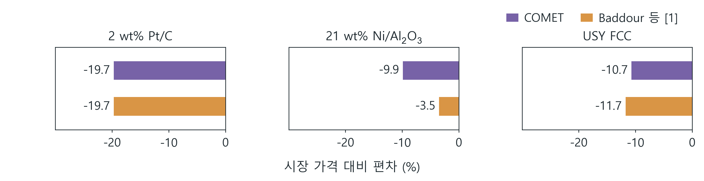
(a)
재료비
C_{m}
조성 및 가격
+
간접비 및
판매
마진
단가
P
가공비
C_{p}
제조 경로 및 주문량
(b)
(c)
Notes:
Editable COMET figure deck, 2026-09-16. Numeric panels are matplotlib renders of the frozen COMET analysis files (see panels/panels.json); they are not editable data. Conceptual artwork is identified in artwork-provenance.json. Labels and panel letters are native slide objects.

