Slide 1
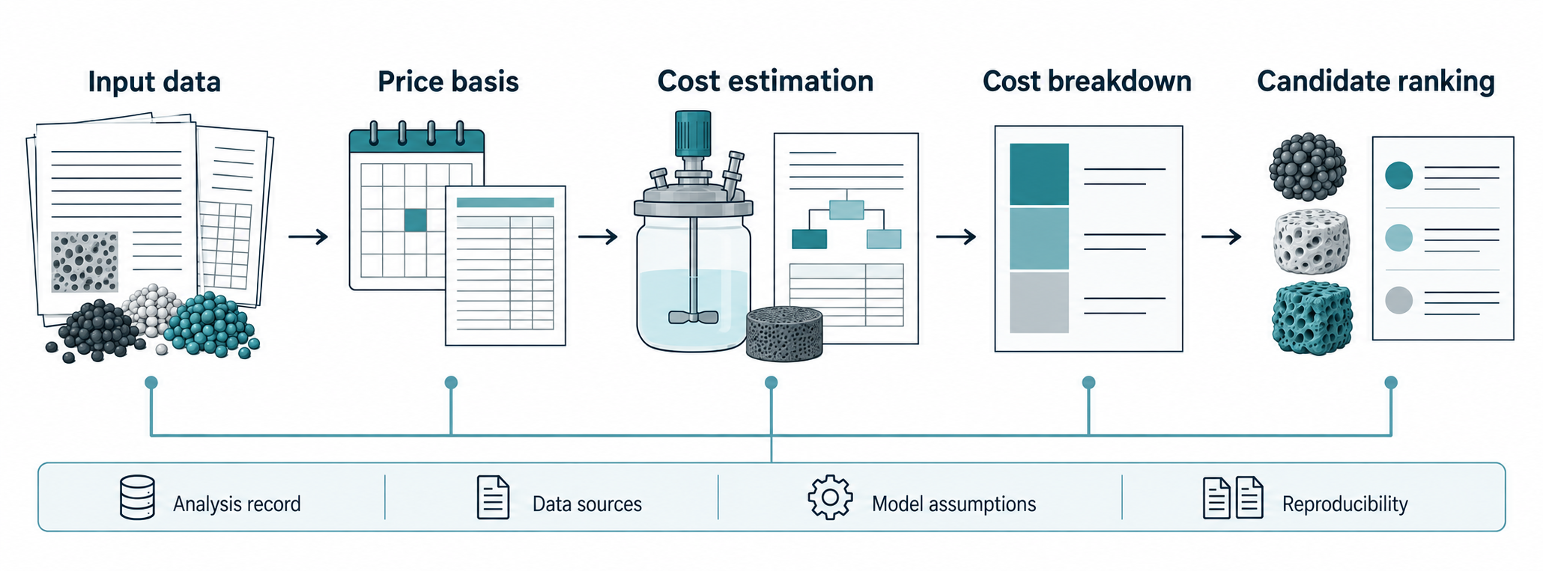
Notes:
COMET. Author-selected OpenAI image-generation artwork, September 13, 2026. English GPT v2; Korean labels localized with the same tool. Illustrative objects do not represent experimental observations or a prescribed route. This deck embeds raster artwork without manual image edits; labels are part of the image. See README.md and artwork provenance.

Slide 2
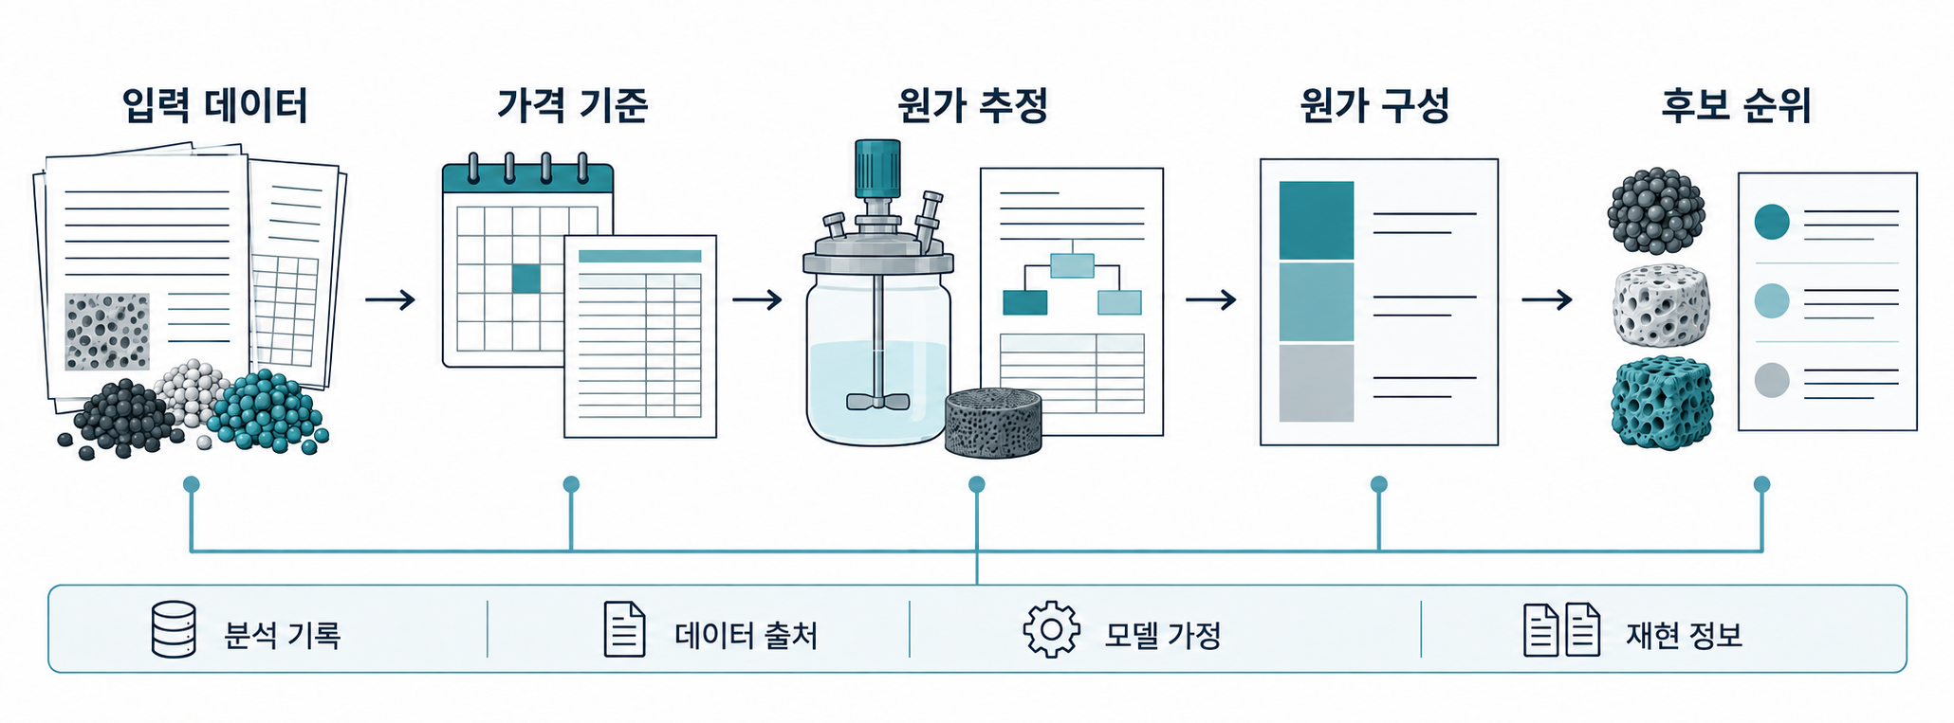
Notes:
COMET. Author-selected OpenAI image-generation artwork, September 13, 2026. English GPT v2; Korean labels localized with the same tool. Illustrative objects do not represent experimental observations or a prescribed route. This deck embeds raster artwork without manual image edits; labels are part of the image. See README.md and artwork provenance.

