Slide 1
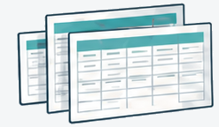



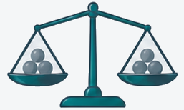
Input data
Price basis
Cost estimation
Cost breakdown
Candidate ranking
Analysis record
Data sources
Model assumptions
Reproducibility
Notes:
COMET Figure 1. Stage artwork reused from fig1_workflow_stack_raw_chatgpt.png, generated with ChatGPT (OpenAI), September 10, 2026. Source, assumption and reproducibility fields are defined in the manuscript and caption. See fig1_workflow_stack.provenance.md.

Slide 2
입력 데이터
가격 기준
원가 추정
원가 구성
후보 순위
분석 기록
데이터 출처
계산 가정
재현 정보
Notes:
COMET Figure 1. Stage artwork reused from fig1_workflow_stack_raw_chatgpt.png, generated with ChatGPT (OpenAI), September 10, 2026. Source, assumption and reproducibility fields are defined in the manuscript and caption. See fig1_workflow_stack.provenance.md.

