Slide 1
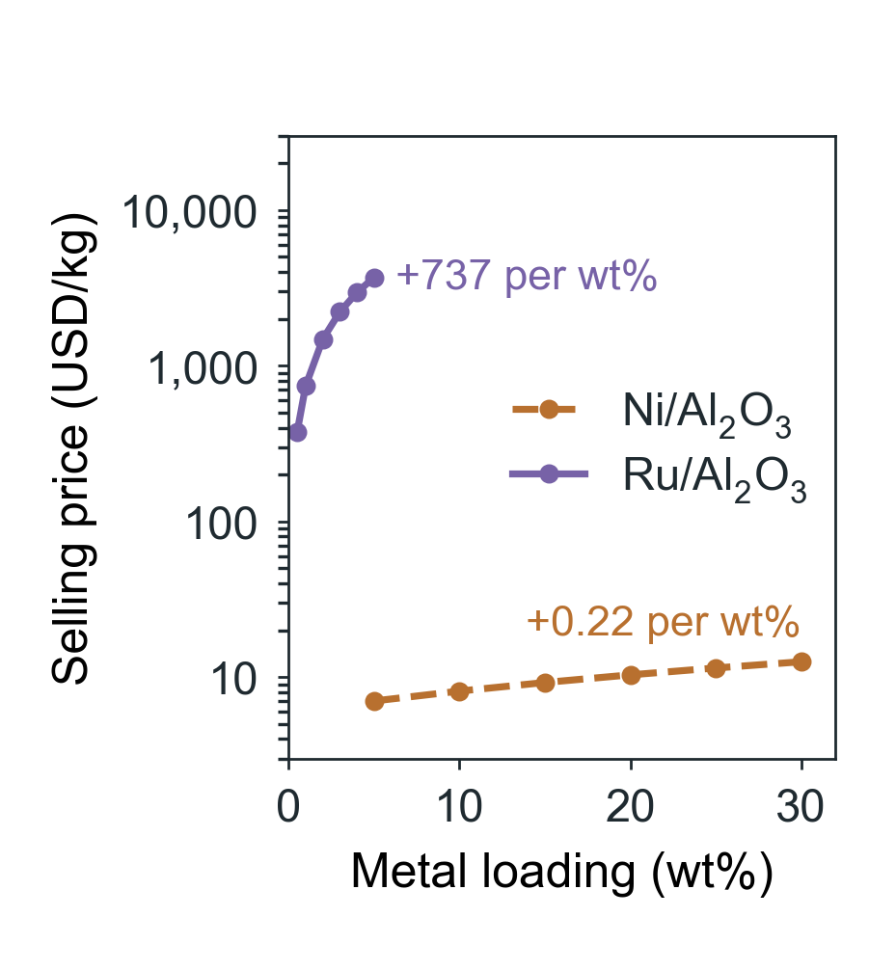
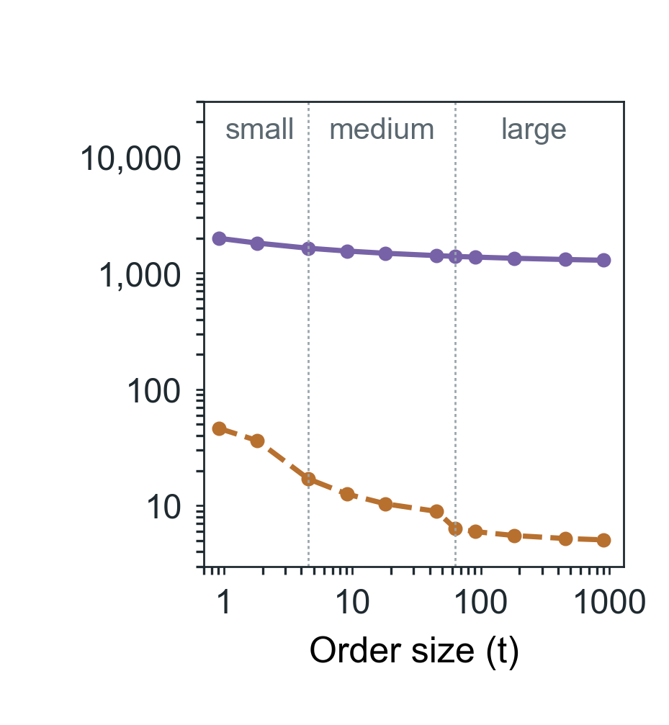
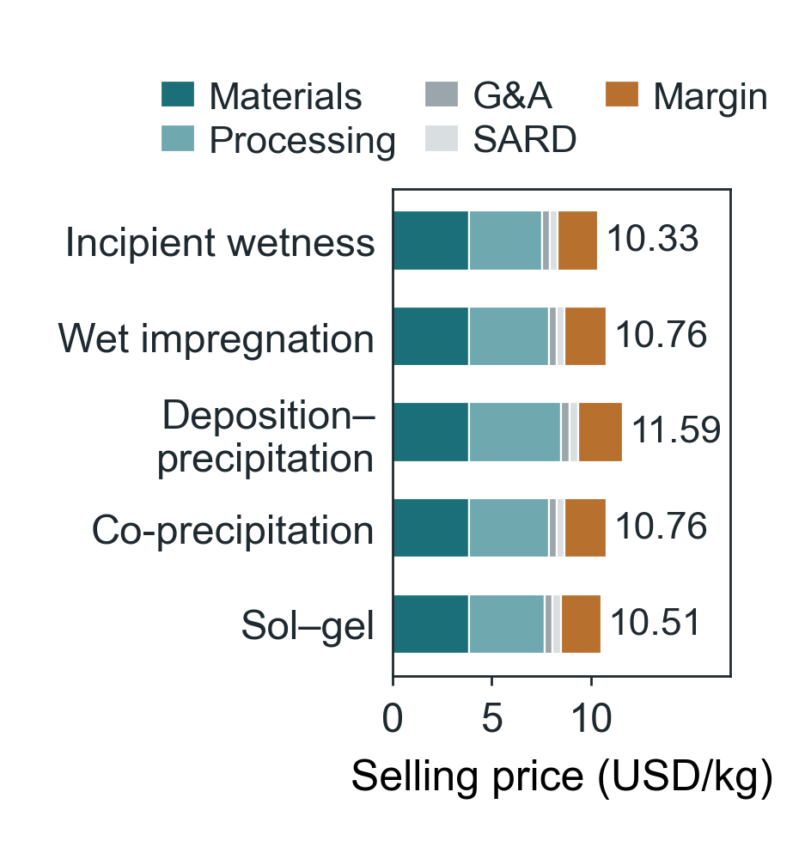
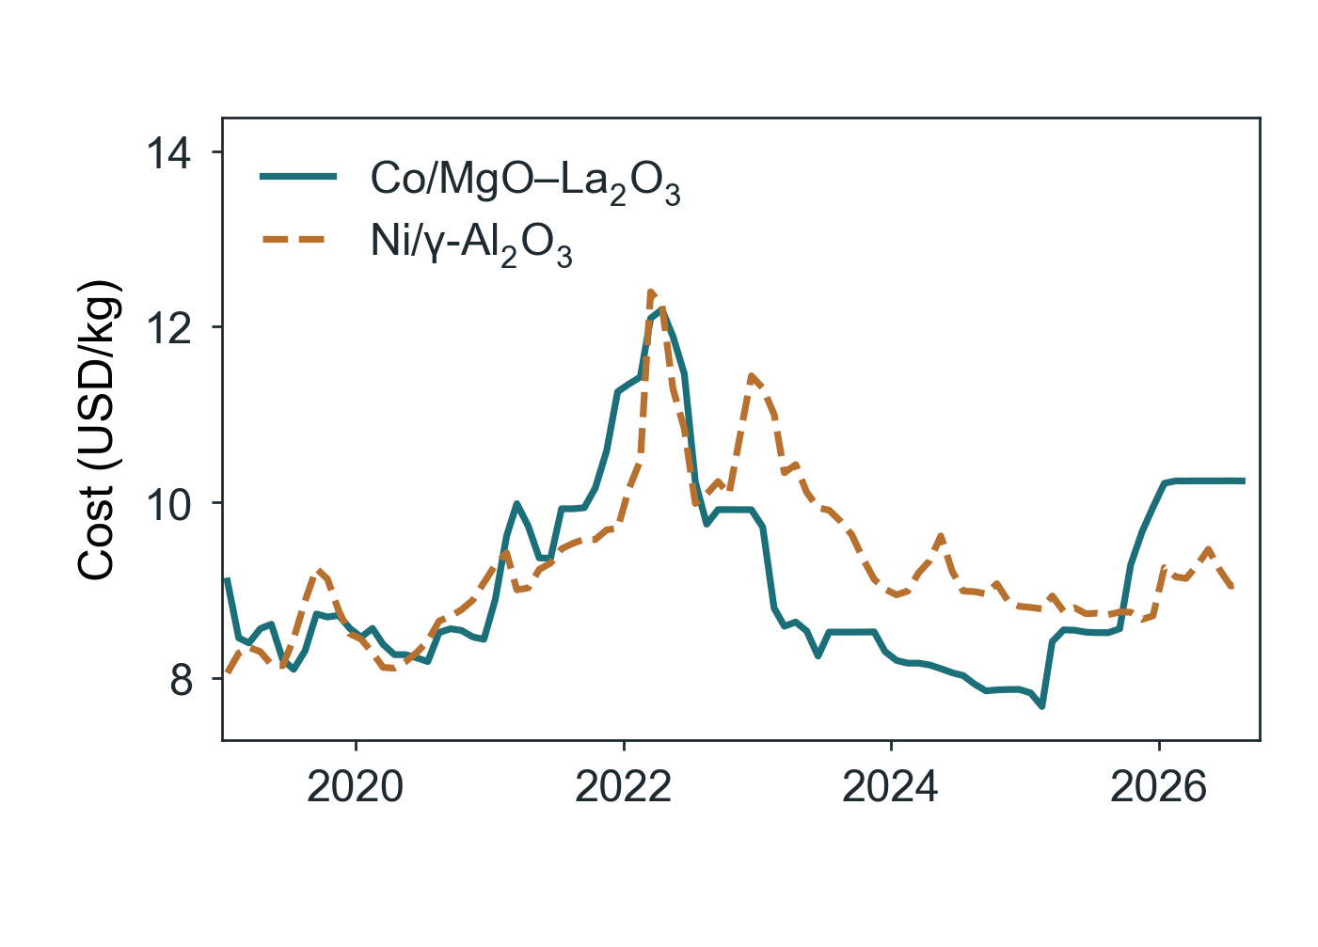
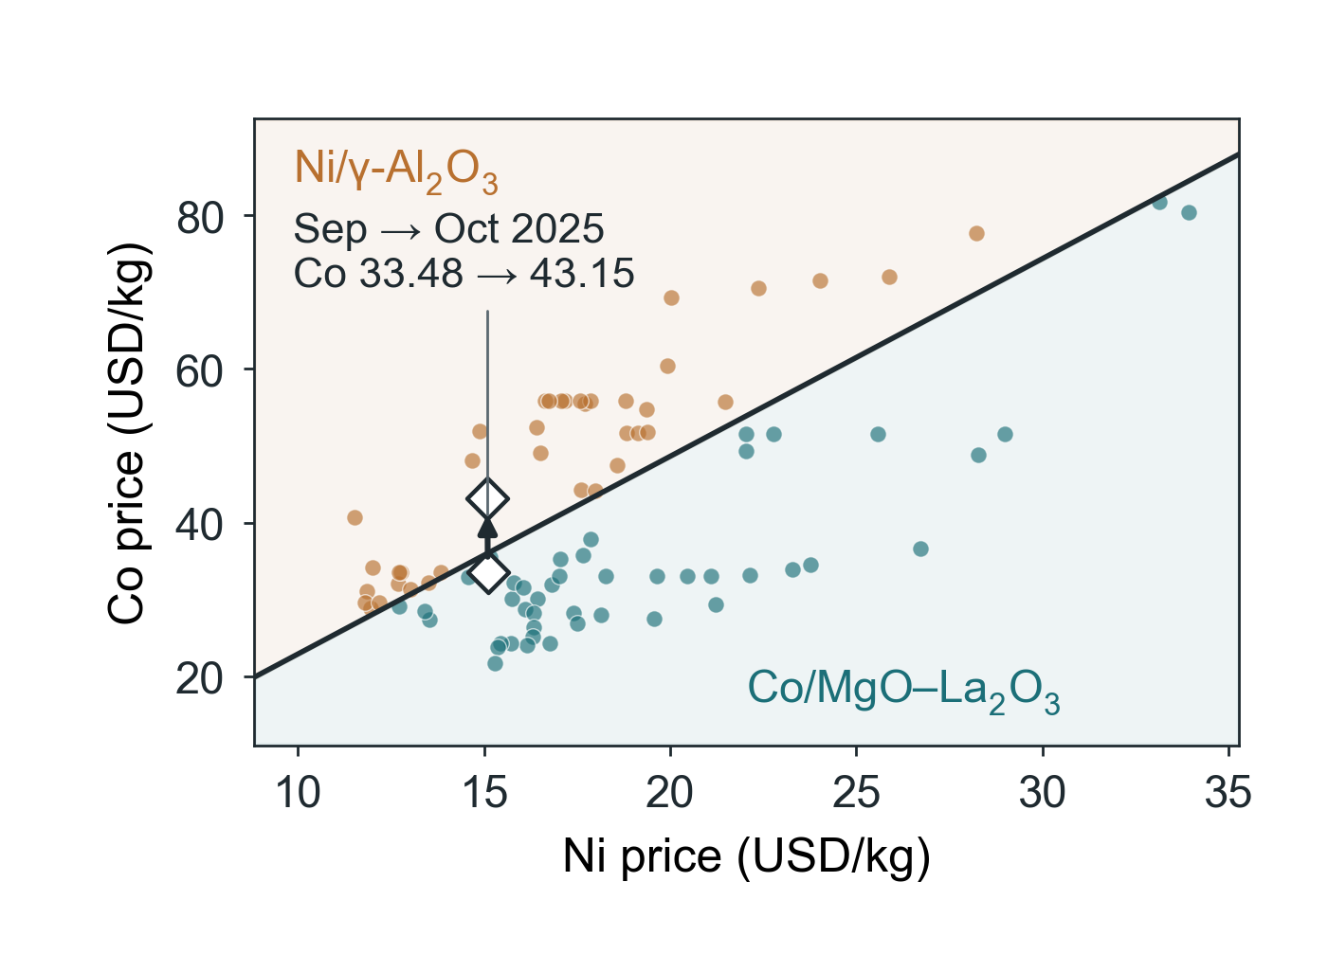
(a)
(b)
(c)
(d)
(e)
Notes:
Editable COMET figure deck, 2026-09-16. Numeric panels are matplotlib renders of the frozen COMET analysis files (see panels/panels.json); they are not editable data. Conceptual artwork is identified in artwork-provenance.json. Labels and panel letters are native slide objects.

Slide 2
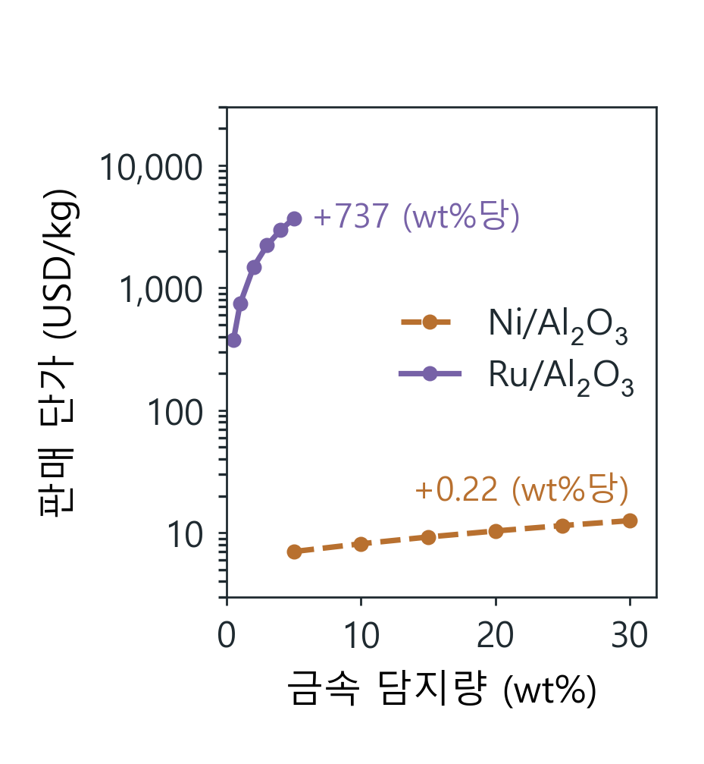
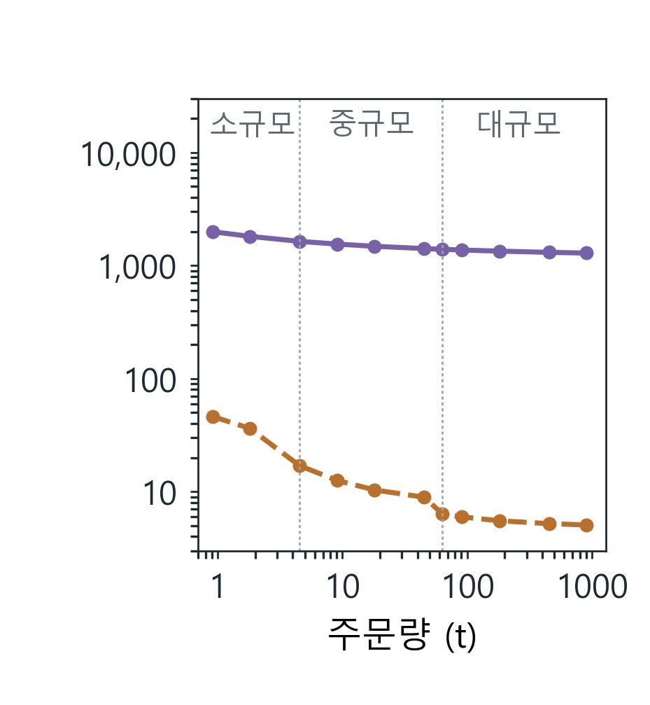
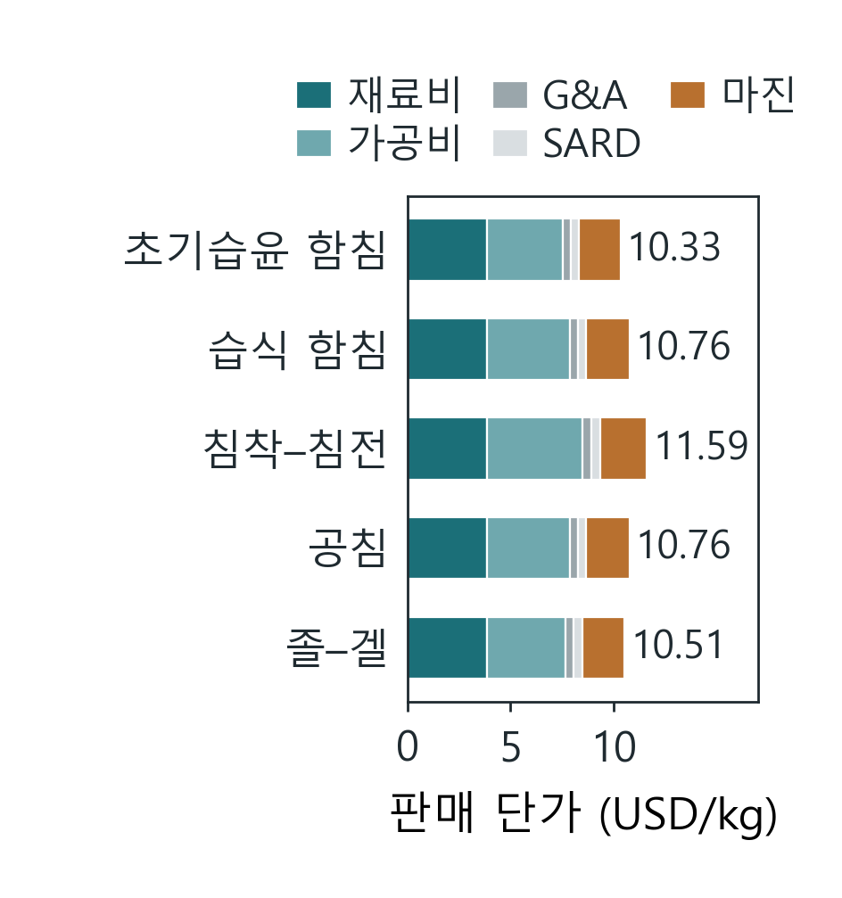
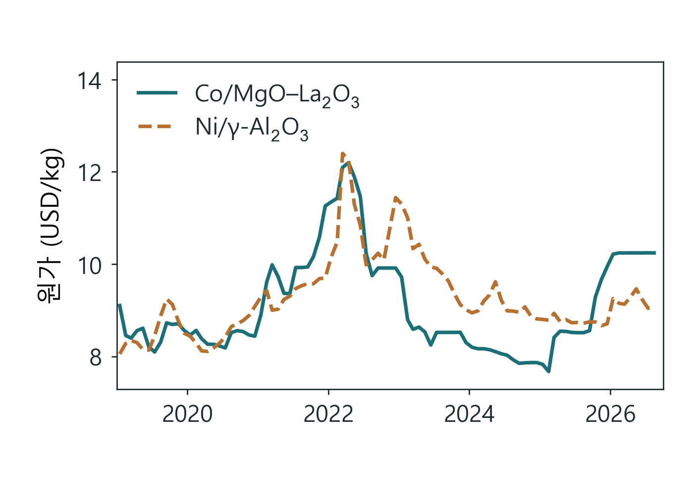
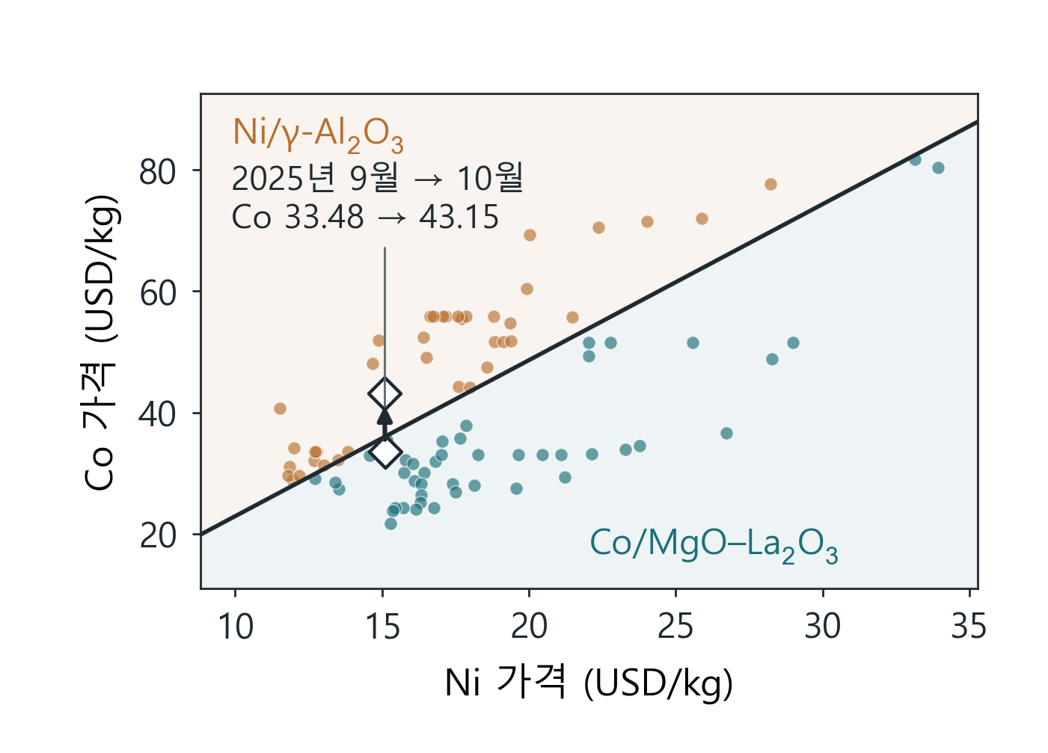
(a)
(b)
(c)
(d)
(e)
Notes:
Editable COMET figure deck, 2026-09-16. Numeric panels are matplotlib renders of the frozen COMET analysis files (see panels/panels.json); they are not editable data. Conceptual artwork is identified in artwork-provenance.json. Labels and panel letters are native slide objects.

