Slide 1
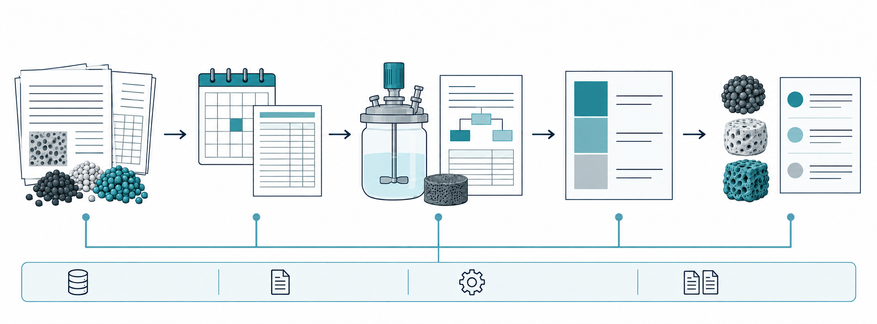
Input data
Price basis
Cost estimation
Cost breakdown
Candidate ranking
Analysis record
Data sources
Model assumptions
Reproducibility
Notes:
COMET, September 13, 2026. Accepted GPT schematic artwork edited with OpenAI image generation to remove lettering, then embedded without manual raster edits. All wording is native editable PowerPoint text in English or Korean. Scientific illustrations are schematic, not observations or a required preparation route. See README.md and recorded prompts.

Slide 2
입력 데이터
가격 기준
원가 추정
원가 구성
후보 순위
분석 기록
데이터 출처
계산 가정
재현 정보
Notes:
COMET, September 13, 2026. Accepted GPT schematic artwork edited with OpenAI image generation to remove lettering, then embedded without manual raster edits. All wording is native editable PowerPoint text in English or Korean. Scientific illustrations are schematic, not observations or a required preparation route. See README.md and recorded prompts.

