Slide 1
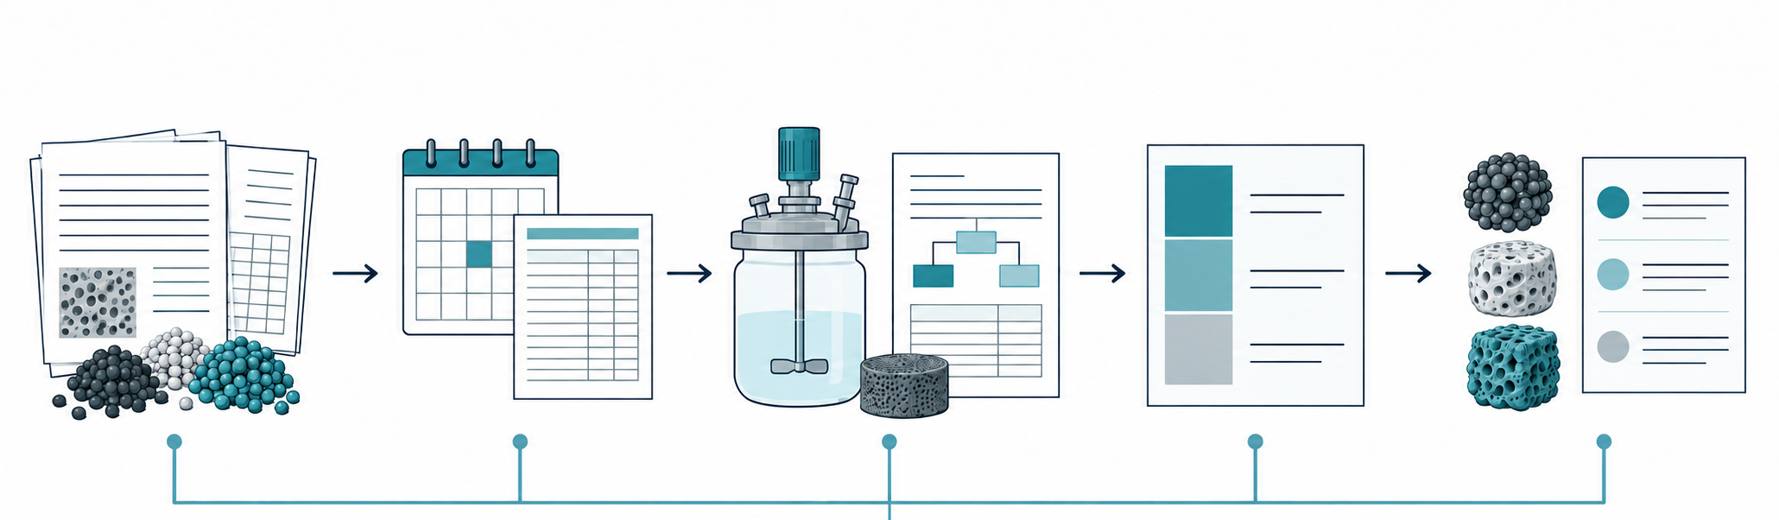
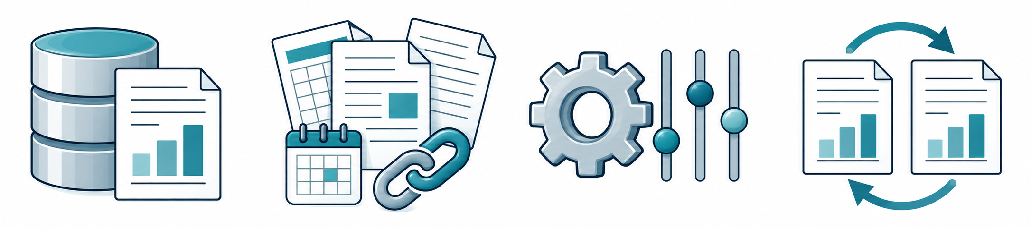
Input data
Price basis
Cost estimation
Cost breakdown
Candidate ranking
Analysis record
Data sources
Model assumptions
Reproducibility
Notes:
COMET Figure 1, September 13, 2026. Upper workflow artwork and labels retained from H24. The old record strip is hidden using native PowerPoint picture cropping. Four larger conceptual record illustrations were generated with the built-in OpenAI image-generation tool using the upper artwork as a style reference. Original PNG bytes are embedded unchanged. Labels and record connectors are native PowerPoint objects. Illustrative report marks are schematic, not measured data. See artwork/fig1_records.prompt.md, artwork-provenance.json and README.md.

Slide 2
입력 데이터
가격 기준
원가 추정
원가 구성
후보 순위
분석 기록
데이터 출처
계산 가정
재현 정보
Notes:
COMET Figure 1, September 13, 2026. Upper workflow artwork and labels retained from H24. The old record strip is hidden using native PowerPoint picture cropping. Four larger conceptual record illustrations were generated with the built-in OpenAI image-generation tool using the upper artwork as a style reference. Original PNG bytes are embedded unchanged. Labels and record connectors are native PowerPoint objects. Illustrative report marks are schematic, not measured data. See artwork/fig1_records.prompt.md, artwork-provenance.json and README.md.

