Slide 1
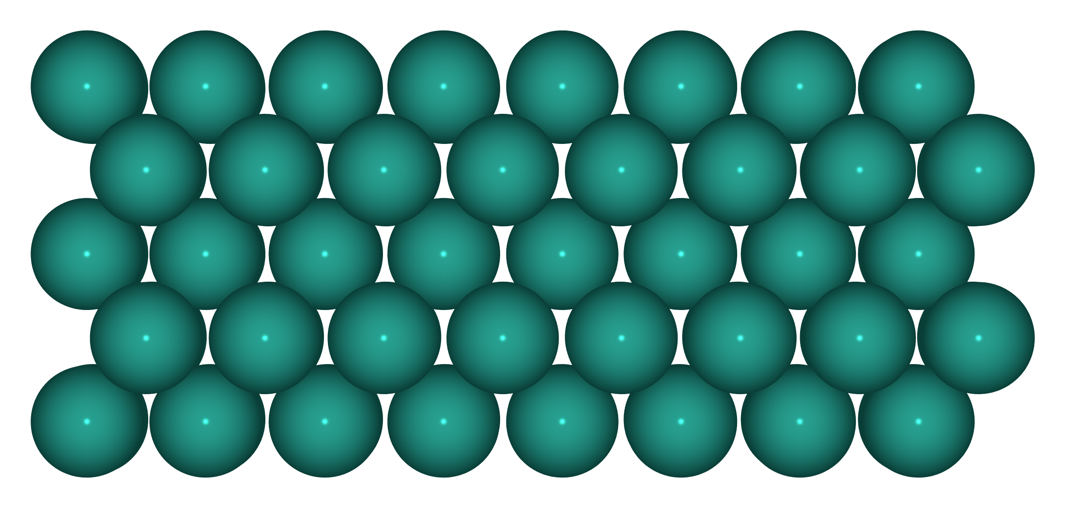
Slab side view — S1: Pd(100) (Pd⁰)

Slide 2
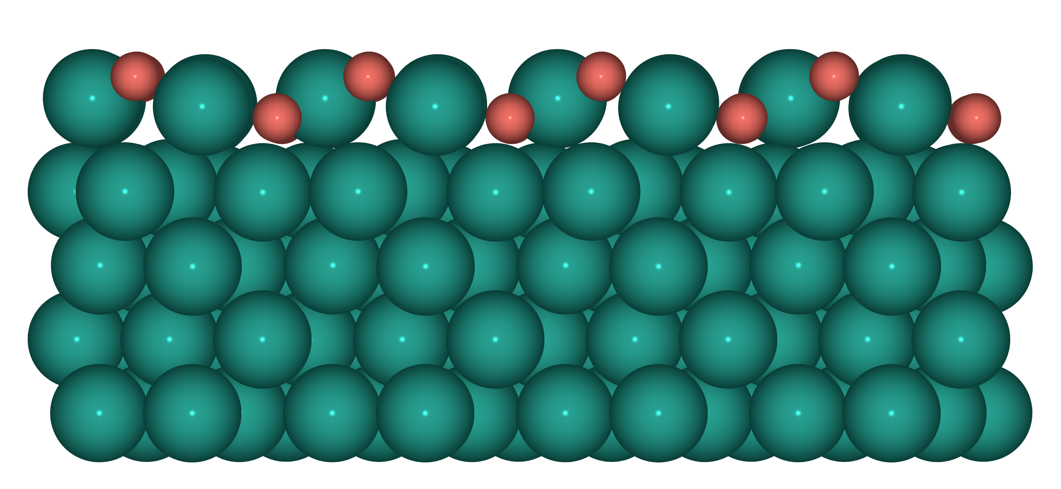
Slab side view — S2: 1ML PdO(101)/Pd(100) (Pd⁰+Pd²⁺)

Slide 3
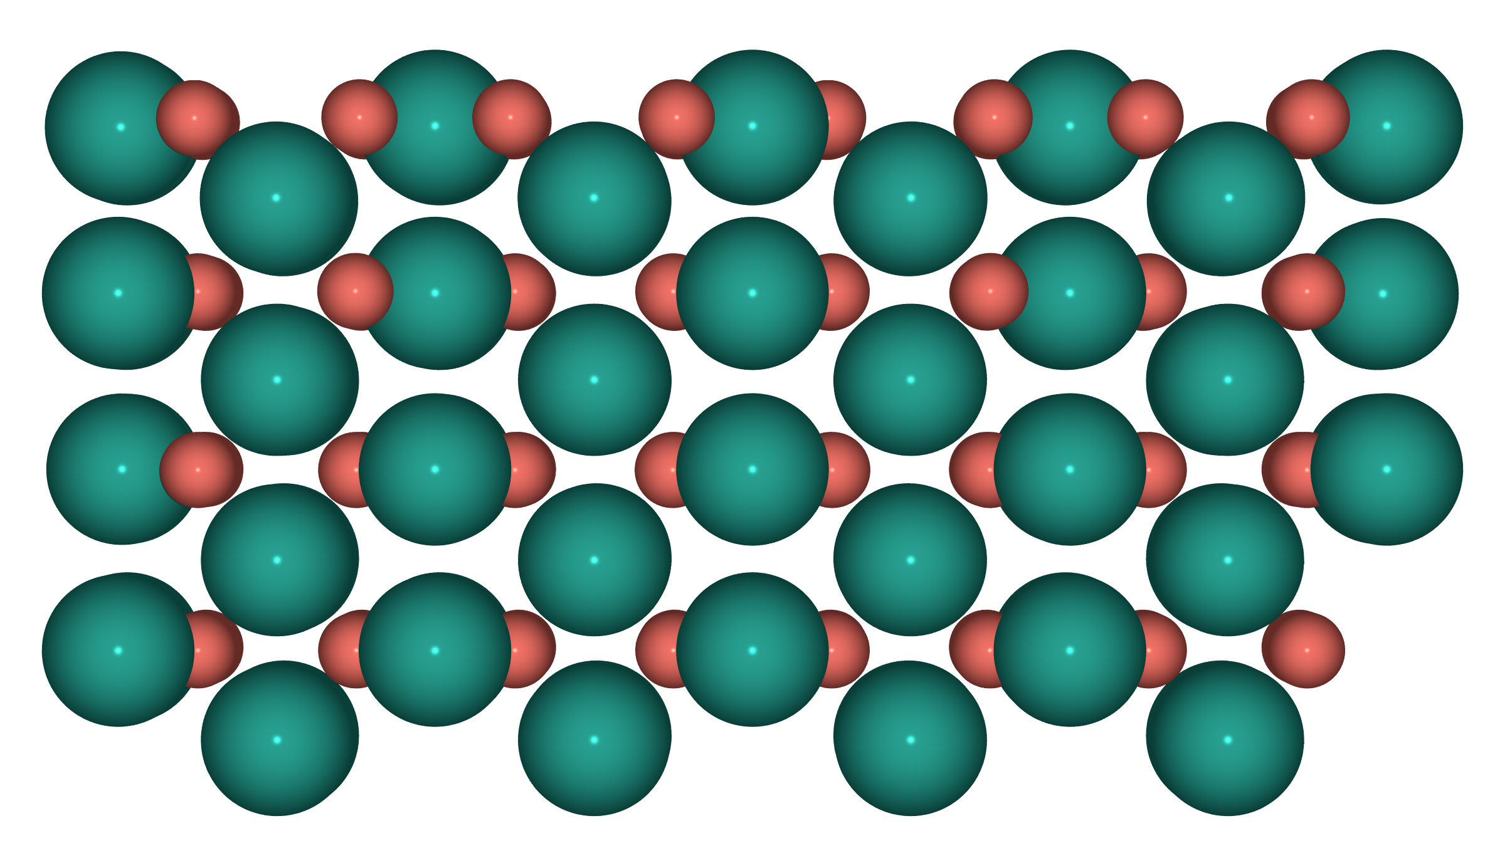
Slab side view — S3: O-rich PdO(100) (Pd²⁺)

Slide 4
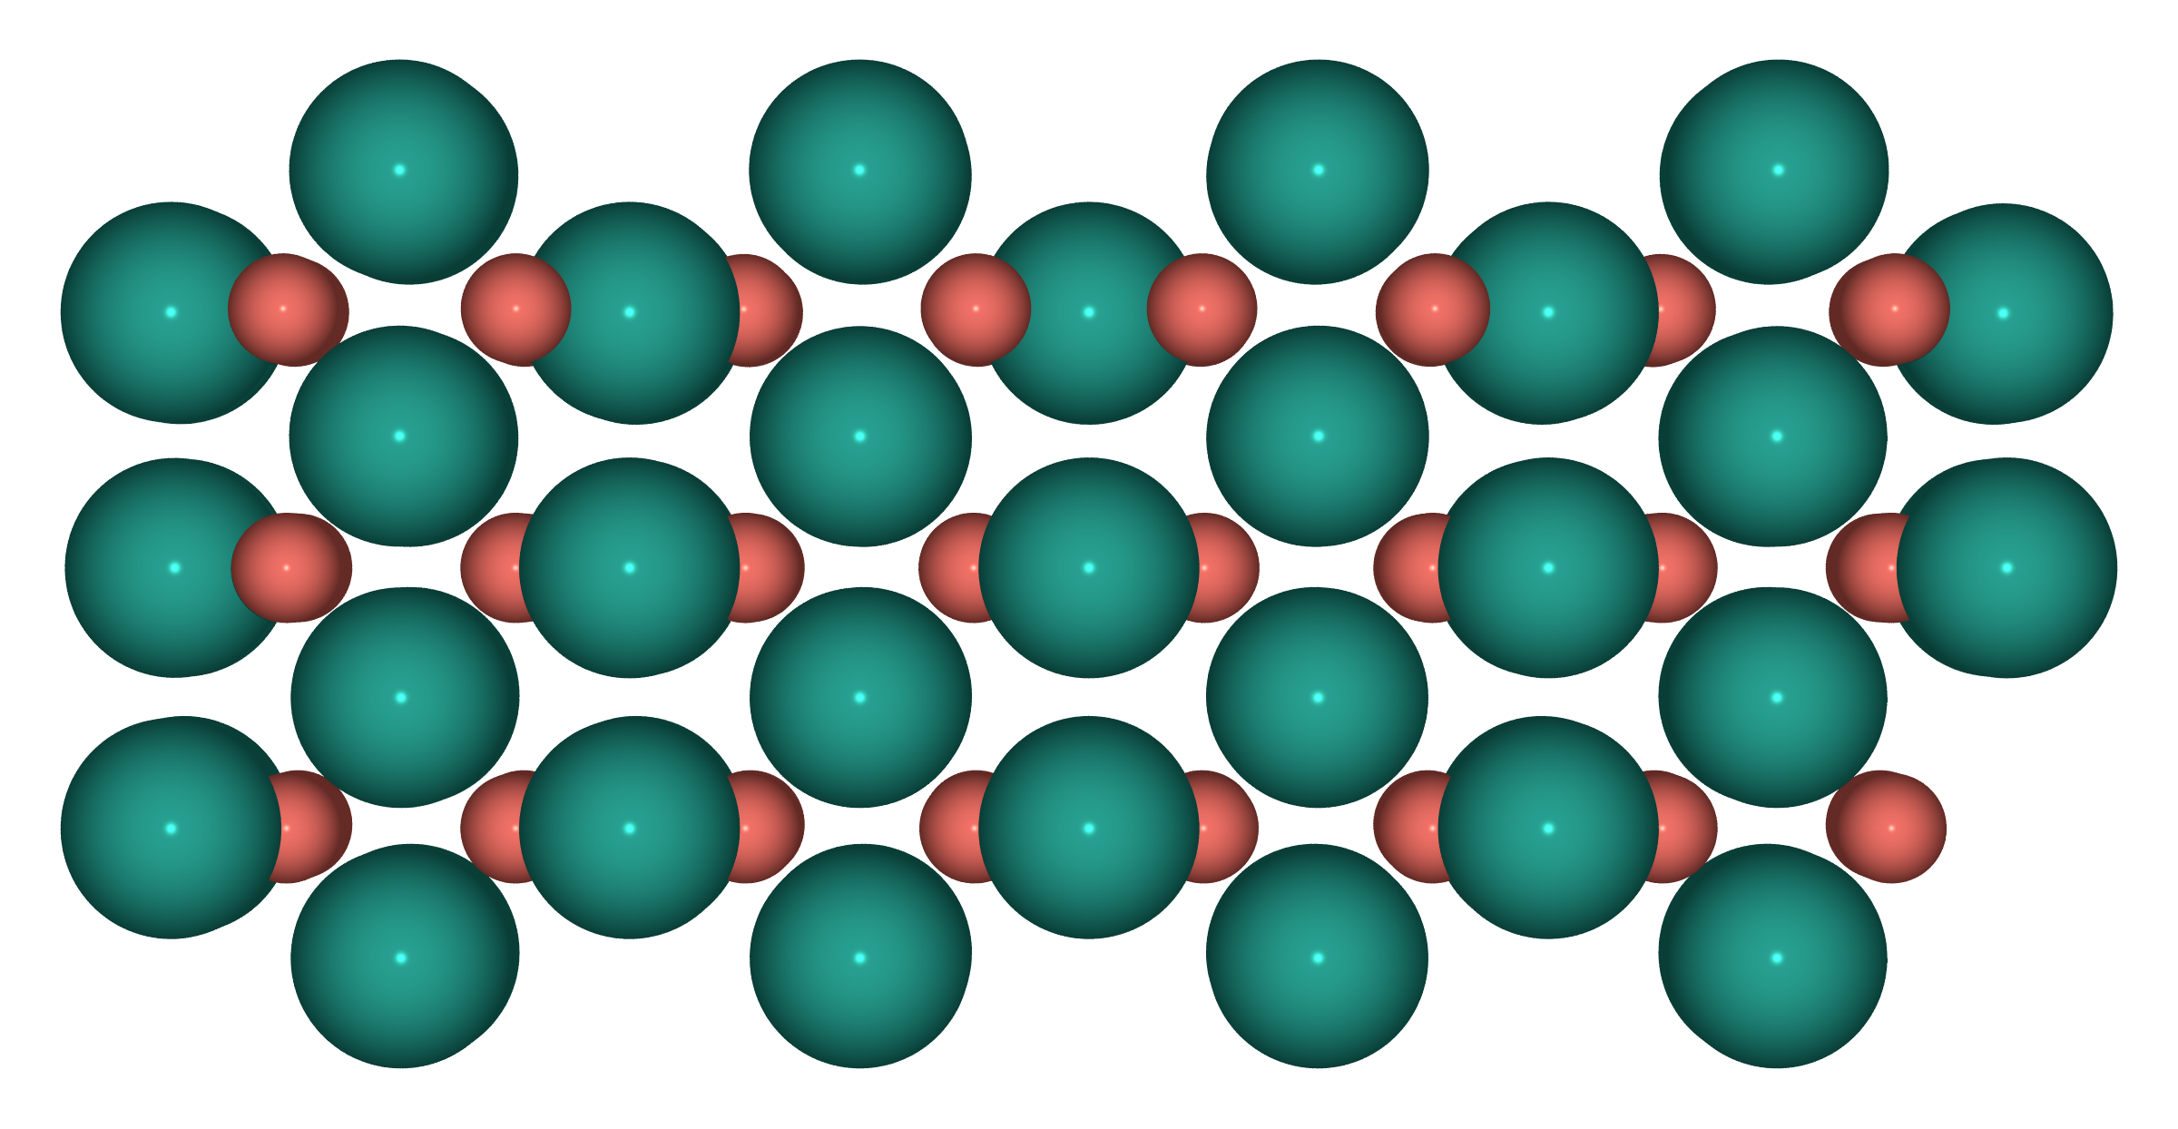
Slab side view — S3b: Pd-rich PdO(100) (Pd²⁺)

Slide 5
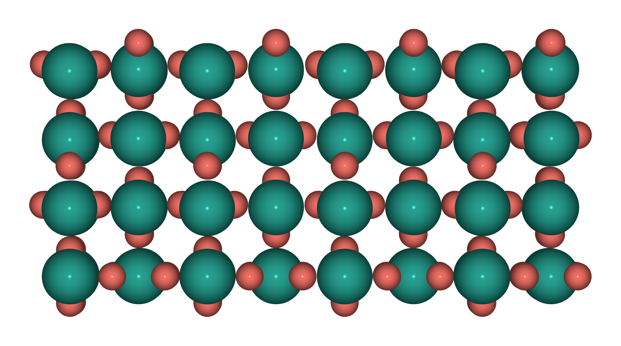
Slab side view — S4: PdO₂(110) (Pd⁴⁺)

Slide 6
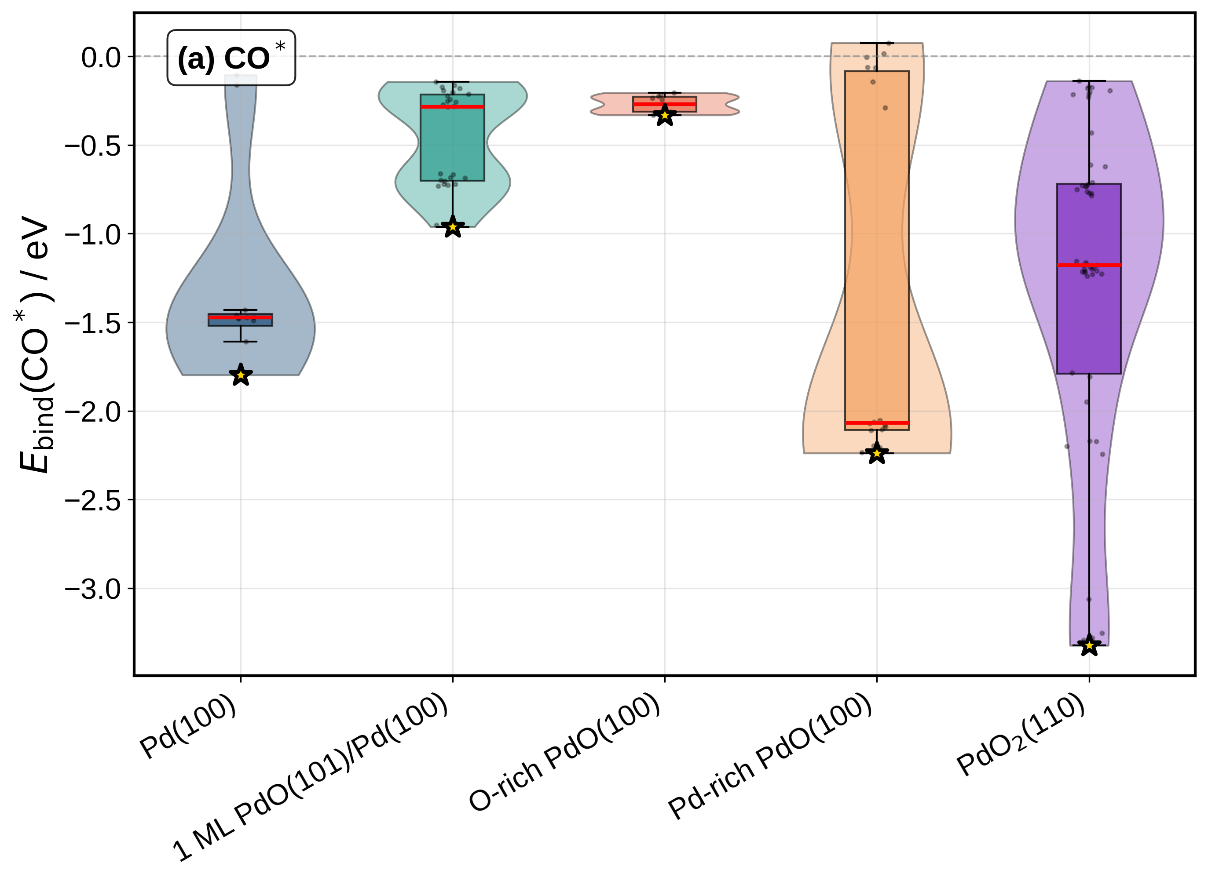
E_bind distribution — CO*

Slide 7
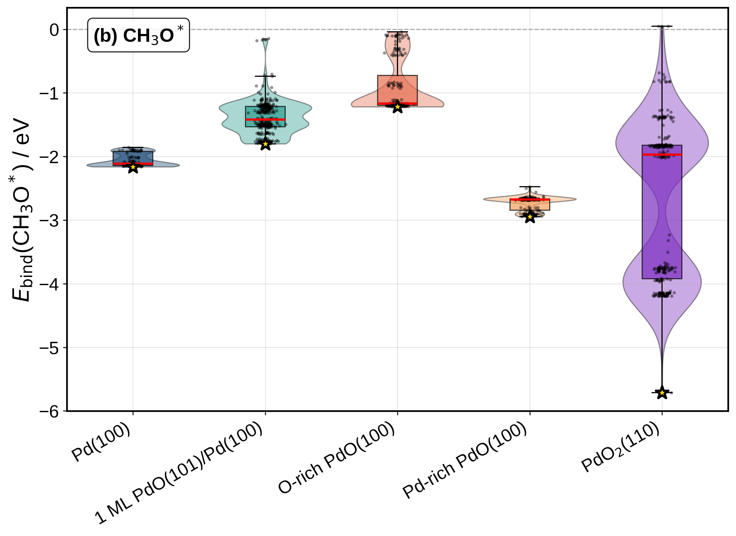
E_bind distribution — CH₃O*

Slide 8
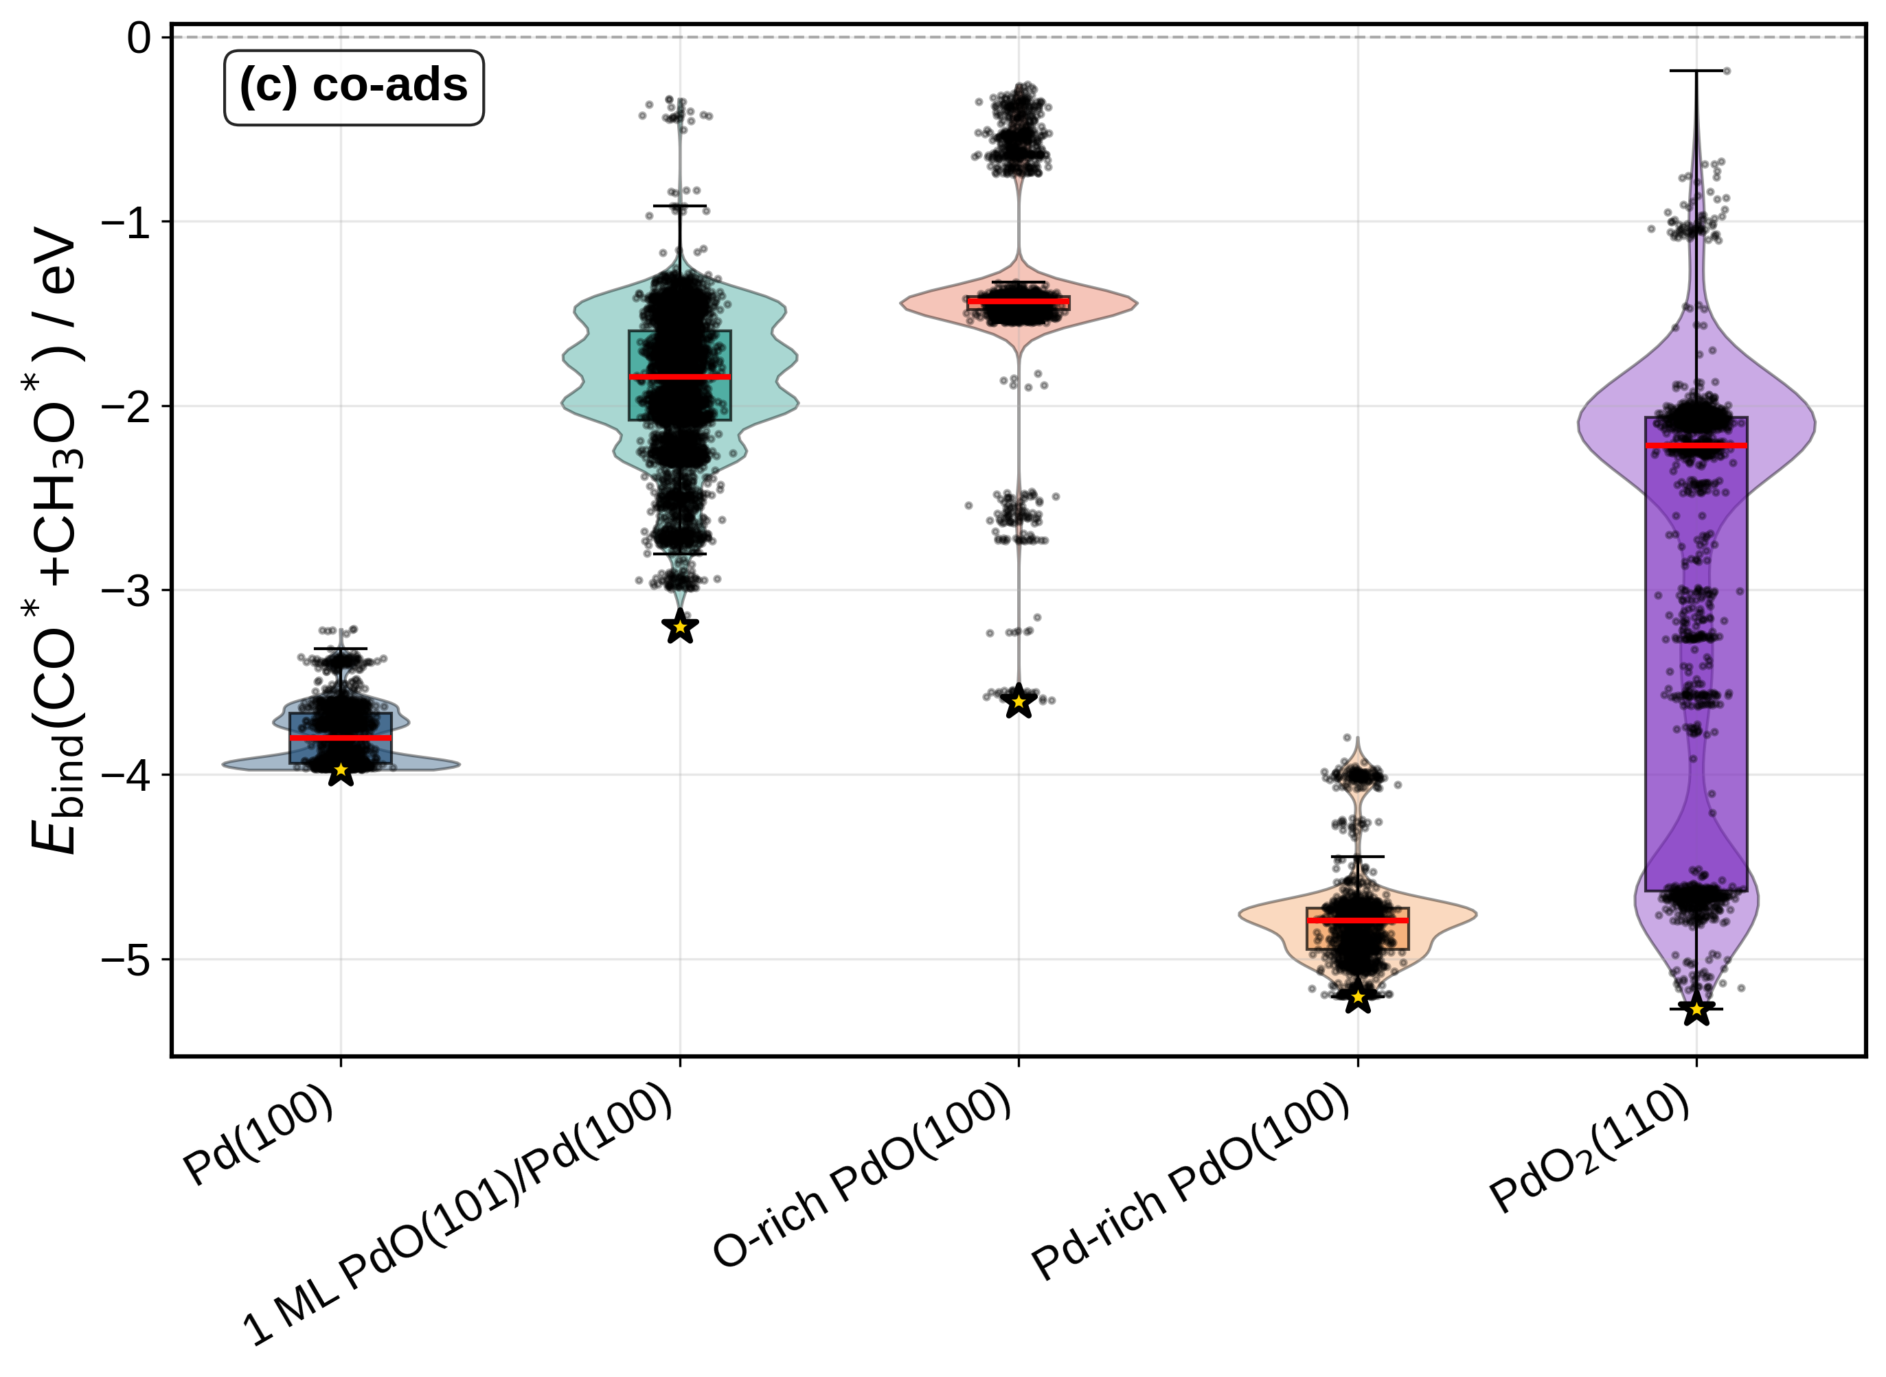
E_bind distribution — co-ads (CO* + CH₃O*)

Slide 9
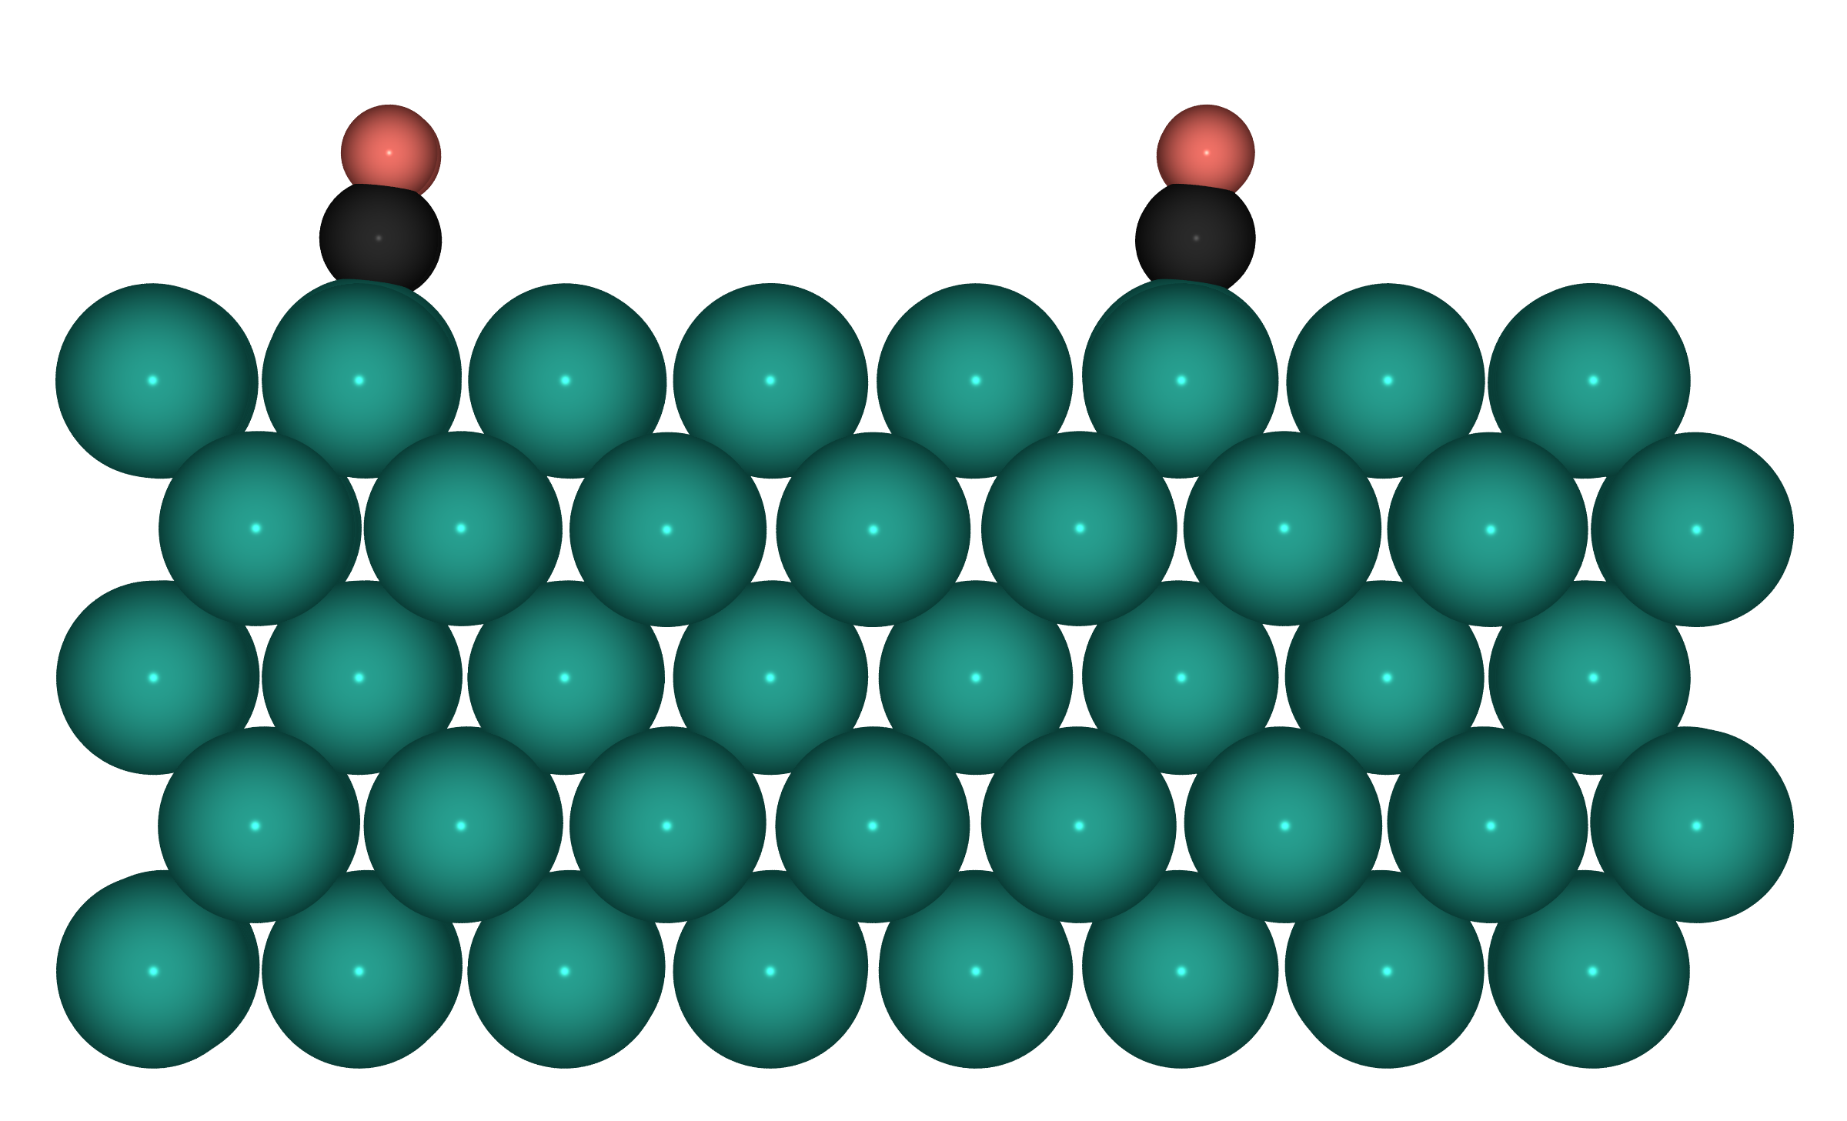
Top-1 CO* — S1: Pd(100), Pd⁰

Slide 10
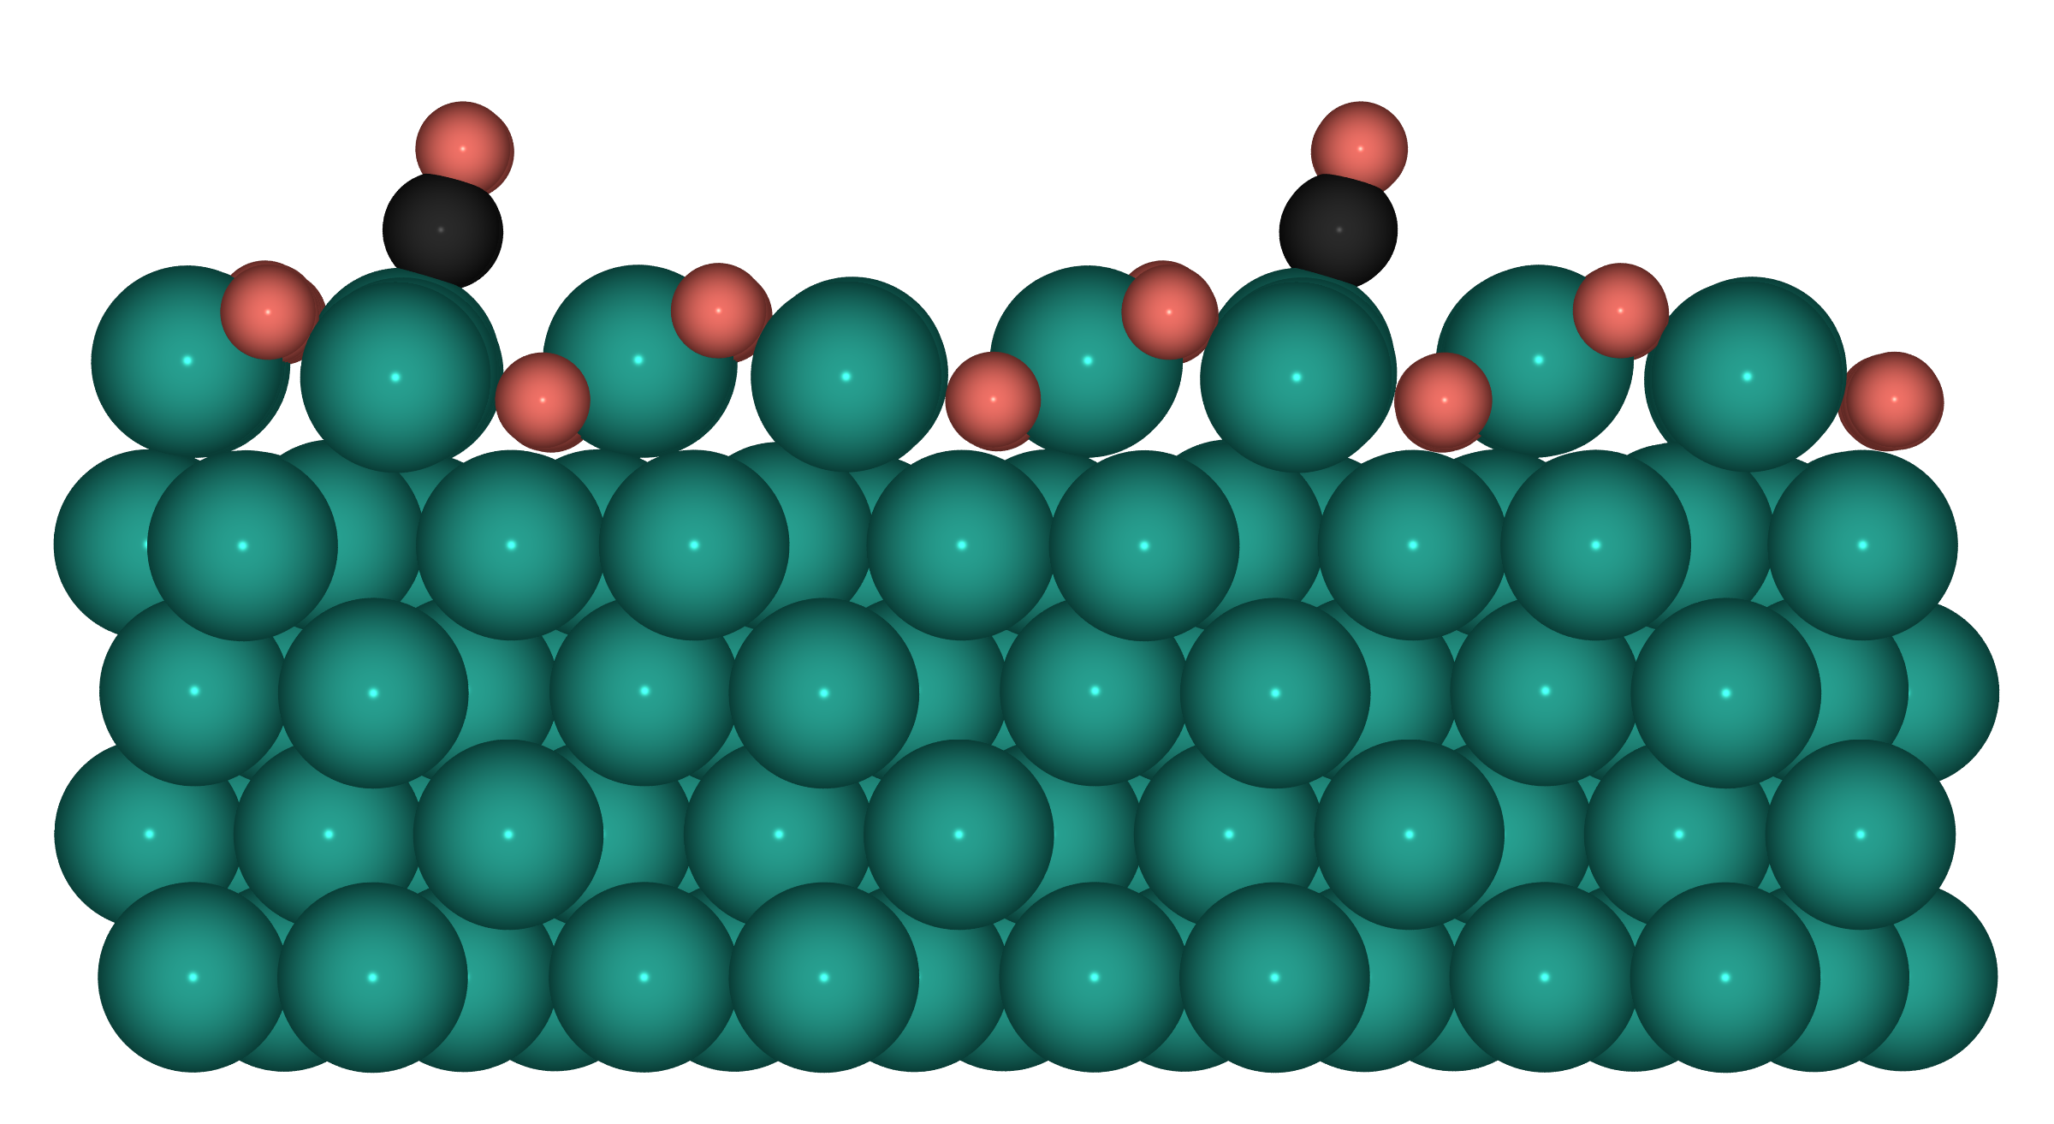
Top-1 CO* — S2: 1ML PdO(101)/Pd(100)

Slide 11
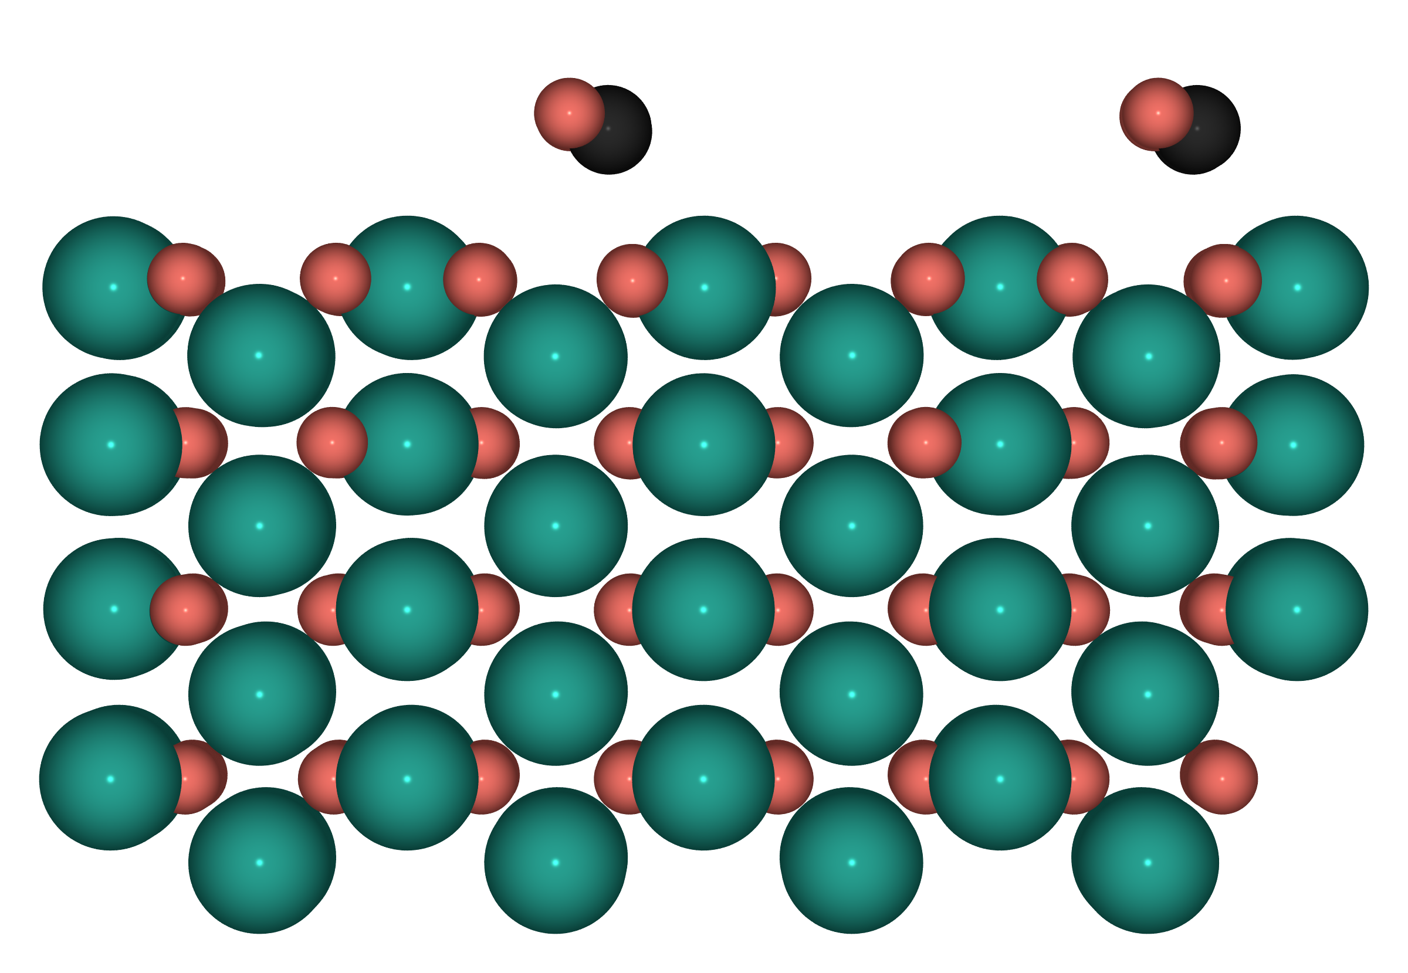
Top-1 CO* — S3: O-rich PdO(100)

Slide 12
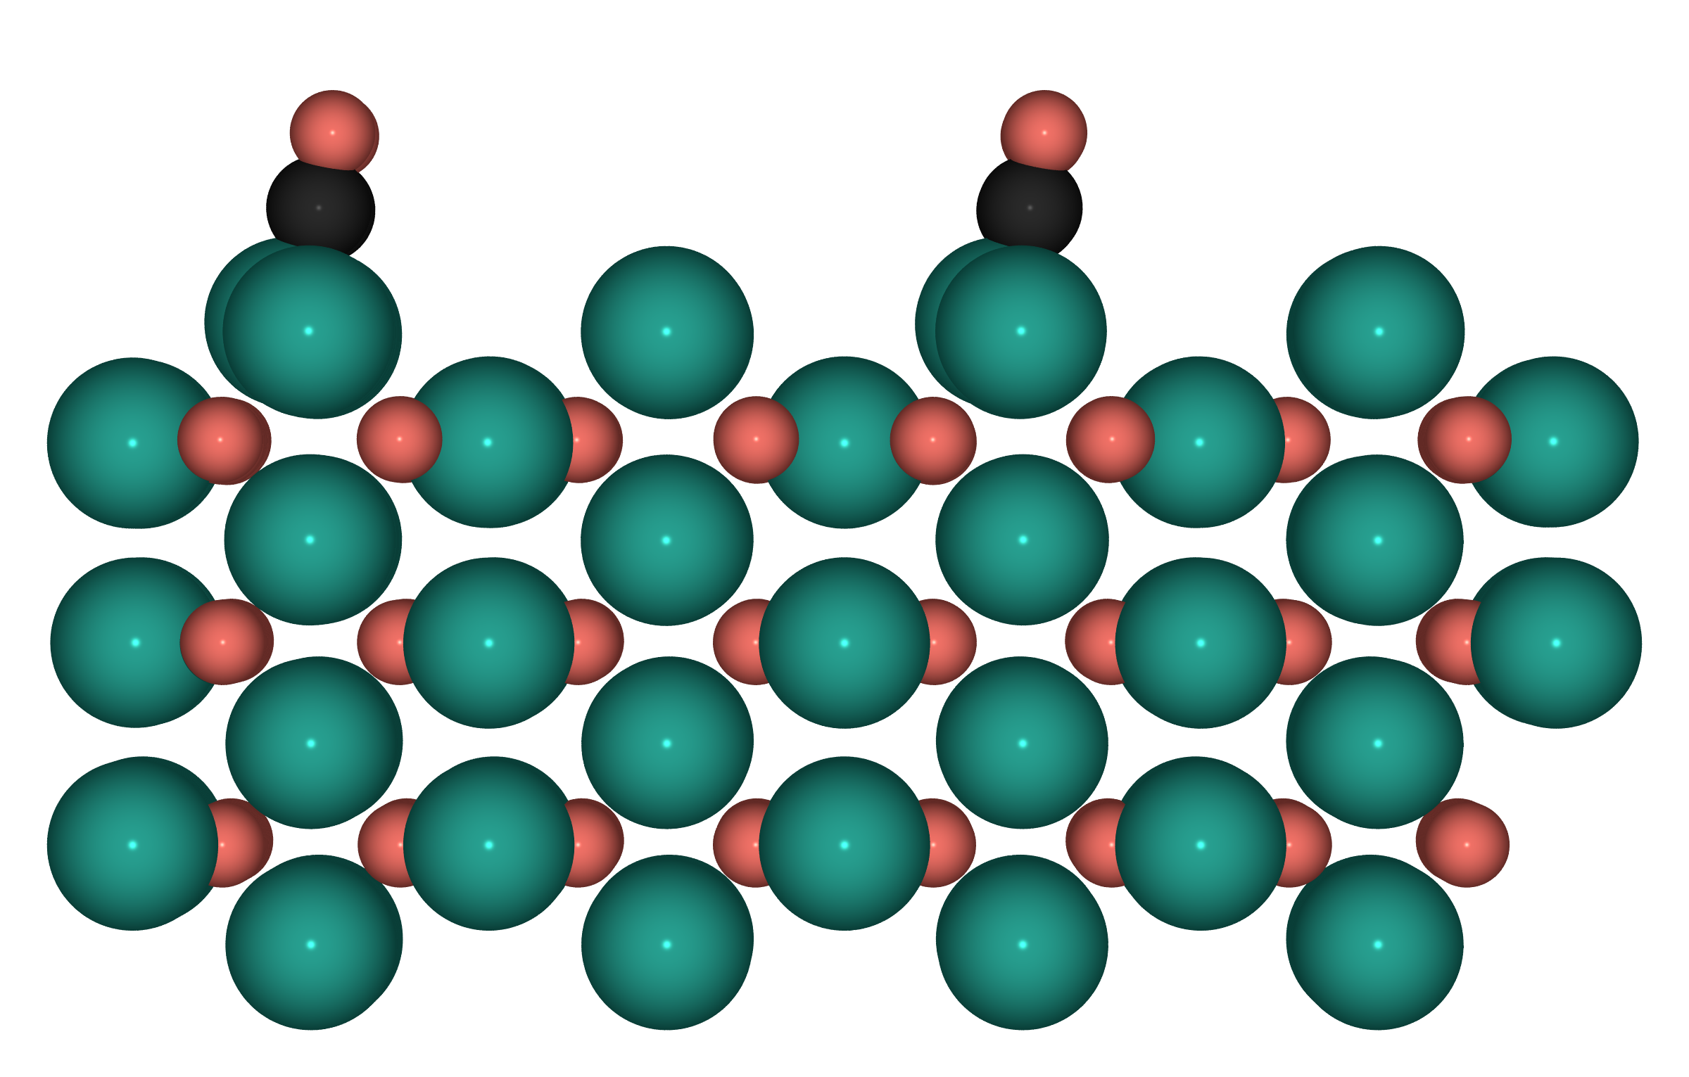
Top-1 CO* — S3b: Pd-rich PdO(100)

Slide 13
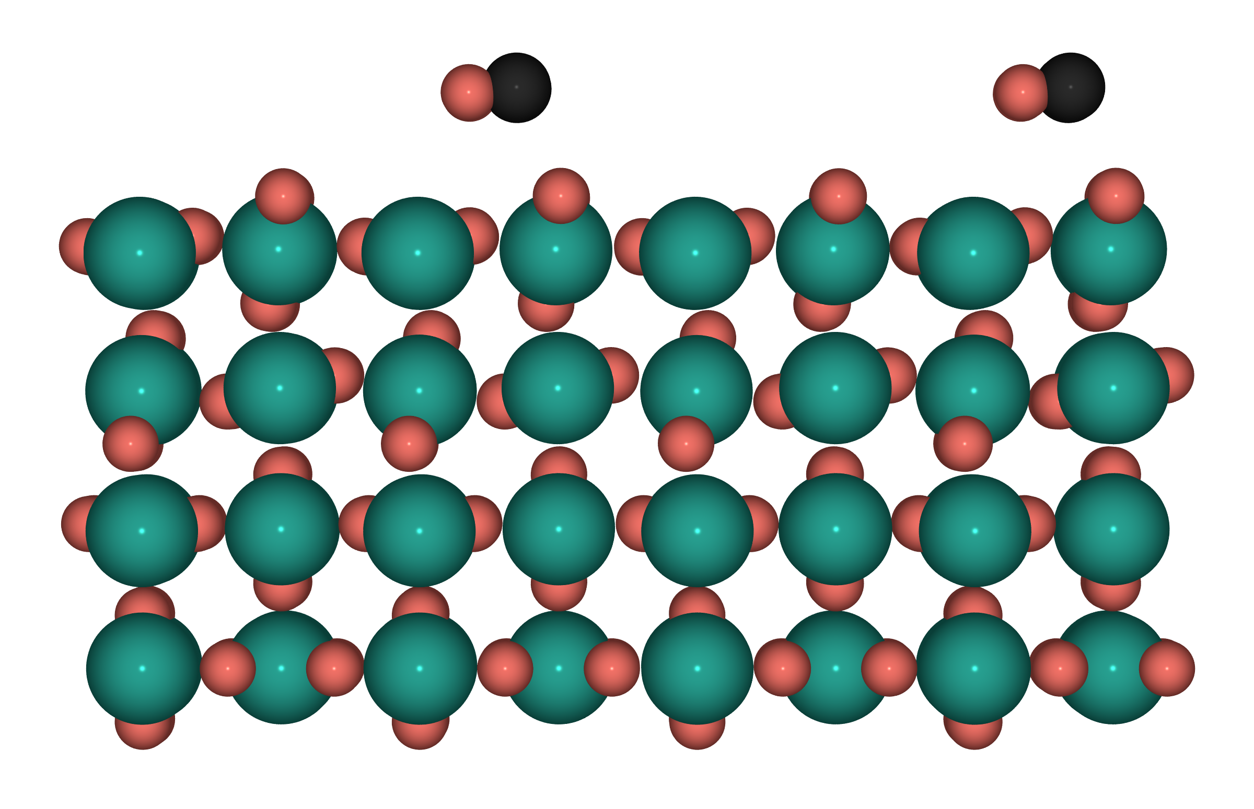
Top-1 CO* — S4: PdO₂(110), Pd⁴⁺

Slide 14
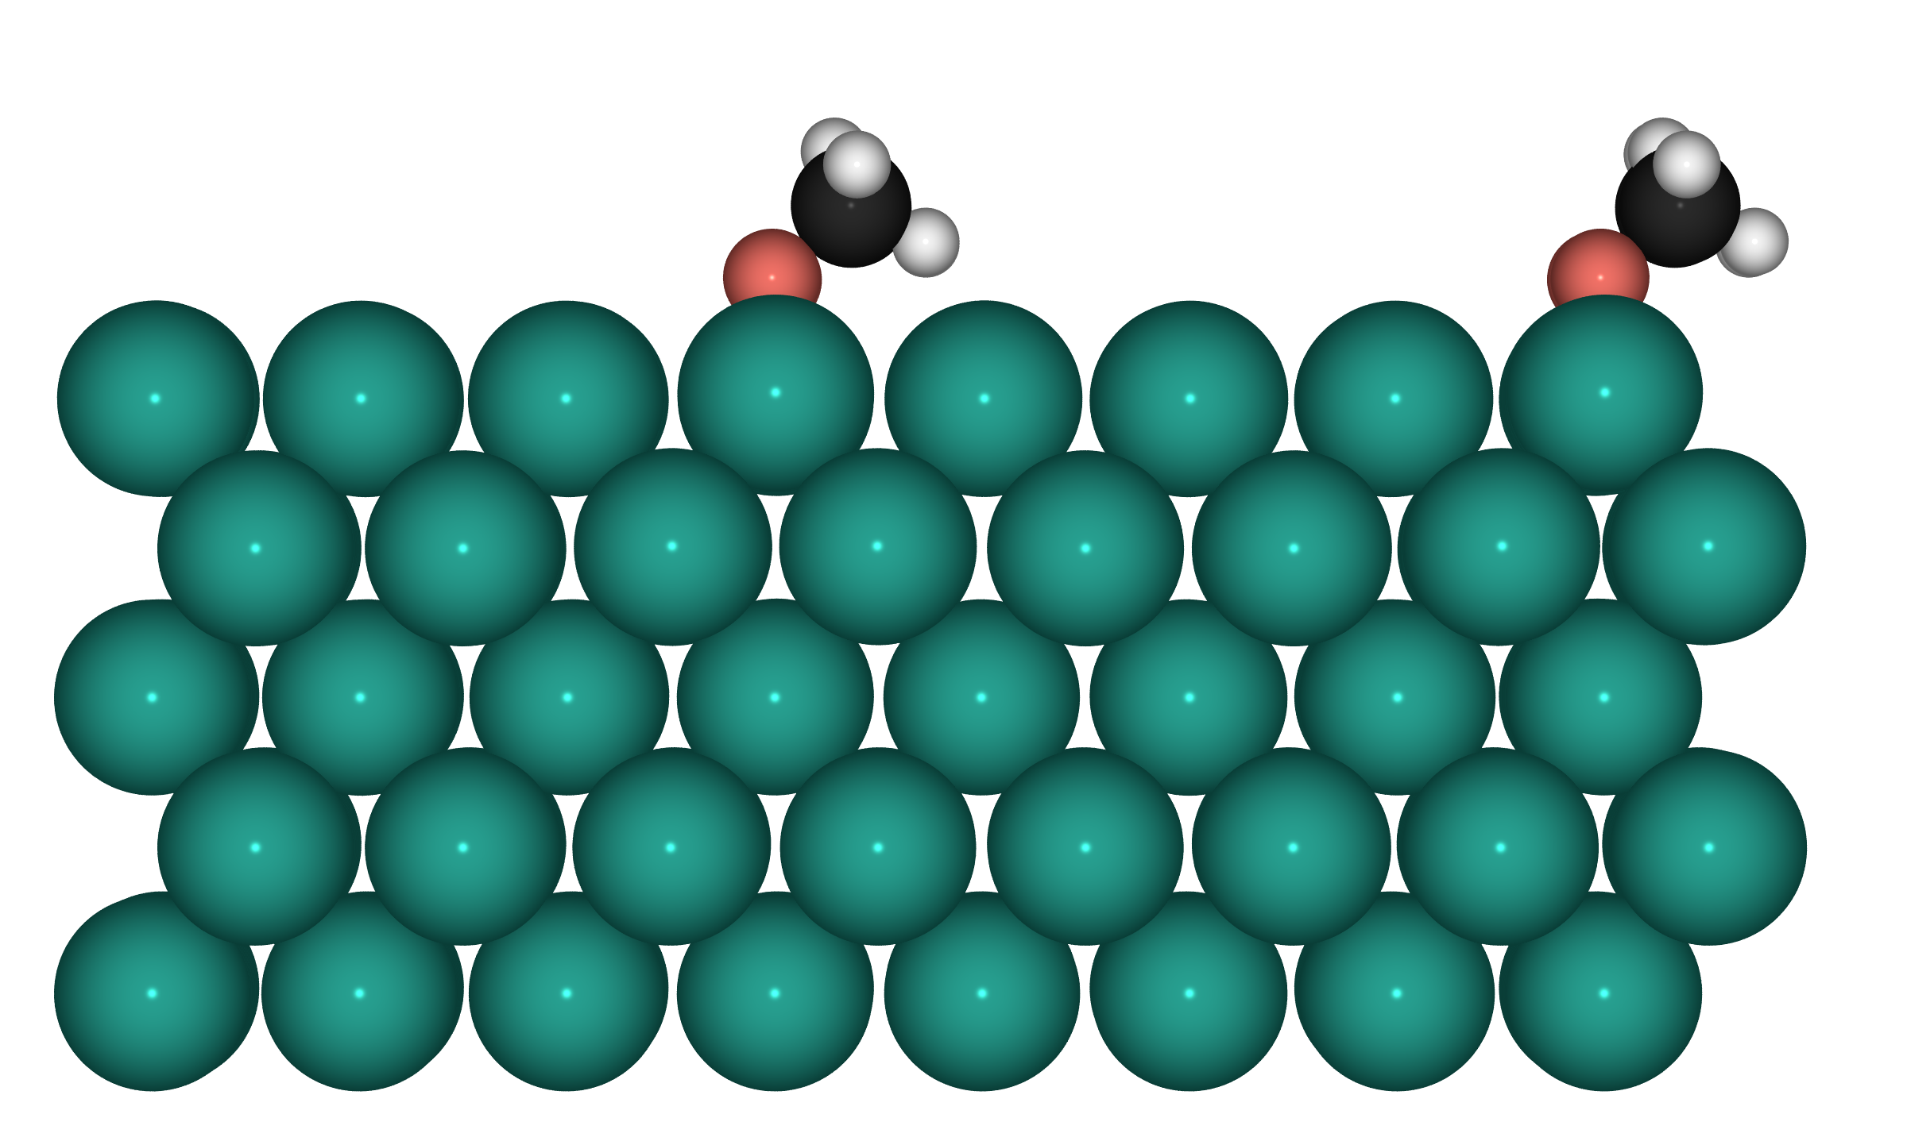
Top-1 CH₃O* — S1: Pd(100), Pd⁰

Slide 15
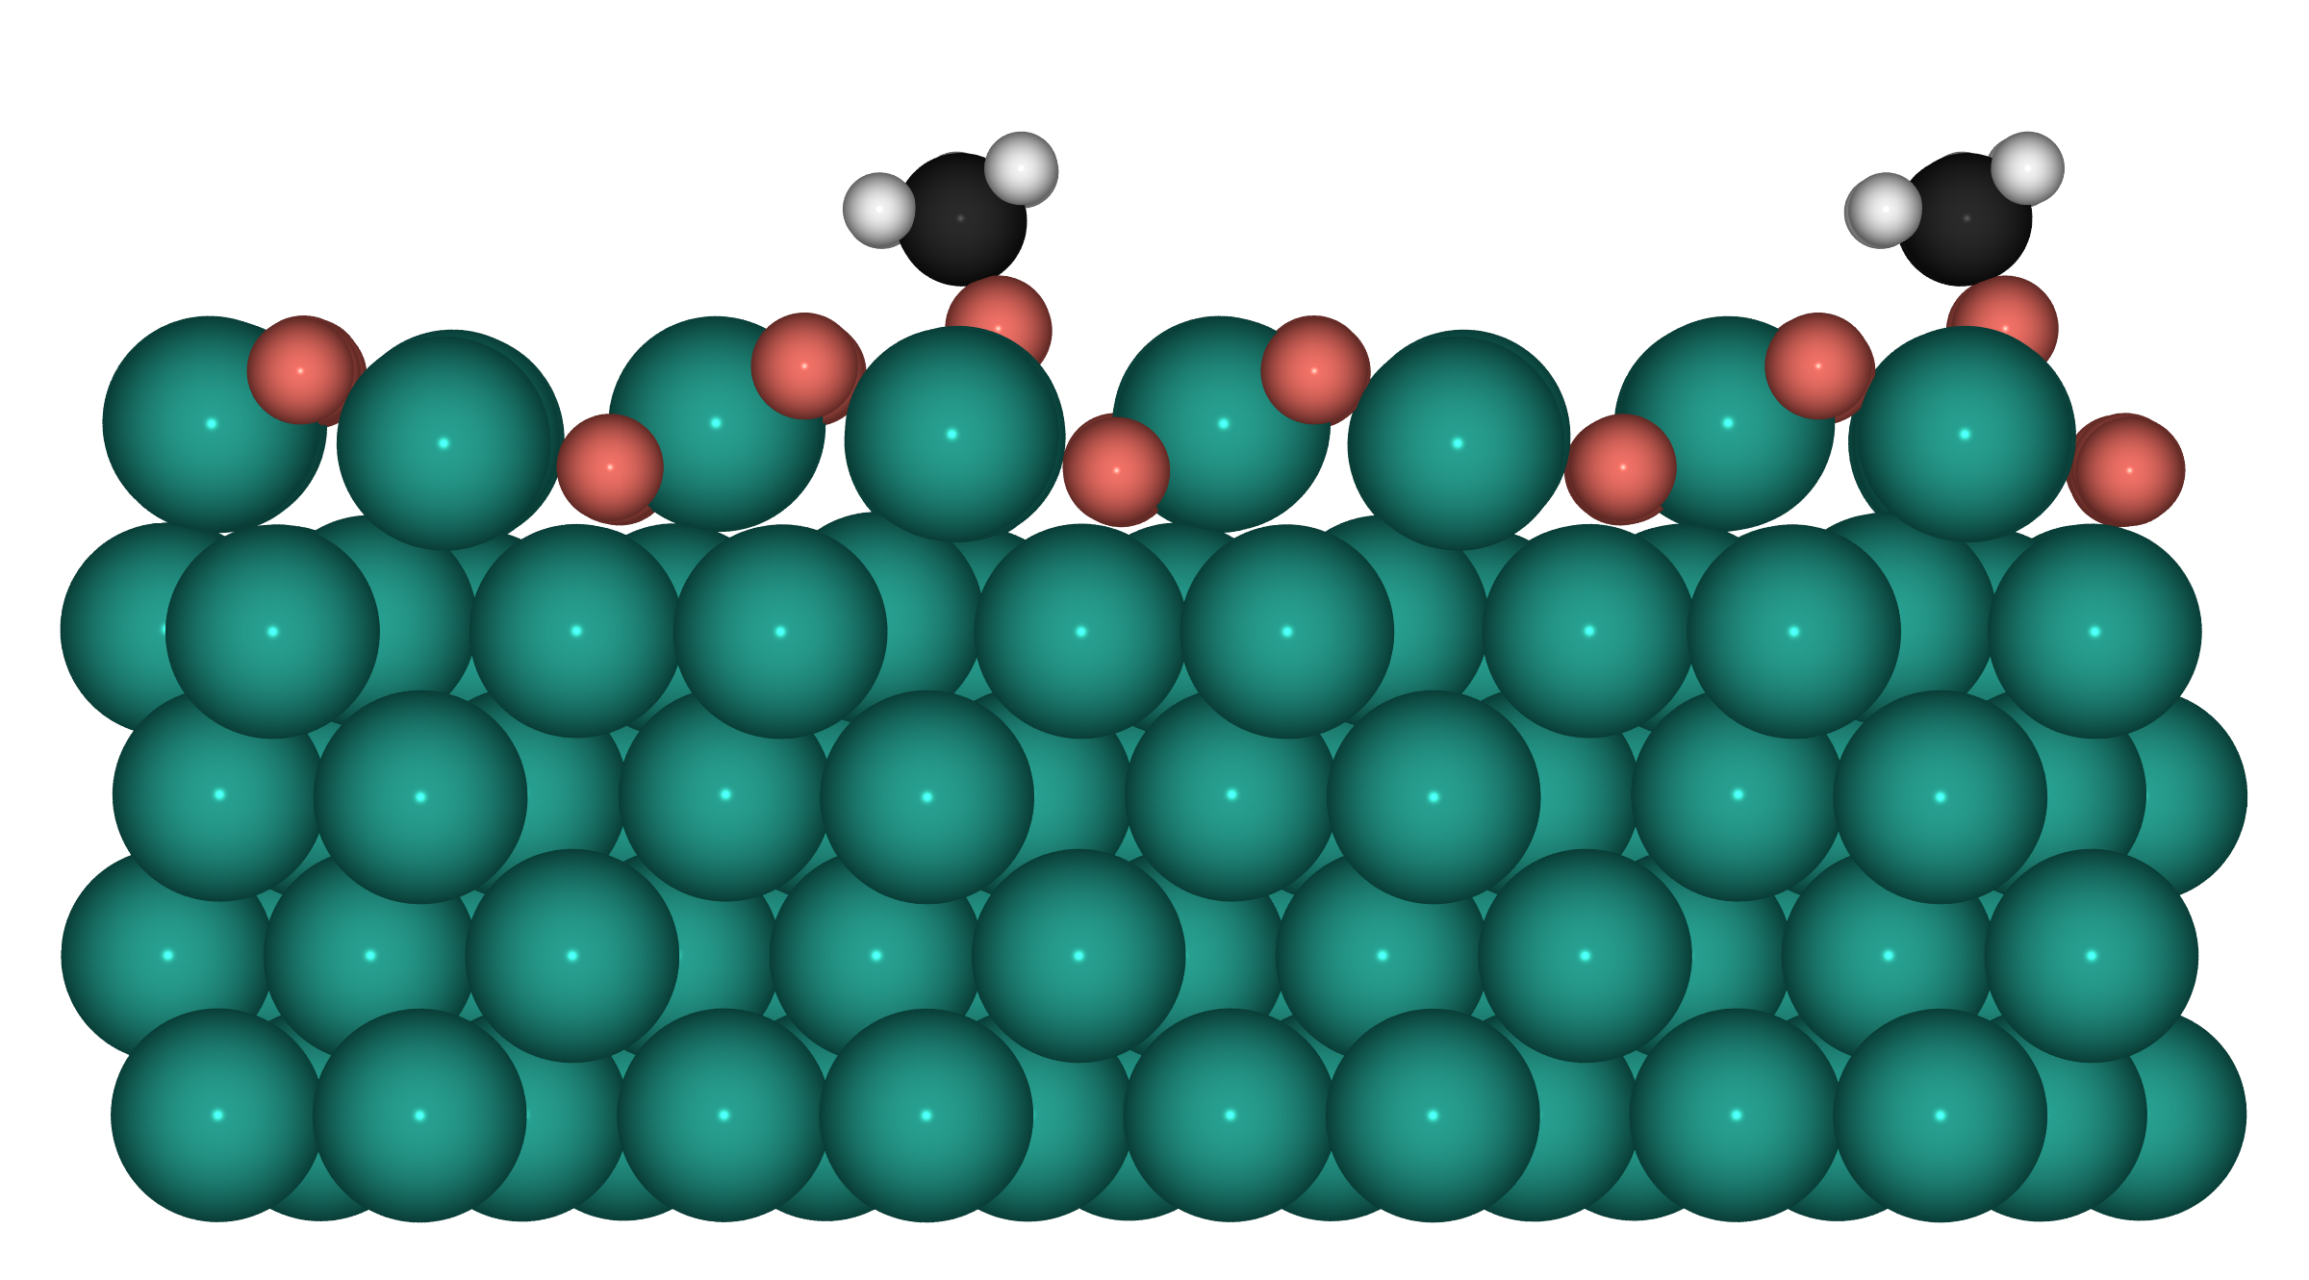
Top-1 CH₃O* — S2: 1ML PdO(101)/Pd(100)

Slide 16
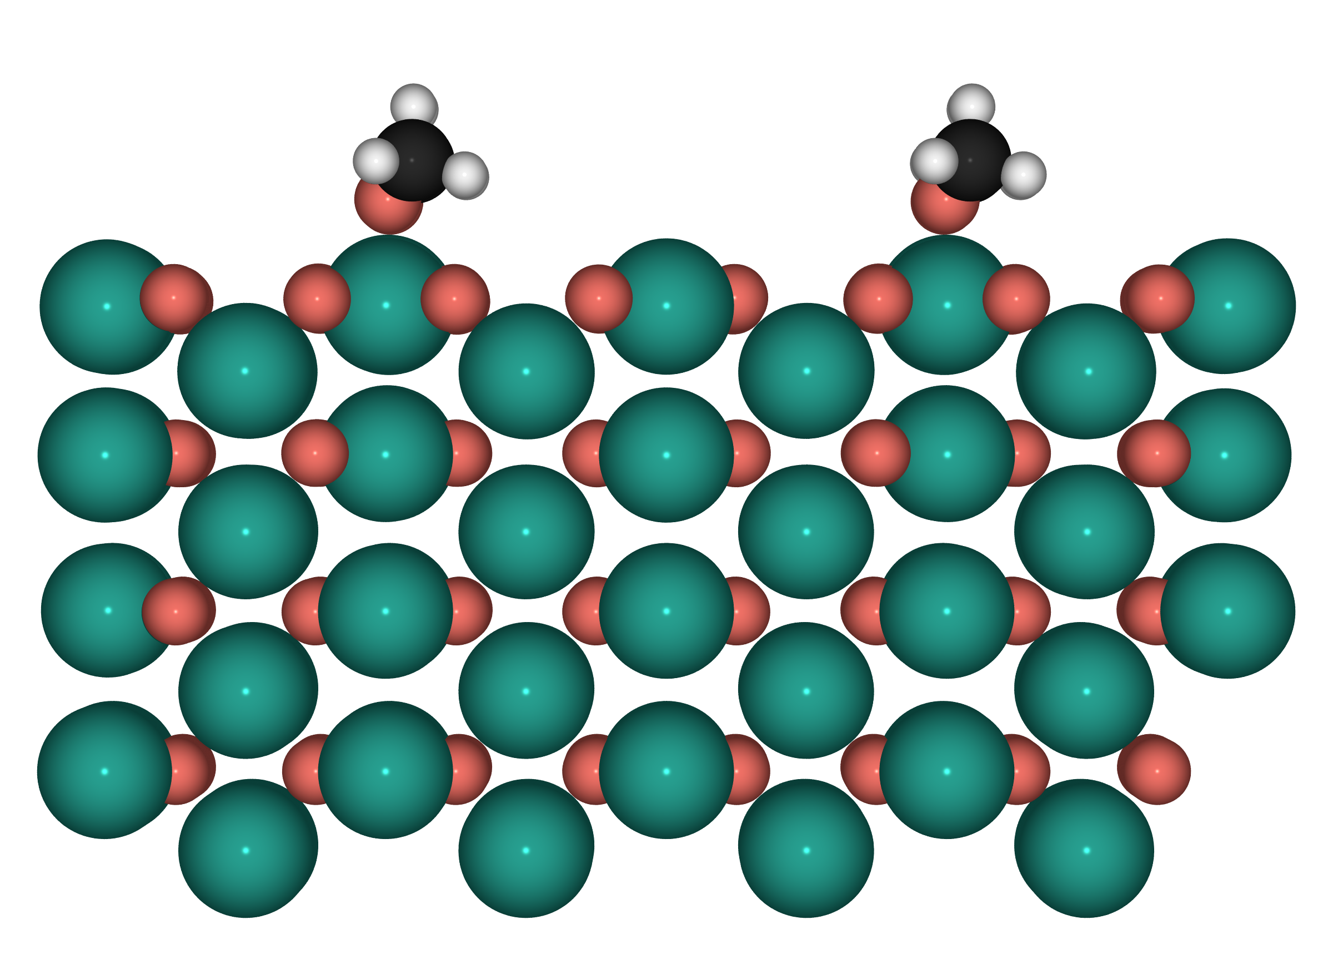
Top-1 CH₃O* — S3: O-rich PdO(100)

Slide 17
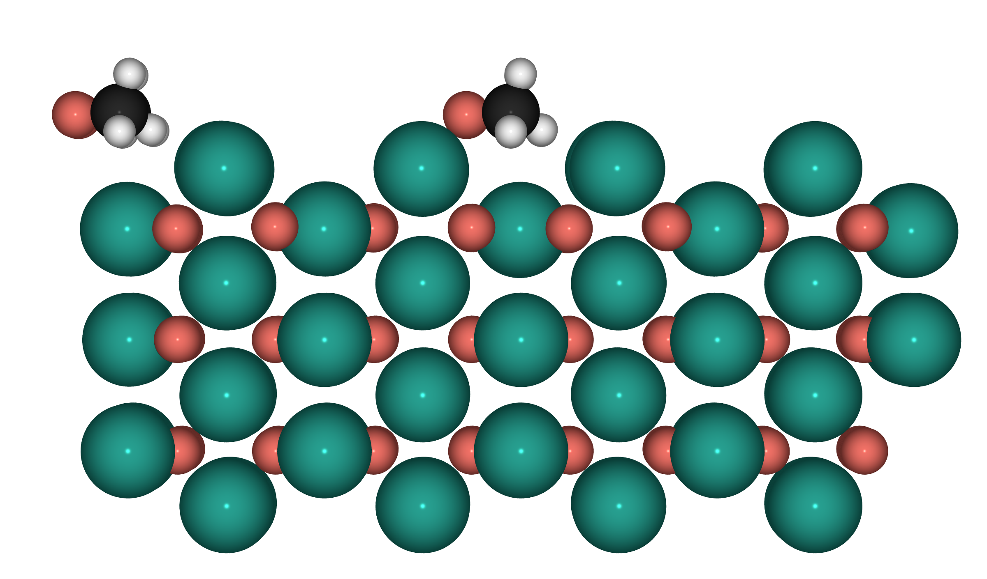
Top-1 CH₃O* — S3b: Pd-rich PdO(100)

Slide 18
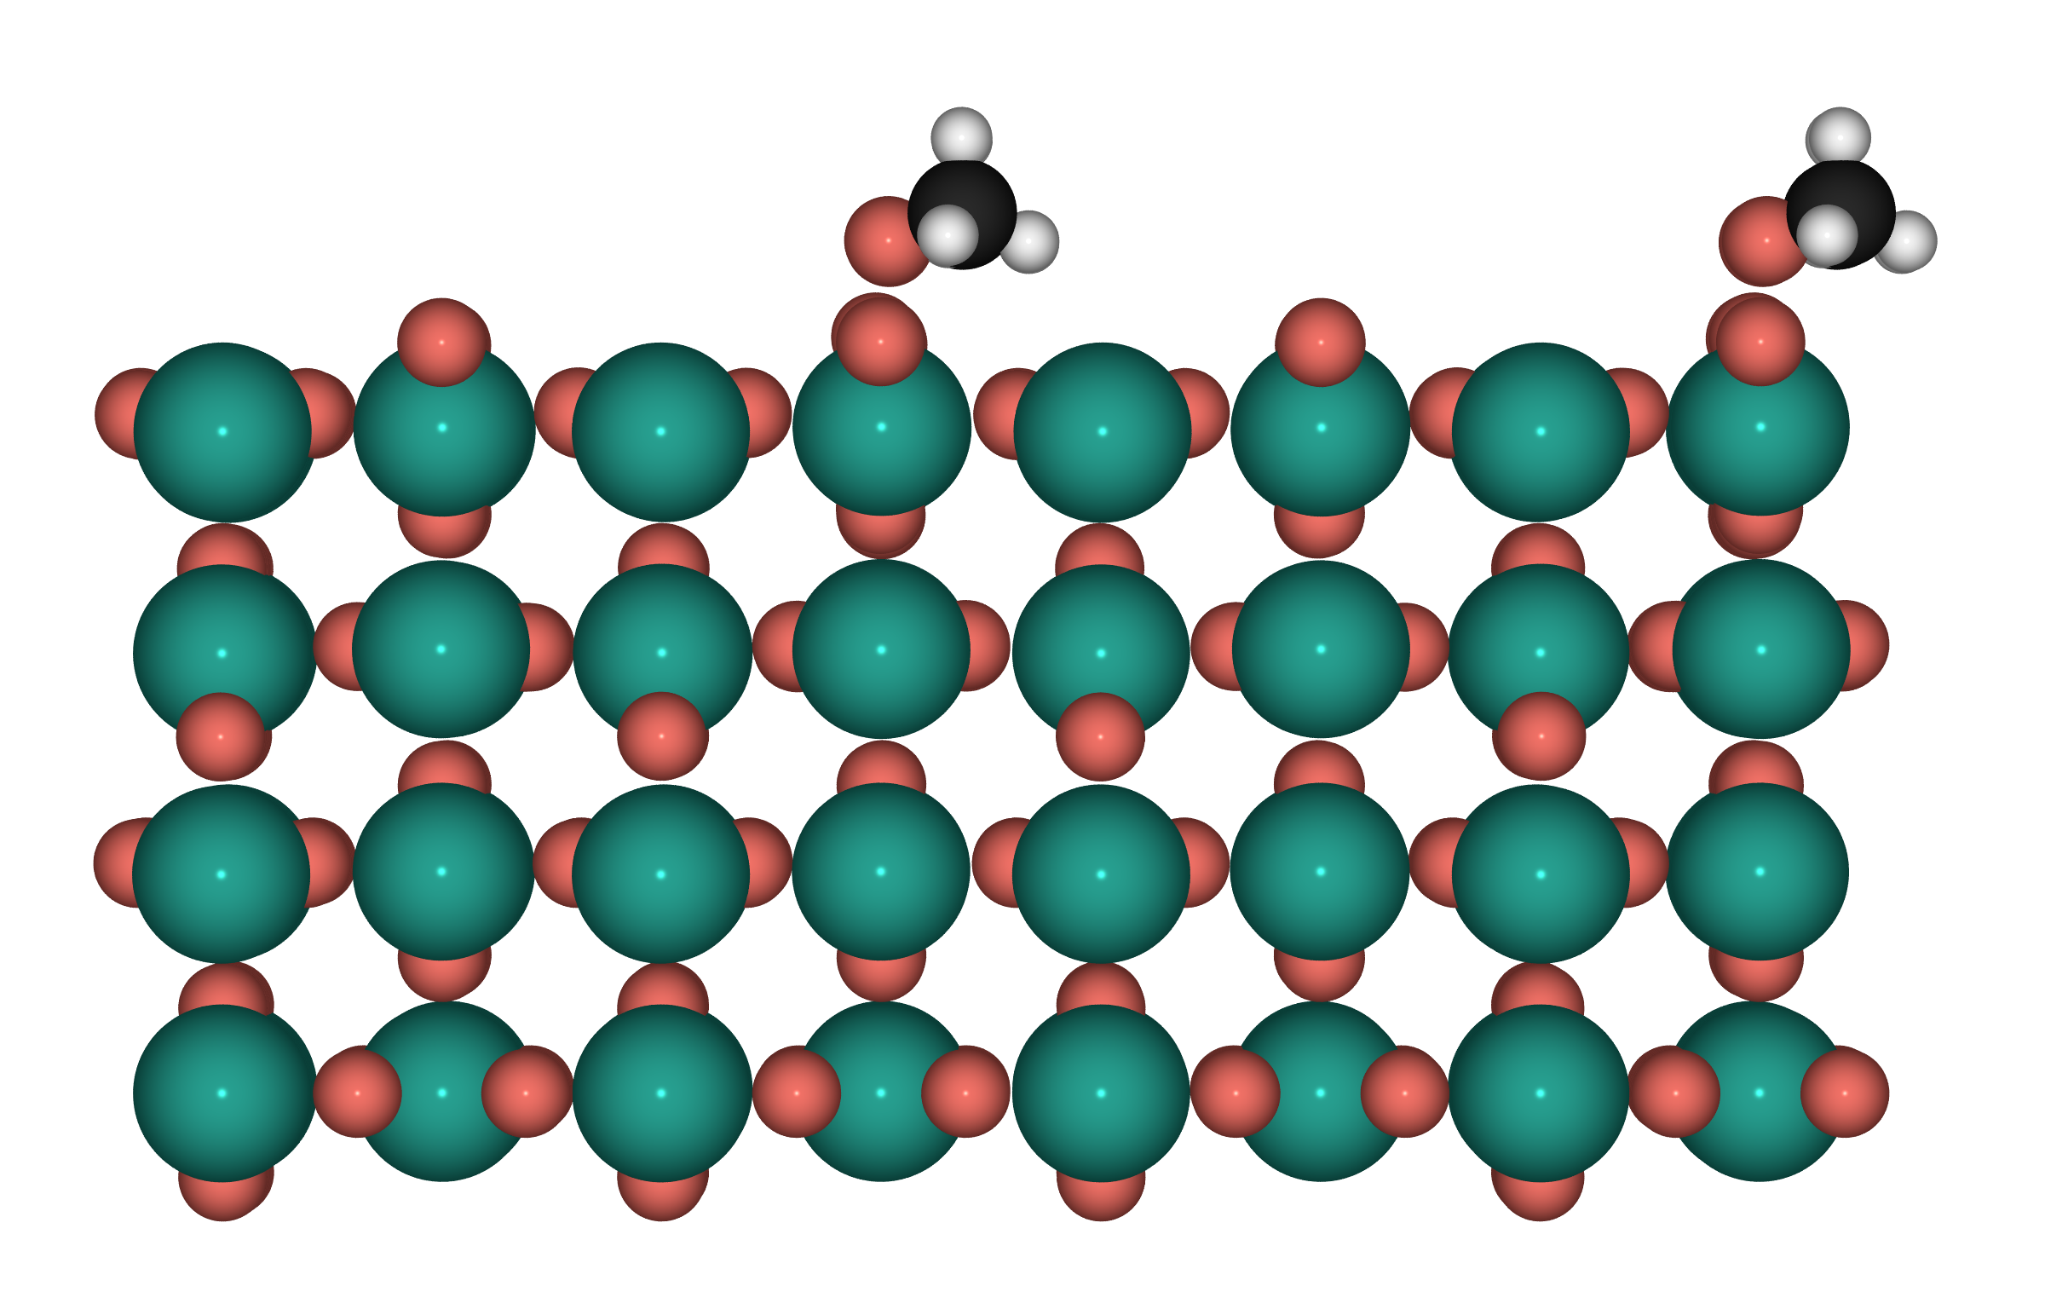
Top-1 CH₃O* — S4: PdO₂(110), Pd⁴⁺

