Slide 1
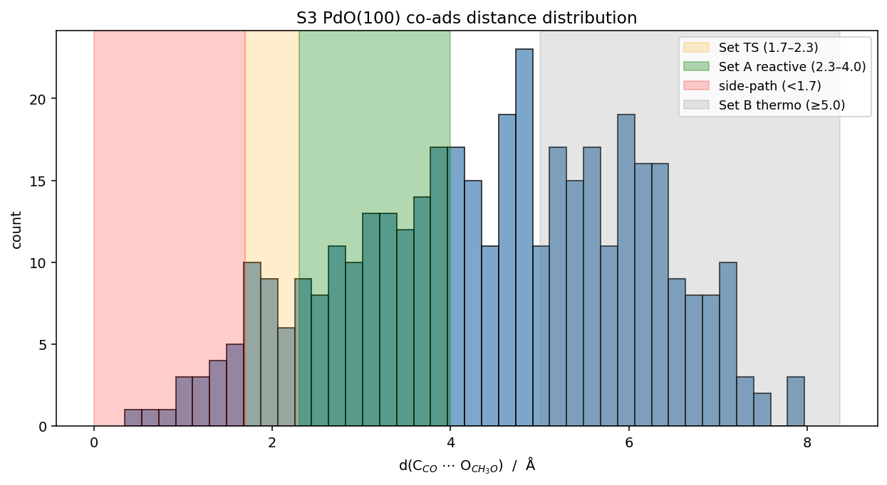
G3 Adsorbate Sampling Dry-run — S1 vs S3 Comparison
Heuristic (AutoAdsorbate, mode='all') — NO MLIP, NO DFT. Awaiting advisor approval.
 | S1 Pd(100) | S3 PdO(100) O-term
Sites (mode='all') | 112 | 135
→ nonequivalent | 7 | 21
CO* (Cl[C]=O) | 112 | 135
CH₃O* (ClOC) | 336 | 405
Co-ads pairs | 400 | 400
Set A reactive | 110 | 108
Set B thermo | 141 | 161
Set TS-like | 28 | 25
side-path | 23 | 19
Key findings: (1) S3 has 3× more nonequivalent sites than S1 due to PdO chemical diversity. (2) Set A reactive count similar (~110) — heuristic geometric, not energy-based. (3) S3 side-path includes shorter overlaps (min 0.35 Å vs S1 0.59 Å) — overlap filter needed. (4) S1 4-fold hollow not detected by AutoAdsorbate (precision artifact, 3-fold split).

