Slide 1
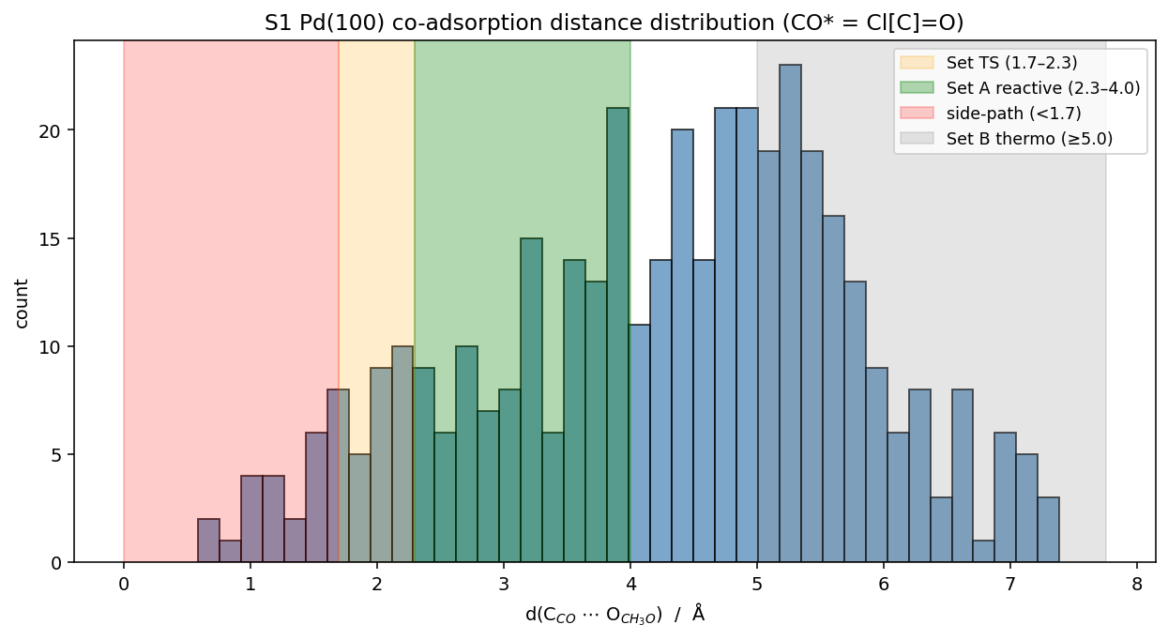
S1 Pd(100) — G3 Adsorbate Sampling (dry-run, Cl[C]=O fix)
Step | Adsorbate | Count | Note
T1.10 | site map | 112 | 16 atop + 32 bridge + 64 3-fold
T1.11 | CO* (Cl[C]=O) | 112 | pure C+O, mode='all'
T1.12 | CH₃O* (ClOC) | 336 | rotation + conformers
T1.13 | co-ads Set A (reactive 2.3–4.0 Å) | 110 | Phase 2 TS pool
 | co-ads Set B (thermo ≥5.0 Å) | 141 | independent species
 | co-ads Set TS (1.7–2.3 Å) | 28 | TS-like
 | co-ads side-path (<1.7 Å) | 23 | incl. atomic overlap, filter later
SMILES fix: guideline 'Cl[C-]#[O+]' fails in current RDKit (valence). Fallback 'ClC=O' gave CHO* (formyl with implicit H). Corrected to 'Cl[C]=O' (brackets → no implicit H, pure CO).
Heuristic-only. NO MLIP, NO DFT. Awaiting advisor approval before T1.14 onward.

