Slide 1
Modeling
Data
  variables
Method
  machine learning
  model selection
Results
  performance of best models
  next step

Slide 2
Variables
Dependent variable
predict whether price increases by more than 0.33% after an hour
make prediction every ten minutes
Predictors (in total 164)
use data at the moment, ten minutes earlier and twenty
Discussion
post number trend, number of participants trend, click trend, etc.
Price
closing price the day before, price volatility, price trend, difference between selling and buying price of each period, price gap volatility, trade volume trend, etc.

Slide 3
Variables
Dependent variable
predict whether price increases by thirty percent one hour later
make prediction every ten minutes
Predictors (in total 164)
use data at the moment, ten minutes earlier and twenty
Time
different time slots (early morning, morning, lunch, etc.)
Market index
Market capital, KOSPI and KOSDAQ index and their trend
Different square and interaction terms
Notes:
Transform data in pandas
KOSPI is weighted average stock price for 887 (in total 2200) companies in Korea, KOSDAQ is weighted average stock price for 1258 mid and small size companies. (scrapper)

Slide 4
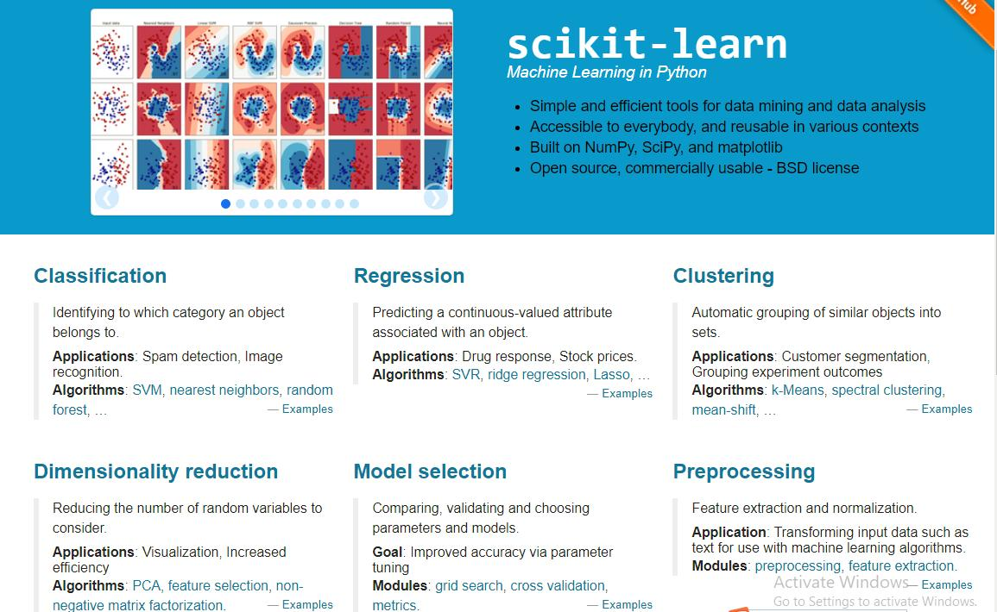
Predicting methods
scikit-learn API

Slide 5
Predicting methods
Logistic regression
from sklearn.linear_model import LogisticRegression
K Nearest Neighbors (KNN)
from sklearn.neighbors import KNeighborsClassifier
Principal component regression (PCR)
from sklearn.decomposition import PCA
Partial least squares regression (PLS)
from sklearn.cross_decomposition import PLSRegression
Tree-based methods
Suport vector machines (SVM)
from sklearn.svm import SVC

Slide 6
Tree-based methods
decision tree, bagging, random forest, boosting
Decision Tree
from sklearn.tree import DecisionTreeClassifier, export_graphviz
import graphviz
Important variables
price volatility: (maximum price – minimum price) / minimum price
average price volatility: price volatility / increase count
alpha: price increase – market increase
variation ten minutes before squared: the squared price variation between ten minutes before and eleven minutes before
Notes:
Transform data in pandas
Price volatility = (max price - min price)/min price
Average price volatility = price volatility / increase count
Price gap volatility = how close sell and buy price

Slide 7
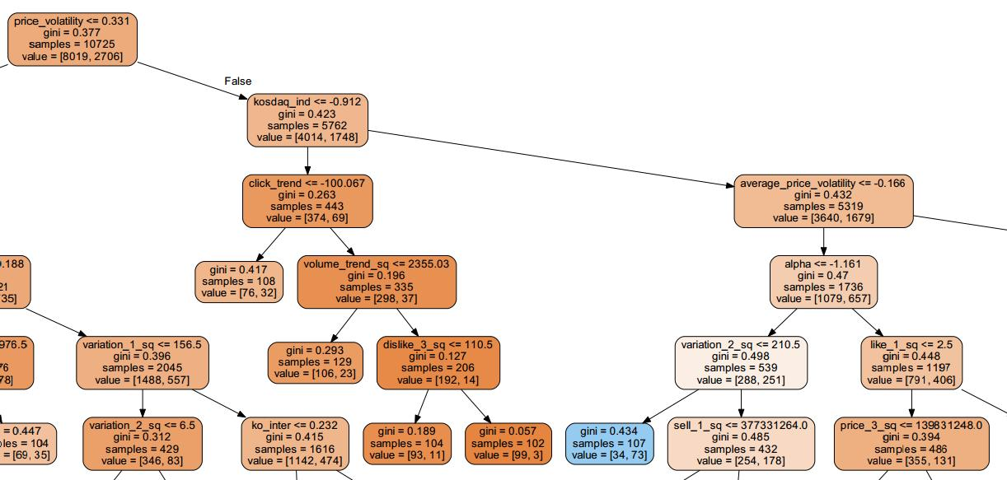
Tree-based methods
Notes:
Price_voli

Slide 8
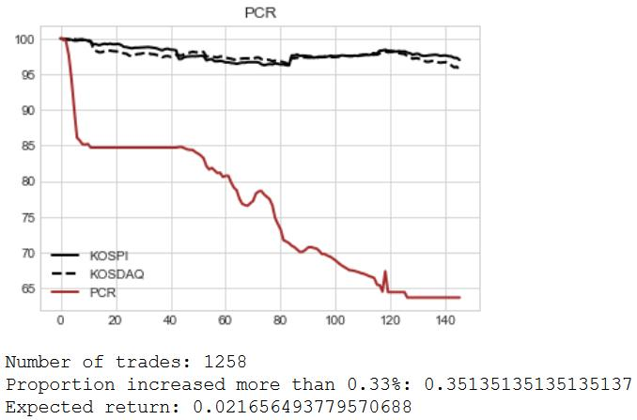
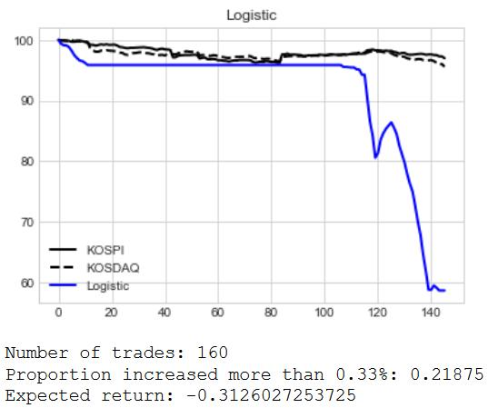
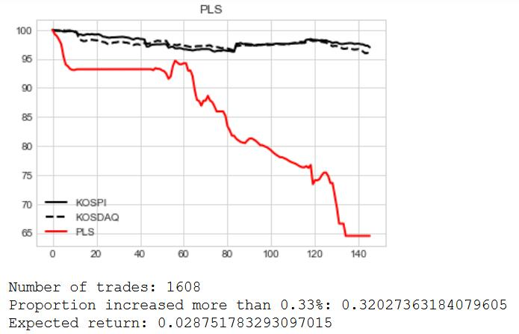
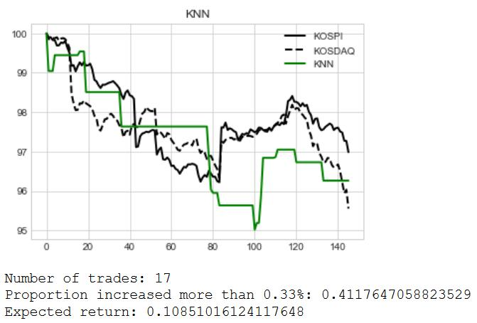
Model performances

Slide 9
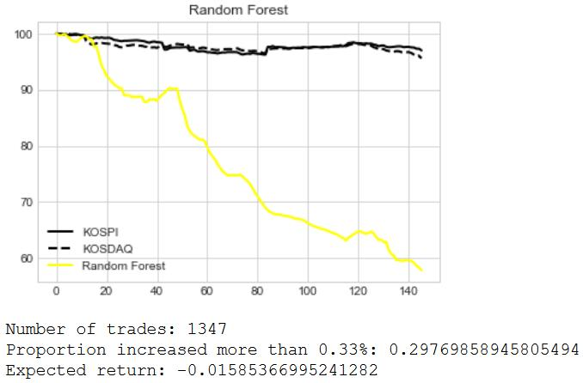
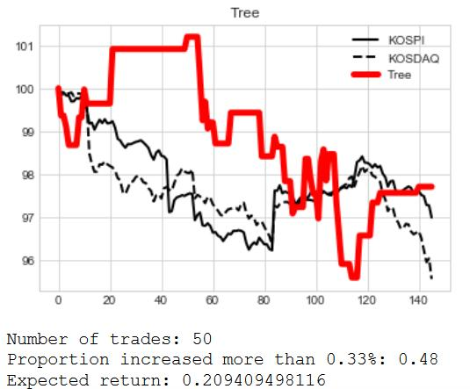
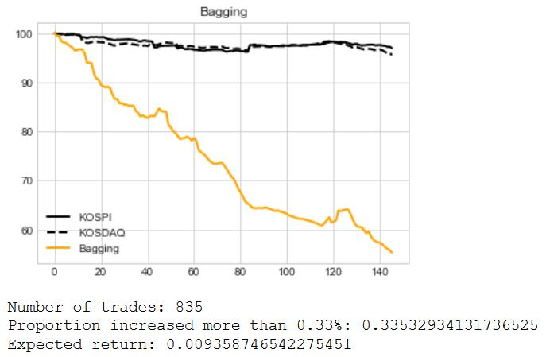
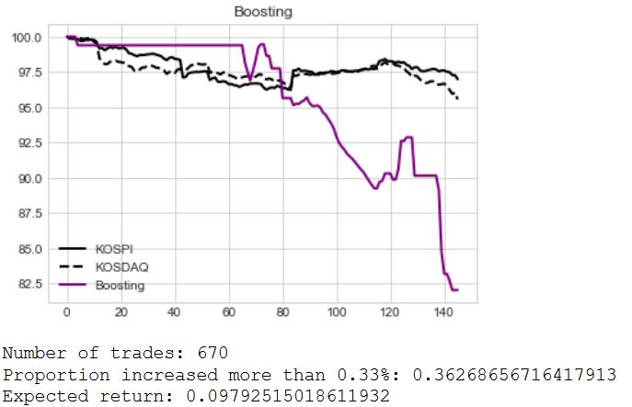
Model performances

Slide 10
Model selection
Validation set approach
training set: February 14, 20 21, 22, 23, 26
testing set: February 27, 28, March 2, 3, 6, 7
Tuning parameters
Regression vs non-linear models
Penalty for non-linearity
February 14 – 21 as training set, February 22 – 26 as validation set,
after February 27 testing set
Using mean square error
from sklearn.metrics import mean_squared_error, classification_report

