Slide 1
CodeEducation Week 2/3
By: Shashank Golla

Slide 2
Review
Does everyone have python installed on their computer?
If not go to this website: https://www.python.org/downloads/ and download Python 3.5.0.

Slide 3
How to run python program?
Open a text file and write the python program you would like.
Use your command line interface to go to the file directory(cd to change directory) where your program is and type “python filmename.py”
If command line is uncomfortable use the following IDEs:

Slide 4
Introduction to Python syntax
Differences between python and other programming languages:
Python does not require you to explicitly say the type of the variable
Python is closer to what you would write as psuedo-code than C++ or Java.

Slide 5
First Exercise(Review)
Make your python script(another word for file) print “Hello World” twice.
Now put a “#” sign in front of one of the print statements for printing “Hello World”, what does this do?
Questions?

Slide 6
Numbers and Math
What do you think these symbols do: +, -, /, *, %, <, >, <=, >=
Give me the answer to “3+2%5” , “7/4” and “7.0/4.0” using python on your computer.
Make sure above each line you use “#” to comment for future reference.

Slide 7
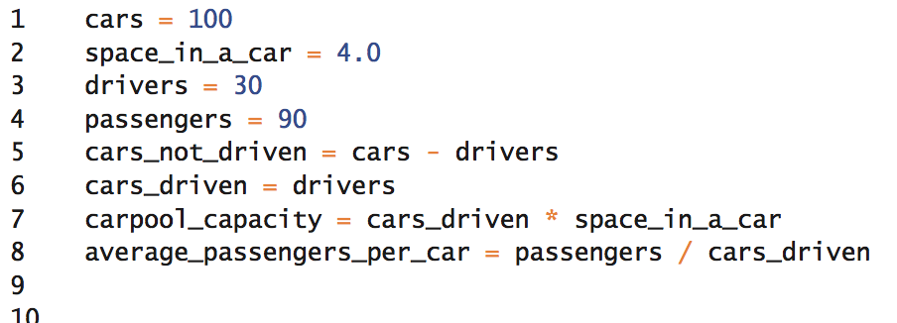
Variables(Review)
Declare the following variables with these values:
Calculate the value for number of passengers per driver.

Slide 8
More Variables(Printing strings)
Python knows you want something to be a string when you put either “” or ‘’, you can use either.
In order to be able to be able to print variables do the following:
string1= things
“This class better teach me %s” %string1

Slide 9
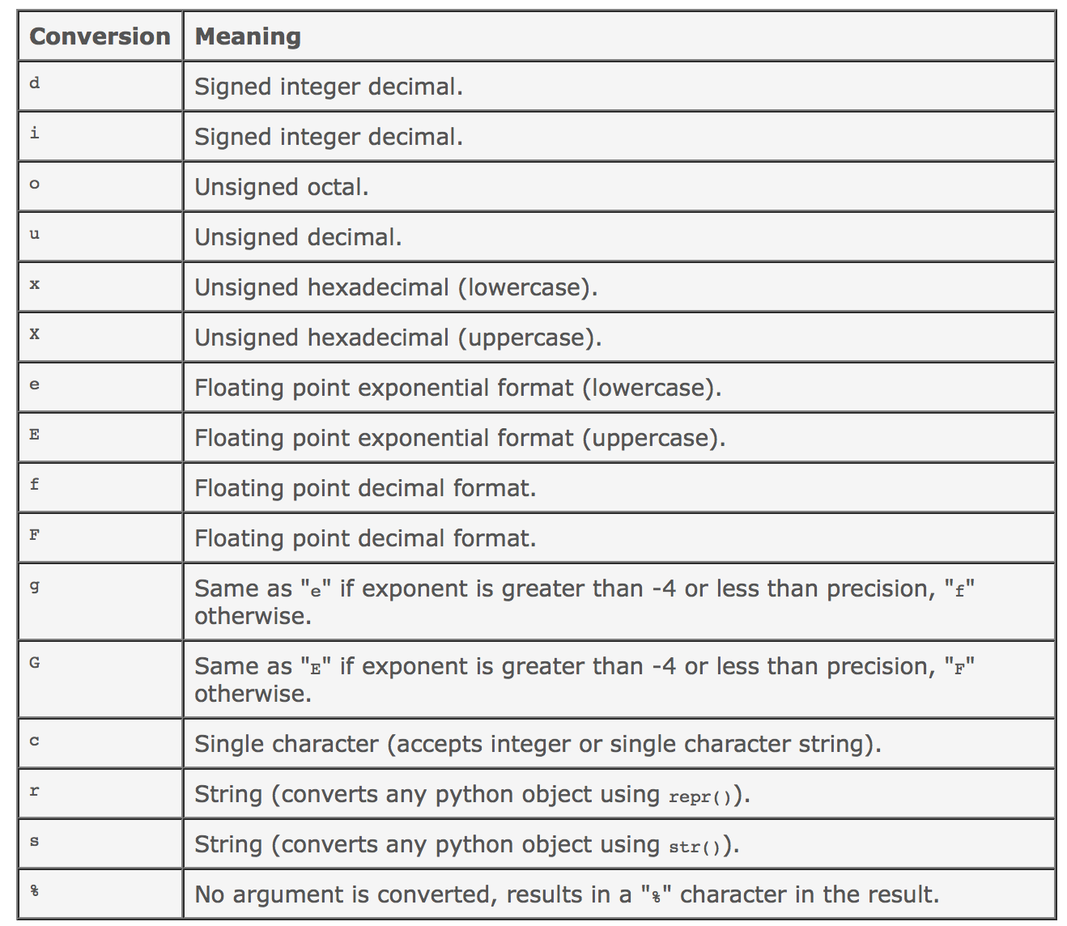
Reference

Slide 10
Printing strings(More than one)
In order to be able to print more than one string you do the following:
my_eyes=“brown”
my_weight=“200”
Print “My eyes are %s and my weight is %d” (my_eyes, my_weight)

Slide 11
Software overview
What does most software do?
Take some kind of input form a user.
Change it or use it in some format(authentication, add to database, etc).
Print out something to show how it changed.

Slide 12
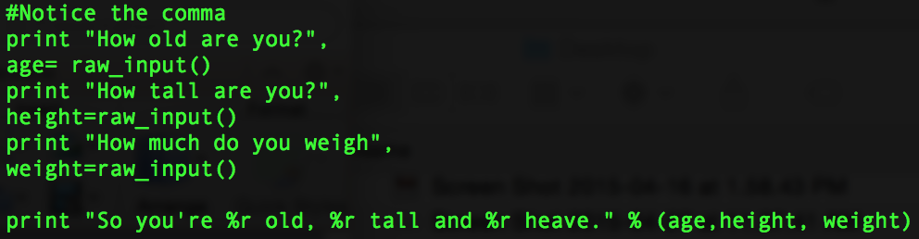
Input(Example)

Slide 13
Input(Example)
After seeing this example, now have your python program prompt for “How many hours have you been in this room(in hours)?” , followed by answering it and then converting it into minutes.

Slide 14
Loops in python
Loops are used in a programming language to iterate n number of times.
Ex: Trying to find the value of each value from 1-10 multiplied by 2?

