Slide 1
An Introduction to Distributed Version Control (DVS)

Slide 2
What is version control?
Version control is a system that records changes to a file or set of files over time so that you can recall specific versions later.
Why?
Code changes often
Hard to do manually (diff and patch)
Clutter free

Slide 3


Centralized Version Control (CVS)
Version Control Server
> Branching & Merging
> Issue Tracking
> Less Overhead
DEV A
DEV B
DEV C
DEV D

Slide 4
Distributed Version Control (DVS)
> Their own VCS
> Same features
as CVS
DEV B
DEV A
DEV C
DEV D

Slide 5

Benefits of using DVS
Extremely Fast
No Canonical copies
Committing locally
Redundancy
Work Offline (More )
R.I.P CVS

Slide 6
DVS Explained
Committed Files
Staged Files
Untracked File or Unstaged Changes

Slide 7

Git Basics
Local git init git add git commit -m git status git log git branch git checkout | Remote git push git pull

Slide 8
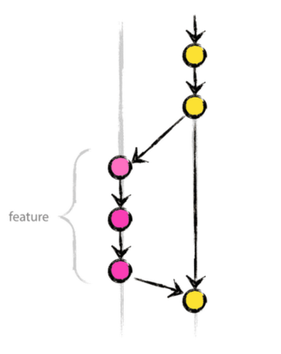
Branching
MASTER
Q: What should you do when you have a crazy idea?
A: You should do “git branching” first because, you don’t want everyone to go crazy in the middle of the night!
ADD a branch to your repo:
git branch crazy_idea
git checkout crazy_idea
(OR)
git checkout –b crazy_idea

Slide 9
Merging
To merge any branch:
git commit –m “added crazy feature”
git checkout master
git merge crazy_idea
To delete the branch:
git branch –d crazy_idea (invisible to others)
git branch –D crazy_idea (delete permanently)
To view conflicts during merge:
git diff <source_branch> <target_branch>

Slide 10
Other useful commands
To connect to a existing repository
git remote add origin <server>
To add all the files in your repo
git add *
Push changes of a branch
git push origin <branch>
Tagging your version numbers using git
git tag 1.0.1 <commit_id>
To drop all changes and start afresh (which you never really want)
“git fetch origin” followed by “git reset –hard origin/master”

Slide 11
Useful Resources
http://rogerdudler.github.io/git-guide/
http://git-scm.com/docs/gittutorial
http://git-scm.com/docs/giteveryday
https://ru.atlassian.com/git/tutorials/setting-up-a-repository

