Slide 1

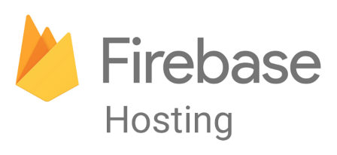
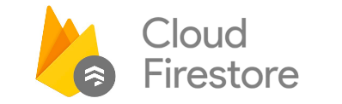

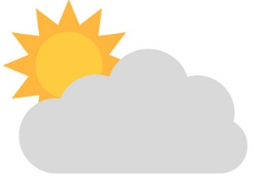
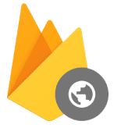
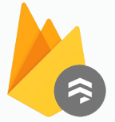
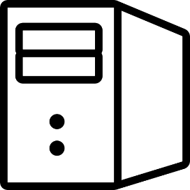
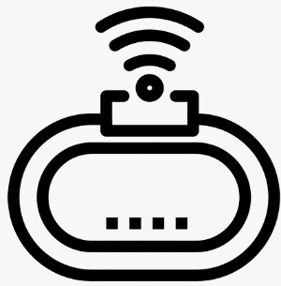

Firebase
DataBase
기상청 API
동네예보조회
Hosting
Cloud Firestore
Client
Node.JS Server
IoT Device

Slide 2
Firebase
DataBase
Firebase
Cloud Firestore
Select
Insert
기상청 API
동네예보조회
Client
Node.JS Server
IoT Device

