Slide 1
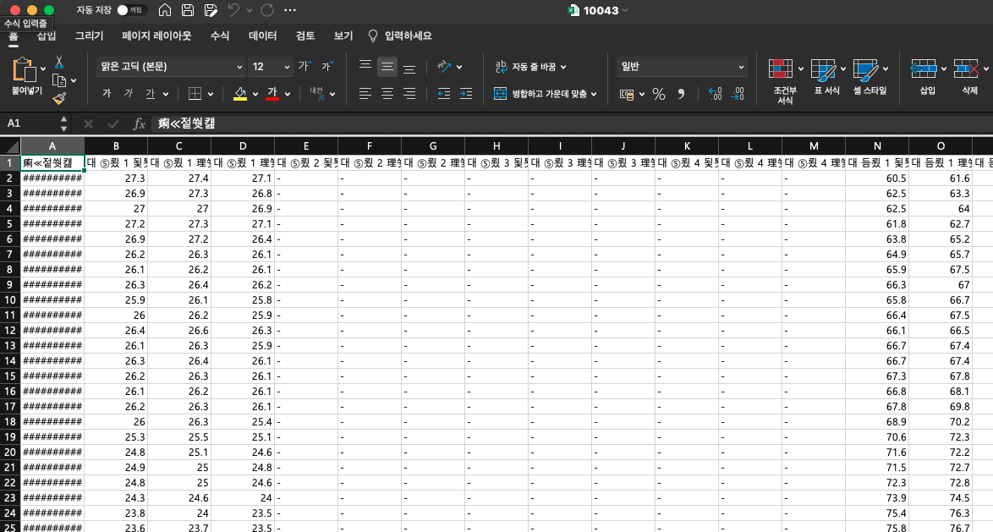
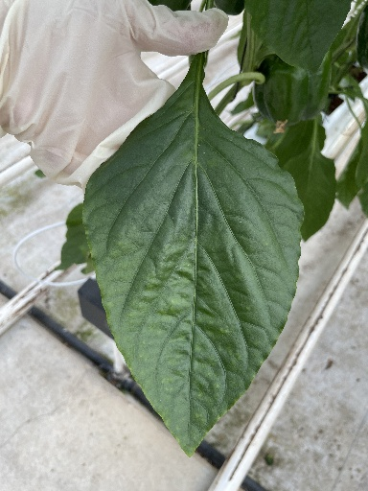
LSTM
hidden_dim=200
num_layer=1
fc 200
fc 25
환경 데이터
RNN
Concatenate
fc 25
CNN
(Efficient Net B0/V2 Small)
Image
Basic CNN2RNN Template

Slide 2
모델 번호 | CNN | Pretrained Weight(CNN) | Pretrained Weight(RNN) | Cutmix | 개별성능
 |  |  |  |  | Public Score | Private Score
1 | V2 Small | Pre-task* | Pre-task* | X | 0.93829543 | 0.94300122
2 |  | ImageNet |  | O | 0.9445167 | 0.94610543
3
4
5
6
7 | B0 |  |  | X | 0.94144398 | 0.94511532
5-Fold Ensemble

Slide 3
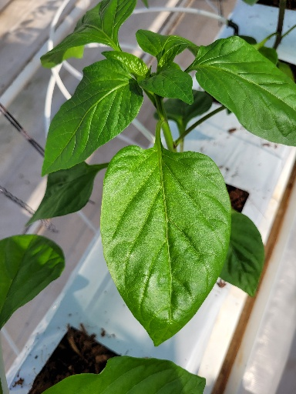
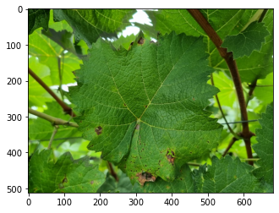
Copy & Paste

Slide 4
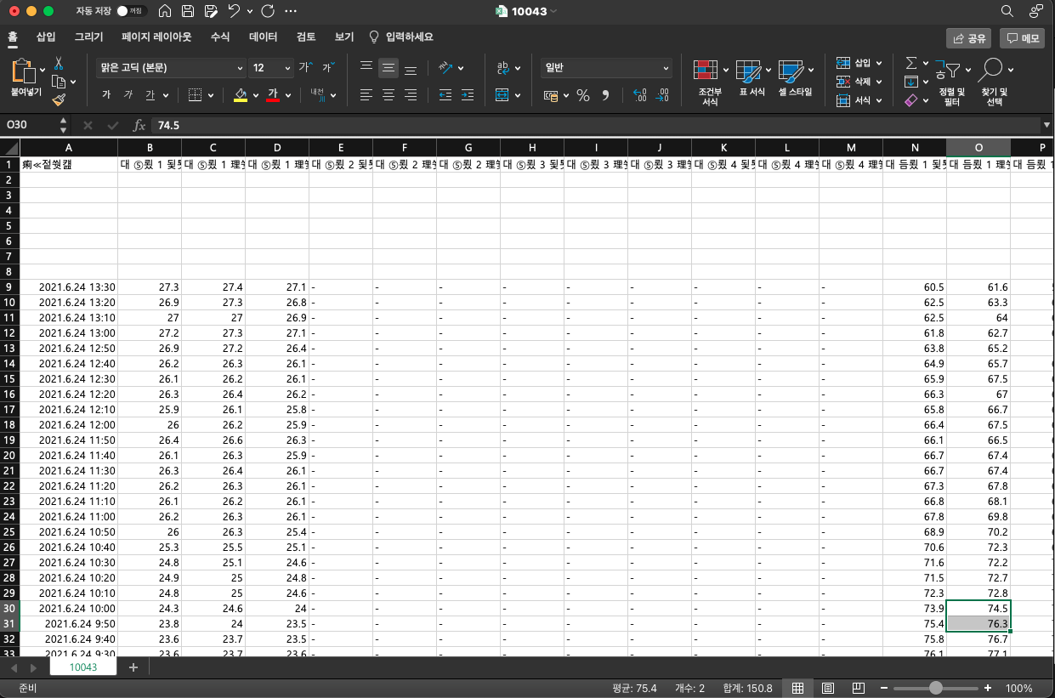
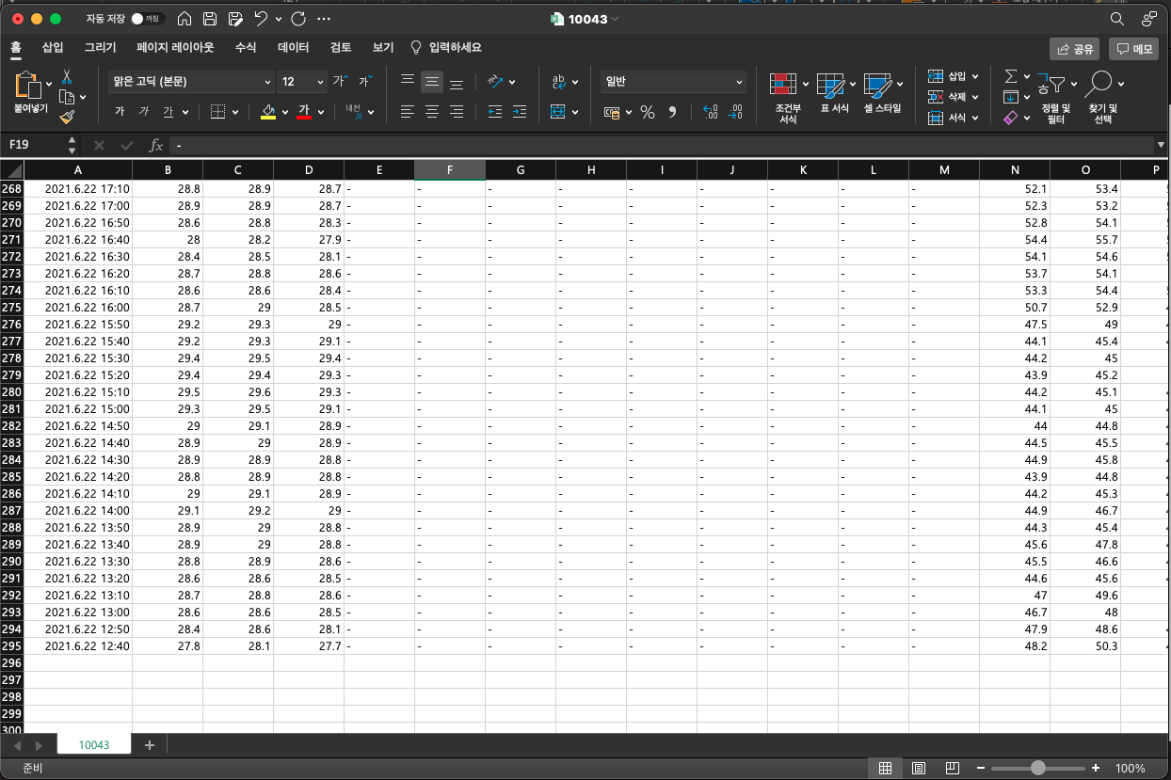
Copy & Paste

