Slide 1
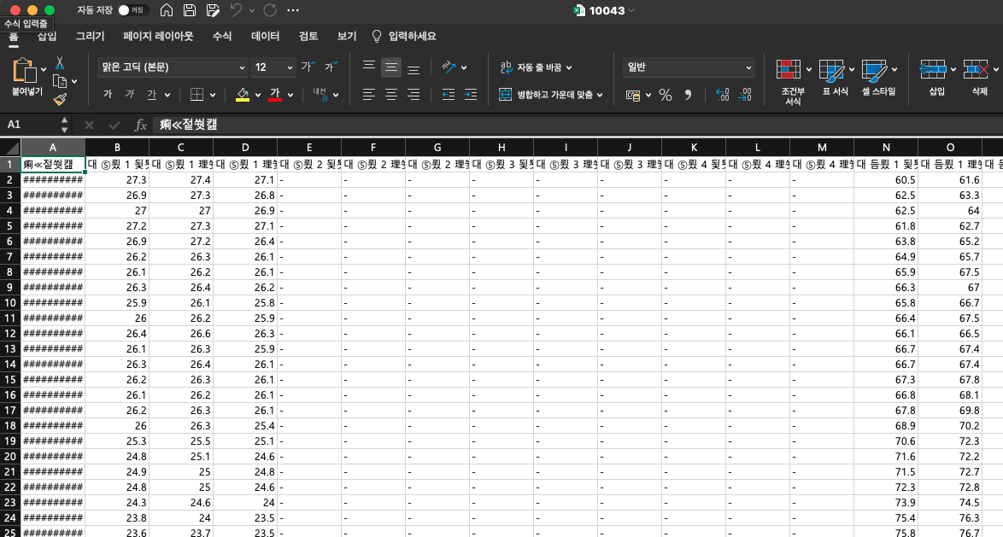
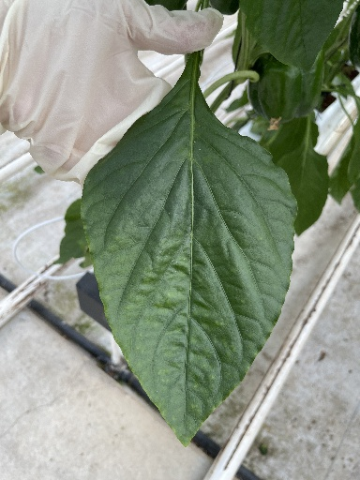
LSTM
hidden_dim=200
num_layer=1
fc 200
fc 25
환경 데이터
RNN
Concatenate
fc 25
CNN
(Efficient Net B0/V2 Small)
Image
Basic CNN2RNN Template

Slide 2
모델 번호 | CNN | Pretrained Weight (CNN) | Pretrained Weight (RNN) | Cutmix | 개별성능 |  | Ensemble(Final Score)
 |  |  |  |  | Public Score | Private Score | Public Score | Private Score
1 | V2 Small | Pre-task* | Pre-task* | X | 0.9382 | 0.9430 | 0.9483 | 0.9530
2 |  | ImageNet |  | O | 0.9445 | 0.9461
3
4
5
6
7 | B0 |  |  | X | 0.9414 | 0.9451
5-Fold Ensemble

Slide 3
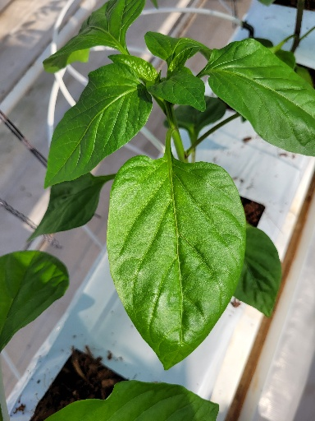
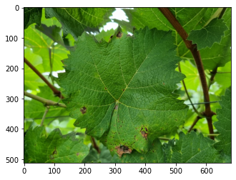
Copy & Paste

Slide 4
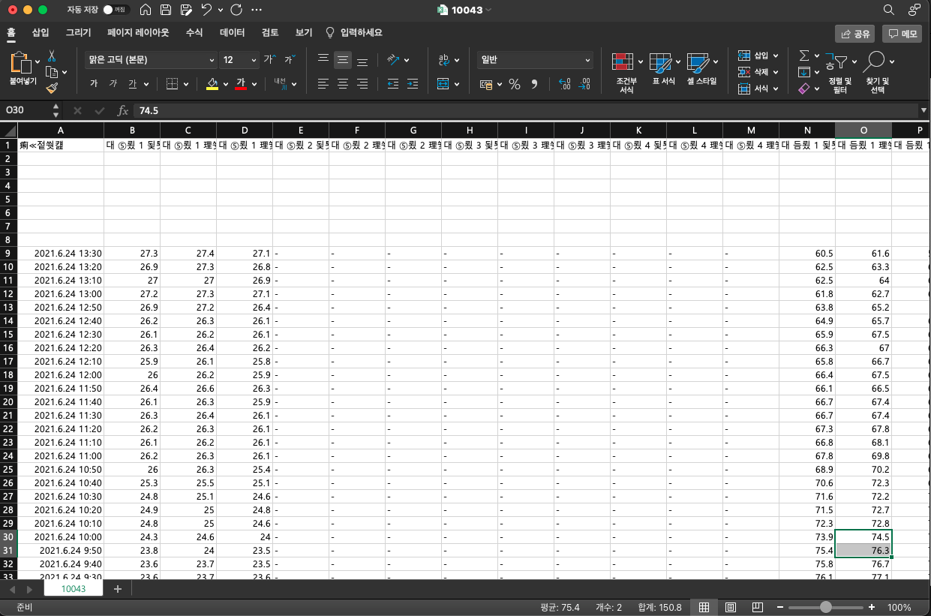
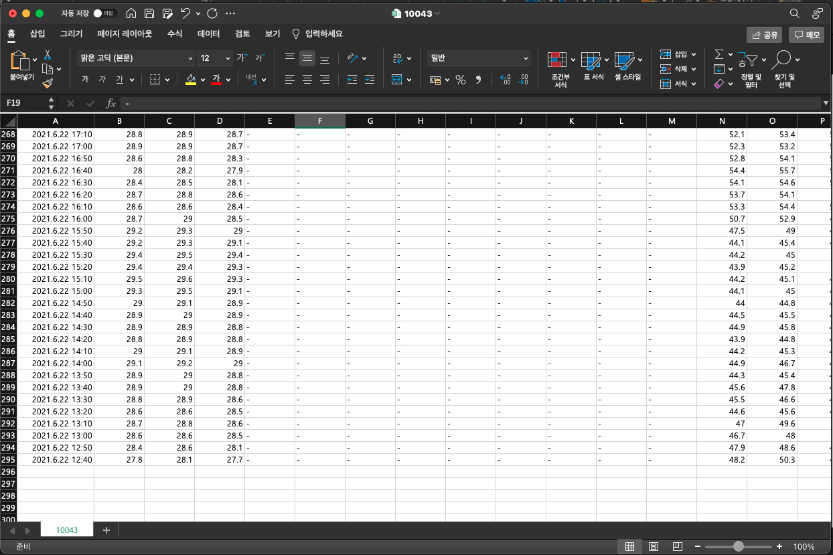
Copy & Paste

