Slide 1
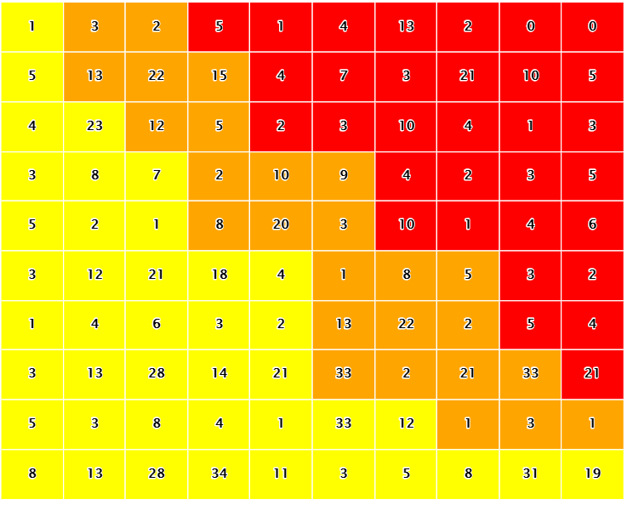
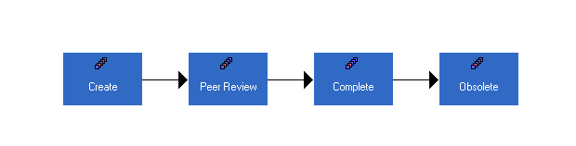









LIST
pFMEA
dFMEA
H
H
LIST
M
M
L
L
L
L
F
F

