Slide 1
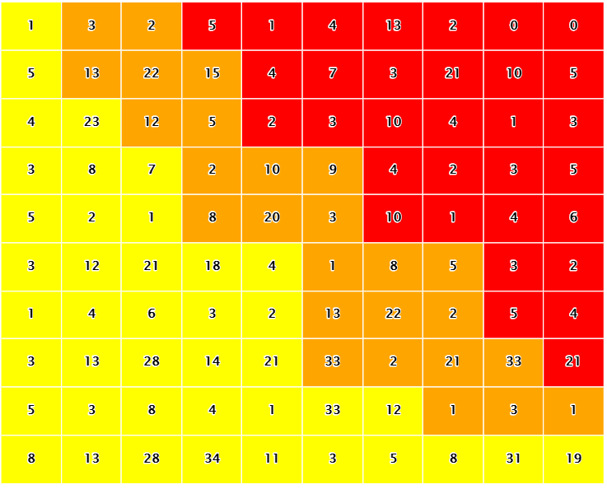
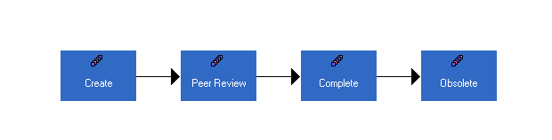






LIST
pFMEA
dFMEA
H
H
LIST
M
M
L
L

