Slide 1



ISOP: Machine Learning-Assisted Inverse Stack-Up Optimization for Advanced Package Design
Hyunsu Chae¹, Bhyrav Mutnury³, Keren Zhu¹, Douglas Wallace³, Douglas Winterberg³, Daniel de Araujo⁴
Jay Reddy³, Adam Klivans² and David Z. Pan¹
¹ECE Department, The University of Texas at Austin
²CS Department, The University of Texas at Austin
³Dell Infrastructure Solutions Group
⁴Electronic Board Systems, Siemens EDA
This work is supported in part by NSF under grants 1718570, 2019844, and 2112665, and by the NSF AI Institute for Foundations of Machine Learning (IFML).

Slide 2
Outline
Motivation
Problem formulation
ISOP framework
Experimental results
Conclusion

Slide 3
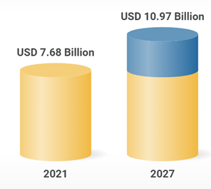
Advanced Package Design and PCB trend
High Density Interconnect (HDI) PCB Market forecast
CAGR 6.1%
Main goal of PCB design is to ensure
component connectivity and communication
Growing demand for
low loss and high-speed HDI PCBs
https://www.researchandmarkets.com/reports/5682545
Motivation
Problem Formulation
ISOP
Results
Conclusion

Slide 4
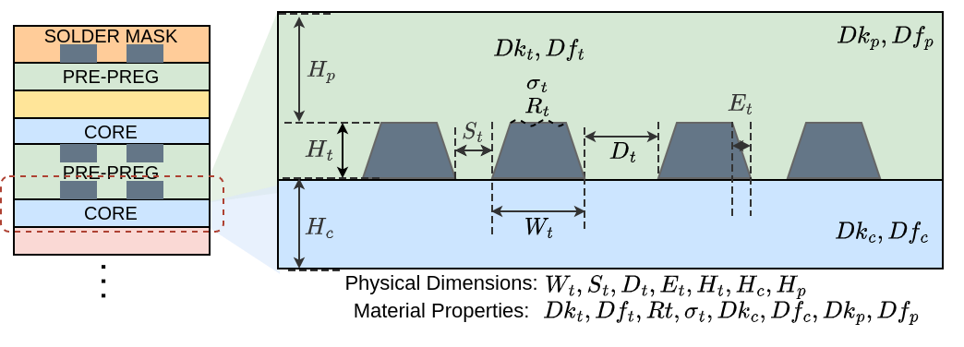
PCB Stack-Up Design Challenges
PCB Stack-up
15+ parameters, big solution space
Different system and technology requires different specifications
Uses computationally expensive EM (electromagnetic) simulations
→ Done manually → time-consuming, tedious and sub-optimal
Motivation
Problem Formulation
ISOP
Results
Conclusion

Slide 5



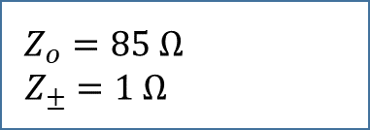
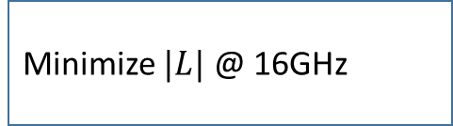
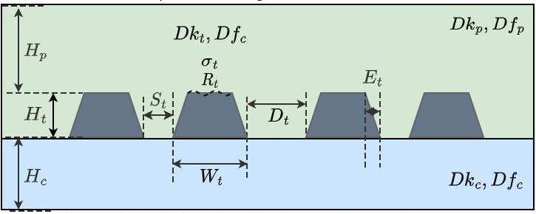

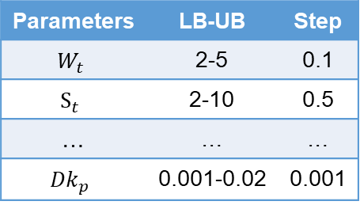
Inverse Stack-Up Design Task
Parameters | LB-UB | Step
$$W_{t}$$ | 2-5 | 0.1
$$S_{t}$$ | 2-10 | 0.5
… | … | …
$${Dk}_{p}$$ | 0.001-0.02 | 0.001
What is the optimal stack-up design?
Motivation
Problem Formulation
ISOP
Results
Conclusion

Slide 6
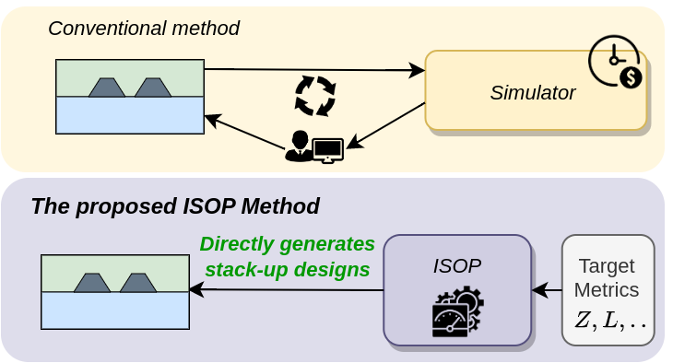


ISOP Framework
ISOP leverages:
1) Hyper-parameter optimization process
2) ML surrogate model
3) Efficient objective function
ISOP could be extended to other scenarios of interconnect optimization
Motivation
Problem Formulation
ISOP
Results
Conclusion

Slide 7
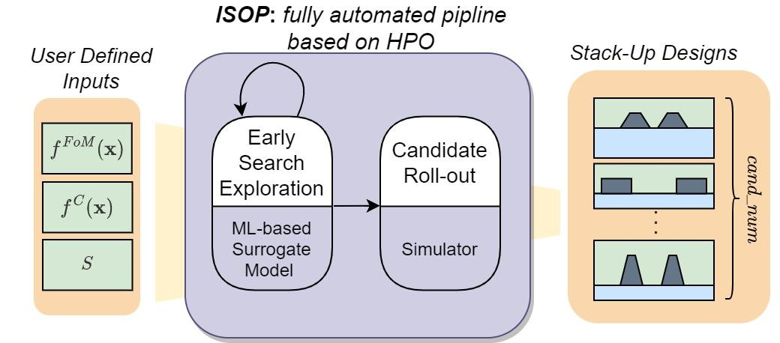




ISOP Framework
Overall flow
Non-convex search space
$$↓$$
Discrete HPO algorithm
(Harmonica)
Runtime overhead
$$g\left(x\right)$$
$$\hat{g}\left(x\right)$$
$$↓$$
ML surrogate model
Multiple different objectives
$$↓$$
Efficient objective function
Motivation
Problem Formulation
ISOP
Results
Conclusion

Slide 8
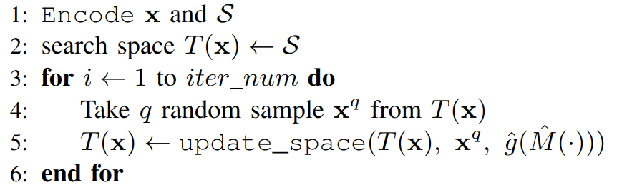
HPO algorithm
Harmonica algorithm
Discrete domain HPO
→ avoid explorations with invalid design parameters
Parallelized design parameter sampling
→ fast and efficient batched evaluation of samples
Motivation
Problem Formulation
ISOP
Results
Conclusion

Slide 9
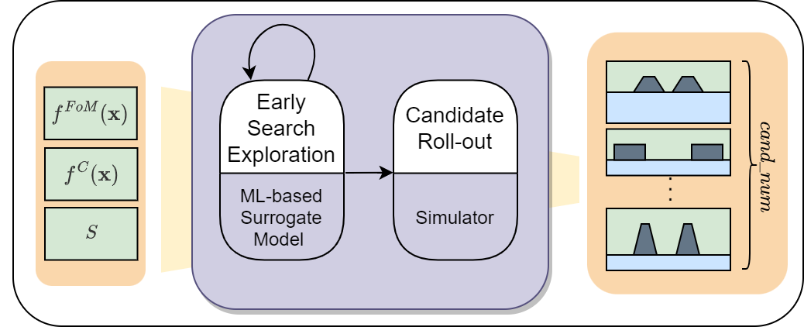
ML Surrogate Model
ML surrogate model replaces expensive EM simulations
Fast query of evaluation metrics -> observe more samples in large search space with reduced runtime
Regression problem with tabular features
90k unique stack-up designs
Preprocessing
One model for each objectives
MAPE/sMAPE
Motivation
Problem Formulation
ISOP
Results
Conclusion

Slide 10

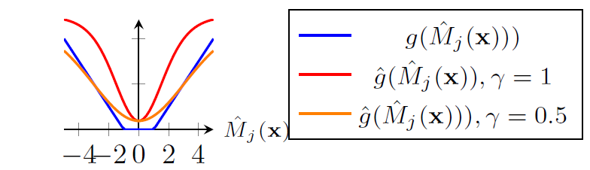

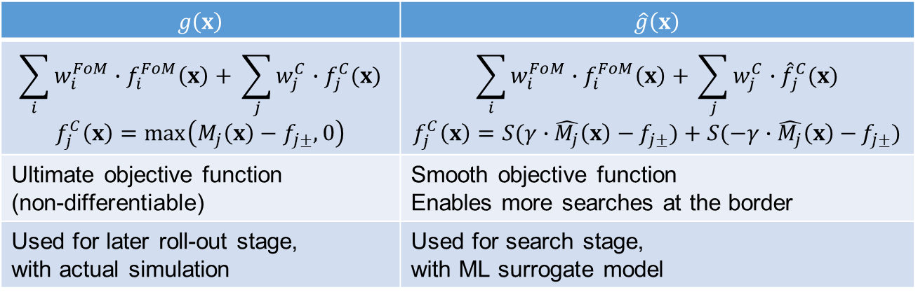
$$x^{∗}=\underset{x∈X}{argmin}{g(x)}$$
Optimization objective functions
$$g\left(x\right)$$ | $$\hat{g}\left(x\right)$$
$$\sum_{i}{w_{i}^{FoM}∙f_{i}^{FoM}\left(x\right)+ }\sum_{j}{w_{j}^{C}∙f_{j}^{C}(x)}$$ $$f_{j}^{C}\left(x\right)=\max\left(M_{j}\left(x\right)−f_{j±}, 0\right)$$ | $$\sum_{i}{w_{i}^{FoM}∙f_{i}^{FoM}\left(x\right)+ }\sum_{j}{w_{j}^{C}∙{\hat{f}}_{j}^{C}(x)}$$ $$f_{j}^{C}\left(x\right)=S(γ∙\hat{M_{j}}\left(x\right)−{f_{j±}})+S(−γ∙\hat{M_{j}}\left(x\right)−{f_{j±}})$$
Ultimate objective function (non-differentiable) | Smooth objective function Enables more searches at the border
Used for later roll-out stage, with actual simulation | Used for search stage, with ML surrogate model
Motivation
Problem Formulation
ISOP
Results
Conclusion

Slide 11
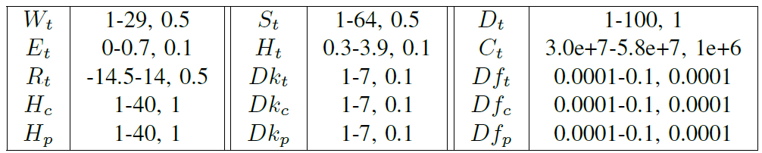
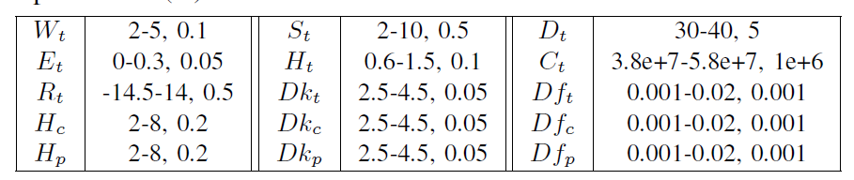
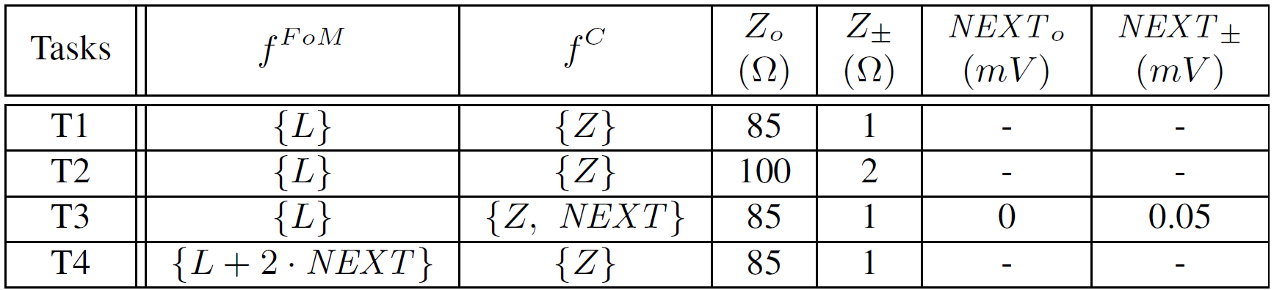


Experiment Setting
ML Training Dataset Space
Experiment Search Space
> ${10}^{29}$
> ${10}^{19}$
Experiment Tasks
Motivation
Problem Formulation
ISOP
Results
Conclusion

Slide 12
Experiments: ISOP vs Baseline
Under similar runtime
Under similar samples seen
Success rate | T1 | T2 | T3 | T4
SA-1 | 1 | 1 | 0.1 | 0.1
BO-1 | 1 | 1 | 1 | 1
ISOP | 1 | 1 | 1 | 1
Success rate | T1 | T2 | T3 | T4
SA-2 | 1 | 1 | 0.2 | 0.1
BO-2 | 1 | 1 | 1 | 1
ISOP | 1 | 1 | 1 | 1
2.41%
2.54%
21.00%
24.97%
3.78%
1.86%
14.95%
13.20%
Motivation
Problem Formulation
ISOP
Results
Conclusion

Slide 13
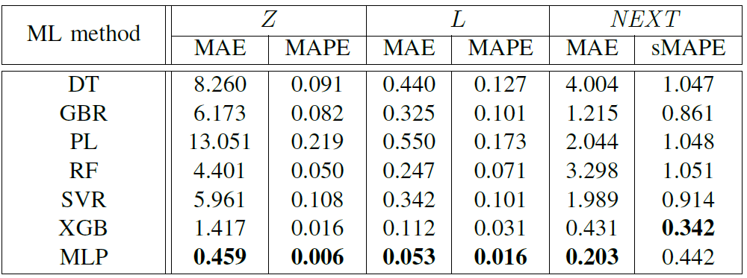
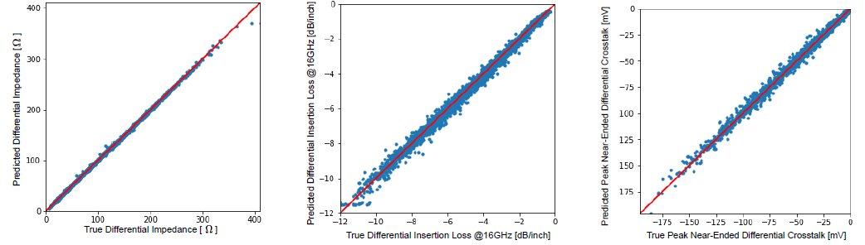
Experiments: ML surrogate model accuracy
Evaluation of trained models
Predicted performance verses ground truth
Motivation
Problem Formulation
ISOP
Results
Conclusion

Slide 14
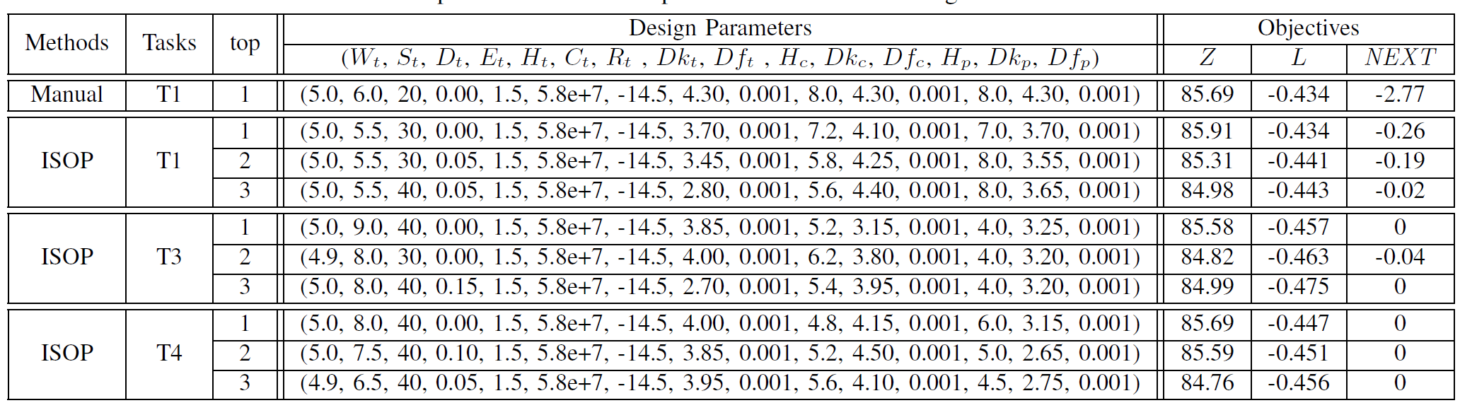
Experiments: Case Study
Example of output
The advantages of our flexible framework will continue to expand to enable global optimization over different performance metrics
Motivation
Problem Formulation
ISOP
Results
Conclusion

Slide 15
Conclusion
ISOP offers agile HDI PCB stack-up design framework, automating the process and producing excellent results in minutes.
Inverse stack-up optimization is formulated as an HPO problem, and accelerated with efficient ML surrogate model and objective function.
ISOP reduces design cycle time from hours to minutes and outperforms baseline methods, as demonstrated in experiments.
ISOP can be extended to other interconnect optimization scenarios.
Motivation
Problem Formulation
ISOP
Results
Conclusion

Slide 16
Thank You

