Slide 1
Claude Code Experience
• Quota: Opus 4 via Max plan ($200/mo); typical session uses 30–60 tool calls; multi-file edits, model runs, and test suites within a single conversation
• Environment: WSL2 Ubuntu + conda (ghim, Python 3.11) + editable install; Claude Code hooks for Telegram notifications (alert bot for milestones, tracker bot for all tool calls); session context files in context/ for cross-session continuity; auto-memory in .claude/projects/ for persistent knowledge

Slide 2
GHIM Energy Module
A Recursive-Dynamic Energy-Economy Model
10 AR6 Regions · 2000–2150 · 5-year timesteps
Hyuntae Choi · February 2026

Slide 3
Motivation & Model Identity
• GHIM: independent energy module, not a GCAM fork — own solver, architecture, and codebase
• Python-first for rapid iteration, transparency, and reproducibility
• Leverages GCAM data infrastructure (fossil supply curves, calibration) while redesigning the modeling approach
• Hybrid design: DICE/WITCH macro-economics + GCAM technology detail + MERGE preference factors
• Target: integration into the full GHIM integrated model (energy + land use + water + climate)

Slide 4
Model Framework — Regions, Periods, Solution Method
Current Implementation
Improvement Directions
Regions: 10 AR6 R10 macro-regions (Africa, Asia-Pacific Dev., Eastern Asia, Eurasia, Europe, Latin America, Middle East, North America, SE Asia & dev. Pacific, Southern Asia)
Time horizon: 2000–2150, 5-year timesteps (31 periods)
Calibration: Historical period 2000–2020 (SSP Historical Reference); model is calibrated at 2020 (TFP, capital stock, technology shares, preference factors)
Projection: 2025–2150 forward-solved with endogenous GDP, trade, technology choice
Solution method: Recursive-dynamic (period-by-period, myopic expectations) — each period solves given current state without anticipating future prices or policies
R10 → Country-level: Current R10 aggregation loses within-region heterogeneity (e.g., India vs. Bangladesh in Southern Asia). Country-level resolution would allow direct calibration to national IEA data and policy analysis at country scale. Requires: country-level SSP data (available), demand calibration, trade matrix expansion.
5-year → 1-year timesteps: Finer temporal resolution improves: (a) stock turnover realism (15-yr vehicle fleet → 3 period steps vs 15), (b) policy phase-in smoothness, (c) investment timing. Trade-off: 6× more periods, solver runtime scales linearly.
Recursive-dynamic → Foresight: Current myopic solver cannot optimize over time. Options: (a) Perfect foresight (full intertemporal optimization, computationally expensive), (b) Imperfect / rolling limited foresight (e.g., 20-year lookahead window, re-solve each period) — captures investment anticipation without full optimization. Key benefit: agents can anticipate carbon price ramps and invest in clean tech earlier.

Slide 5
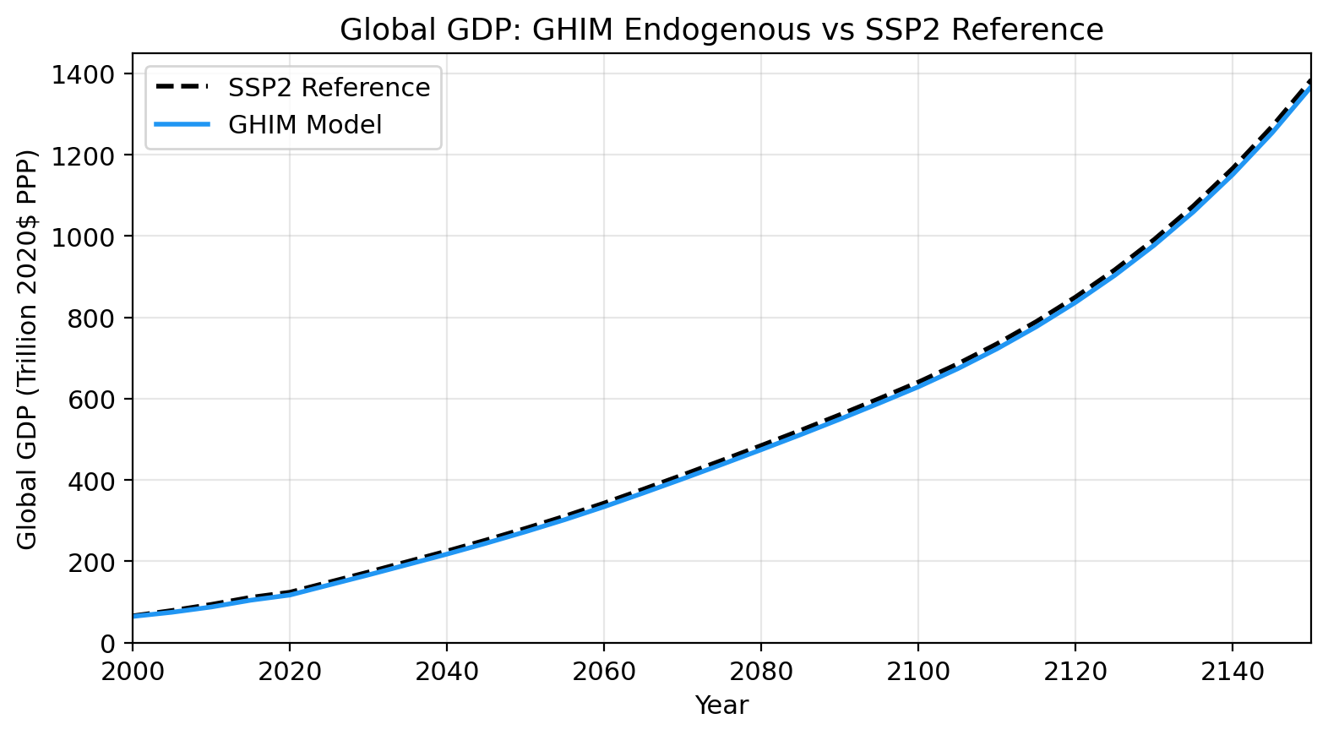
Economic Core — KLEM Production & General Equilibrium
Homogeneous GE with Energy Cost Feedback
Production function: Y = A(t) · K(t)ᵅ · L(t)¹⁻ᵅ (α = 0.3, Cobb-Douglas)
Single representative agent: Each region has one aggregate production function — homogeneous general equilibrium, not multi-sector CGE
Energy as a cost: Net output = Gross output − Energy cost; energy cost = Σ(carrier_demand_EJ × carrier_price_$/GJ)
Capital dynamics: I = s · Y_net (s=0.22), K(t+1) = (1−δ)⁵ · K(t) + I · 5; energy cost shock → lower net Y → lower I → lower future K → lower future GDP
TFP calibration: A(t) calibrated from SSP GDP path via backward K solve (2020→2000) then forward calibration (2020→2150). TFP held fixed during projection — GDP deviates from SSP only through energy cost feedback.
KLEM-sector coupling: KLEM total energy sets the macro envelope; sector demands (industry/buildings/transport) set relative shares; klem_scale = klem_total / sector_sum, clamped to [0.5, 2.0]
Known Issue: Capital Layer Inconsistency
Macro K vs. Sector K: The KLEM aggregate capital stock K (used in Y = AKᵅL¹⁻ᵅ) is a single number per region. But each technology has its own capital_cost ($/kW) embedded in LCOE calculations. These two capital concepts are disconnected.
No adding-up: Σ(tech capital stocks) ≠ K_macro. The macro K governs GDP and investment, while tech-level capex only affects relative costs in the logit. A power plant investment does not draw down from the macro K pool.
Consequence: Energy sector investment can expand without crowding out non-energy capital. This overstates the economy's ability to simultaneously grow GDP and invest in clean energy. A proper fix requires either a multi-sector CGE with capital allocation, or an investment budget constraint linking macro I to sector capex.

Slide 6
Primary Energy Demand — Derived Demand by Sectors
Primary energy demand is not demanded directly — it is derived from final sector demands for energy services. Sectors demand energy carriers (electricity, refined liquids, gas, etc.), and these are traced back through transformation sectors (power generation, refining, hydrogen production) to primary fuel requirements.
Nested Demand Tree (per region)
From Final Demand to Primary Fuel
Final demand sectors (GDP-driven total, income elasticity):
Industry (ε=0.6): heavy (coal/gas/elec), light (elec/gas), data centers (100% elec)
Buildings (ε=0.5): residential (elec/gas/biomass), commercial (elec/gas)
Transport (ε=0.7): passenger (ref. liquids/elec), freight (ref. liquids/gas)
Carrier choices via logit: At each tree node, children compete via relative-preference logit with stock turnover. sᵢ = αᵢ·exp(−k·Pᵢ)·Cᵢᵝ / Σ
6 energy carriers: coal, refined liquids, gas, electricity, biomass, hydrogen
Step 1 — Sector totals: Each sector's total demand scales with GDP: E_sector = E_base × (GDP/GDP_base)^(ε). KLEM coupling then rescales all sectors so their sum matches the macro energy envelope.
Step 2 — Carrier allocation: Within each sector/subsector, logit + stock turnover determines the split across 6 carriers. Result: carrier_demand_EJ per region.
Step 3 — Secondary transformation: • Electricity demand → 8-tech generation mix (coal, gas CC, oil, nuclear, hydro, wind, solar, biomass) → fuel inputs via efficiency • Refined liquids demand → oil refining (η=0.85) → crude oil input • Hydrogen demand → SMR (gas) + electrolysis (elec) → gas/elec inputs
Step 4 — Primary fuel aggregation: Sum all fuel inputs across final demand + electricity + refining + hydrogen: coal = direct_coal + elec_coal_input oil = refining_oil_input + elec_oil_input gas = direct_gas + elec_gas_input + h2_smr_gas_input

Slide 7
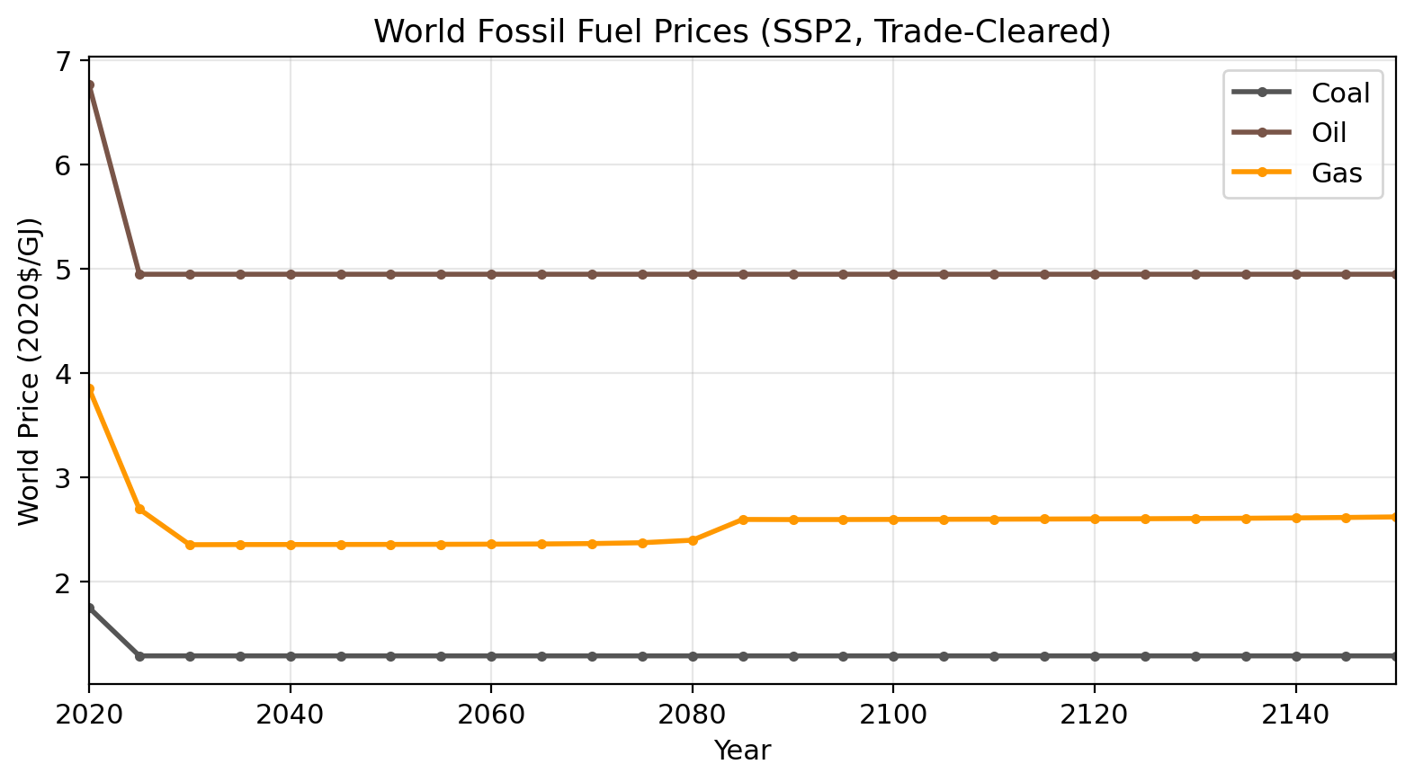
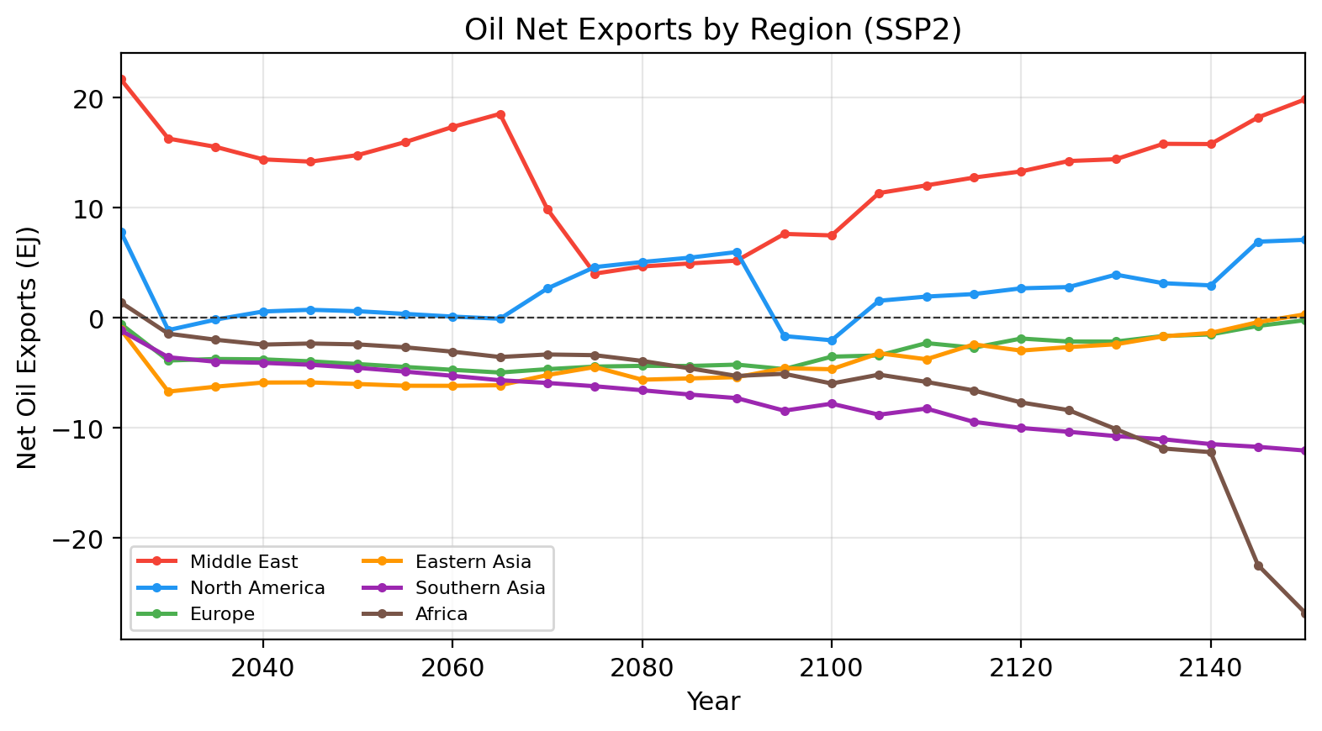
Primary Energy Supply — Resource Curves & Trade Clearing
Grade-Based Supply Curves (per region, per fuel)
Global Market Clearing (coal, oil, gas)
GCAM supply curves: Fossil fuels (coal, oil, gas) modeled as multi-grade supply curves with increasing extraction cost. Each grade has a resource amount (EJ) and an extraction cost ($/GJ). Original data from GCAM R32 regions.
Aggregation pipeline: R32 grades → country-level (GDP-share downscaling) → R10 aggregation. Result: ~3–5 grades per fuel per R10 region.
Piecewise-linear supply: production_at_price(p) ramps linearly between grade boundaries (first grade ramps from p=0). This eliminates step-function discontinuities that cause solver oscillation.
Production cap: max_annual_production = 3× base-year production per region. Prevents unrealistic instantaneous scaling.
Renewables: Wind, solar, hydro, biomass — no resource depletion. Cost determined entirely by technology capital cost + learning curves. Supply is effectively unlimited at the technology's LCOE.
Bisection algorithm: For each fuel, find world price p* such that Σ_r supply_r(p*) = Σ_r demand_r(p*). Price search over [FLOOR=0.1, CEILING=50] $/GJ, tolerance 0.01 $/GJ.
Calibration rents: At base year, observed price often exceeds the supply-curve clearing price (market power, transport costs, taxes). Rent = observed − cleared, locked at 2025, passed as price_adder into bisection. Supply evaluated at extraction_cost + rent; world_price includes rent.
Stabilization mechanisms: • Inter-period price clamping: max 30% price change per 5-year period • Production inertia: max 30% decline per region per period (growth unconstrained) • Demand-trade iteration: up to 10 rounds with 50% damping per period • Warm-start: previous period's cleared prices seed next period's bisection
Net exports: net_exports_r = production_r(p*) − demand_r. Positive = exporter, negative = importer.

