Slide 1

Data Analytics Assignment Adobe Systems Incorporated Customer and Product
Irene Hyunyou Choi January 4, 2018
Presentation format taken from © 2017 Adobe Systems Incorporated.

Slide 2
Executive Summary
Objective of the Presentation and Documentation is to:
Provide basic analysis of the dataset using correlation and Shiny tool;
Describe the analysis process for logistic regression;
Describe the feature selection process using decision tree; and
Discuss the findings attained by basic analysis, logistic regression and decision tree.
Presentation format taken from © 2017 Adobe Systems Incorporated.

Slide 3
Dataset Overview
The Open University Learning Analytics Dataset (“OULAD”) contains data about courses, students and the interactions with Virtual Learning Environment (VLE). The dataset is divided into three schema and further divided into seven csv files. Please see below for the dataset divisions
Module Presentation
Courses;
Assessment;
Vle;
Student-Demographics
StudentInfo;
Student-Activities
StudentRegistration;
StudentAssessment; and
StudentVle.
Name | Observations | Variables | Missing Variable (count)
Assessments.csv | 206 | 6 | date(11)
Courses.csv | 22 | 3
studentAssessment.csv | 173,912 | 5 | score(173)
studentInfo.csv | 32,593 | 12
studentRegistration.csv | 32,593 | 5 | date_registration(45) date_unregistration(22,521)
studentVle.csv | 106,552,806 | 6
Vle.csv | 6,364 | 6 | week_from(5243) week_to(5243)
Presentation format taken from © 2017 Adobe Systems Incorporated.

Slide 4
Dataset Preprocessing
assessments.csv
code_module
code_presentation
id_assessment
assessment_type
date
weight
df_studentVle_v1
studentVle.csv
code_module
code_presentation
id_student
id_site
date
sum_click
assessments_courses
studentInfo.csv
code_module
code_presentation
id_student
gender
region
highest_education
imd_band
age_band
num_of_prev_attempts integer
studied_credits
disability
final_result
courses.csv
code_module
code_presentation
length
df_assessments
studentAssessment.csv
id_assessment
id_student
date_submitted
is_banked
score
df_studentInfo
coursesInfo
vle.csv
id_site
code_module
code_presentation
activity_type
week_from
week_to
studentRegistration.csv
code_module
code_presentation
date_registration
date_unregistration
df_studentReg_v1

Slide 5
Candidate Modeling – Modeling Choice
Method and Description | Advantages | Disadvantages
Linear Regression: A simple regression determining relationship between an independent variable and a dependent variable. | Simple, transparent, straightforward. Low model risk due to low complexity. | Low accuracy in a dataset with large number of variables
Multivariate Regression: A complex version of the Linear Regression that determines relationship between multiple independent variable and a dependent variable. | Relatively simple, transparent, straightforward Able to find relative impact of multiple variables in a dataset | Require all the assumption test Low accuracy
Decision Tree: A decision support tool that uses model of decisions and the possible consequences. | Simple to use Easy to understand if there are not too many branches | Inadequate in applying regression and predicting continuous values Large decision tree with multiple branches are hard to comprehend
Logistic Regression: A regression that measures a correlation for a dichotomous dependent variable for multiple independent variables. | Possible to interpret the relationships of dependent and independent variables | Overfitting Multicollinearity
Presentation format taken from © 2017 Adobe Systems Incorporated.

Slide 6
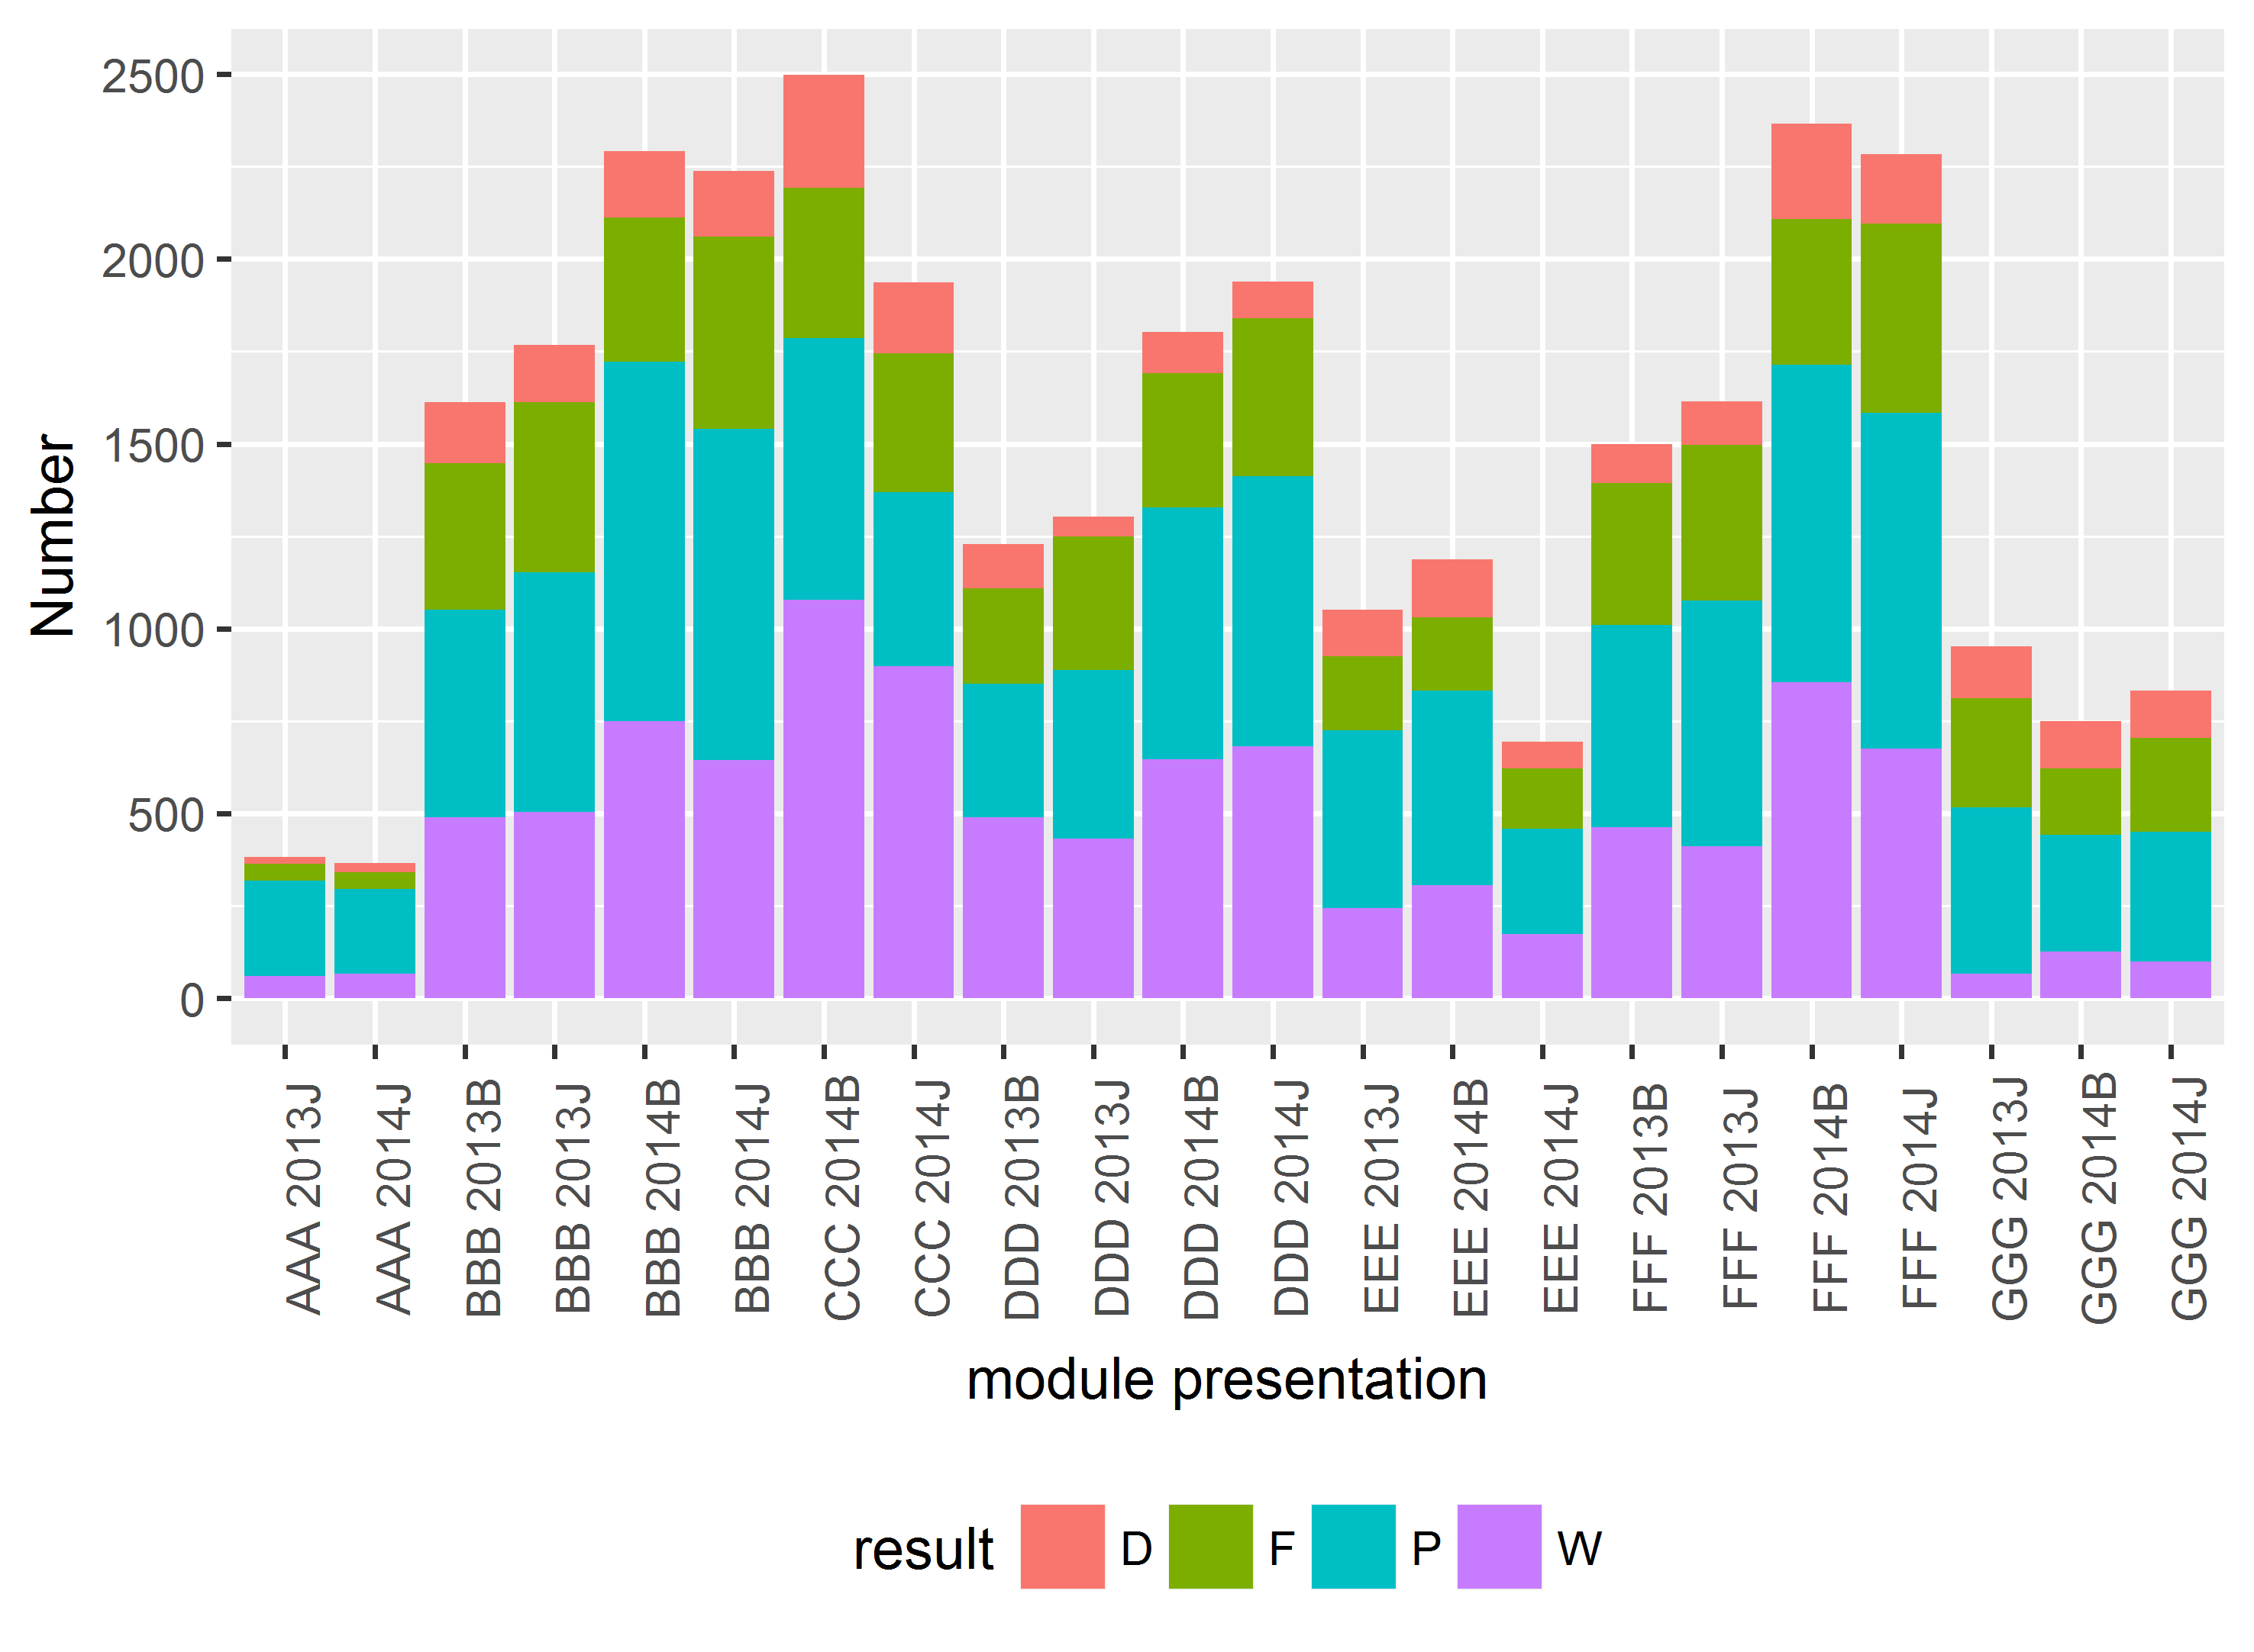
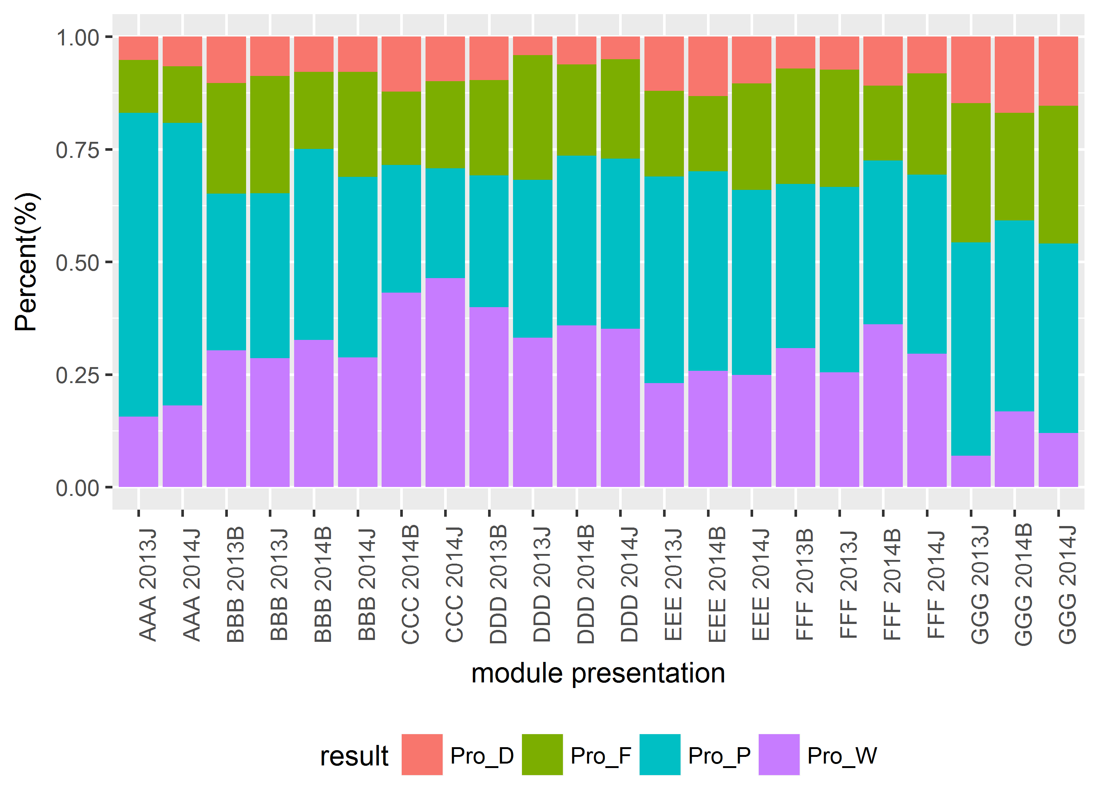
Basic Analysis – Overview and Identification of Top 5
Top five module-presentations for each Final Result
Final Result | First | Second | Third | Fourth | Fifth
Distinction | GGG 2014B | GGG 2014J | GGG 2013J | EEE 2014B | CCC 2014B
Fail | GGG 2013J | GGG 2014J | DDD 2013J | FFF 2013 J | BBB 2013J
Pass | AAA 2013J | AAA 2014J | GGG 2013J | EEE 2013J | EEE 2014B
Withdrawal | CCC 2014J | CCC 2014B | DDD 2013B | FFF 2013 B | DDD 2014B
Presentation format taken from © 2017 Adobe Systems Incorporated.

Slide 7
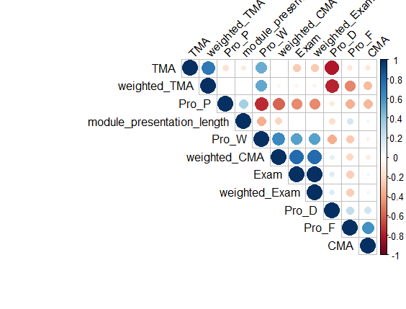
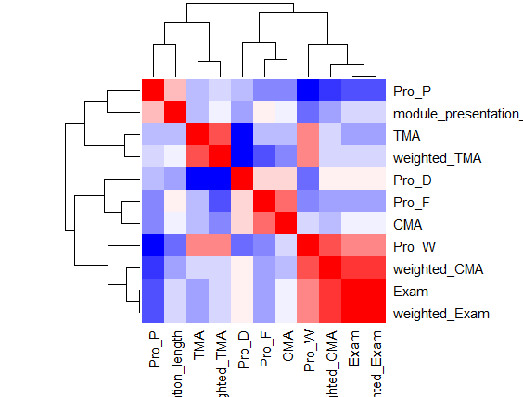
Basic Analysis – Analysis using Top 5
Meaningful results from the Correlation Plot and Heatmap Plot
Weighted proportion of the Computer Marked Assessment (“CMA”) and weighted proportion of the Exam are highly correlated with Student withdrawal.
Number of assessment for TMA has a negative correlation with the distinction student results
Presentation format taken from © 2017 Adobe Systems Incorporated.

Slide 8
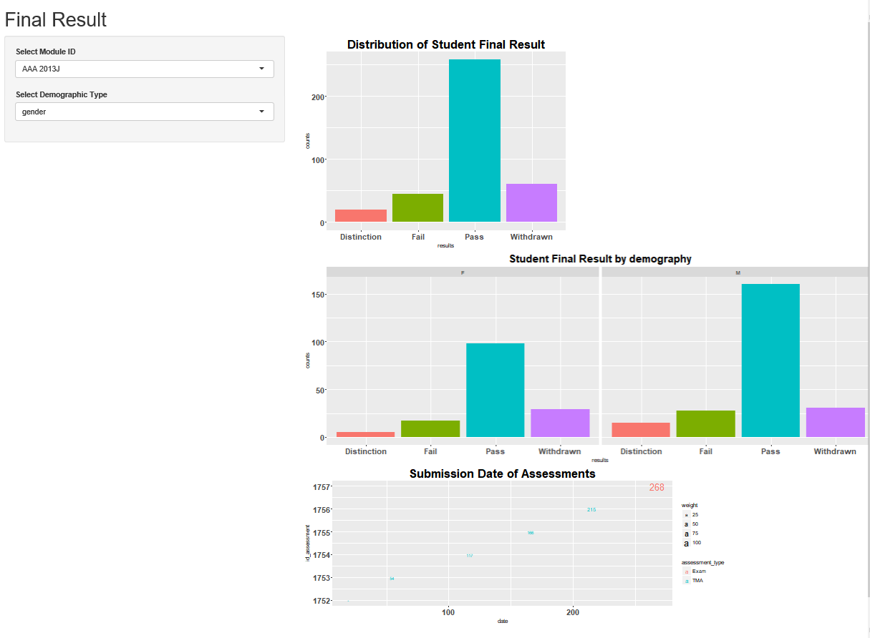
Basic Analysis – Shiny tool
Presentation format taken from © 2017 Adobe Systems Incorporated.

Slide 9
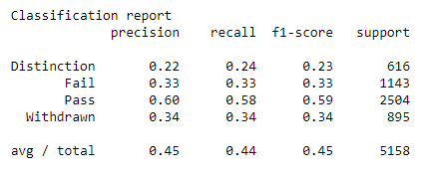
Decision Tree Analysis
Model fit result
Presentation format taken from © 2017 Adobe Systems Incorporated.

Slide 10
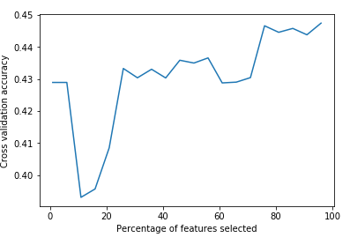
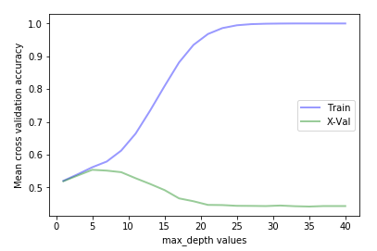
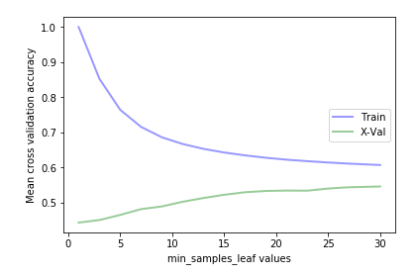
Decision Tree Analysis – Parameter Optimization
1. Feature Selection
The top 30% of the most important feature using a chi2 test.
top four features were “studied_credits”, “count_date”, “sum_click_sum”, and “avg_date_submission”.
2. Best Percentile
3. Max Depth Value
4. Mean Sample Leaf
5. Final result
Accuracy improve from 0.45 to 0.56 after parameter optimization process
Presentation format taken from © 2017 Adobe Systems Incorporated.

Slide 11
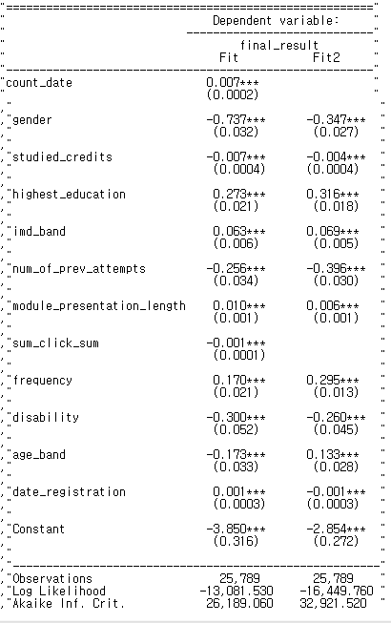
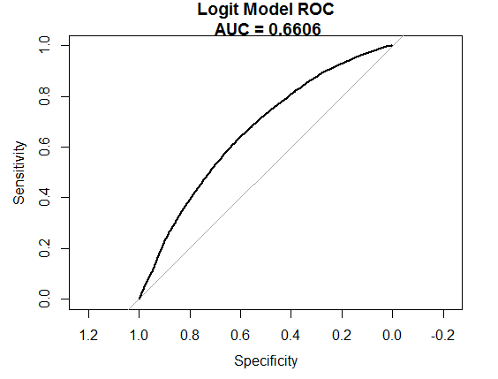
Logistic Regression Analysis
Model Fit
Model Fit
Create binary target variable
Model Fit (Fit)
Multicollinearity test
Fit Model again (Fit 2 –Final Mdoel )
Accuracy test
Stability test (bootstrapping)
Accuracy
Presentation format taken from © 2017 Adobe Systems Incorporated.

Slide 12
Potential ERD Suggestion
studentRegistration.csv
code_module(FK)
code_presentation(FK)
date_registration
date_unregistration
courses.csv
code_module
code_presntation
length
vle.csv
id_site
code_module(FK)
code_presentation(FK)
activity_type
week_from
week_to
studentVle.csv
code_module(FK)
code_presentation(FK)
id_student
id_site(FK)
date
sum_click
studentInfo.csv
code_module
code_presentation
id_student
gender
region
highest_education
imd_band
age_band
num_of_prev_attempts integer
studied_credits
disability
final_result
assessments.csv
code_module(FK)
code_presentation(FK)
id_assessment
assessment_type
assessment_date
weight
studentAssessment.csv
id_assessment(FK)
id_student(FK)
date_submitted
is_banked
score

Slide 13
Conclusion
Assessment type and composition affect to final result.
Based on model development analysis, student performance such as access to VLE, submission the materials on time affect to final result.
Highest education and frequency of access to the VLE have a positive impact on the final result.
A student who is male or has a disability will get low final result than others.
The biggest problem area is data collection process. It need to improve the database structure(ERD) to store the variables more effectively.
Presentation format taken from © 2017 Adobe Systems Incorporated.

