Slide 1
TİK sunum
Hüseyin YÜRÜK

Slide 2
Outline
problem definition
literature
future plan

Slide 3
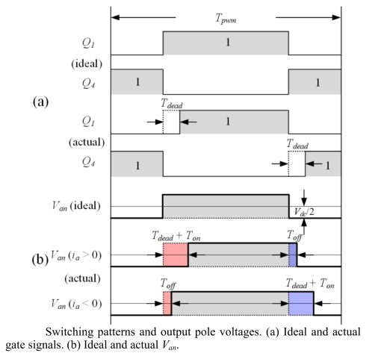
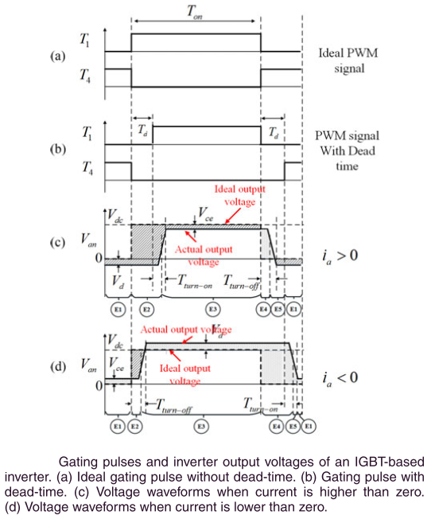
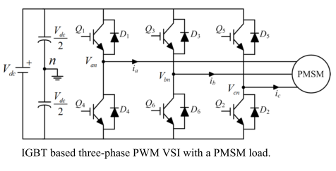
Dead-time
dead time is used to avoid the short circuit of DC link for the three phase PWM-VSI
Notes:
Reference:
Z. Tang and B. Akin, “Compensation of dead-time effects based on revised repetitive controller for PMSM drives,” Conf. Proc. - IEEE Appl. Power Electron. Conf. Expo. - APEC, vol. 32, no. 3, pp. 2730–2737, 2017.
Y. Wang, S. Member, W. Xie, and X. Wang, “Strategy for Voltage Source Inverters,” vol. 65, no. 1, pp. 59–66, 2018.

Slide 4
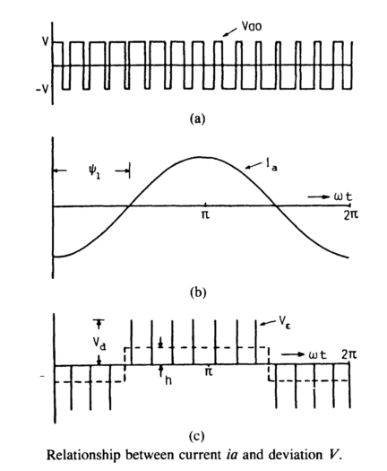
Dead-time
assume deviated pulse V_{Ɛ} is defined as difference between ideal output voltage Vao and actual output voltage Va.
V_{Ɛ} = V_{ao} – V_{a}
V_{Ɛ} = V_{d} * t_{dead} (in simple way)
h * T_{o}/2 = (f_{s} / f_{o}) / 2 * V_{Ɛ}
h = f_{s} * V_{Ɛ}
so as fs ↗ distortion also ↗
effect of the distortion gets more severe when
output frequency fo is low & output magnitude is low
iron and core losses and torque ripple increases
Notes:
Reference:
Y. Murai, T. Watanabe, and H. Iwasaki, “Waveform distortion and correction circuit for pwm inverters with switching lag-times,” IEEE Trans. Ind. Appl., vol. IA-23, no. 5, pp. 881–886, 1987.

Slide 5
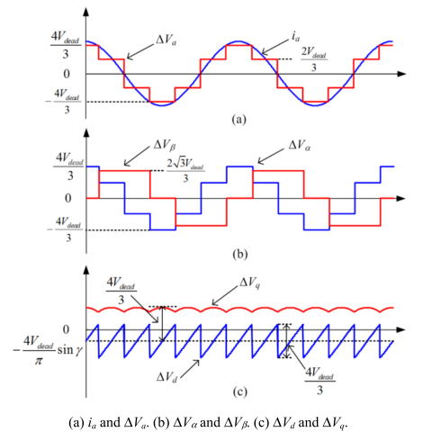

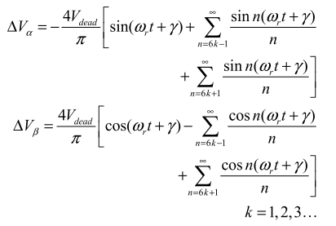
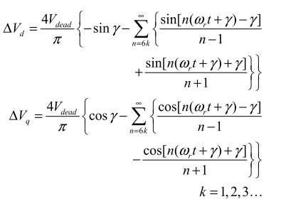
Dead-time
analysis demonstrates that the dead-time effects mainly produce 5th and 7th harmonics in the α-β reference frame and 6th voltage harmonic and its multiples in the d-q reference frame which cause current harmonics
Notes:
Reference:
Z. Tang and B. Akin, “Compensation of dead-time effects based on revised repetitive controller for PMSM drives,” Conf. Proc. - IEEE Appl. Power Electron. Conf. Expo. - APEC, vol. 32, no. 3, pp. 2730–2737, 2017.

Slide 6
literature
various compensation methods have been proposed
hardware based
terminal voltage is measured by analog circuitry and used as a feedback
software based
current harmonic analysis based method
based on monitoring harmonic distortion in the d-axis current
estimator based method
estimators (or observers) are designed to extract the disturbance voltage based on the motor model
instantaneous average voltage method
compensate the average voltage error between reference voltage and actual voltage in each switching period
Notes:
Reference:
Y. Wang, S. Member, W. Xie, and X. Wang, “Strategy for Voltage Source Inverters,” vol. 65, no. 1, pp. 59–66, 2018.

Slide 7
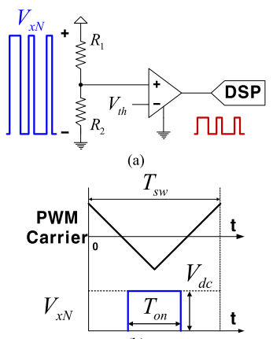
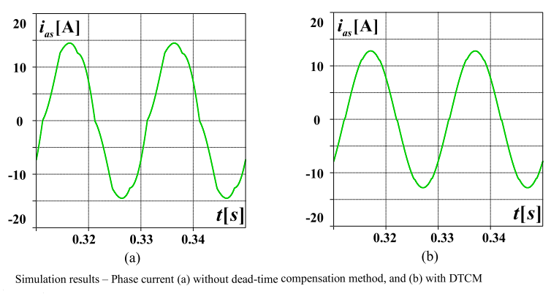
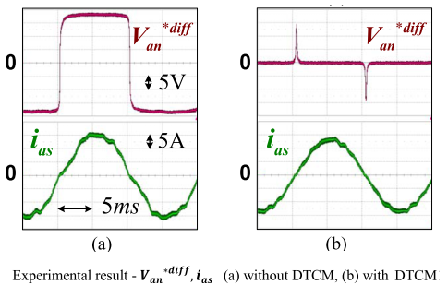
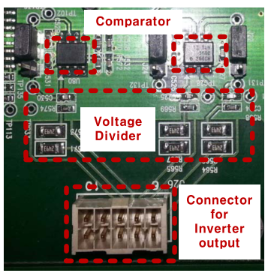
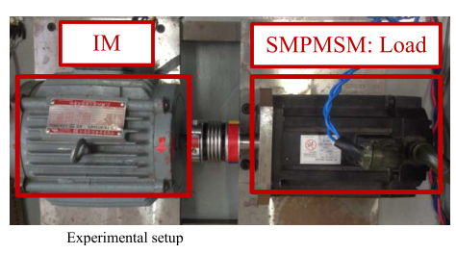
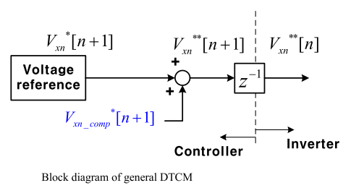
literature
an example of hardware based compensation method
Notes:
Reference:
S. J. Chee, J. Kim, and S. K. Sul, “Dead-time compensation based on pole voltage measurement,” 2015 IEEE Energy Convers. Congr. Expo. ECCE 2015, pp. 1549–1555, 2015.

Slide 8
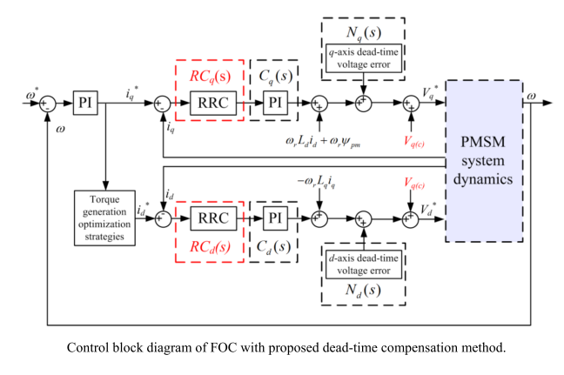
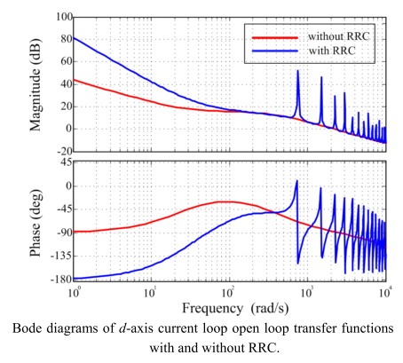
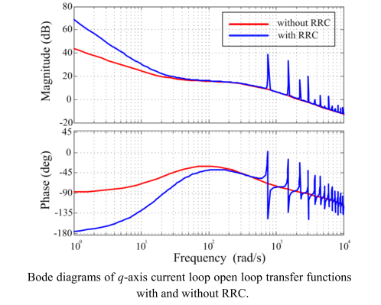
literature
an example of software based compensation method (revised repetitive controller RRC)

Slide 9
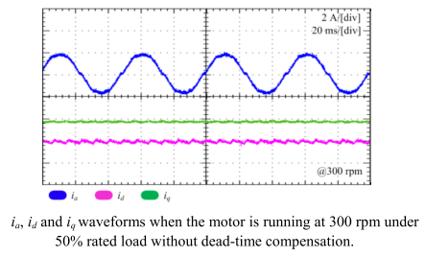
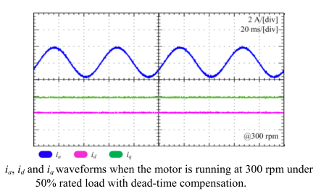
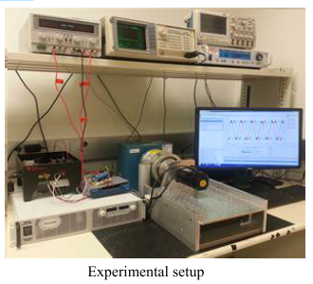
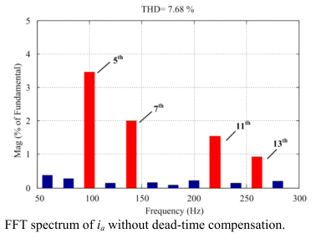
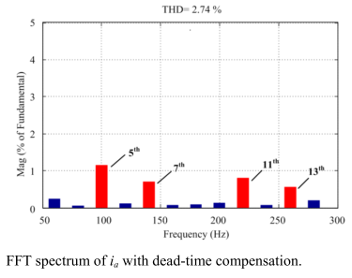
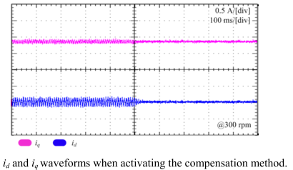
literature
an example of software based compensation method (revised repetitive controller RRC) (cont’d)
Notes:
Reference:
Z. Tang and B. Akin, “Compensation of dead-time effects based on revised repetitive controller for PMSM drives,” Conf. Proc. - IEEE Appl. Power Electron. Conf. Expo. - APEC, vol. 32, no. 3, pp. 2730–2737, 2017.

Slide 10
future plan
the effect of the dead time will be analyzed and investigated for both mosfet and igbt based VSI and for various PMSMs
proposed dead time compensation method will
be software based hence no requirement additional hardware
not need precise current sampling especially in the zero crossing regions
the method will be integrated to the PMSM drive which is controlled by FOC algorithm
the effectiveness of the proposed method will be verified by experimental results and spectrum analysis
the waveforms of the phase, id and iq currents will be compared with and without compensation in the steady state and also during the dynamic process

