Slide 1
TİK May 2018
Hüseyin YÜRÜK

Slide 2
Outline
problem definition
literature
future plan

Slide 3
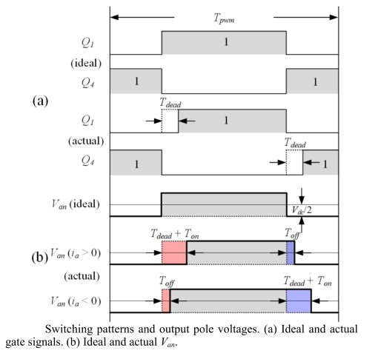
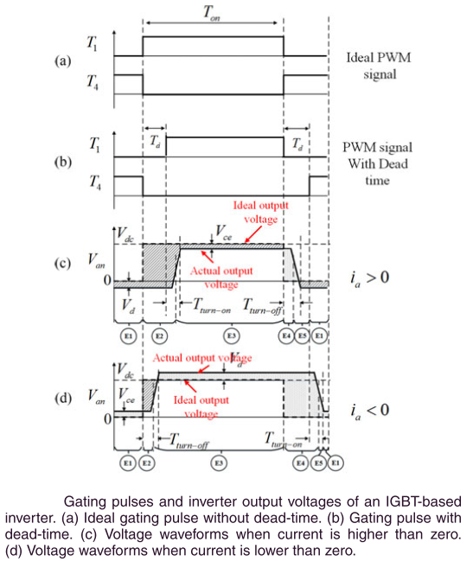
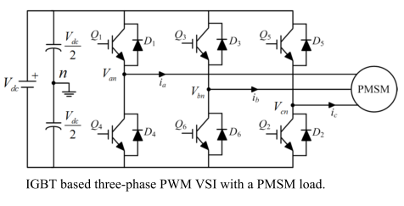
Dead-time
dead time is used to avoid the short circuit of DC link for the three phase PWM-VSI
Notes:
Reference:
Z. Tang and B. Akin, “Compensation of dead-time effects based on revised repetitive controller for PMSM drives,” Conf. Proc. - IEEE Appl. Power Electron. Conf. Expo. - APEC, vol. 32, no. 3, pp. 2730–2737, 2017.
Y. Wang, S. Member, W. Xie, and X. Wang, “Strategy for Voltage Source Inverters,” vol. 65, no. 1, pp. 59–66, 2018.

Slide 4
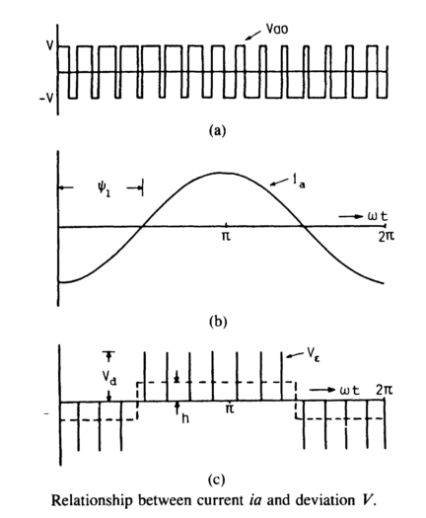
Dead-time
assume deviated pulse V_{Ɛ} is defined as difference between ideal output voltage Vao and actual output voltage Va.
V_{Ɛ} = V_{ao} – V_{a}
V_{Ɛ} = V_{d} * t_{dead} (in simple way)
h * T_{o}/2 = (f_{s} / f_{o}) / 2 * V_{Ɛ}
h = f_{s} * V_{Ɛ}
so as fs ↗ distortion also ↗
effect of the distortion gets more severe when
output frequency fo is low & output magnitude is low
iron and core losses and torque ripple increases
Notes:
Reference:
Y. Murai, T. Watanabe, and H. Iwasaki, “Waveform distortion and correction circuit for pwm inverters with switching lag-times,” IEEE Trans. Ind. Appl., vol. IA-23, no. 5, pp. 881–886, 1987.

Slide 5
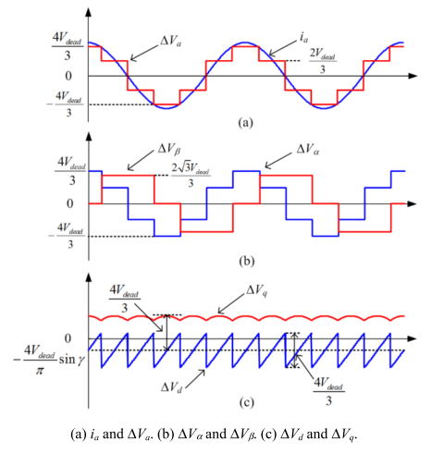

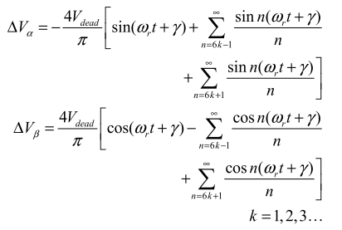
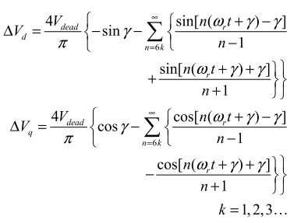
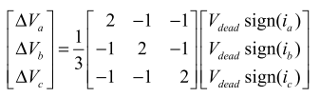
Dead-time
analysis demonstrates that the dead-time effects mainly produce 5th and 7th harmonics in the α-β reference frame and 6th voltage harmonic and its multiples in the d-q reference frame which cause current harmonics
Notes:
Reference:
Z. Tang and B. Akin, “Compensation of dead-time effects based on revised repetitive controller for PMSM drives,” Conf. Proc. - IEEE Appl. Power Electron. Conf. Expo. - APEC, vol. 32, no. 3, pp. 2730–2737, 2017.

Slide 6
literature
various compensation methods have been proposed
hardware based
terminal voltage is measured by analog circuitry and used as a feedback
software based
current harmonic analysis based method
based on monitoring harmonic distortion in the d-axis current
estimator based method
estimators (or observers) are designed to extract the disturbance voltage based on the motor model
instantaneous average voltage method
compensate the average voltage error between reference voltage and actual voltage in each switching period
Notes:
Reference:
Y. Wang, S. Member, W. Xie, and X. Wang, “Strategy for Voltage Source Inverters,” vol. 65, no. 1, pp. 59–66, 2018.

Slide 7
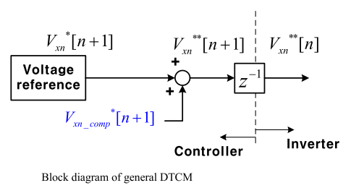
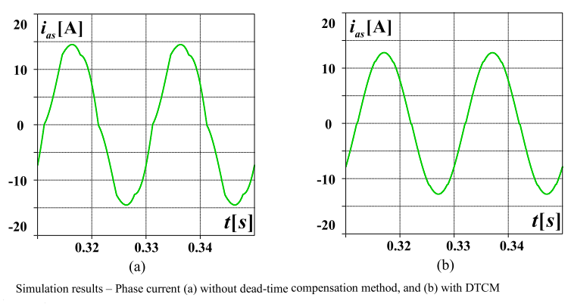
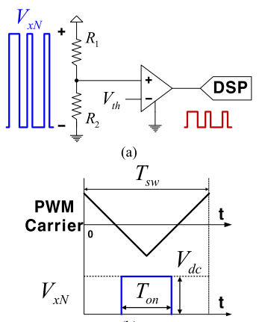
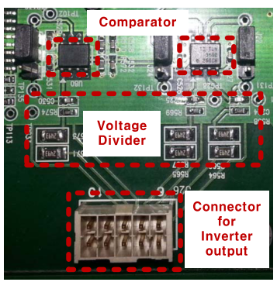
literature
an example of hardware based compensation method
Notes:
Reference:
S. J. Chee, J. Kim, and S. K. Sul, “Dead-time compensation based on pole voltage measurement,” 2015 IEEE Energy Convers. Congr. Expo. ECCE 2015, pp. 1549–1555, 2015.

Slide 8
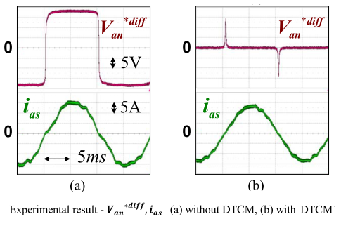
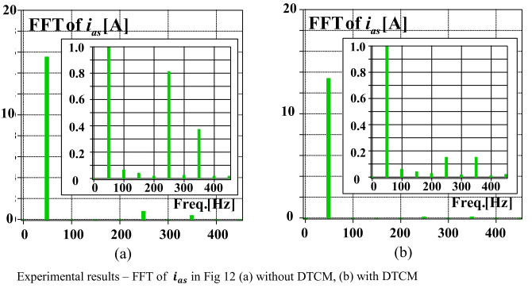
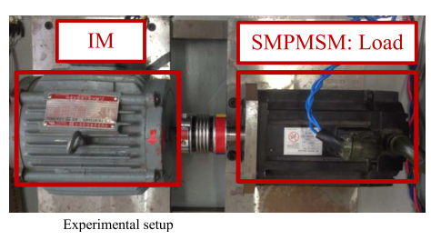
literature
an example of hardware based compensation method (cont’d)
Notes:
Reference:
S. J. Chee, J. Kim, and S. K. Sul, “Dead-time compensation based on pole voltage measurement,” 2015 IEEE Energy Convers. Congr. Expo. ECCE 2015, pp. 1549–1555, 2015.

Slide 9
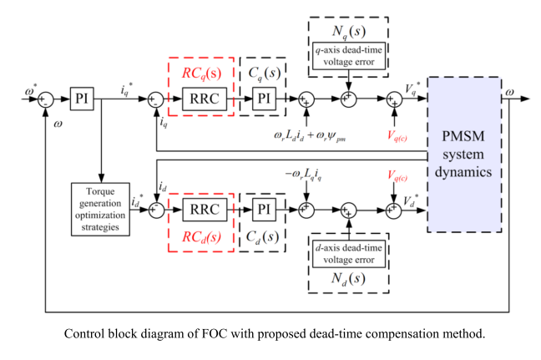
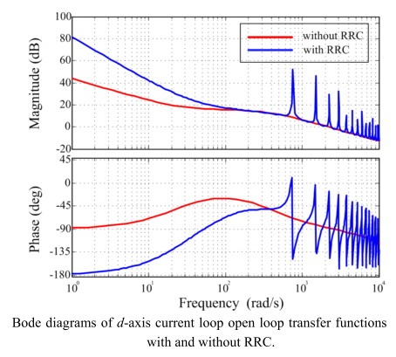
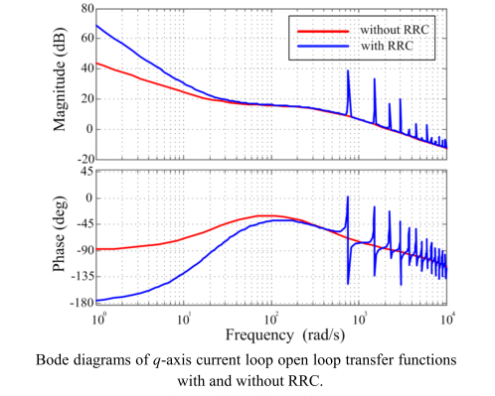
literature
an example of software based compensation method (revised repetitive controller RRC)
Notes:
Reference:
Z. Tang and B. Akin, “Compensation of dead-time effects based on revised repetitive controller for PMSM drives,” Conf. Proc. - IEEE Appl. Power Electron. Conf. Expo. - APEC, vol. 32, no. 3, pp. 2730–2737, 2017.

Slide 10
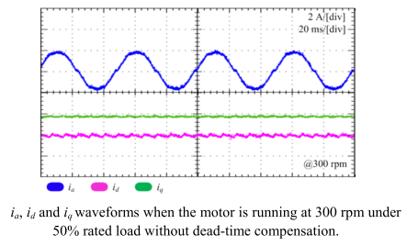
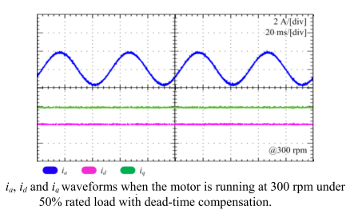
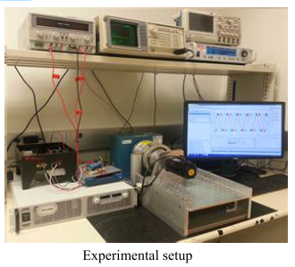
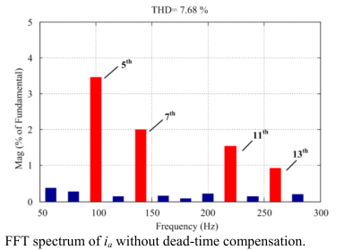
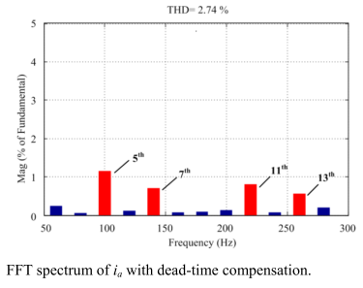
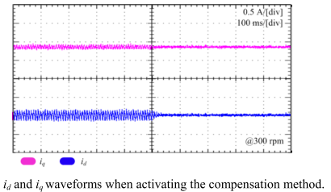
literature
an example of software based compensation method (revised repetitive controller RRC) (cont’d)
Notes:
Reference:
Z. Tang and B. Akin, “Compensation of dead-time effects based on revised repetitive controller for PMSM drives,” Conf. Proc. - IEEE Appl. Power Electron. Conf. Expo. - APEC, vol. 32, no. 3, pp. 2730–2737, 2017.

Slide 11
future plan (up to next tik)
the effect of the dead time will be analyzed and investigated for both mosfet and igbt based VSI and for various PMSMs
some of the literature compensation methods will be applied by experimentally and the results will be observed
a dead time compensation method will be proposed and the method will
be software based hence no requirement additional hardware
not need precise current sampling especially in the zero crossing regions
the method will be integrated to the PMSM drive which is controlled by FOC algorithm
the effectiveness of the proposed method will be verified by experimental results and spectrum analysis
the waveforms of the phase, id and iq currents will be compared with and without compensation in the steady state and also during the dynamic process

Slide 12
future plan
up to next year
 | 2018 |  |  |  |  |  |  | 2019
 | June | July | August | September | October | November | December | January | February | March | April | May
analyze & investigate the dead-time effect on the VSIs for various PMSMs | x | x
apply the literature compensation methods by experimentally |  | x | x
propose a software based dead time compensation method |  |  | x | x
verify the effectiveness of the method by experimental results |  |  |  | x | x
submit the results of the proposed method to a conference (*) |  |  |  |  | x | x
model the VSI and PMSM and simulate the proposed method |  |  |  |  |  |  | x | x
improve the method and verify with both simulation and experimental |  |  |  |  |  |  |  |  | x | x
submit the results of the proposed method to a journal (**) |  |  |  |  |  |  |  |  |  |  | x | x

Slide 13
future plan
(*) candidate conferences
2019 IEEE 13th International Conference on Power Electronics and Drive Systems (PEDS), France
Abstract Submission Deadline: 15 Nov 2018, Conference Date: 09-12 Jul 2019
2019 21st European Conference on Power Electronics and Applications (EPE '19 ECCE Europe), Italy
Abstract Submission Deadline: 15 Nov 2018, Conference Date: 02-05 Sep 2019
2019 10th International Conference on Power Electronics and ECCE Asia (ICPE 2019 - ECCE Asia), Korea (South)
Abstract Submission Deadline: 13 Oct 2018, Conference Date: 27-31 May 2019
2019 IEEE 13th International Conference on Compatibility, Power Electronics and Power Engineering (CPE-POWERENG), Denmark
Abstract Submission Deadline: 16 Nov 2018, Conference Date: 23-25 Apr 2019
2019 International Aegean Conference on Electrical Machines and Power Electronics (ACEMP) & 2019 International Conference on Optimization of Electrical and Electronic Equipment (OPTIM), Turkey
Draft paper submission deadline：2019-03-20, Conference Date: 02-04 Sep 2019

Slide 14
future plan
(**) candidate journals
Power Electronics Magazine, IEEE
Power Electronics, IEEE Transactions on
Industrial Electronics Magazine, IEEE
Industry Applications, IEEE Transactions on
Industry Applications Magazine, IEEE
Notes:
No Open Access

Slide 15
thank you

