Slide 1
Compensation of Nonlinearities of the Voltage Source Inverters for High Precision Position Control Applications
Hüseyİn YÜRÜK
TİK DECEMBER 2018

Slide 2
Outline
problem definition
motivation
experimental works
literature
future plan

Slide 3
problem definition
following nonlinearities cause distortion on the output voltage of the VSI
dead-time
switching time
delay time
voltage drops on the power switch and the freewheeling diode
parasitic capacitance of the power switch

Slide 4
problem definition
output voltage distortion causes
low order harmonic components in the output current of the inverter
deformation of the phase currents, especially in the current zero-crossing region
these distortions
effects the control performance of the applications that require low speed & low torque
degrades the efficiency and increases the torque ripple
As the switching frequency increases effect of
dead-time
switching time of power switch / gate driver
delay time of the power switch / gate driver
will also increases.
But, to get high current control bandwidth, higher switching frequency is needed, especially to control low inductance motors

Slide 5
motivation
High performance VSI-fed PMSM motor drive can be achieved by having high current control bandwidth where effect of the VSI nonlinearities are lowered
High performance VSI-fed PMSM motor drive will be more crucial for the applications which have the following properties:
low magnitude dc link
low torque
low inductance machine
high precision position control
for ex. gimbal applications (rf, optic etc.), robot arm, optic stabilizer, CNC machines, active vibration canceller etc.

Slide 6
Experimental works
analysis demonstrates that the nonlinear effects mainly produce 5th and 7th harmonics in the α-β reference frame and 6th voltage harmonic and its multiples in the d-q reference frame which cause current harmonics
to observe current harmonics in the phase current and also in the d-q reference frame currents, an air cored (ironless winding) low inductance servo motor is driven by MOSFET based PWM VSI inverter at open loop

Slide 7
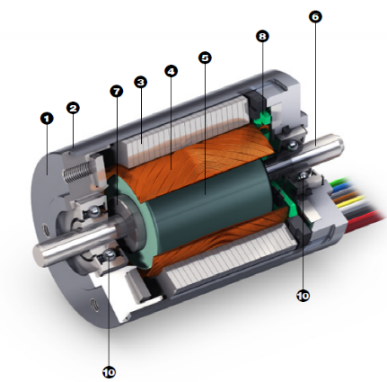

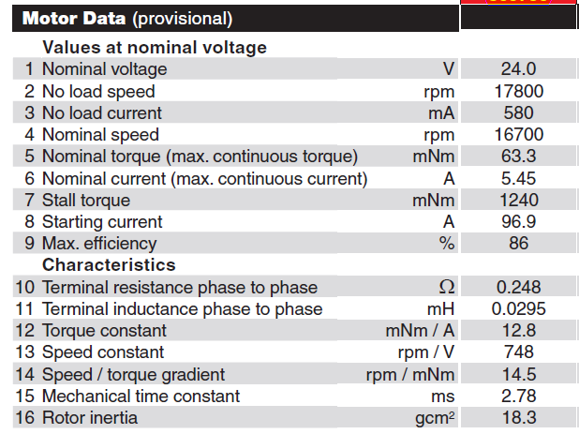
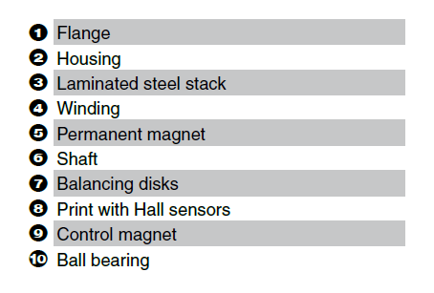
Experimental works
motor parameters

Slide 8
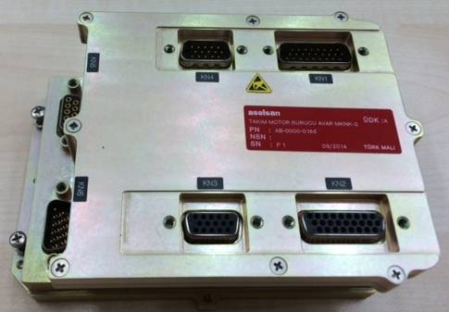
Experimental works
MOSFET based PWM VSI inverter parameters:
AVAR servo driver (REHİS-MMTM design)
Input voltage 18-50VDC
5Arms output current
Resolver, QEP, Hall, Abs Encoder feedback
CAN, RS422, Ethernet communication
ΔΣ phase current sensing
MOSFET (SUM90N10), gate driver (IRS2336D)
TMS320F28235 DSP

Slide 9
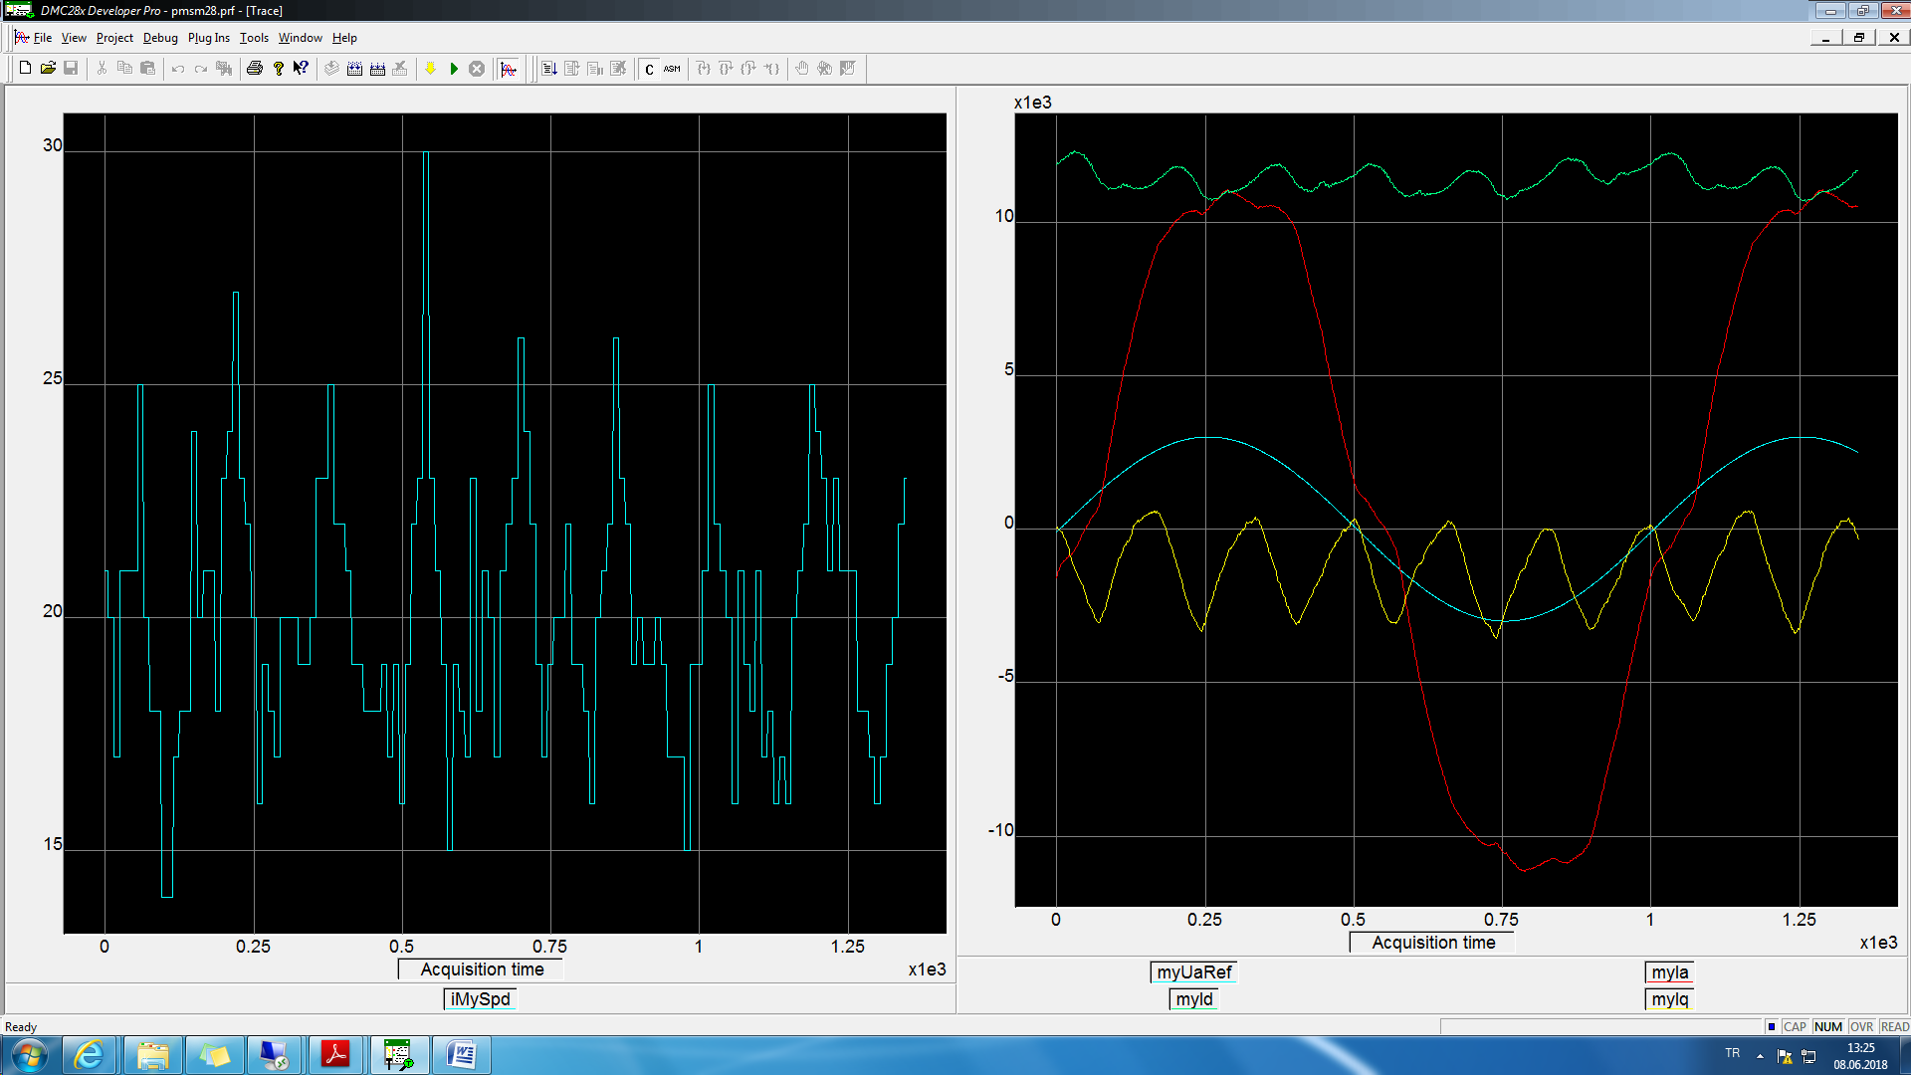
Experimental works
left figure motor speed, right figure blue phaseA pwm reference, red phaseA, green Id, yellow Iq current @10Hz speed @open loop

Slide 10
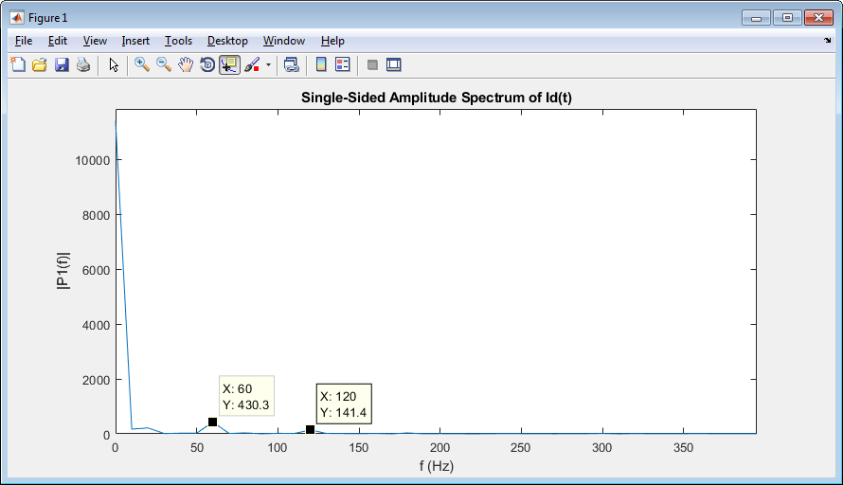
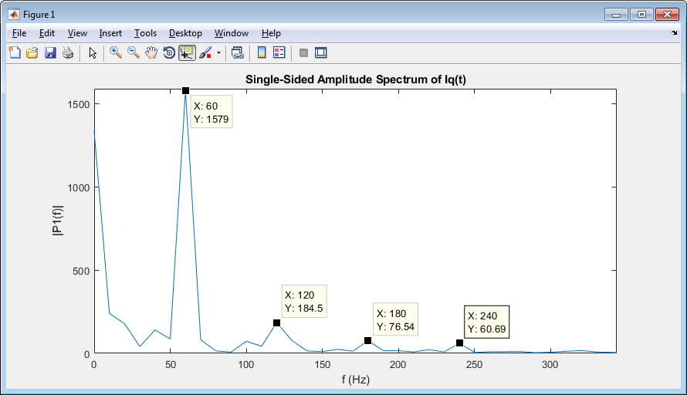
Experimental works
Id & Iq current, FFT analysis @10Hz speed @open loop

Slide 11
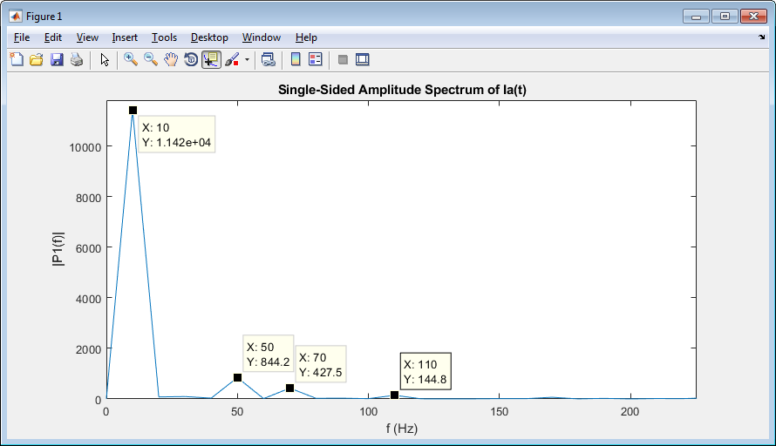
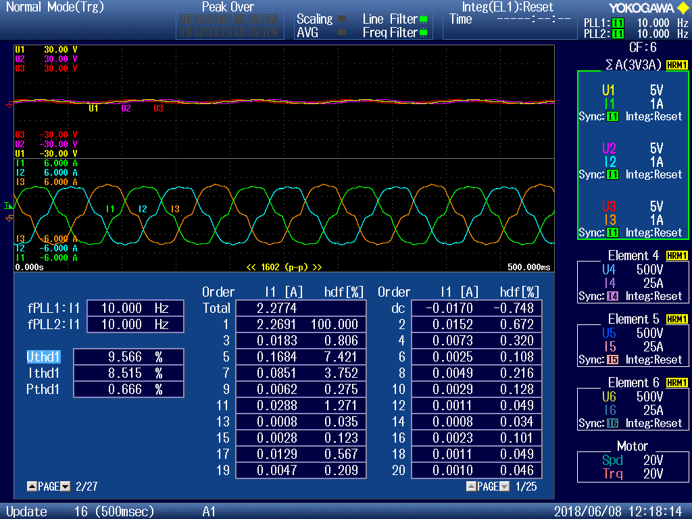
Experimental works
phaseA current, FFT analysis @10Hz speed @open loop
phase voltage and currents, and current harmonic distortions @10Hz speed @open loop

Slide 12
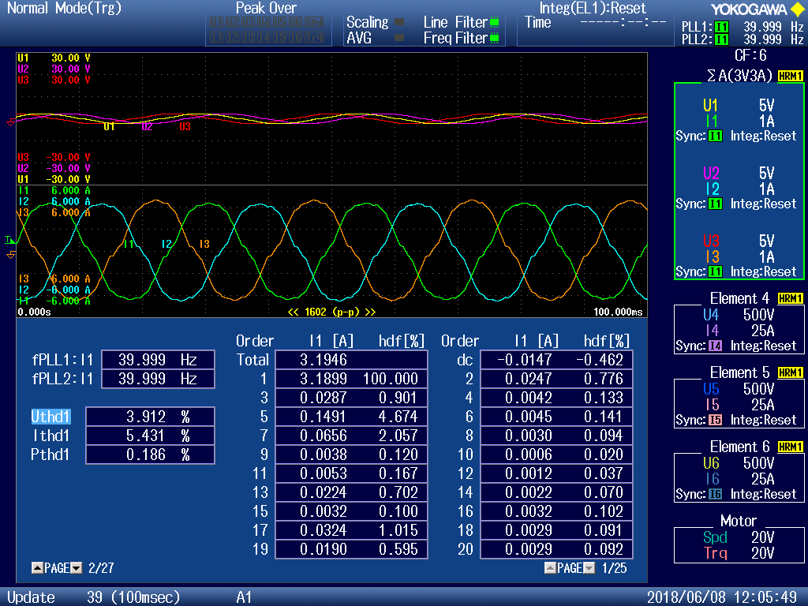
Experimental works
As the output frequency increases i.e. speed increases, current distortion decreases which can be seen below figure. (Ithd1 is decreased)
phase voltage and currents, and current harmonic distortions @40Hz speed @open loop

Slide 13
Experimental works
to observe effects of switching frequency on the nonlinearity regular PI current control is used
to eliminate effect of the back emf voltage, iq_ref is given zero
to eliminate Ls effect id_ref is varied so slow then only remains Rs value
especially at zero crossing regions of id current, nonlinearities can be seen more easily
as the switching frequency increases, nonlinearities get more severe as can be seen below id and Ud figures.

Slide 14
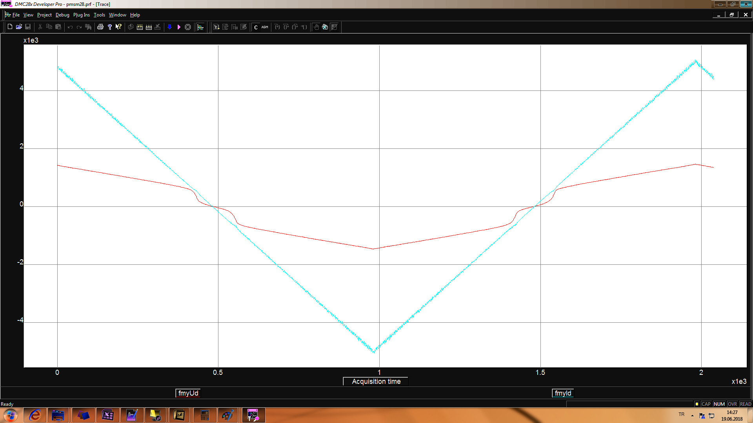
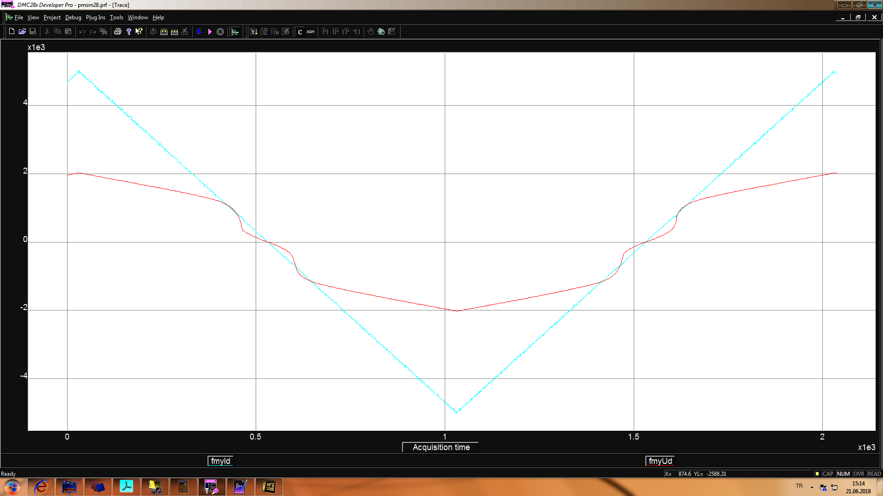
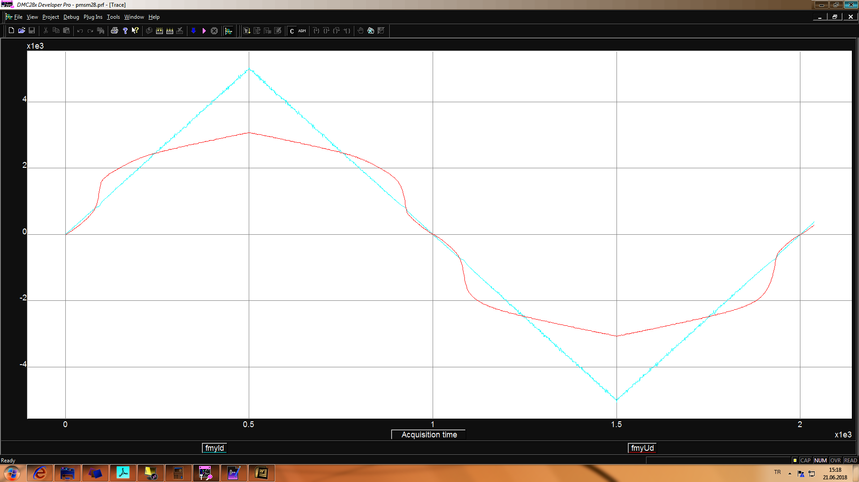
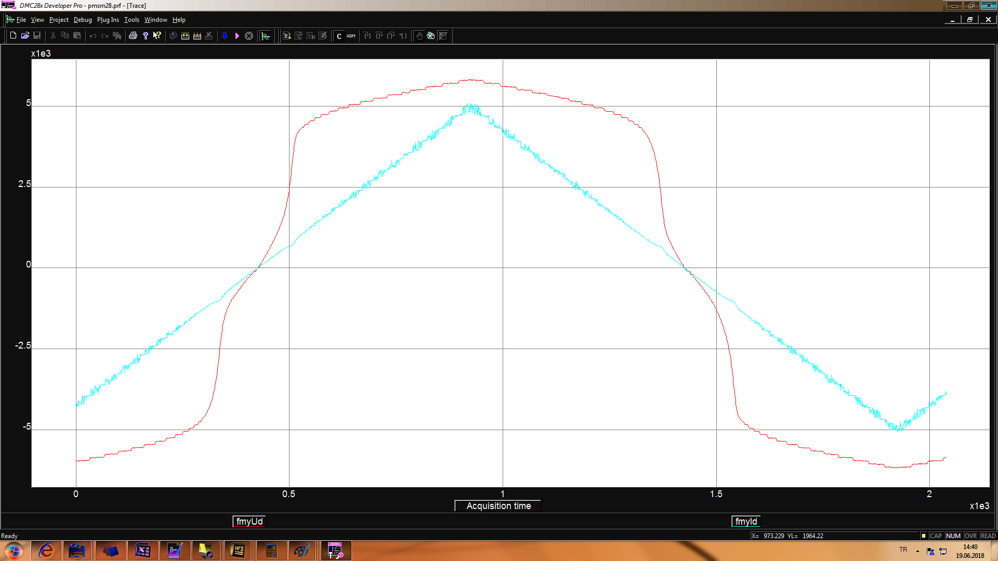
Experimental works
Fsw 10kHz
Fsw 20kHz
blue Id current and red Ud voltage
Fsw 40kHz
Fsw 100kHz

Slide 15
Experimental works
to observe effects of switching frequency on the nonlinearity regular PI current control is used
to eliminate effect of the back emf voltage, iq_ref is given zero
to eliminate Ls effect id_ref is varied so slow then only remains Rs value
especially at zero crossing regions of id current, nonlinearities can be seen more easily
as the switching frequency increases, nonlinearities get more severe as can be seen below id and Ud figures.

Slide 16
Experimental works
to find function of id f(id), the measured Id & Ud values are used which are taken at 20kHz switching frequency
Id & Ud graphs @fsw=20kHz @current loop

Slide 17
Experimental works
Ud vs Id graph is separated into pieces of parts, and curve fitting is applied to each parts to find f(id)
Id & Ud graph, pieces of parts @fsw=20kHz @current loop
Id & Ud graph, fitted curves @fsw=20kHz @current loop

Slide 18
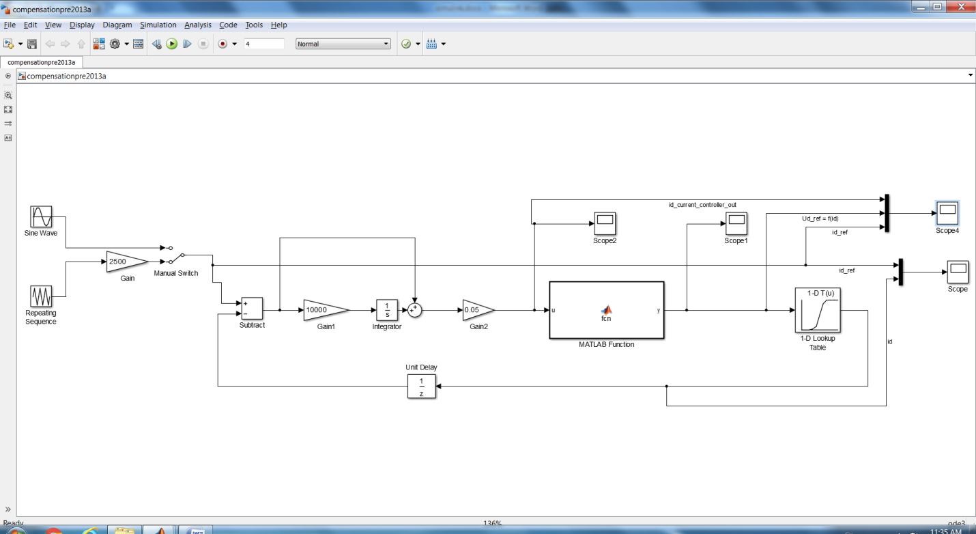
Experimental works
If nonlinearity is compensated by using f(id) to get Ud voltage, id controller output will see only Rs
simulink model, nonlinearity is compensated by using f(id)

Slide 19
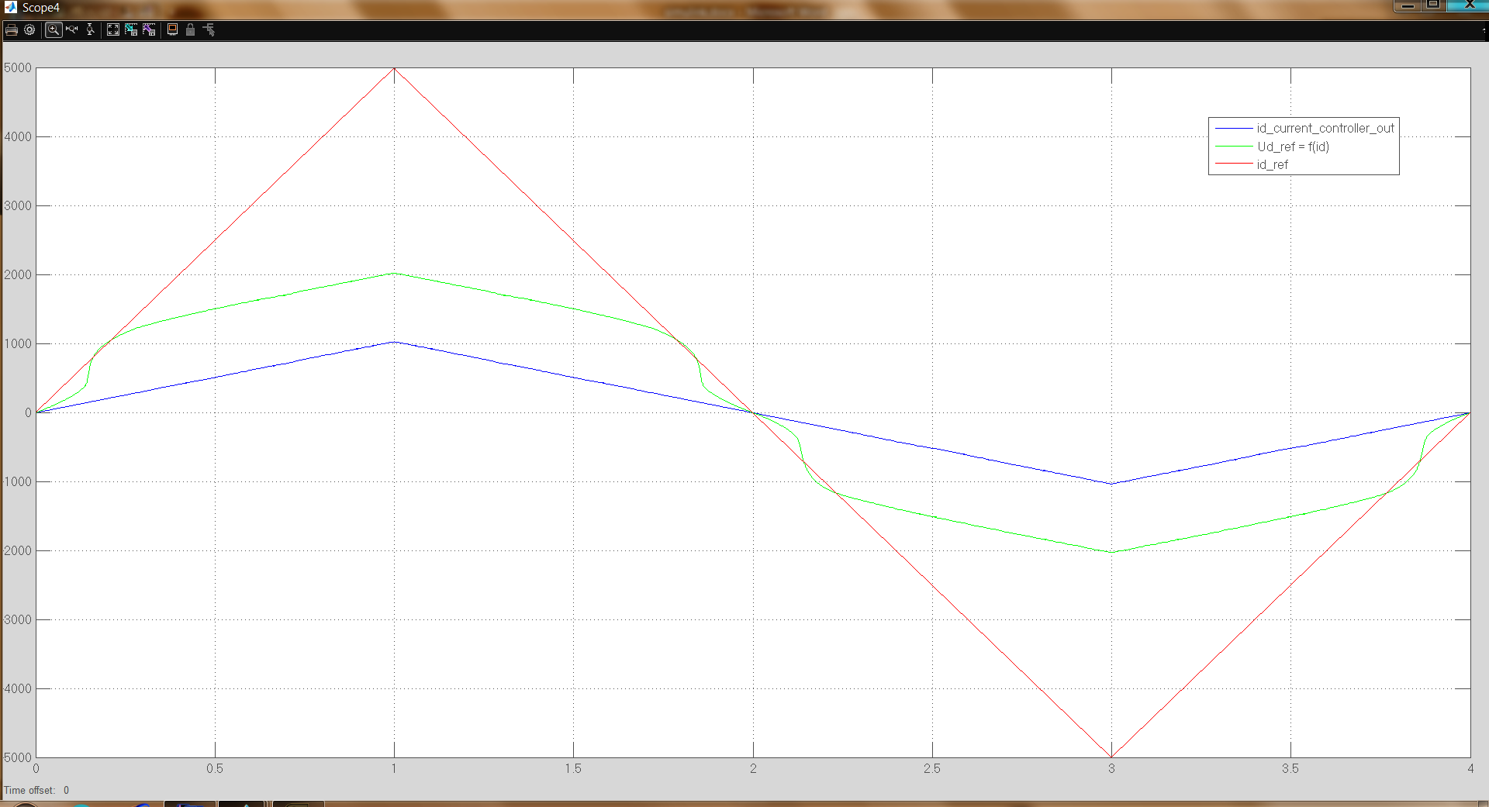
Experimental works
simulation data, red id_ref, green f(id), blue id controller output, nonlinearity is compensated by using f(id)

Slide 20
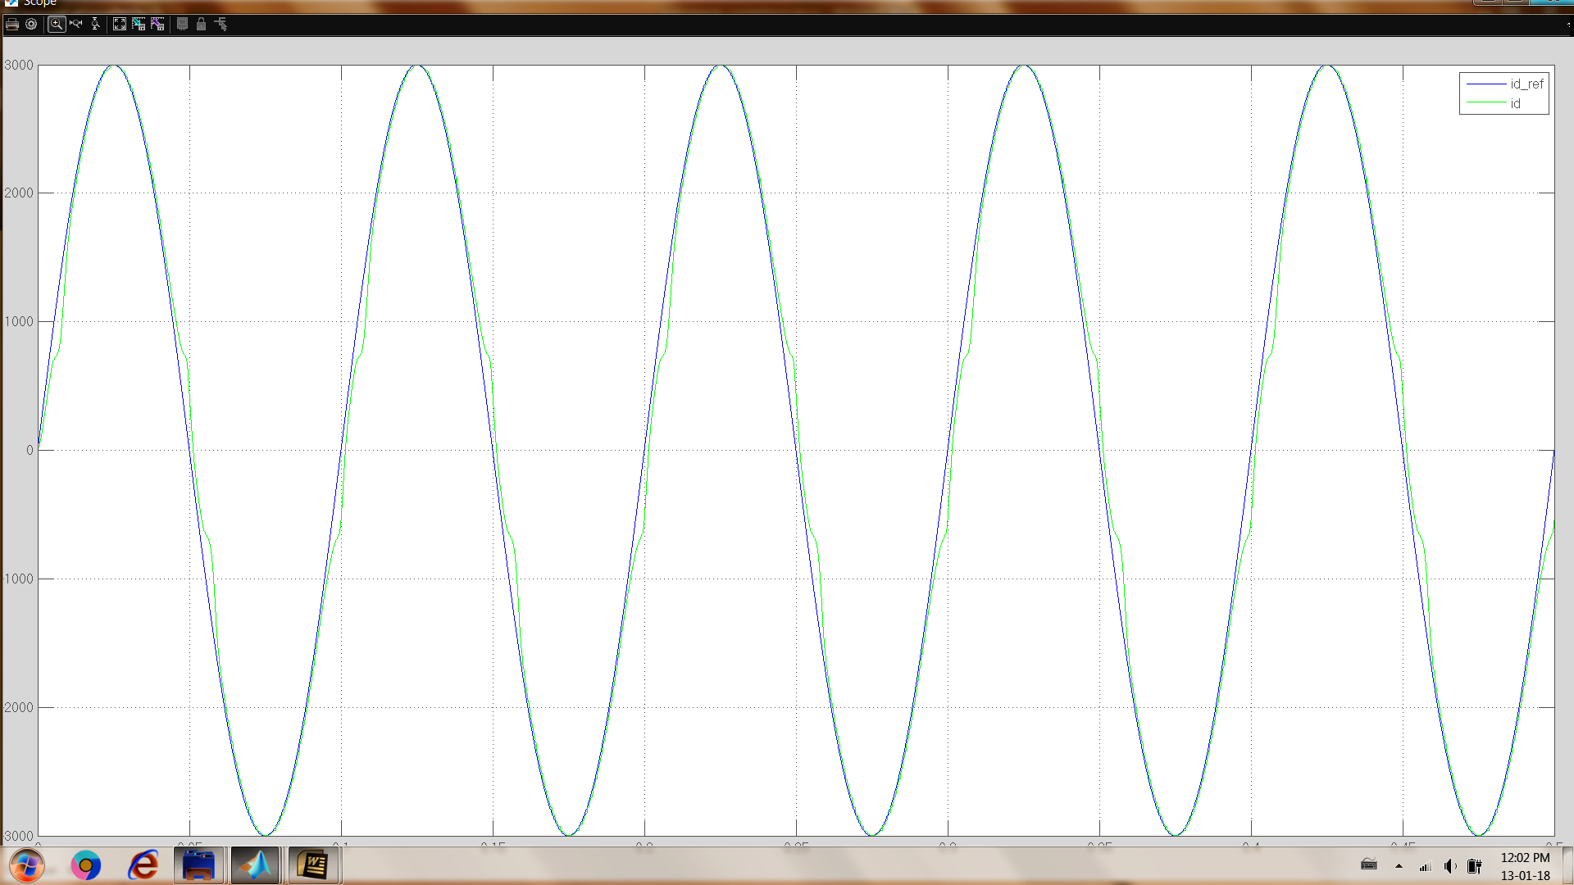

Experimental works
simulation data, blue id_ref, green id, nonlinearity is not compensated, 10hz sine wave id_ref
simulation data, blue id_ref, green id, nonlinearity is compensated, 10hz sine wave id_ref
Notes:
simulation data, blue id_ref, green id, nonlinearity is not compensated, 10hz sine wave id_ref

Slide 21
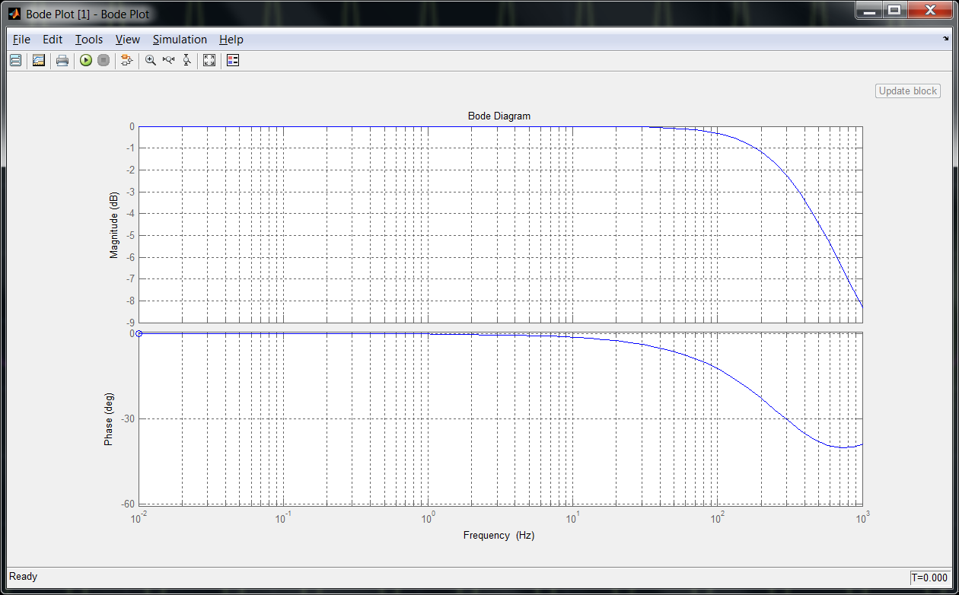
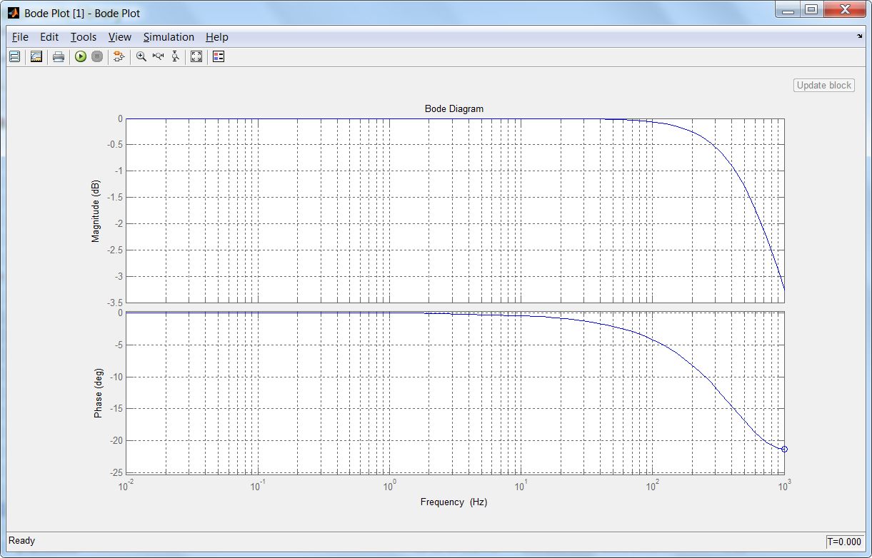
Experimental works
with compensation, bandwidth of the current controller is also increases as can be seen below bode diagrams
bode diagram of current controller, without nonlinearity compensation
bode diagram of current controller, with nonlinearity compensation

Slide 22
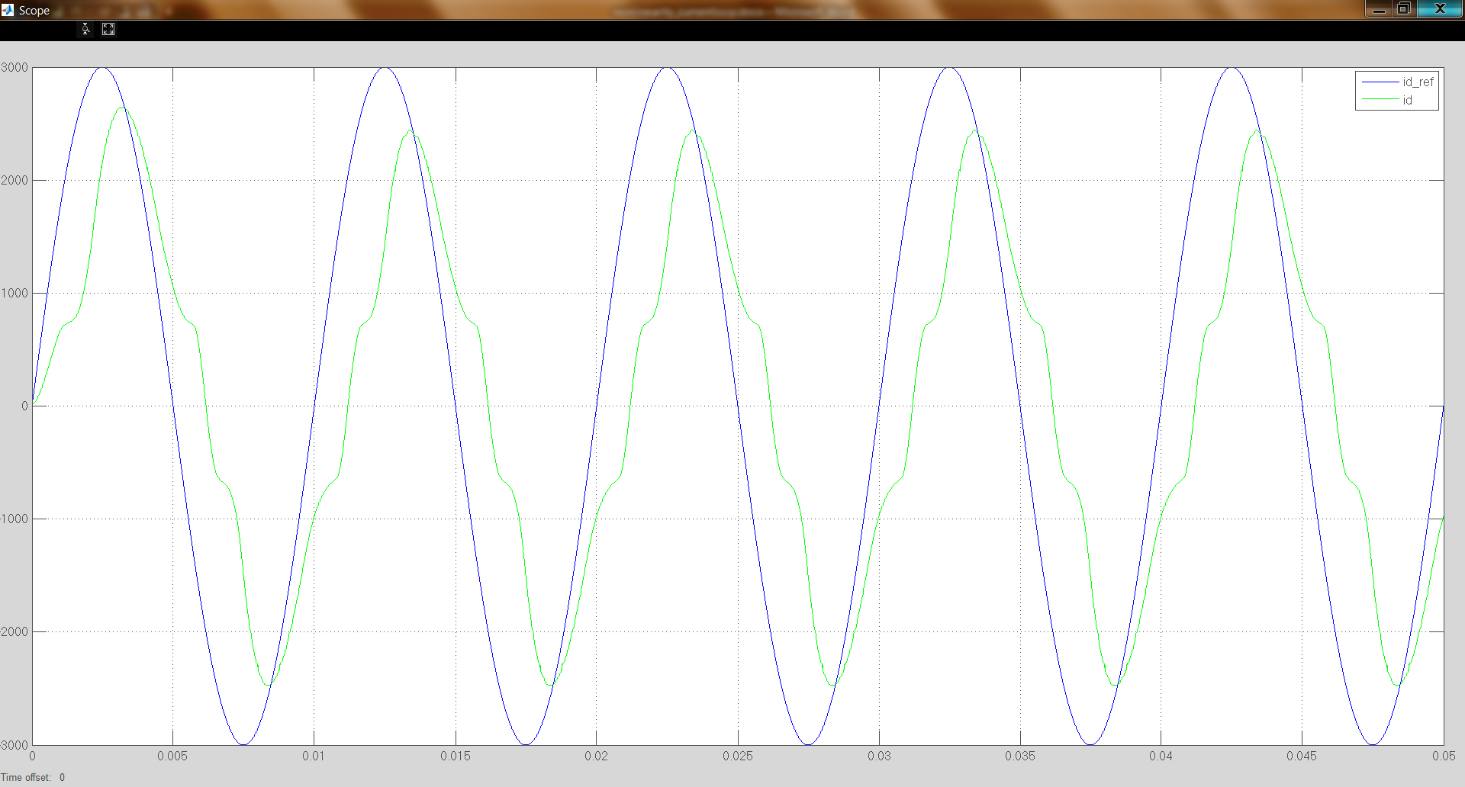
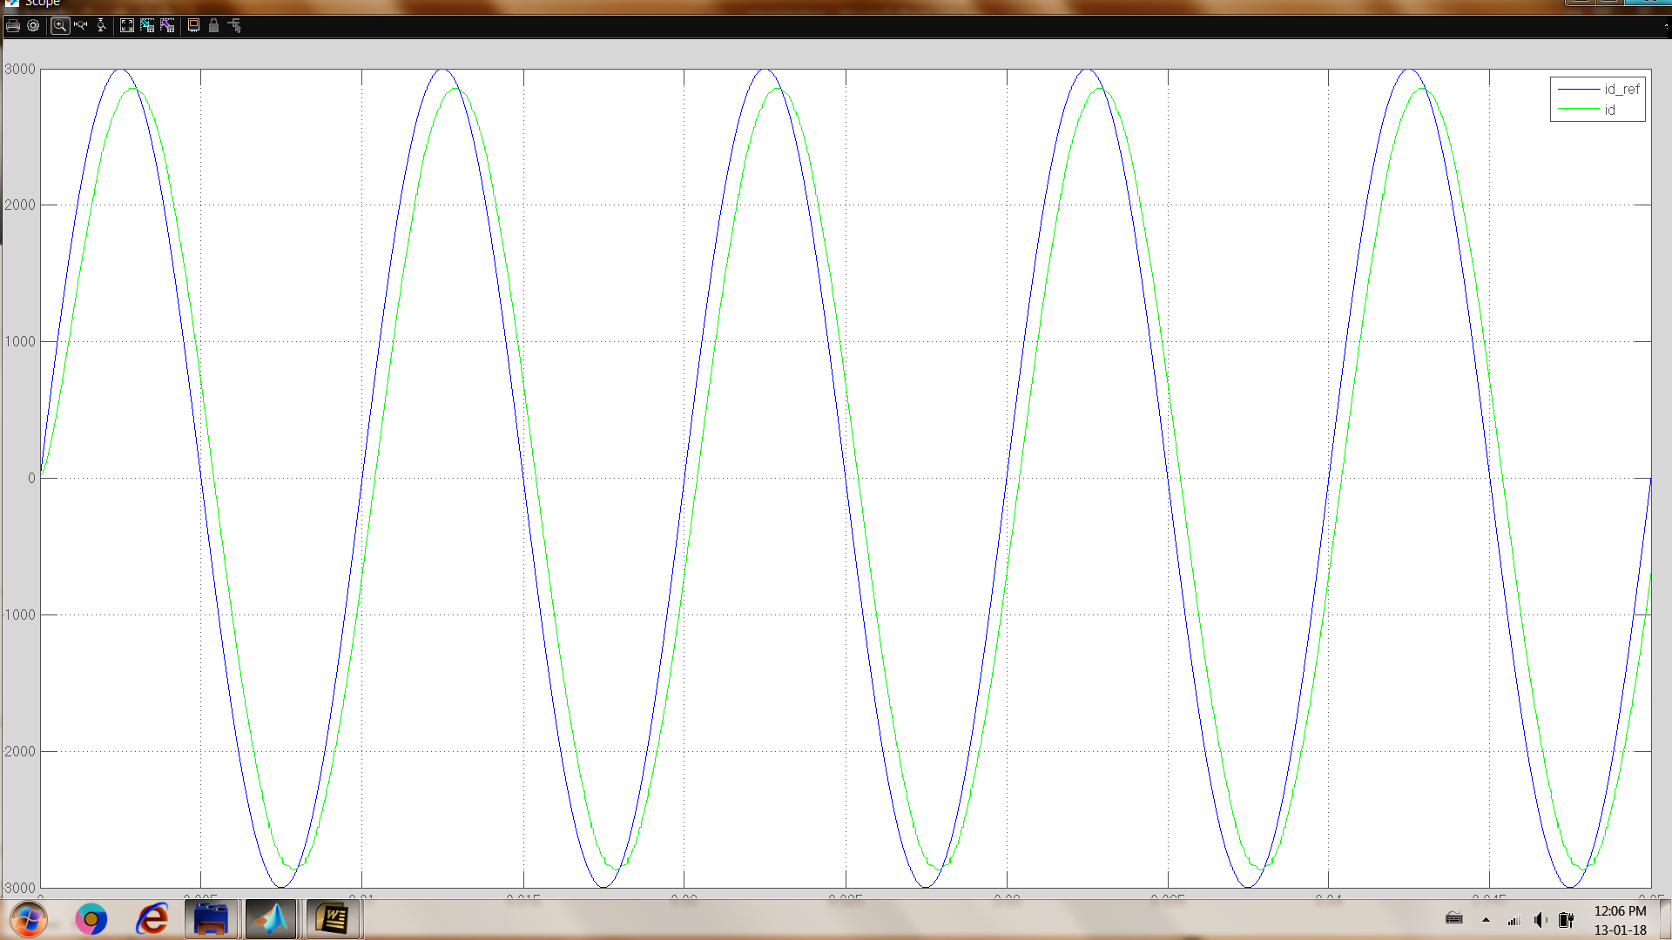
Experimental works
simulation data, blue id_ref, green id, nonlinearity is not compensated, 100hz sine wave id_ref
simulation data, blue id_ref, green id, nonlinearity is compensated, 100hz sine wave id_ref
Notes:
simulation data, blue id_ref, green id, nonlinearity is not compensated, 10hz sine wave id_ref

Slide 23
Experimental works
similar tests are repeated by experimentally
experimental data, orange id_ref, red id, blue f(id) nonlinearity is compensated, 10hz sine wave id_ref
experimental data, orange id_ref, red id, blue f(id) nonlinearity is compensated, 10hz sine wave id_ref

Slide 24
Experimental works
experimental data, orange id_ref, red id, blue f(id) nonlinearity is compensated, 100hz sine wave id_ref
experimental data, orange id_ref, red id, blue f(id) nonlinearity is compensated, 100hz sine wave id_ref

Slide 25
Experimental works
s
experimental data, orange id_ref, red id, blue f(id) nonlinearity is compensated, 10hz sine wave id_ref
experimental data, orange id_ref, red id, blue f(id) nonlinearity is compensated, 10hz sine wave id_ref

Slide 26
future plan
up to next tik
the effect of the nonlinearities will be analyzed and investigated for both MOSFET and IGBT based VSI and for various PMSMs
some of the literature compensation methods will be applied by experimentally and the results will be observed
a nonlinearity compensation method will be proposed and it will
be software based hence no requirement additional hardware
not need precise current sampling especially in the zero crossing regions

Slide 27
future plan
up to next year
 | 2018 |  |  |  |  |  |  | 2019
 | June | July | August | September | October | November | December | January | February | March | April | May
analyze & investigate the nonlinearity effect on the VSIs for various PMSMs | x | x
apply the literature compensation methods by experimentally |  | x | x
propose a software based nonlinearity compensation method |  |  | x | x
verify the effectiveness of the method by experimental results |  |  |  | x | x
submit the results of the proposed method to a conference (*) |  |  |  |  | x | x
model the VSI and PMSM and simulate the proposed method |  |  |  |  |  |  | x | x
improve the method and verify with both simulation and experimental |  |  |  |  |  |  |  |  | x | x
submit the results of the proposed method to a journal (**) |  |  |  |  |  |  |  |  |  |  | x | x

Slide 28
future plan
(*) candidate conferences
2019 IEEE 13th International Conference on Power Electronics and Drive Systems (PEDS), France
Abstract Submission Deadline: 15 Nov 2018, Conference Date: 09-12 Jul 2019
2019 21st European Conference on Power Electronics and Applications (EPE '19 ECCE Europe), Italy
Abstract Submission Deadline: 15 Nov 2018, Conference Date: 02-05 Sep 2019
2019 10th International Conference on Power Electronics and ECCE Asia (ICPE 2019 - ECCE Asia), Korea (South)
Abstract Submission Deadline: 13 Oct 2018, Conference Date: 27-31 May 2019
2019 IEEE 13th International Conference on Compatibility, Power Electronics and Power Engineering (CPE-POWERENG), Denmark
Abstract Submission Deadline: 16 Nov 2018, Conference Date: 23-25 Apr 2019
2019 International Aegean Conference on Electrical Machines and Power Electronics (ACEMP) & 2019 International Conference on Optimization of Electrical and Electronic Equipment (OPTIM), Turkey
Draft paper submission deadline：2019-03-20, Conference Date: 02-04 Sep 2019

Slide 29
future plan
(**) candidate journals
Power Electronics Magazine, IEEE
Power Electronics, IEEE Transactions on
Industrial Electronics Magazine, IEEE
Industry Applications, IEEE Transactions on
Industry Applications Magazine, IEEE
IEEE Journal of Emerging and Selected Topics in Power Electronics
IEEE Transactions on Education

Slide 30
thank you

