Slide 1
TİK sunum
Hüseyin YÜRÜK

Slide 2
Outline
problem definition
literature
future plan

Slide 3
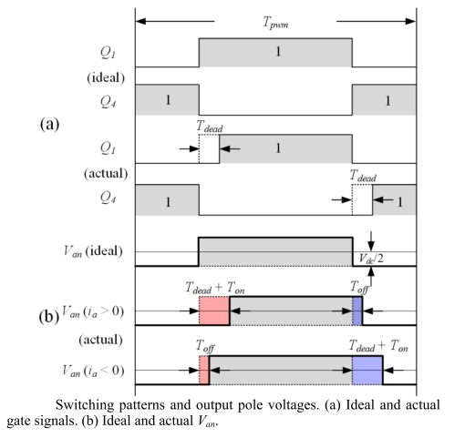
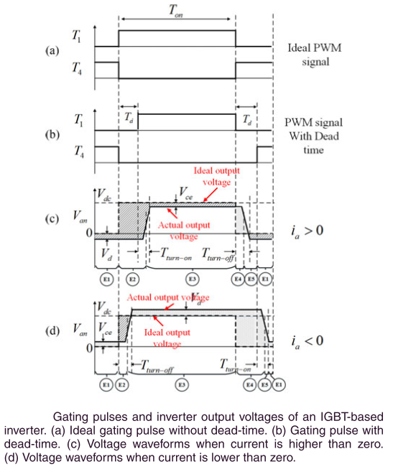
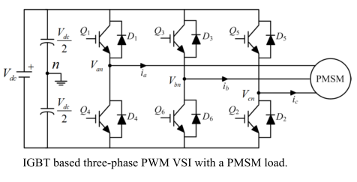
Dead-time
dead time is used to avoid the short circuit of DC link for the three phase PWM-VSI
Notes:
Reference:
Z. Tang and B. Akin, “Compensation of dead-time effects based on revised repetitive controller for PMSM drives,” Conf. Proc. - IEEE Appl. Power Electron. Conf. Expo. - APEC, vol. 32, no. 3, pp. 2730–2737, 2017.
Y. Wang, S. Member, W. Xie, and X. Wang, “Strategy for Voltage Source Inverters,” vol. 65, no. 1, pp. 59–66, 2018.

Slide 4
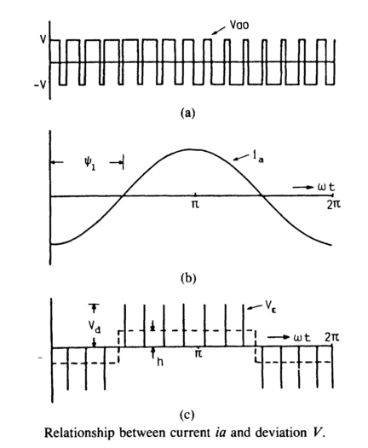
Dead-time
assume deviated pulse V_{Ɛ} is defined as difference between ideal output voltage Vao and actual output voltage Va.
V_{Ɛ} = Vao – Va
V_{Ɛ} = Vd * tdead (in simple way)
h * To/2 = (fs / fo) / 2 * V_{Ɛ}
h = fs * V_{Ɛ}
so as fs ↗ distortion also ↗
effect of the distortion gets more severe when
output frequency fo is low & output magnitude is low
iron and core losses and torque ripple increases
Notes:
Reference:
Y. Murai, T. Watanabe, and H. Iwasaki, “Waveform distortion and correction circuit for pwm inverters with switching lag-times,” IEEE Trans. Ind. Appl., vol. IA-23, no. 5, pp. 881–886, 1987.

Slide 5
Dead-time
analysis demonstrates that the dead-time effects mainly produce 5th

