Slide 1
Compensation of Nonlinearities of the Voltage Source Inverters for High Precision Position Control Applications
Hüseyin YÜRÜK
TİK MAY 2018

Slide 2
Outline
problem definition
motivation
literature
future plan

Slide 3
problem definition
following nonlinearities cause distortion on the output voltage of the VSI
dead-time
switching time
delay time
voltage drops on the power switch and the freewheeling diode
parasitic capacitance of the power switch
output voltage distortion causes
low order harmonic components in the output current of the inverter
deformation of the phase currents, especially in the current zero-crossing region
affects the control performance of the applications that require low speed-torque
degrades the efficiency and increases the torque ripple

Slide 4
motivation
performance improvements of VSI-fed PMSM drive can be achieved by means of accurate current controls where VSI nonlinearities are highly compensated
this will be more crucial for the applications which have the following properties
low magnitude dc link
low speed
low torque
low inductance machine
high precision position control
Gimbal applications (rf, optic etc.)

Slide 5
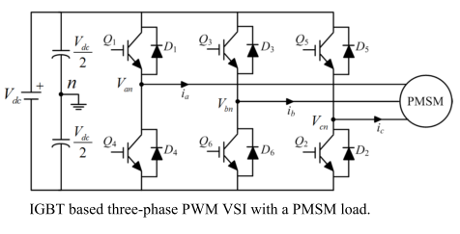
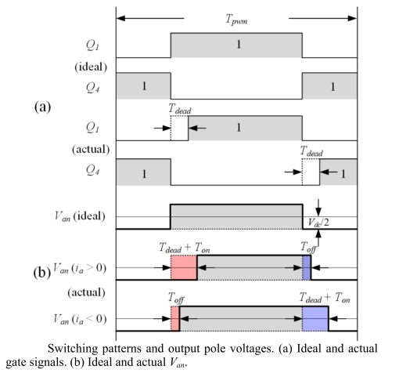
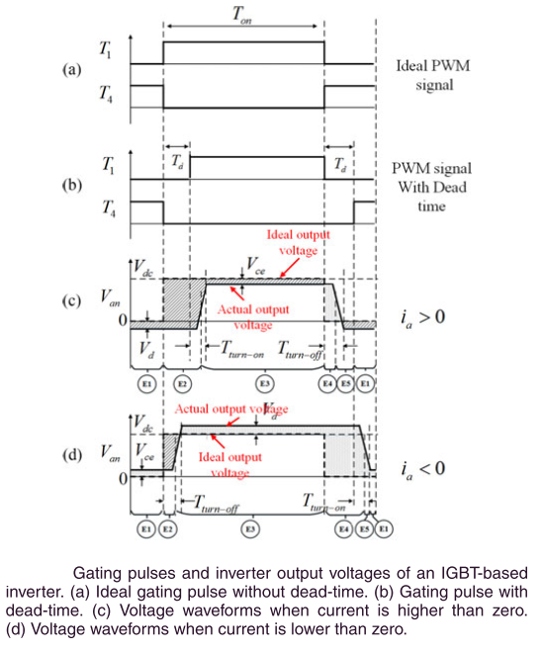
Nonlinearities
Z. Tang and B. Akin, “Compensation of dead-time effects based on revised repetitive controller for PMSM drives,” Conf. Proc. - IEEE Appl. Power Electron. Conf. Expo. - APEC, vol. 32, no. 3, pp. 2730–2737, 2017.
Y. Wang, S. Member, W. Xie, and X. Wang, “A Precise Voltage Distortion Compensation Strategy for Voltage Source Inverters,” vol. 65, no. 1, pp. 59–66, IEEE TRANSACTIONS ON INDUSTRIAL ELECTRONICS, VOL. 65, NO. 1, JANUARY 2018
Notes:
Reference:
Z. Tang and B. Akin, “Compensation of dead-time effects based on revised repetitive controller for PMSM drives,” Conf. Proc. - IEEE Appl. Power Electron. Conf. Expo. - APEC, vol. 32, no. 3, pp. 2730–2737, 2017.
Y. Wang, S. Member, W. Xie, and X. Wang, “A Precise Voltage Distortion Compensation Strategy for Voltage Source Inverters,” vol. 65, no. 1, pp. 59–66, IEEE TRANSACTIONS ON INDUSTRIAL ELECTRONICS, VOL. 65, NO. 1, JANUARY 2018

Slide 6
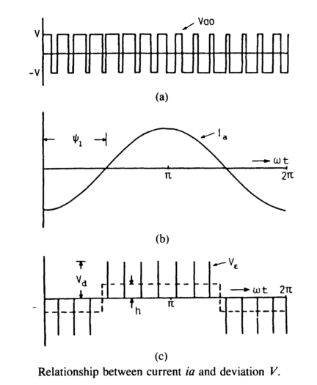
Nonlinearities
assume deviated pulse V_{Ɛ} is defined as difference between ideal output voltage Vao and actual output voltage Va.
V_{Ɛ} = V_{ao} – V_{a}
V_{Ɛ} = V_{d} * t_{dead} (in simple way)
h * T_{o}/2 = (f_{s} / f_{o}) / 2 * V_{Ɛ}
h = f_{s} * V_{Ɛ}
so as fs ↗ distortion also ↗
effect of the distortion gets more severe when
output frequency fo is low & output magnitude is low
iron and core losses and torque ripple increases
Y. Murai, T. Watanabe, and H. Iwasaki, “Waveform distortion and correction circuit for pwm inverters with switching lag-times,” IEEE Trans. Ind. Appl., vol. IA-23, no. 5, pp. 881–886, 1987.
Notes:
Reference:
Y. Murai, T. Watanabe, and H. Iwasaki, “Waveform distortion and correction circuit for pwm inverters with switching lag-times,” IEEE Trans. Ind. Appl., vol. IA-23, no. 5, pp. 881–886, 1987.

Slide 7
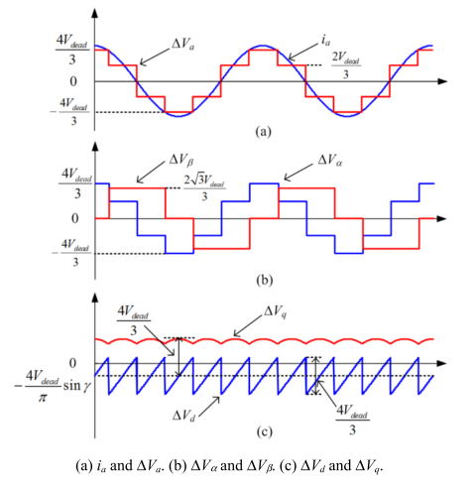

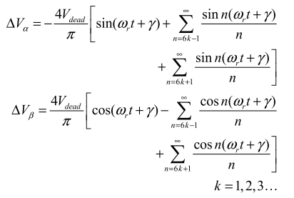
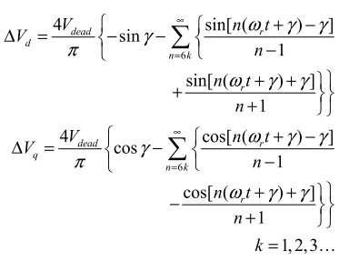
Nonlinearities
analysis demonstrates that the nonlinear effects mainly produce 5th and 7th harmonics in the α-β reference frame and 6th voltage harmonic and its multiples in the d-q reference frame which cause current harmonics
Z. Tang and B. Akin, “Compensation of dead-time effects based on revised repetitive controller for PMSM drives,” Conf. Proc. - IEEE Appl. Power Electron. Conf. Expo. - APEC, vol. 32, no. 3, pp. 2730–2737, 2017.
Notes:
Reference:
Z. Tang and B. Akin, “Compensation of dead-time effects based on revised repetitive controller for PMSM drives,” Conf. Proc. - IEEE Appl. Power Electron. Conf. Expo. - APEC, vol. 32, no. 3, pp. 2730–2737, 2017.

Slide 8
literature
various compensation methods have been proposed
hardware based
terminal voltage is measured by analog circuitry and used as a feedback
S. J. Chee, J. Kim, and S. K. Sul, “Dead-time compensation based on pole voltage measurement,” 2015 IEEE Energy Convers. Congr. Expo. ECCE 2015, pp. 1549–1555, 2015.
software based
current harmonic analysis based method
based on monitoring harmonic distortion in the d-axis current
B. Ludek and O. Lukas, “Online adaptive compensation scheme for inverter nonlinearity in PMSM drive,” in Proc 7th Int. Congr. Ultra Mod. Telecommun. Control Syst. Workshops, Jan. 2016, pp. 166–171.
estimator based method
estimators (or observers) are designed to extract the disturbance voltage based on the motor model
L. Buchta and L. Otava, “Adaptive compensation of inverter non-linearities based on the Kalman filter,” IECON Proc. (Industrial Electron. Conf., pp. 4301–4306, 2016.
instantaneous average voltage method
compensate the average voltage error between reference voltage and actual voltage in each switching period
Y. Wang, S. Member, W. Xie, and X. Wang, “A Precise Voltage Distortion Compensation Strategy for Voltage Source Inverters,” vol. 65, no. 1, pp. 59–66, IEEE TRANSACTIONS ON INDUSTRIAL ELECTRONICS, VOL. 65, NO. 1, JANUARY 2018
Notes:
Reference:
Y. Wang, S. Member, W. Xie, and X. Wang, “Strategy for Voltage Source Inverters,” vol. 65, no. 1, pp. 59–66, 2018.

Slide 9

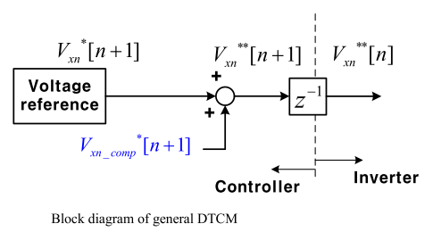
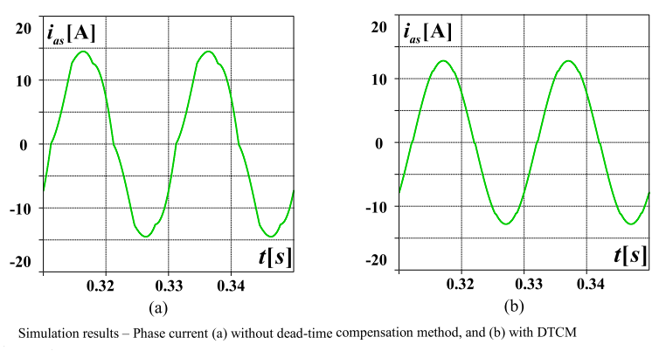
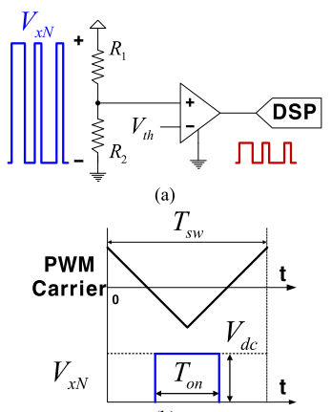
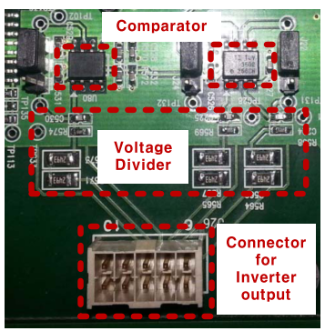
literature
an example of hardware based compensation method
S. J. Chee, J. Kim, and S. K. Sul, “Dead-time compensation based on pole voltage measurement,” 2015 IEEE Energy Convers. Congr. Expo. ECCE 2015, pp. 1549–1555, 2015.
Notes:
Reference:
S. J. Chee, J. Kim, and S. K. Sul, “Dead-time compensation based on pole voltage measurement,” 2015 IEEE Energy Convers. Congr. Expo. ECCE 2015, pp. 1549–1555, 2015.

Slide 10
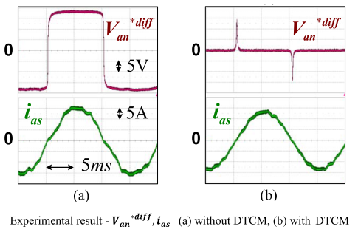
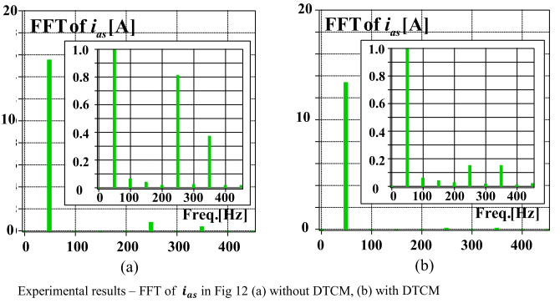
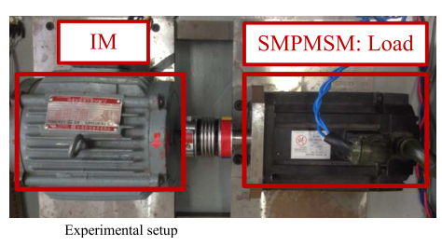
literature
an example of hardware based compensation method (cont’d)
S. J. Chee, J. Kim, and S. K. Sul, “Dead-time compensation based on pole voltage measurement,” 2015 IEEE Energy Convers. Congr. Expo. ECCE 2015, pp. 1549–1555, 2015.
Notes:
Reference:
S. J. Chee, J. Kim, and S. K. Sul, “Dead-time compensation based on pole voltage measurement,” 2015 IEEE Energy Convers. Congr. Expo. ECCE 2015, pp. 1549–1555, 2015.

Slide 11
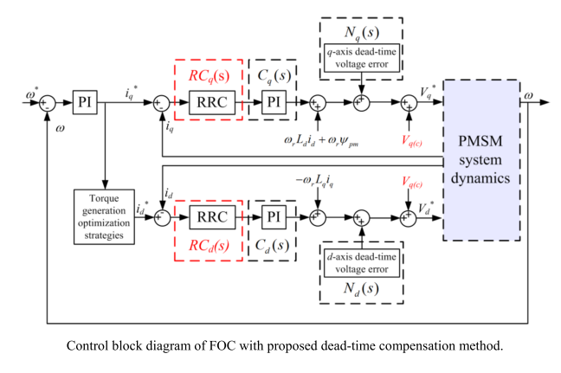
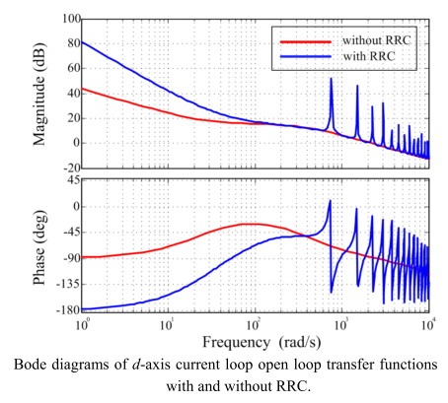
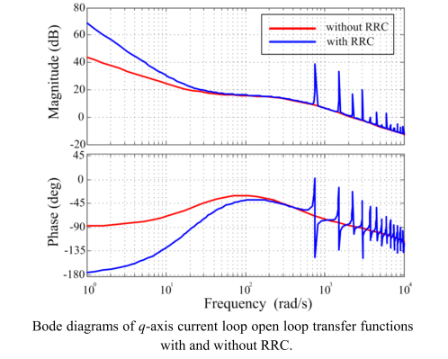
literature
an example of software based compensation method (revised repetitive controller RRC)
Z. Tang and B. Akin, “Compensation of dead-time effects based on revised repetitive controller for PMSM drives,” Conf. Proc. - IEEE Appl. Power Electron. Conf. Expo. - APEC, vol. 32, no. 3, pp. 2730–2737, 2017.
Notes:
Reference:
Z. Tang and B. Akin, “Compensation of dead-time effects based on revised repetitive controller for PMSM drives,” Conf. Proc. - IEEE Appl. Power Electron. Conf. Expo. - APEC, vol. 32, no. 3, pp. 2730–2737, 2017.

Slide 12
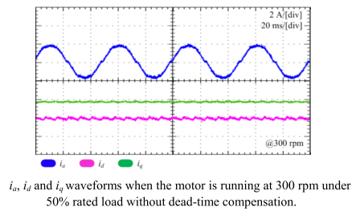
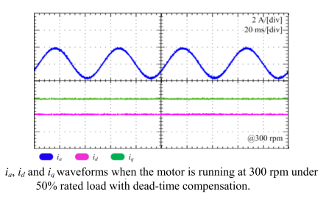
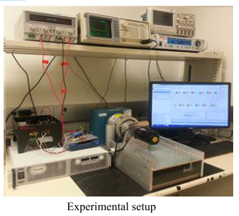
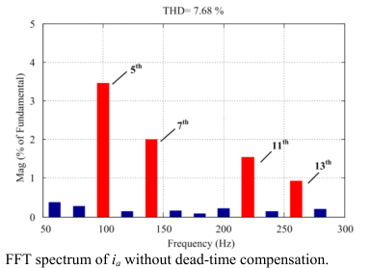
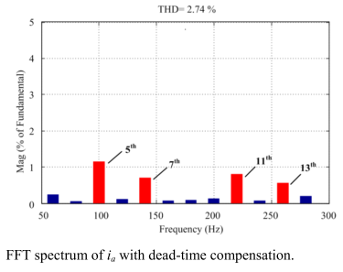
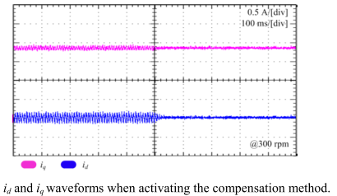
literature
an example of software based compensation method (revised repetitive controller RRC) (cont’d)
Z. Tang and B. Akin, “Compensation of dead-time effects based on revised repetitive controller for PMSM drives,” Conf. Proc. - IEEE Appl. Power Electron. Conf. Expo. - APEC, vol. 32, no. 3, pp. 2730–2737, 2017.
Notes:
Reference:
Z. Tang and B. Akin, “Compensation of dead-time effects based on revised repetitive controller for PMSM drives,” Conf. Proc. - IEEE Appl. Power Electron. Conf. Expo. - APEC, vol. 32, no. 3, pp. 2730–2737, 2017.

Slide 13
future plan (up to next tik)
the effect of the nonlinearities will be analyzed and investigated for both MOSFET and IGBT based VSI and for various PMSMs
some of the literature compensation methods will be applied by experimentally and the results will be observed
a nonlinearity compensation method will be proposed and the method will
be software based hence no requirement additional hardware
not need precise current sampling especially in the zero crossing regions
the method will be integrated to the PMSM drive which is controlled by FOC algorithm
the effectiveness of the proposed method will be verified by experimental results and spectrum analysis
the waveforms of the phase, id and iq currents will be compared with and without compensation in the steady state and also during the dynamic process

Slide 14
future plan
up to next year
 | 2018 |  |  |  |  |  |  | 2019
 | June | July | August | September | October | November | December | January | February | March | April | May
analyze & investigate the nonlinearity effect on the VSIs for various PMSMs | x | x
apply the literature compensation methods by experimentally |  | x | x
propose a software based nonlinearity compensation method |  |  | x | x
verify the effectiveness of the method by experimental results |  |  |  | x | x
submit the results of the proposed method to a conference (*) |  |  |  |  | x | x
model the VSI and PMSM and simulate the proposed method |  |  |  |  |  |  | x | x
improve the method and verify with both simulation and experimental |  |  |  |  |  |  |  |  | x | x
submit the results of the proposed method to a journal (**) |  |  |  |  |  |  |  |  |  |  | x | x

Slide 15
future plan
(*) candidate conferences
2019 IEEE 13th International Conference on Power Electronics and Drive Systems (PEDS), France
Abstract Submission Deadline: 15 Nov 2018, Conference Date: 09-12 Jul 2019
2019 21st European Conference on Power Electronics and Applications (EPE '19 ECCE Europe), Italy
Abstract Submission Deadline: 15 Nov 2018, Conference Date: 02-05 Sep 2019
2019 10th International Conference on Power Electronics and ECCE Asia (ICPE 2019 - ECCE Asia), Korea (South)
Abstract Submission Deadline: 13 Oct 2018, Conference Date: 27-31 May 2019
2019 IEEE 13th International Conference on Compatibility, Power Electronics and Power Engineering (CPE-POWERENG), Denmark
Abstract Submission Deadline: 16 Nov 2018, Conference Date: 23-25 Apr 2019
2019 International Aegean Conference on Electrical Machines and Power Electronics (ACEMP) & 2019 International Conference on Optimization of Electrical and Electronic Equipment (OPTIM), Turkey
Draft paper submission deadline：2019-03-20, Conference Date: 02-04 Sep 2019

Slide 16
future plan
(**) candidate journals
Power Electronics Magazine, IEEE
Power Electronics, IEEE Transactions on
Industrial Electronics Magazine, IEEE
Industry Applications, IEEE Transactions on
Industry Applications Magazine, IEEE
IEEE Journal of Emerging and Selected Topics in Power Electronics
IEEE Transactions on Education
Notes:
No Open Access

Slide 17
thank you

