Slide 1
PRESENTATION
Members of group:
Dang Viet Hung
Le Quoc Vu
Le Truong Ngan Chau

Slide 2
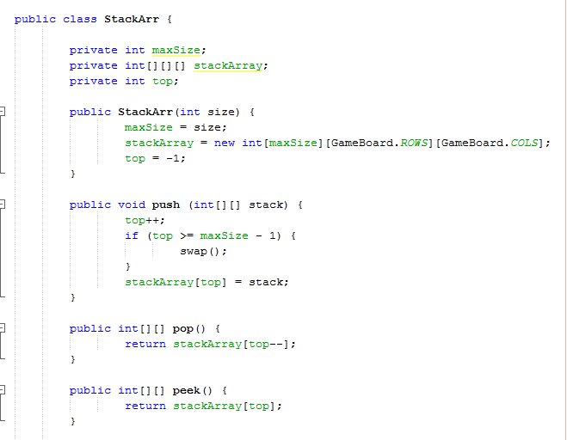
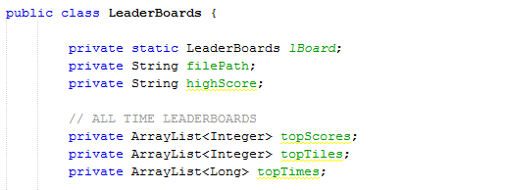
Uses:
Eclipse, NetBeans.
Link GitHub: https://github.com/hyylian/2048
Data Structures:
Stack (for redo and undo), ArrayList.

Slide 3
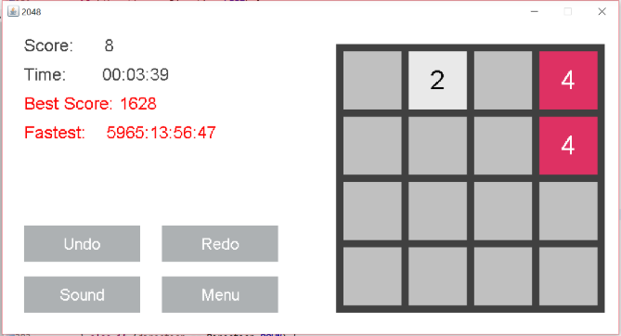
Rules:
Use up, down, left, right to play.
Combine various tiles starting with a tile of 2 and combining them together to reach 2048.
Contribution:
Hung: Leader, Algorithms, Undo&Redo, Gui.
Vu: Support, Main function, Draw the frame, Draw the board & tiles, Key listener.
Chau: Support, Score, Sound, Report.

Slide 4
END

