Slide 1
PLANT VS ZOMBIE
Members:
Lê thị phương linh
Nguyễn hoàng quyết
Đặng việt hùng

Slide 2
Game rules
Use the left mouse button to perform drag and drop operations.
Your mission in the game is to protect the garden from the zombies' attack.
Resist the zombie attack by collecting sun and using it to buy defensive plants to place on your lawn.
Use your plants to slow down, weaken and kill zombies before they can reach your front door and eat your brains!
In this version, you will only have:
4 powerful perennials( 2 types of peashooters, wall nut, sun flower)
1 zombie types
1 level

Slide 3
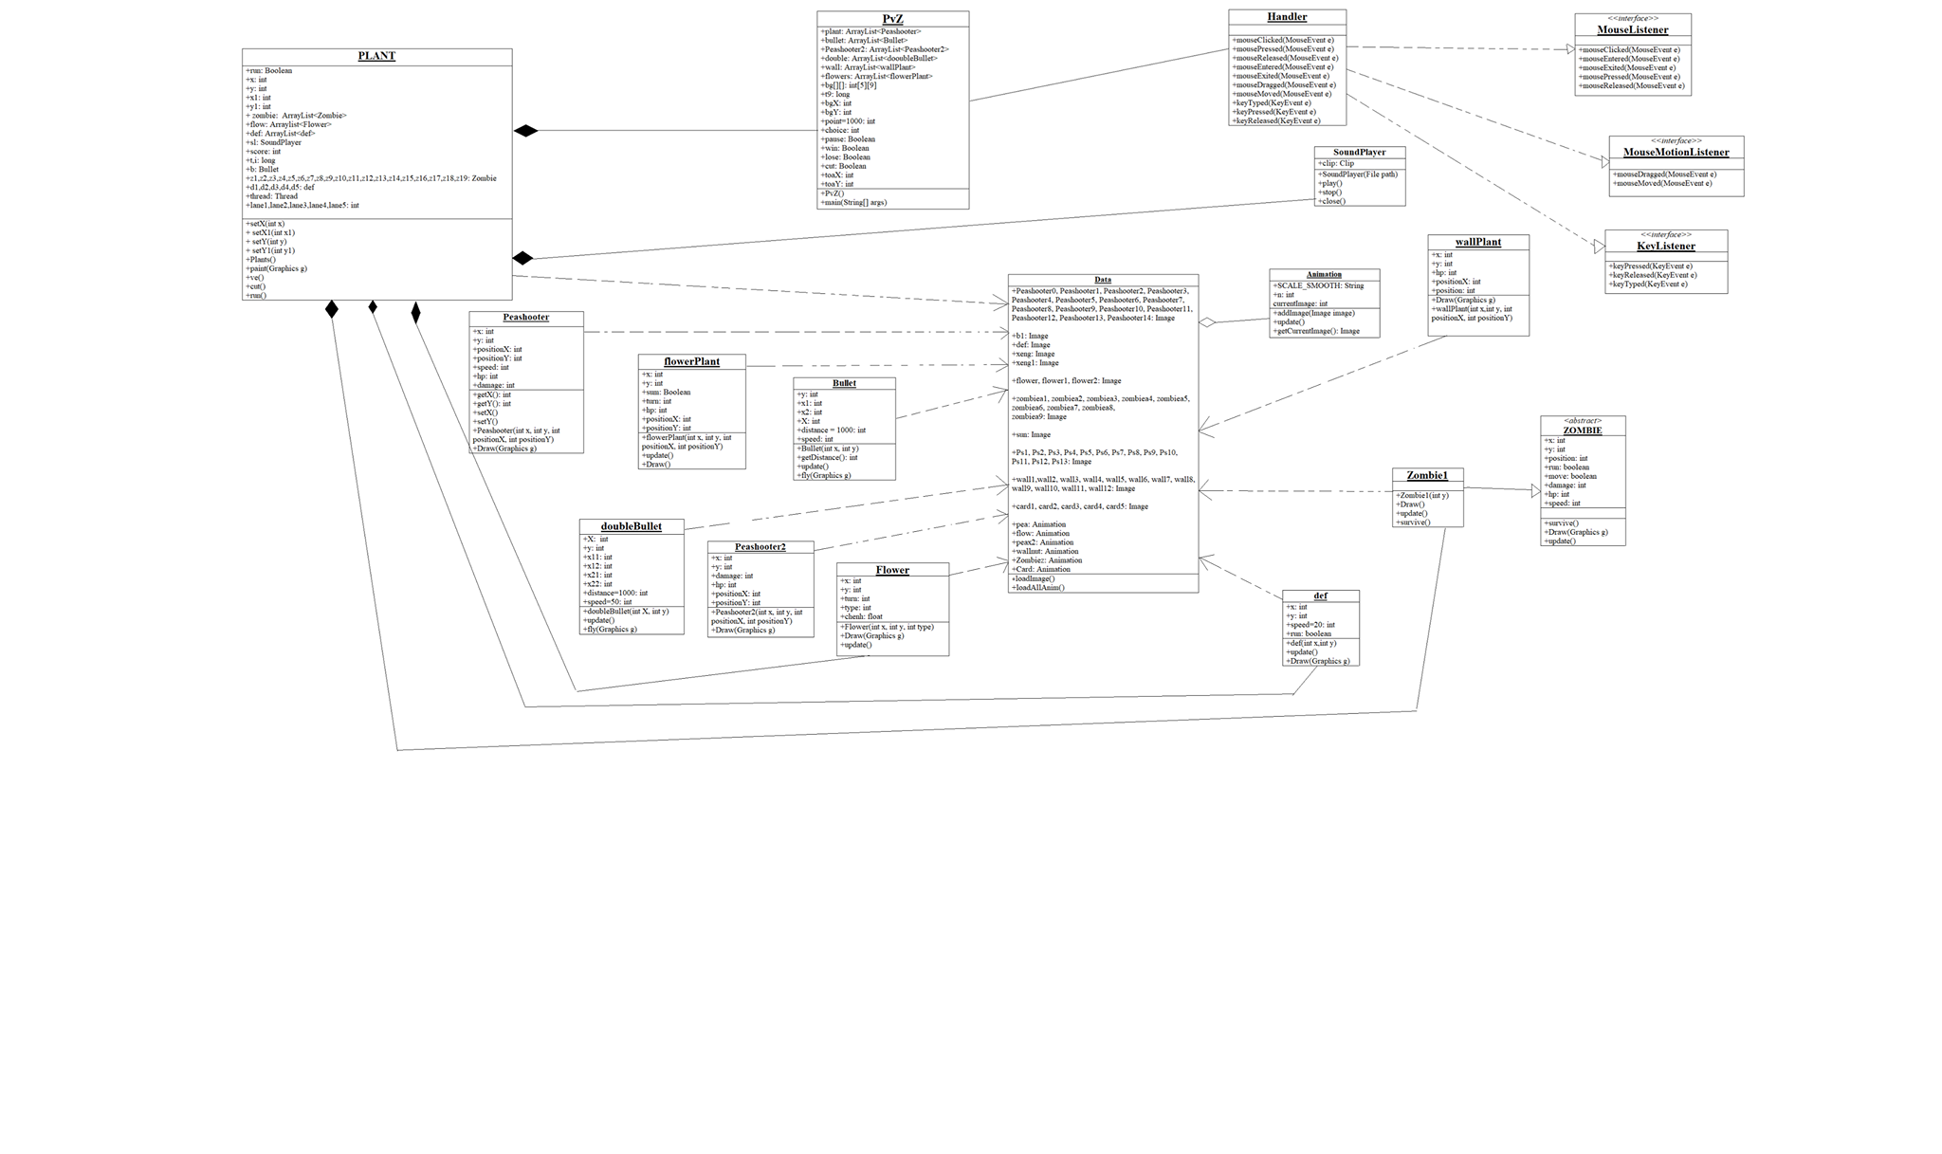
Design

