Slide 1
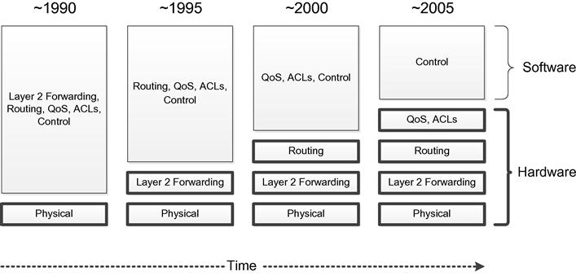
Evolution of switches and control plane
~1990 - Simple Forwarding and Routing Using Software
~1995 - Only L2 forwarding moves to hardware
~2000 – L3 forwarding also moves to hardware
~2005 - Some Control Software also move into Silicon
~2010 - Ever increasing feature set turning control software to unmanageable behemoth.

Slide 2
The Growing Need for Simplification
As time has passed, networking devices have become increasingly complex. This is partly due to the existing independent and autonomous design of devices that make it necessary for so much intelligence be placed inside each device. Placing more functionality in hardware in some ways simplifies the device but in other ways makes the device more complicated because of the difficult handshakes and tradeoffs between handling packets in hardware versus software.
The general trend of adding features to legacy devices tends to complicate implementations rather than simplifying them.
Rather than using primitive network management tools such as SNMP and CLI, network operators would prefer to use policy-based management systems.

Slide 3
Moving Control Off the Device
Forwarding, filtering, and prioritization responsibilities, implemented in hardware tables, remain on the device. In addition, features such as filtering based on ACLs and traffic prioritization are enforced locally on the device as well.
Complicated control software is removed from the device and placed into a centralized controller, which has a complete view of the network and the ability to make optimal forwarding and routing decisions.
Above the controller is where the network applications run, implementing higher-level functions and, additionally, participating in decisions about how best to manage and control packet forwarding and distribution within the network.

Slide 4
Solving the issue with ever Increasing Cost of Development
Today’s autonomous networking devices must store, manage, and run the complicated control plane software leading to increased cost per device (increased processing power, cost due to advanced software development, advanced ASIC development, as well as increase in storage capacity).
SDN reduces the cost of network by readily available open source software. Application server frameworks provide platforms that allow software developers just to concentrate on solving domain-specific problems. Each vendor need not have to develop, test, and maintain large amounts of redundant code (Hence no interoperability cost).
Some silicon vendors have been producing common off-the-shelf (COTS) ASICs that are capable of speeds and functionalities that rival or surpass the proprietary versions developed by networking hardware vendors.

Slide 5
Environments Encourage Vendor Lock-in
Vendors implements standards being developed in the networking space for most relevant protocols and data to be used by switches and routers. This allows heterogeneous networks of devices from multiple vendors to coexist with one another.
Enhancements are often added to these standard implementations, that allow a vendor’s product to outperform its competition. With many vendors adding such enhancements, the end result is the cost of interoperability.
As a result, customers frequently gets locked in to a vendor they chose years or even decades before. This makes the vendor largely safe from competition and can thus preserve high profit margins.
Adherence to standards helps alleviate the issues associated with attempting to support multiple vendor types in a network.

Slide 6
Complexity and Resistance to Change
Once the network is operational, the normal impulse from that point on is to just leave things as they are, to not disturb things lest the system break leading to multiple business consequences. Often, that closed, complex solution may be easier to deploy if adopted from single vendor precisely due to interoperability issues.
The resistance to change by vendor, service provider, and enterprise customers results in long-term technological stagnation and sluggishness.
Hence emerged the ideal for simpler, more progressive world of networking, with open, efficient, and less expensive networking devices (This is the goal of SDN).

Slide 7
Increased Cost of Operating the Network
As networks become ever larger and more complex, the operational expense (OPEX) of the network grows. This component of the overall costs is increasingly seen to be more significant than the corresponding capital expense(CAPEX) component.
SDN has the capacity to accelerate the automation of network management tasks in a multivendor environment. This, combined with the fact that SDN will permit faster provisioning of new services and provides the agility to switch equipment between different services, should lead to lower OPEX with SDN.

Slide 8
SDN Promotes Research and Innovation
Open software environments such as Linux have helped to promote this rapid pace of advancement.
in the area of server virtualization or databases, there are open source packages like KVM, Xenand, MySQL and Postgres.
The current closed nature of networking software, network protocols, network security, and network virtualization stymies experiments, tests , research and innovation.
A number of universities collaborated to propose a new standard for networking called OpenFlow, which would allow for this free and open research by academicia.
Ultimately OpenFlow will be to the world of networking what Linux has become to the world of computing.

Slide 9
Data Center Innovation
In the last few years, server virtualization has caused both the capacity and the efficiency of data centers to increase exponentially. This unbounded growth has made possible new computing trends such as the cloud, which is capable of holding massive amounts of computing power and storage capacity.

Slide 10
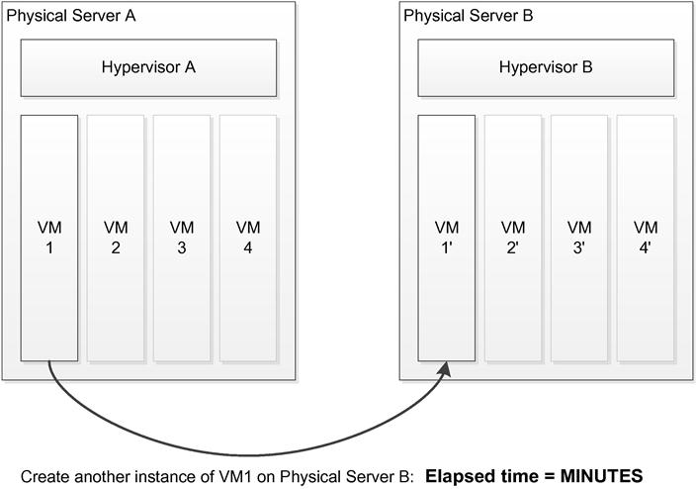
Compute and Storage Virtualization
Commercial software ( such as Vmware Hyper-V, KVM, and Citrix) for virtualizing desktops as well as servers started a decade ago that helps dynamically create and tear down servers, as well as moving them from one physical server to another to a matter of minutes or even seconds.
Abstracting storage blocks and allowing them to be separated from the actual physical storage hardware yield efficiency in terms of speed (e.g., moving frequently used data to a faster device) as well as in terms of utilization (e.g., allowing multiple servers to share the same physical storage device).
.

Slide 11
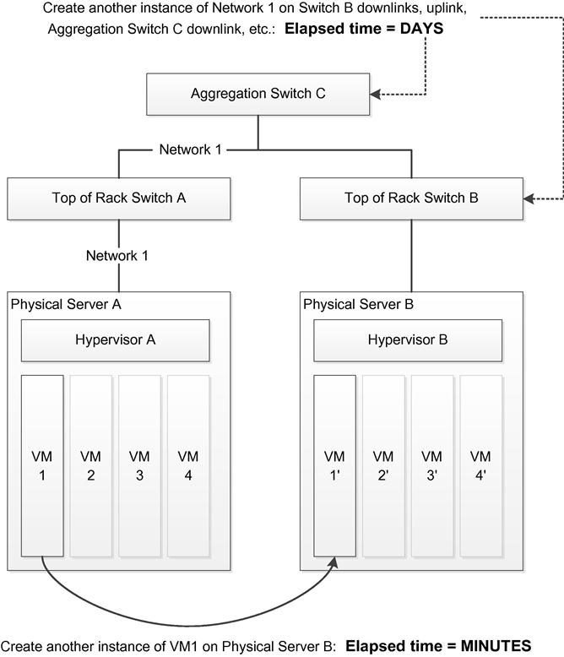
Inadequacies in Networks Today
In large part, networks and networking devices have evolved to overcome rare but severe failures such as outages and hardware or software failures. But the network today is slow in responding to frequent and immediate changes in data center.
The tasks of creating a new network, moving a new network, and removing a network are similar to those performed for servers and storage. Whereas the latter is achieved in minutes, the former needs work orders, coordination between server and networking administrators, physical or logical coordination of links, network interface cards (NICs), and ToR switches (to name a few).
SDN holds the promise that the time required for such network reconfiguration be
reduced to the order of minutes.

Slide 12
Inadequacies in Networks Today (Continued)
the control plane of legacy networks had sophisticated ways of autonomously and dynamically distributing layer two and layer three states,. But no corresponding protocols exist for distributing the policies that are used in policy-based routing (PBR).
configuring security policy, such as ACLs or virtualization policy such as to which VLAN a host belongs, remains static and manual in traditional networks. Therefore, the task of reconfiguring a network in a modern data center does not take minutes but rather days.
Such inflexible networks are hindering IT administrators in their attempts to automate and streamline their virtualized data center environments.
SDN holds the promise that the time required for such network reconfiguration be reduced to the order of minutes.

Slide 13
Data Center’s demand from NEMs
Automation - Automation allows networks to come and go at will, following the movements of servers and storage as needs change. This is sometimes referred to as agility—the ability to dynamically instantiate networks and to disable them when they are no longer needed. This must happen fast, efficiently, and with a minimum of human intervention. Not only do networks come and go—they also tend to expand and contract. Clearly, it may require a dynamic, agile, and automated network to keep pace with these changes.
Scalability - With data centers being in cloud environments, the sheer number of end stations that connect to a single network has grown exponentially. The limitations of MAC address table sizes and number of VLANs have become impediments to network installations and deployments. The large number of physical devices present in the data centers also poses a broadcast control problem. The use of tunnels and virtual networks can contain the number of devices in a broadcast domain to a reasonable number.

Slide 14
Data Center’s demand from NEMs (Continued)
Multitenancy - With the advances in data center technology coupled with the advent of cloud computing, the idea of hosting dozens or even hundreds or thousands of customers, or tenants, in the same physical data center has become a requirement. Multitenancy implies that the data center has to provide each of its multiple tenants with its own (virtual) network that it can manage in a manner similar to the way it would manage a physical network.

Slide 15
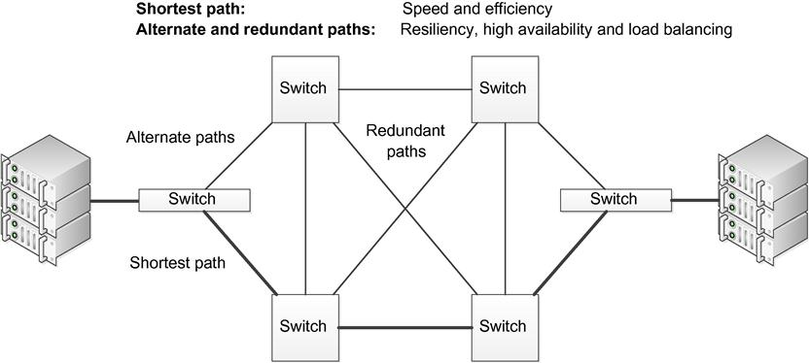
Data Center’s demand from NEMs (Continued)
Multipathing – In addition to scalability requirement the network must be efficient and reliable. The network must make optimal use of its resources. It must explore both shortest path and redundant paths so that multiple paths not be wasted by being blocked and, instead, be put into use to improve efficiency as well as to achieve resiliency and load balancing. it is to be resistant to failures of any kind and if failures do occur, the network must be able to recover within acceptable time frame. .

Slide 16
Network Virtualization
The urgency for automation, multitenancy, and multipathing has increased as a result of the scale and fluidity introduced by server and storage virtualization.
The general idea of virtualization is that the network administrator creates a higher-level abstraction that runs on top of the actual physical entity being abstracted. This means having a virtual abstraction of a network running on top of the actual physical network.
Some of these requirements are met to some degree by tunnels and other types of technologies, but fundamental network issues still remain.
Intelligent virtualization network software should be developed so that the network administrator should be able to create a network anytime and anywhere, as well as expanding and contracting networks that already exist.

Slide 17
Precursors of SDN
Project | Description
Open signaling | Separating the forwarding and control planes in ATM switching
Active networking | Separating control and programmable switches (late 1990s)
DCAN | Separating the forwarding and control planes in ATM switching (1997)
IP switching | Controlling layer two switches as a layer three routing fabric (late 1990s)
MPLS | Separating control software, establishing semi-static forwarding paths for flows in traditional routers (late 1990s). Used for TE, VPN.
Orchestration | Using SNMP and CLI to help automate networking configuration(2008)
Virtualization Manager | Using plug-ins to perform network support server virtualization (2011)
ForCES | Separating the forwarding and control planes (2003)
4D | Locating control plane intelligence in a centralized system (2005)
Ethane | Achieving complete enterprise and network access and control using separate forwarding and control planes and utilizing a centralized controller (2007)
RADIUS, COPS | Using admission control to dynamically provision policy (2010)

Slide 18
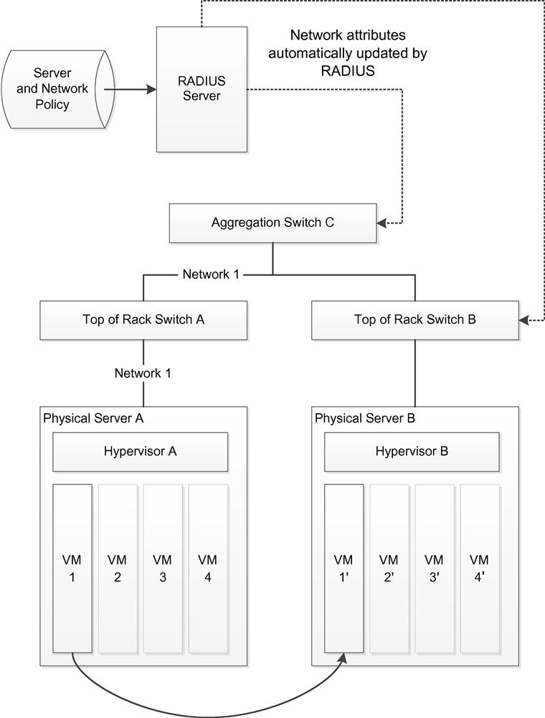
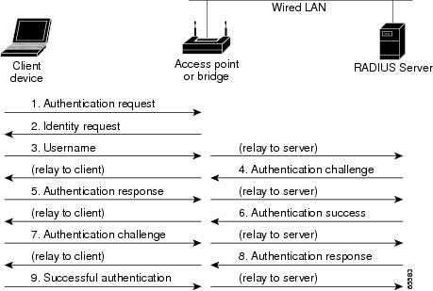
Network Access Control products
Remote Authentication Dial-In User Service (RADIUS) or Common Open Policy Service(COPS) are examples of network access control (NAC) products. These control access to a network based on policies established by the network administrator. E.g., the decision whether or not to admit a customer onto the network, is usually accomplished by
The exchange of credentials between the user and the network. This dynamic provisioning is usually delegated to separate dedicated server.

Slide 19
Orchestration
Early attempts at automation involved applications that were commonly labeled orchestrators. Just as a conductor can make a harmonious whole out of the divergent instruments of an orchestra, such applications could take a generalized command or goal and apply it across a wide range of often heterogeneous devices. These orchestration applications would typically utilize common device application programmer interfaces (APIs) such as the Command-Line Interface (CLI) or Simple Network Management Protocol(SNMP).

Slide 20
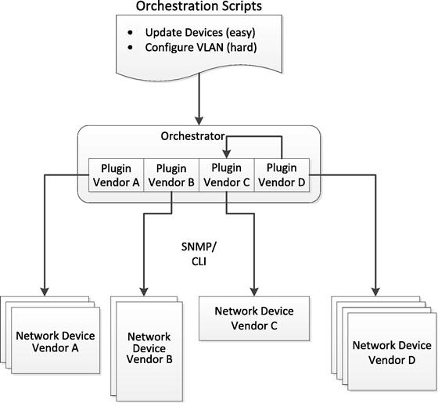
Orchestration (Continued)
The figure shows SNMP/CLI plug-ins for each vendor’s specific type of equipment; an orchestration solution can then have certain higher-level policies that are in turn executed at lower levels by the appropriate plugins. The vendor-specific plugins are used to convert the higher-level policy requests into the corresponding native SNMP or CLI request specific to each vendor.
An overview of the layout and operation of an orchestration management solution for automating the process of creating network connectivity for a virtual server.

Slide 21
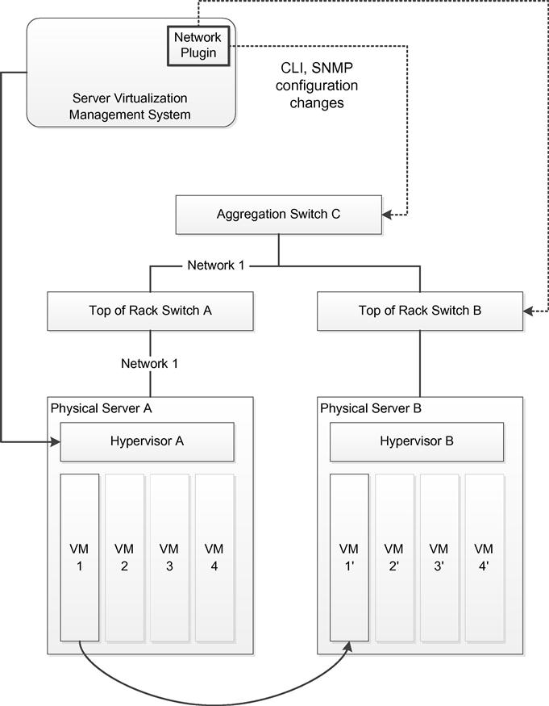
Virtualization Manager Network Plugins
The concept of virtualization manager network plugins builds on the notion of orchestration and attempts to automate the network updates that are required in a virtualization environment. Tools specifically targeted at the data center would often involve virtualization manager plugins (e.g., plugins for VMware’s vCenter, which would be configured to take action in the event of a server change, such as a vMotion . The plugins would then take the appropriate actions on the networking devices they controlled in order to make the network follow the server and storage changes with changes of its own. Generally, the mechanism for making changes to the network devices would be SNMP or CLI commands.

Slide 22
ForCES: Separation of Forwarding and Control Planes
ForCES was one of the original proposals recommending the decoupling of forwarding and control planes. The general idea of ForCES was to provide simple hardware-based forwarding entities at the foundation of a network device and software-based control elements above. These simple hardware forwarders were constructed using cell-switching or tag-switching technology. The software-based control had responsibility for the broader tasks, often involving coordination between multiple network devices (e.g., BGP routing updates).

Slide 23
ForCES (Continued)
The functional components of ForCES are as follows:
Forwarding Element - The Forwarding Element (FE) would be typically implemented in hardware and located in the network. The FE is responsible for enforcement of the forwarding and filtering rules that it receives from the controller.
Control Element - The Control Element (CE) is concerned with the coordination between the individual devices in the network and for communication forwarding and routing information to the FEs below.
Network Element - The Network Element (NE) is the actual network device that consists of one or more FEs and one or more CEs.
ForCES protocol - The ForCES protocol is used to communicate information back and forth between FEs and CEs.

Slide 24
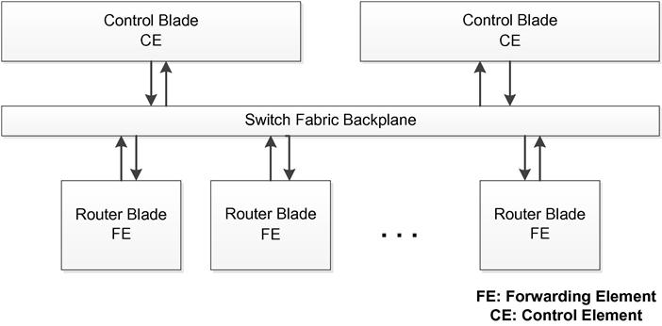
ForCES (Continued)
ForCES proposes the separation of the forwarding plane from the control plane, and it suggests two different embodiments of this architecture. In one of these embodiments, both the forwarding and control elements are located within the networking device. The other embodiment speculates that it would be possible to actually move the control element(s) off the device and to locate them
on an entirely different system. Although the suggestion of a separate controller thus exists in ForCES, the emphasis is on the communication between CE and FE over a switch backplane, as shown in the adjacent figure.

Slide 25
Centralized Network Control – 4D Architecture
Seminal work on the topic of moving networking technology from distributed networking elements into a centralized controller appeared in the 4D proposal – “A Clean Slate 4D Approach to Network Control and Management”.
4D stands for the architecture’s 4 planes, namely –
- Decision : all management and control logic
- Dissemination : communicating with routers
- Discovery : topology and traffic monitoring
- Data : packet handling
4D argues that the state of networking today is fragile and, often teeters on the edge of failure because of its design is based on distributed, autonomous systems. Such systems exhibit a defining characteristic of unstable, complex systems: a small local event such as a mis-configuration of a routing protocol can have a severe, global impact. The proposal argues that the root cause is the fact that the control plane is running on the network elements themselves.
Network-level objectives
Network-wide views
Decision
Dissemination
Direct control
Discovery
Data

Slide 26
4D Continued
4D centers around three design principles:
- Network-level objectives: In short, the goals and objectives for the network system should be stated in network-level terms based on the entire network domain, separate from the network elements, rather than in terms related to individual network device performance.
- Network-wide view: There should be a comprehensive understanding of the whole network. Topology, traffic, and events from the entire system should form the basis on which decisions are made and actions are taken.
- Direct control: The control and management systems should be able to exert direct control over the networking elements, with the ability to program the forwarding tables for each device rather than only being able to manipulate some remote and individual configuration parameters, as is the case today.

Slide 27
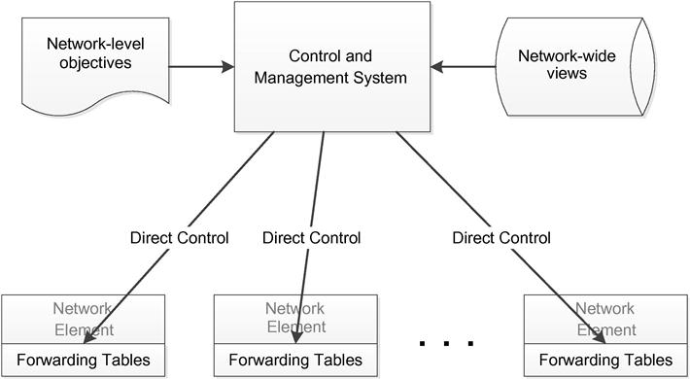
4D Continued
4D indeed emphasised for a clean slate approach, meaning the abandoning of the current manner of networking in favor of this new architecture. Alongwith it delineates some challenges to be faced by the proposed centralized architecture:
- Latency: Nontrivial round-trip latency as the networking element requests policy directions from the controllerScale: as more and more network devices are added to the network, questions arise of scale and the ability of a single controller to handle all those devices.
The general architecture of a 4D solution, with centralized network control via the control and management system.
High availability (HA): The centralized controller must not constitute a single point of failure for the network. This implies the need for redundancy schemes in a number of areas.
Security: Having a centralized controller means that security attacks are able to focus on that one point of failure, and thus the possibility exists that this type of solution is more vulnerable to attack than a more distributed system.

Slide 28
Ethane: Controller-Based Network Policy

Slide 29
Network Virtualization – Nicira Architecture
Nicira Architecture is based on the following 7 design phylosophy:
1. Independence from network hardware
2. Faithful reproduction of the physical network service model
3. Following an operational model of compute virtualization
4. Compatibility with any hypervisor platform
5. Secure isolation among virtual networks, the physical networks, and the control plane
6. Cloud performance and scale
7. Programmatic network provisioning and control

Slide 30
Fundamental Characteristics of SDN
Plane Separation: The first fundamental characteristic of SDN is the separation of the forwarding and control planes.
Forwarding functionality, including the logic and tables for choosing how to deal with incoming packets based on characteristics such as MAC address, IP address, and VLAN ID, resides in the forwarding plane.
The fundamental actions performed by the forwarding plane can be described by the way it dispenses with arriving packets. It may forward, drop, consume, or replicate an incoming packet.
For basic forwarding, the device determines the correct output port by performing a lookup in the address table in the hardware ASIC. A packet may be dropped due to buffer overflow conditions or due to specific filtering resulting from a QoS rate-limiting function, for example.
In case of forwarding pertaining to multicast, the incoming packet must be replicated before forwarding the various copies out different output ports.
Special-case packets that require processing by the control or management planes are consumed and passed to the appropriate plane.

Slide 31
Fundamental Characteristics of SDN (Continued)
Control Plane: The protocols, logic, and algorithms that are used to program the forwarding plane reside in the control plane. Many of these protocols and algorithms require global knowledge of the network. The control plane determines how the forwarding tables and logic in the data plane should be programmed or configured.
Since in a traditional network each device has its own control plane, the primary task of that control plane is to run routing or switching protocols so that all the distributed forwarding tables on the devices throughout the network stay synchronized. This software-based controller manages the network using higher-level policies.
Instead of hundreds of thousands of lines of complicated control plane software running on a device and allowing the device to behave autonomously, that software is removed from the device and placed in a centralized controller.
The controller then provides primitive instructions to the simplified devices when appropriate in order to allow them to make fast decisions about how to deal with incoming packets

Slide 32
Network Automation and Virtualization
Three basic abstractions precisely forms the basis for SDN, namely
- distributed state abstraction
- forwarding abstraction
- configuration abstraction

Slide 33
The distributed state abstraction provides the network programmer with a global network view that shields the programmer from the realities of a network that is actually comprised of many machines, each with its own state, collaborating to solve network-wide problems.
The forwarding abstraction allows the programmer to specify the necessary forwarding behaviors without any knowledge of vendor-specific hardware. This implies that whatever language or languages emerge from the abstraction need to represent a sort of lowest common denominator of forwarding capabilities of network hardware.
The configuration abstraction, which is sometimes called the specification abstraction, must be able to express the desired goals of the overall network without getting lost in the details of how the physical network will implement those goals.

Slide 34
Characteristic of SDN
Openness: A characteristic of Open SDN is that its interfaces should remain standard, well documented, and not proprietary.
The APIs that are defined should give software sufficient control to experiment with and control various control plane options. The premise is that keeping open both the northbound and southbound interfaces to the SDN controller will allow researchers to innovative new methods of network operation.
Research institutions as well as entrepreneurs can take advantage of this capability in order to easily experiment test new ideas.
Hence the speed at which network technology is developed and deployed is greatly increased as much larger numbers of individuals and organizations are able to apply themselves to today’s network problems, resulting in better and faster technological advancement in the structure and functioning of networks.

Slide 35
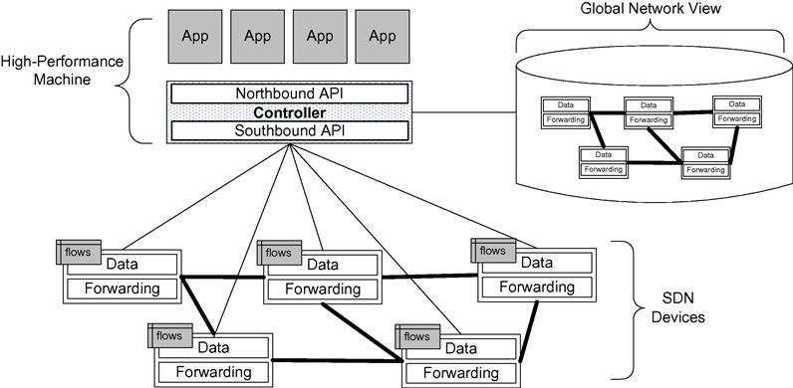
SDN Operation
At a conceptual level, the behavior and operation of a Software Defined Network is straightforward. the SDN devices contain forwarding functionality for deciding what to do with each incoming packet. The devices also contain the data that drives those forwarding decisions. The data itself is actually represented by the flows defined by the controller, as depicted in the upper-left portion of each device.
SDN operation overview.

Slide 36
SDN Operation (Continued)
A flow describes a set of packets transferred from one network endpoint (or set of endpoints) to another endpoint (or set of endpoints). The endpoints may be defined as IP address-TCP/UDP port pairs, VLAN endpoints, layer three tunnel endpoints, and input ports, among other things. One set of rules describes the forwarding actions that the device should take for all packets belonging to that flow. A flow is unidirectional in that packets flowing between the same two endpoints in the opposite direction could each constitute a separate flow. Flows are represented on a device as a flow entry.

Slide 37
SDN Operation (Continued)
A flow table resides on the network device and consists of a series of flow entries and the actions to perform when a packet matching that flow arrives at the device. When the SDN device receives a packet, it consults its flow tables in search of a match. These flow tables had been constructed previously when the controller downloaded appropriate flow rules to the device. If the SDN device finds a match, it takes the appropriate configured action, which usually entails forwarding the packet. If it does not find a match, the switch can either drop the packet or pass it to the controller, depending on the version of OpenFlow and the configuration of the switch. The definition of a flow is a relatively simple programming expression of what may be a very complex control plane calculation previously performed by the controller.

Slide 38
SDN Operation (Continued)
The SDN controller is responsible for abstracting the network of SDN devices it controls and presenting an abstraction of these network resources to the SDN applications running above. The controller allows the SDN application to define flows on devices and to help the application respond to packets that are forwarded to the controller by the SDN devices. In the last figure we see on the right side of the controller that it maintains a view of the entire network that it controls. This permits it to calculate optimal forwarding solutions for the network in a deterministic, predictable manner. Since one controller can control a large number of network devices, these calculations are normally performed on a high-performance machine with an order-of-magnitude performance advantage over the CPU and memory capacity than is typically afforded to the network devices themselves.

Slide 39
SDN Application – Traffic Flow
SDN applications are built on top of the controller. These applications should not be confused with the application layer defined in the seven-layer OSI model of computer networking. Since SDN applications are really part of network layers two and three, this concept is orthogonal to that of applications in the tight hierarchy of OSI protocol layers. The SDN application interfaces with the controller, using it to set proactive flows on the devices and to receive packets that have been forwarded to the controller. Proactive flows are established by the application; typically the application will set these flows when the application starts up, and the flows will persist until some configuration change is made. This kind of proactive flow is known as a static flow. Another kind of proactive flow is where the controller decides to modify a flow based on the traffic load currently being driven through a network device.

Slide 40
SDN Application – Traffic Flow(Continued)
In addition to flows defined proactively by the application, some flows are defined in response to a packet forwarded to the controller. Upon receipt of incoming packets that have been forwarded to the controller, the SDN application will instruct the controller as to how to respond to the packet and, if appropriate, will establish new flows on the device in order to allow that device to respond locally the next time it sees a packet belonging to that flow. Such flows are called reactive flows. In this way, it is now possible to write software applications that implement forwarding, routing, overlay, multipath, and access control functions, among others.

Slide 41
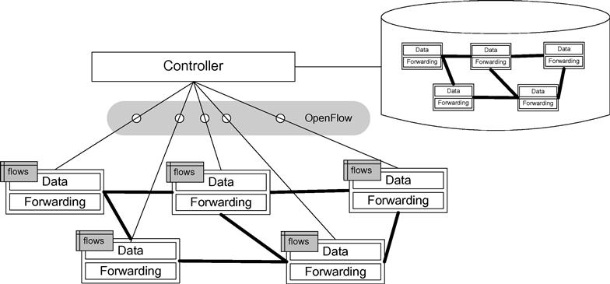
SDN Application – Traffic Flow(Continued)
There are also reactive flows that are defined or modified as a result of stimuli from sources other than packets from the controller. For example, the controller can insert flows reactively in response to other data sources such as intrusion detection systems (IDS) or the NetFlow traffic analyzer .
The adjacent figure depicts the OpenFlow protocol as the means of communication between the controller and the device. OpenFlow is currently the defined standard for such communication in Open SDN.
Controller-to-device communication.

Slide 42
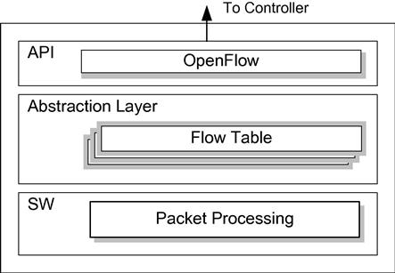
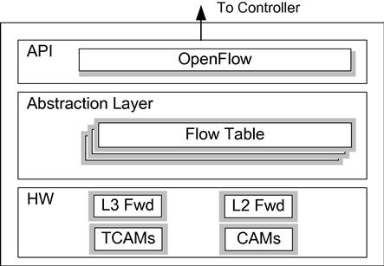
SDN Devices
An SDN device is composed of an API for communication with the controller, an abstraction layer, and a packet-processing function. In the case of a virtual switch, this packet-processing function is packet-processing software, as shown in the figure. In the case of a physical switch, the packet-processing function is embodied in the hardware for packet-processing logic, as shown in the figure.
SDN software switch anatomy
SDN software switch anatomy

Slide 43
SDN Devices (Continued)
The abstraction layer embodies one or more flow tables. The packet-processing logic consists of the mechanisms to take actions based on the results of evaluating incoming packets and finding the highest-priority match. When a match is found, the incoming packet is processed locally unless it is explicitly forwarded to the controller. When no match is found, the packet may be copied to the controller for further processing. This process is also referred to as the controller consuming the packet. I
In the case of a hardware switch, these mechanisms are implemented by the specialized hardware. In the case of a software switch, these same functions are mirrored by software. Such a software switch is implemented as an application usually running in conjunction with a hypervisor in a data center rack. Like a VM, the virtual switch can be instantiated or moved under software control. It normally serves as a virtual switch and works collectively with a set of other such virtual switches to constitute a virtual network.

Slide 44
Flow Tables
Flow tables are the fundamental data structures in an SDN device. These flow tables allow the device to evaluate incoming packets and take the appropriate action based on the contents of the packet that has just been received. Packets have traditionally been received by networking devices and evaluated based on certain fields. Depending on that evaluation, actions are taken. These actions may include forwarding the packet to a specific port, dropping the packet, or flooding the packet on all ports, among others. An SDN device is not fundamentally different except that this basic operation has been rendered more generic and more programmable via the flow tables and their associated logic.
Flow tables consist of a number of prioritized flow entries, each of which typically consists of two components: match fields and actions. Match fields are used to compare against incoming packets. An incoming packet is compared against the match fields in priority order, and the first complete match is selected. Actions are the instructions that the network device should perform if an incoming packet matches the match fields specified for that flow entry.

Slide 45
Flow Tables (Continued)
Match fields can have wildcards for fields that are not relevant to a particular match. For example, when matching packets based just on IP address or subnet, all other fields would be wildcarded. Similarly, if matching on only MAC address or UDP/TCP port, the other fields are irrelevant, and consequently those fields are wildcarded. Depending on the application needs, all fields may be important, in which case there would be no wildcards. The flow table and flow entry constructs allow the SDN application developer to have a wide range of possibilities for matching packets and taking appropriate actions.

Slide 46
SDN Software Switches
The previous figure is a depiction of a purely software-based SDN device. Implementation of SDN devices in software is the simplest means of creating an SDN device, because the flow tables, flow entries, and match fields involved are easily mapped to general software data structures, such as sorted arrays and hash tables.
Due to the use of wildcards in matching, which poses a problem for typical hash tables, the packet-processing function depicted in the figure uses sophisticated software logic to implement efficient match field lookups.
Software SDN device implementations suffer less from resource constraints . Hence the ceiling on the number of flow entries on a software SDN device may be orders of magnitude larger than a typical hardware SDN device.
Software SDN device implementations are most often found in the hypervisors of a virtualization system. These hypervisors often incorporate a software switch implementation that connects the various virtual machines to the virtual network. The virtual switch working with a hypervisor is a natural fit for SDN. In fact, the whole virtualization system is often controlled by a centralized management system, which also meshes well with the centralized controller aspect of the SDN paradigm.

Slide 47
Hardware SDN Devices
Hardware implementations of SDN devices hold the promise of operating much faster than their software counterparts and, thus, are more applicable to performance-sensitive environments, such as in data centers and network cores.
Hardware SDN devices utilize specialized hardware designed to facilitate the inspection of incoming packets and the subsequent decisions that follow based on the packet-matching operation.
However, it also presents a series of challenges to the SDN device developer. Specifically:
How best to translate from flow entries to hardware entries; for example, how best to utilize the CAMs, TCAMs, or hardware-based hash tables?
Which of the flow entries to handle in hardware versus how many to fall back to using software?
How to deal with hardware action limitations that may impact whether to implement the flow in hardware versus software?
How to track statistics on individual flows?
These and other factors will impact the quality, functionality, and efficiency of the SDN device being developed and must be considered during the design process. For example, hardware table sizes may limit the number of flows, and hardware table capabilities may limit the breadth and depth of special features supported. The limitations presented by a hardware SDN device might require adaptations to SDN applications in order to interoperate with multiple heterogeneous types of SDN devices.

Slide 48
SDN Controller
SDN Controller maintains a view of the entire network, implements policy decisions, controls all the SDN devices that comprise the network infrastructure, and provides a northbound API for applications. Policy decisions are regarding routing, forwarding, redirecting, load balancing, and the like.
Controllers often come with their own set of common application modules, such as a learning switch, a router, a basic firewall, and a simple load balancer. These are really SDN applications, but they are often bundled with the controller.

Slide 49
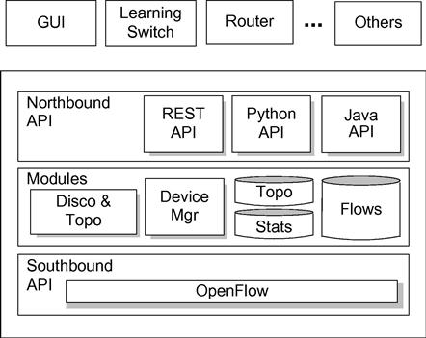
Anatomy of SDN Controller
The figure depicts the modules that provide the controller’s core functionality, both a northbound and a southbound API, and a few sample applications that might use the controller.
the southbound API (e.g. OpenFlow) is used to interface with the SDN devices.
OpenFlow’s companion protocol, OF-Config, and Nicira’s Open vSwitch Database Management Protocol (OVSDB) are both open protocols for the southbound interface, though these are limited to configuration roles.
there is currently no northbound counterpart to the southbound OpenFlow standard or even the de facto legacy standards.
Currently there is no northbound counterpart to the southbound OpenFlow standard or
even the de facto legacy standards.

Slide 50
Core Modules of SDN Controller
The controller abstracts the details of the SDN controller-to-device protocol so that the applications above are able to communicate with those SDN devices without knowing their nuances. The core features in the controller include:
End-user device discovery: Discovery of end-user devices such as laptops, desktops, printers, mobile devices, and so on.
Network device discovery: Discovery of network devices that comprise the infrastructure of the network, such as switches, routers, and wireless access points.
Network device topology: management. Maintain information about the interconnection details of the network devices to each other and to the end-user devices to which they are directly attached.
Flow management: Maintain a database of the flows being managed by the controller and perform all necessary coordination with the devices to ensure synchronization of the device flow entries with that database.
The core functions of the controller are device and topology discovery and tracking, flow management, device management, and statistics tracking. The controller maintains a flow cache that mirrors the flow tables on the various switches it controls. It locally maintains per-flow statistics that it has gathered from its switches.

Slide 51
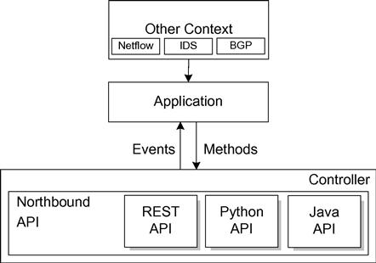
SDN Controller Interfaces
SDN controller provides northbound API being used to access the network devices in a common and consistent manner. Applications are aware of individual devices but is shielded from their differences. In other instances the controller may provide high-level APIs that give an abstraction of the network itself, so that the application developer need not be concerned with individual devices but rather with the network as a whole.
The controller informs the application of events that occur in the network. Events may pertain to an individual packet that has been received by the controller or some state change in the network topology, such as a link going down. Applications use different methods to affect the operation of the network. Such methods may be invoked in response to a received event and may result in a received packet being dropped, modified, and/or forwarded or the addition, deletion, or modification of a flow. The applications may also invoke methods independently, without the stimulus of an event from the controller, represented by the “Other Context” box in the figure.

Slide 52
Current SDN Controllers

Slide 53
Potential Issues with the SDN Controller
A centralized control architecture needed to grapple with the issues of latency, scale, high availability, and security.
The centralized SDN controller will need to confront the challenges of coordination between applications, the lack of a standard northbound API, and flow prioritization.
When more than one SDN application is running on a single controller, issues related to application prioritization and flow handling become pertinent. For example, when an event occurs, which application should handle the event first. Should the first application pass along this event to the next application in line, or can it deem the processing complete, in which case no other applications get a chance to examine and act on the received event.
The lack of an emerging standard for the northbound API is another moot point, stymieing efforts to develop applications that will be reusable across a wide range of controllers.
How does the controller appropriately interleave the flows from all applications? This is a challenge and requires special coordination between the applications.

Slide 54
SDN Applications
SDN applications run above the SDN controller, interfacing to the network via the controller’s northbound APIs.
SDN applications are ultimately responsible for managing the flow entries that are programmed on the network devices using the controller’s APIs to manage flows.
Through these APIs the applications are able to:
configure the flows to route packets through the best path between two endpoints
balance traffic loads across multiple paths or destined to a set of endpoints
react to changes in the network topology such as link failures and the addition of new devices and paths
redirect traffic for purposes of inspection, authentication, segregation, and similar security-related tasks.

Slide 55
SDN Application Responsibilities
The general responsibility of an SDN application is to perform whatever function for which it was designed, whether load balancing, firewalling, or some other operation (like implementation of GUI for managing the controller, a learning switch, and/or a routing application)
Other than handling of events, SDN applications have to respond to external inputs that could include network monitoring systems such as Netflow, IDS, or BGP peers. .
The SDN application registers as a listener for certain events, and the controller will invoke the application’s callback method whenever such an event occurs with appropriate details related to the event. Some examples of events handled by an SDN application are end-user device discovery, network device discovery, and incoming packet.

Slide 56
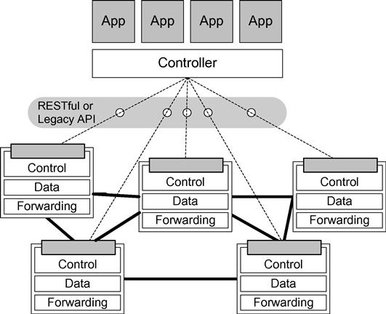
SDN via existing APIs
A richer set of control points are implemented on the devices, which the central controller can invoke to provide the intelligent and predictable network behavior . The APIs are invoked via traditional methods such as SNMP or CLI or by the newer, more flexible mechanisms provided by RESTful APIs.
The genesis of this idea derives from the fact that legacy switches all afford some degree of control over forwarding decisions via their existing management interfaces. By providing a simplifying abstraction to this plethora of interfaces, some network programmability can be gained by this approach and huge investment on legacy switches are protected.
But these will be eventually phased out as they are geared toward relatively rare static tasks and
not for the dynamic, frequent, and automated tasks required such as in today’s data centers.

Slide 57
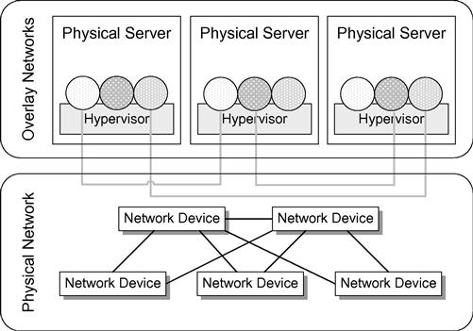
SDN via Hypervisor-Based Overlay Networks
In this scheme, the current physical network is left as it is, with networking devices and their configurations remaining unchanged. Above that, however, hypervisor-based virtualized networks are erected. The systems at the edges of the network interact with these virtual networks, which obscure the details of the physical network from the devices that connect to the overlays.
The SDN applications making use of these overlay network resources are given access to a
virtualized networks and ports, which are abstract in nature and do not necessarily relate directly
to their physical counterparts below.
The hypervisors inject traffic into the virtual network and receive traffic from it. The traffic of the
virtual networks is passed through those physical devices, but the endpoints are unaware of the
details of the physical topology, the way routing occurs, or other basic network functions. Since
these virtual networks are controlled entirely by the devices at the very edge of the network.

Slide 58
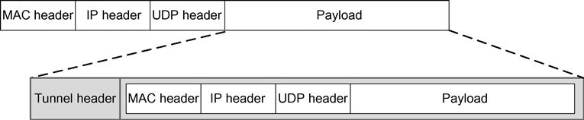
SDN via Hypervisor-Based Overlay Networks (Continued)
The mechanism that makes this possible is tunneling, which uses encapsulation. When a packet enters the edge of the virtual network at the source, the networking device (usually the hypervisor) will take the packet in its entirety and encapsulate it within another frame.
The edge of the virtual network is called a tunnel endpoint or virtual tunnel endpoint (VTEP).
The hypervisor takes this encapsulated packet and, based on information programmed by the controller, sends it to the destination’s VTEP. This VTEP decapsulates the packet and forwards it to the destination host. As the encapsulated packet is sent across the physical infrastructure, it is being sent from the source’s VTEP to the destination’s VTEP. Consequently, the IP addresses are those of the source and destination VTEP.
This tunneling mechanism is referred to as MAC-in-IP tunneling . Different vendors have established their own proprietary methods for it. . Specifically, Cisco offers VXLAN, Microsoft uses NVGRE , and Nicira’s is called STT.

Slide 59
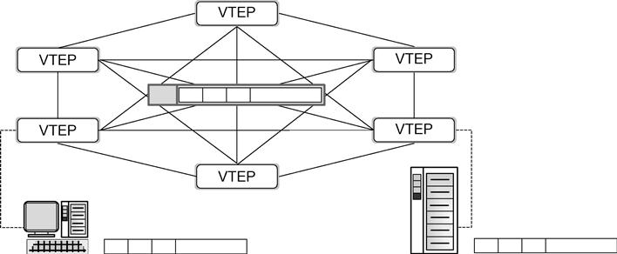
Virtual tunnel endpoints
The roles of VTEPs as they serve the source and destination host devices are depicted in the adjacent figure. The topology of a virtual network consists of the virtual switches interconnected by virtual point-to-point links. The virtual switches are depicted as the VTEPs, and the virtual links are the tunnels interconnecting them.
All the traffic on each virtual network is encapsulated as mac-in-ip as shown in previous figure and sent VTEP-to-VTEP.
Multiple overlay networks can exist independently and simultaneously over the same physical network.
Multiple overlay networks can exist independently and simultaneously over the same physical network.

Slide 60
Efficacy and shortcomings of hypervisor-based overlay networks
SDN via hypervisor-based overlay networks is well suited to environments such as data centers already running compute and storage virtualization software for their servers. It does address a number of the needs of an SDN solution, namely:
it addresses MAC address explosion in data centers and cloud environments because all those host MAC addresses are hidden within the encapsulated frame.
it addresses VLAN limitations because all traffic is tunneled and VLANs are not required for supporting the isolation of multiple tenants.
it addresses agility and automation needs because it is implemented in software, and these virtual networks can be constructed and taken down in a fraction of the time that would be required to change the physical network infrastructure.
SDN via hypervisor-based overlay networks, however does not address the following:
it do not address existing issues within the physical infrastructure, which still requires manual configuration and maintenance.
It do not address traffic prioritization and efficiency in the physical infrastructure, so confronting STP’s blocked links and QoS settings continues to challenge the network engineer.

