Slide 1
Network Virtualization with Mininet
What is Network Virtualization and how it is implemented
Examples of network virtualization and applications
Virtual networking emulation by Mininet
Mininet is essentially a virtual network environment that runs on a single PC. This network conforms to OpenFlow specification and various features of the later is already built in it. It is very useful in learning and doing various experimentation with SDN and OpenFlow in particular.
Mininet runs a real kernel, it can run real switch software, and it can run real application code on a single machine. It provides Command-line graphical user interfaces and Python interfaces to interact with it.
It's very easy to set up a network in Mininet. It's also possible and actually very easy to create custom topologies.
Hosts in the Mininet environment can actually run real programs. So anything that can run on Linux can actually run on a Mininet host as well. That's because Mininet uses OS virtualization.
It supports programmable open flow switches. One can create a virtual network in Mininet, and connect a real open flow controller to real software open flow switches, that are running in the virtual network environment.

Slide 2
Alternative Network Virtualized Environment
Real system
- One can build the network by deploying real physical device (like, switches, routers and appropriately wiring all of them). But that’s time consuming and pain to configure and rewire and reconfigure for new network. But Mininet makes it fairly easy to reconfigure these types of topologies because it's all in software.
Networked VMs
Another option is to use lot and lot virtual machines and networked them together by using software switch that’s running on the host. The problem with that is that, typically virtual machines are fairly heavy weight, so there's a limit to the number of virtual machines that you can run concurrently on a single host. So, one of the advantages to Mininet is that the OS based virtualization that it uses is lightweight enough that it can support hundreds, or potentially even thousands of hosts even on a single PC.
Simulator
By using network simulator. But the problem with that is that there's no clear path to hardware deployment. In particular, because everything is simulated and there's no real running software, and time or timing is not necessarily accurate, then it can be somewhat unclear how to transition an experiment that's run in simulation to a real working deployment.

Slide 3
Simple Mininet Setup
Testing a Simple Mininet Setup
hosts connected to a single switch:
sudo mn --test pingall --topo single,3
This setup uses a default switch controller and switch.Mininet also allows you to use custom remote controllers (and custom switches)

Slide 4
Basic Mininet Command Line
--topo – defines a topology via command line upon mininet start-up.
--switch – defines the switch to be used. By default the OVSK software switch is used.
--controller – defines the controller to be used. If unspecified default controller is used with a default hub behavior.

Slide 5
Mininet networks by example
Minimal network with two hosts, one (1) switch
sudo mn –topo minimal
Example with 4 hosts and 4 switches
sudo mn --topo linear,4
Example with 3 hosts all connected to one switch.
sudo mn --topo single,3
Tree topology with defined depth and fan-out.
sudo mn --topo tree,depth=2,fanout=2

Slide 6
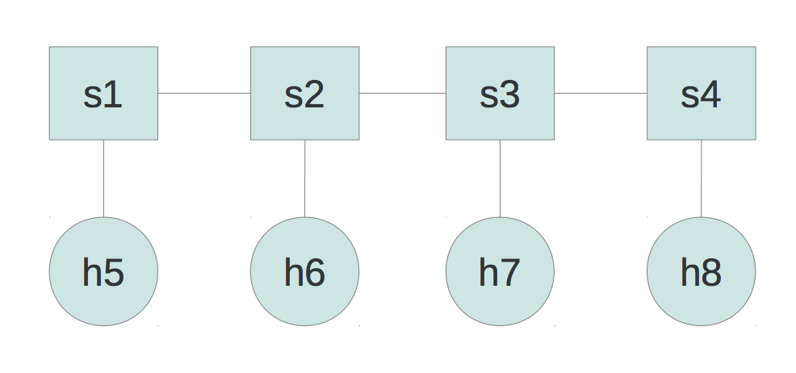
How mn works
“mn” is a launch script that executes Python.
Consider: “—topo = linear, 4”
From mininet.net import Mininet
From mininet.topo import LinearTopo
Linear = LinearTopo(k=4)
Net = Mininet(topo=Linear)
net.start()
net.pingAll()
net.stop()

Slide 7
Mininet Custom Topologies
Example: Two hosts, one switch
mininet.cli.CLI(net) before net.stop() will escape to interactive CLI before script terminates.
addLink allows you to specify:
Bandwidth (bw) in Mbps, Delay(delay), Maximum Queue Size(max_queue_size), Loss (loss) in percentage

Slide 8
Mininet Custom N/W setup
From mininet.net import Mininet
From mininet.util import createLink
Net = Mininet()
#Creating nodes in the network.
C0 = net.addController()
H0 = net.addHost('h0')
S0 = net.addSwitch('s0')
H1 = net.addHost('h1')
# Creating links between nodes in network (2 --‐ ways)
net.addLink(h0, s0)
net.addLink(h1,s0)
#Configuration of IP addresses in Interfaces h0.setIP('192.168.1.1',24)
h1.setIP('192.168.1.2',24)
net.start()
net.pingAll()
net.stop()

