Slide 1
What is Open Flow?
It's a protocol for control the forwarding behavior of Ethernet switches in a Software Defined Network. Initially released by the Clean Slate Program at Stanford, its specification is now maintained by the Open Networking Forum.
Provides open interface to “black box” networking node (ie. Routers, L2/L3 switch) to enable visibility and openness in network
Separation of control plane and data plane.
The datapath of an OpenFlow Switch consists of a Flow Table, and an action associated with each flow entry
The control path consists of a controller which programs the flow entry in the flow table
OpenFlow is like an x86 instruction set for the network nodes.

Slide 2
History of OpenFlow
History of OpenFlow
❑ 2006: Martin Casado, a PhD student at Stanford and team
propose a clean-slate security architecture (SANE) which defines a
centralized control of security (in stead of at the edge as normally done).
Ethane generalizes it to all access policies.
❑ April 2008: OpenFlow paper in ACM SIGCOMM CCR
❑ 2009: Stanford publishes OpenFlow V1.0.0 specs
❑ June 2009: Martin Casado co-founds Nicira
❑ March 2010: Guido Appenzeller, head of clean slate lab at Stanford, cofounds
Big Switch Networks
❑ March 2011: Open Networking Foundation is formed
❑ Oct 2011: First Open Networking Summit.
Juniper, Cisco announce plans to incorporate.
❑ July 2012: VMware buys Nicira for $1.26B
❑ Nov 6, 2013: Cisco buys Insieme for $838M

Slide 3
Need for OpenFlow
Facilitate Innovation in Network
Layered architecture with Standard Open Interfaces
Independent innovation at each layer
More accessibility since software can be easily developed by more vendors
Speed-to-market – no hardware fabrication cycles
More flexibility with programmability and ease of customization and integration with other software applications
Fast upgrades
Program a network vs Configure a network

Slide 4
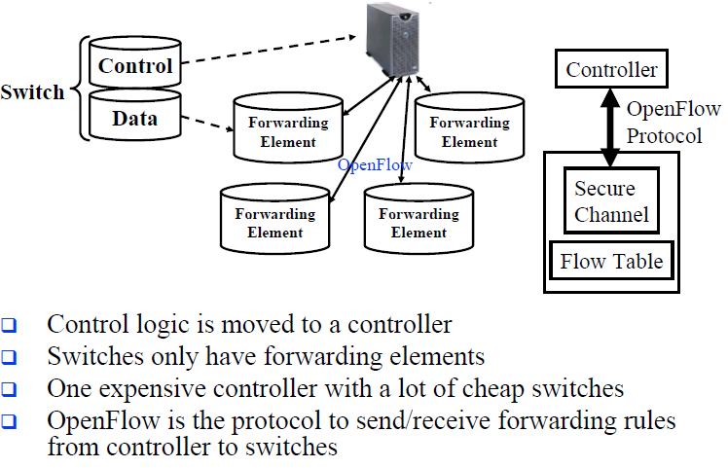
Open Flow Protocol

Slide 5
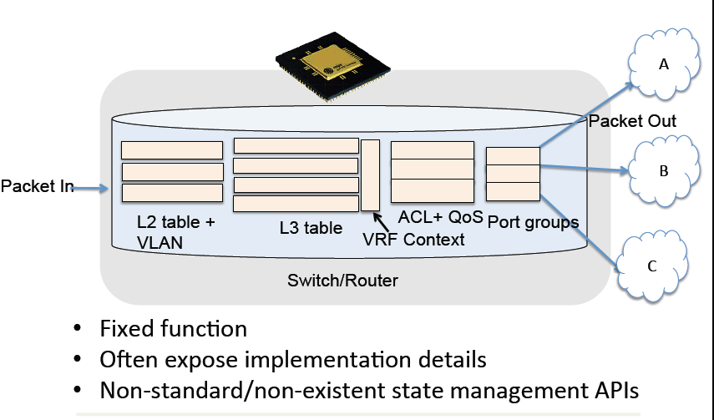
Traditional Switch Forwarding
Source: Adopted from ONF11 presentation by Martin Casado
Notes:
Kasado

Slide 6
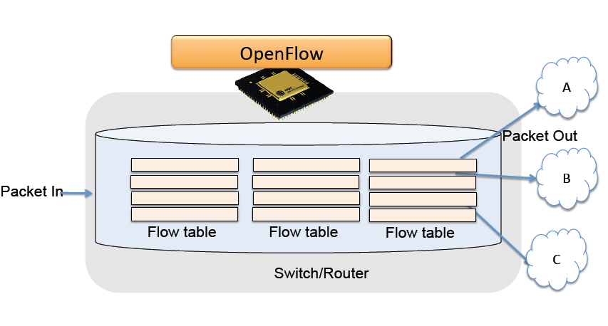
Open Flow Switch Forwarding
Source: Adopted from ONF11 presentation by Martin Casado
Notes:
Kasado

Slide 7
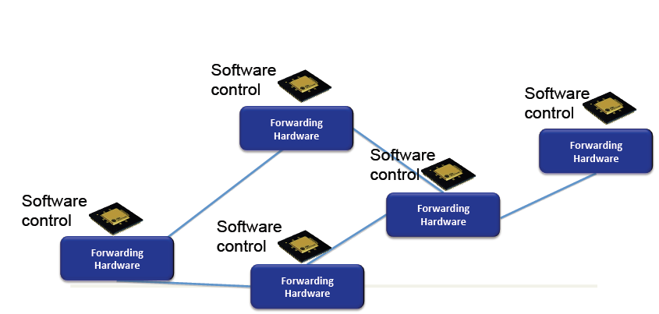
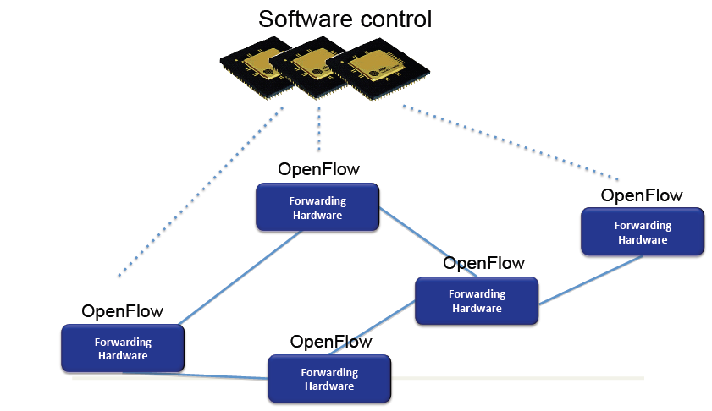
Open Flow Illustration
Source: Adopted from ONF11 presentation by Martin Casado

Slide 8


Components of OpenFlow Network
Controller
OpenFlow Switch
OpenFlow Switch specification
OpenFlow
Protocol
PC
Secure
Channel
TCP / TLS
sw
Flow
Table
hw
* Figure From OpenFlow Switch Specification

Slide 9
OpenFlow Controller
Manages one or more switch via OpenFlow channels.
Uses OpenFlow protocol to communicate with a OpenFlow aware switch.
Acts similar to control plane of traditional switch.
Provides a network wide abstraction for the applications on north bound.
Responsible for programming various tables in the OpenFlow Switch.
Single switch can be managed by more than one controller for load balancing or redundancy purpose. In this case the controller can take any one of the following roles.
Master.
Slave.
Equal.

Slide 10
OpenFlow Channel
Used to exchange OpenFlow message between switch and controller.
Switch can establish single or multiple connections to same or different controllers (auxiliary connections).
A controller configures and manages the switch, receives events from the switch, and send packets out the switch via this interface
The SC connection is a TLS/TCP connection. Switch and controller mutually authenticate by exchanging certificates signed by a site-specific private key

Slide 11
OpenFlow Switch
Consists of one or more flow tables, group table and meter table.
A single switch can be managed by one or more controllers.
The flow tables and group table are used during the lookup or forwarding phase in order to forward the packet to appropriate port.
Meter table is used to perform simple QOS operations like rate-limiting to complex QOS operations like DiffServ etc

Slide 12
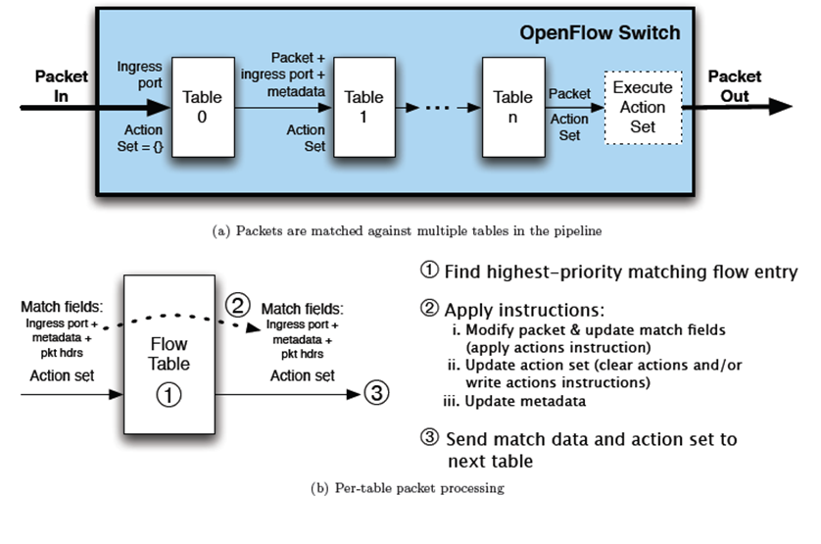
Pipeline Processing
* Figure From OpenFlow Switch Specification

Slide 13
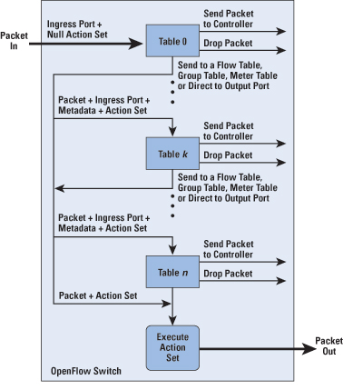
Packet Flow in OpenFlow Switch
* Figure From OpenFlow Switch Specification

Slide 14



OpenFlow usage
Controller
Alice’s Rule
Alice’s code
OpenFlow Switch
PC
Decision?
OpenFlow
Protocol
Alice’s Rule
Alice’s Rule
OpenFlow Switch
OpenFlow Switch
OpenFlow offloads control intelligence to a remote software
Notes:
14
14
How the actual protocol works

Slide 15
OpenFlow Example
Controller
OpenFlow Client
PC
Software
Layer
Flow Table
MAC
src
MAC
dst
IP
Src
IP
Dst
TCP
sport
TCP
dport
Action
Hardware
Layer
*
*
*
5.6.7.8
*
*
port 1
port 1
port 2
port 3
port 4
5.6.7.8
1.2.3.4

Slide 16
OpenFlow Basics Flow Table Entries
Rule
Action
Stats
Packet + byte counters
Forward packet to zero or more ports
Encapsulate and forward to controller
Send to normal processing pipeline
Modify Fields
Any extensions you add!
Switch
Port
VLAN
ID
VLAN
pcp
MAC
src
MAC
dst
Eth
type
IP
Src
IP
Dst
IP
ToS
IP
Prot
L4
sport
L4
dport
+ mask what fields to match
Notes:
Now I’ll describe the API that tries to meet these goals.

Slide 17
OpenFlow usage
Controller
Alice’s Rule
Alice’s code
OpenFlow Switch
PC
Decision?
OpenFlow
Protocol
Alice’s Rule
Alice’s Rule
OpenFlow Switch
OpenFlow Switch
OpenFlow offloads control intelligence to a remote software
Notes:
17
17
How the actual protocol works

Slide 18
OpenFlow: a pragmatic compromise
+ Speed, scale, fidelity of vendor hardware
+ Flexibility and control of software and simulation
Vendors don’t need to expose implementation
Leverages hardware inside most switches today (ACL tables)

Slide 19
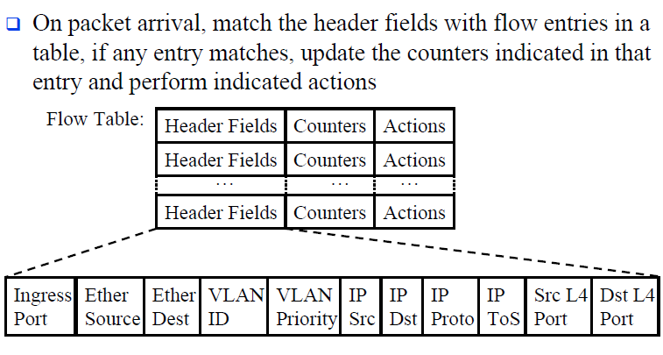
OpenFlow Version 1.0

Slide 20
Flow Table Examples
Switching
Switch
Port
MAC
src
MAC
dst
Eth
type
VLAN
ID
IP
Src
IP
Dst
IP
Prot
TCP
sport
TCP
dport
Action
*
*
00:1f:..
*
*
*
*
*
*
*
port6
Flow Switching
Switch
Port
MAC
src
MAC
dst
Eth
type
VLAN
ID
IP
Src
IP
Dst
IP
Prot
TCP
sport
TCP
dport
Action
port3
00:20..
00:1f..
0800
vlan1
1.2.3.4
5.6.7.8
4
17264
80
port6
Firewall
Switch
Port
MAC
src
MAC
dst
Eth
type
VLAN
ID
IP
Src
IP
Dst
IP
Prot
TCP
sport
TCP
dport
Action
*
*
*
*
*
*
*
*
*
22
drop

Slide 21
Flow Table Examples (Cont…)
Routing
Switch
Port
MAC
src
MAC
dst
Eth
type
VLAN
ID
IP
Src
IP
Dst
IP
Prot
TCP
sport
TCP
dport
Action
*
*
*
*
*
*
5.6.7.8
*
*
*
port6
VLAN Switching
Switch
Port
MAC
src
MAC
dst
Eth
type
VLAN
ID
IP
Src
IP
Dst
IP
Prot
TCP
sport
TCP
dport
Action
port6,
port7,
port9
*
*
00:1f..
*
vlan1
*
*
*
*
*

Slide 22
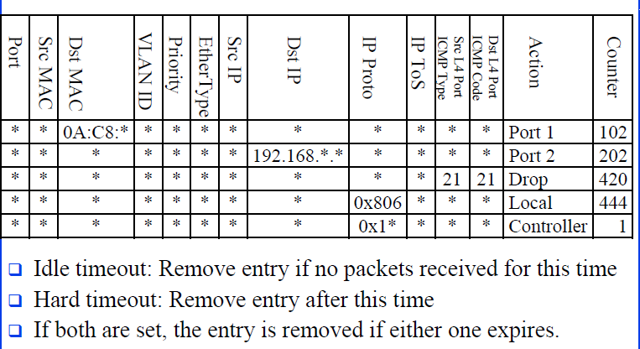
Flow Table Examples (Cont…)

Slide 23
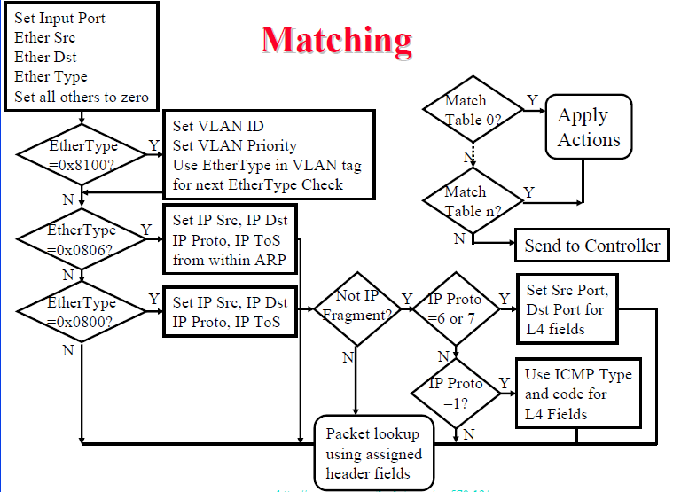
Flow Table Matching Algorithm

Slide 24
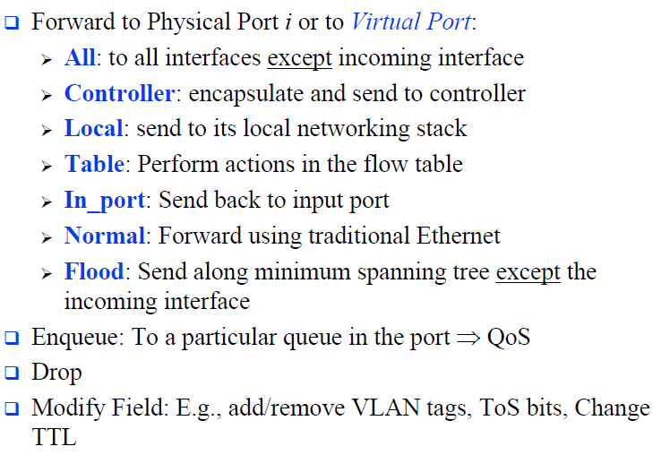
Flow Table Actions

Slide 25
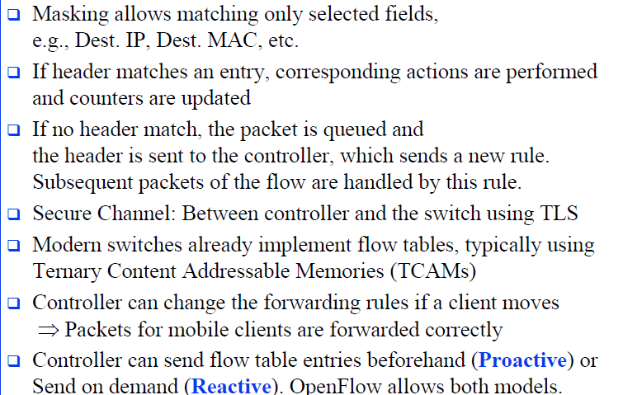
Flow Table Actions (Cont …)

Slide 26
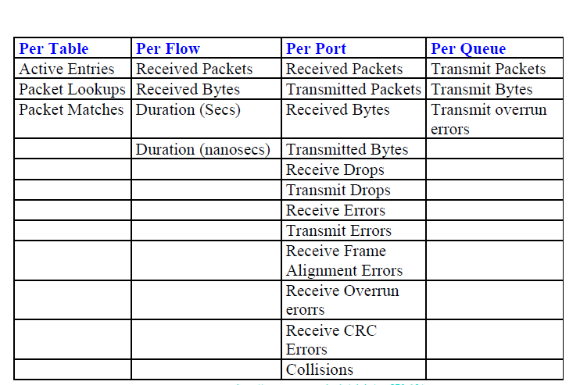
Counters Updates

Slide 27

Centralized vs Distributed Control Both models are possible with OpenFlow
Centralized Control
Distributed Control
Controller
Controller
OpenFlow
Switch
OpenFlow
Switch
Controller
OpenFlow
Switch
OpenFlow
Switch
Controller
OpenFlow
Switch
OpenFlow
Switch

Slide 28
Flow Routing vs. Aggregation Both models are possible with OpenFlow
Flow-Based
Every flow is individually set up by controller
Exact-match flow entries
Flow table contains one entry per flow
Good for fine grain control, e.g. campus networks
Aggregated
One flow entry covers large groups of flows
Wildcard flow entries
Flow table contains one entry per category of flows
Good for large number of flows, e.g. backbone

Slide 29
Reactive vs. Proactive (pre-populated) Both models are possible with OpenFlow
Reactive
First packet of flow triggers controller to insert flow entries
Efficient use of flow table
Every flow incurs small additional flow setup time
If control connection lost, switch has limited utility
Proactive
Controller pre-populates flow table in switch
Zero additional flow setup time
Loss of control connection does not disrupt traffic
Essentially requires aggregated (wildcard) rules

Slide 30
Open Challanges
How do I provide control connectivity? Is it really clean slate?
Why aren’t users complaining about time to setup flows over OpenFlow? (Hint: What is the predominant traffic today?)
Considering switch CPU is the major limit, how can one take down an OpenFlow network?
How to perform topology discovery over OpenFlow-enabled switches?
What happens when you have a non-OpenFlow switch inbetween?
What if there are two islands connected to same controller?
How scalable is OpenFlow? How does one scale deployments?
30

Slide 31
Usage examples
Alice’s code:
Simple learning switch
Per Flow switching
Network access control/firewall
Static “VLANs”
Her own new routing protocol: unicast, multicast, multipath
Home network manager
Packet processor (in controller)
IPvAlice
Stanford demonstrated
VM migration
Server Load balancing
Mobility manager
Power management
Network monitoring and visualization
Network debugging
Network slicing
… and much more you can create!
Notes:
31
31
What is possible in the controller? Anything that needs intelligent routing of a flow
At Stanford, we have even shown how OpenFlow may be used for:
VM migration
Power management
Load balancing
Network monitoring and debugging
Easier network visualization

Slide 32
Where it’s going
OF v1.1: Extensions for WAN, spring 2011
multiple tables: leverage additional tables
tags and tunnels
multipath forwarding
OF v2+
generalized matching and actions: an “instruction set” for networking

Slide 33
Where it’s going
OF v1.1: Extensions for WAN, spring 2011
multiple tables: leverage additional tables
tags and tunnels
multipath forwarding
OF v2+
generalized matching and actions: an “instruction set” for networking

Slide 34
What can you not do with OpenFlow ver1.1
Non-flow-based (per-packet) networking
e.g., Handling pkt 1 differently from pkt 2 of same flow
yes, this is a fundamental limitation
BUT OpenFlow provides the plumbing to connect devices
New forwarding primitives
BUT provides a nice way to integrate them through extensions
New packet formats/field definitions
BUT a generalized OpenFlow (2.0) is on the horizon
Optical Circuits
BUT efforts underway to apply OpenFlow model to circuits
Low-setup-time individual flows
BUT can push down flows proactively to avoid delays

Slide 35









Where is it going? The Open Networking Foundation:
Textbox Headline
The founding Consortium
Adopter Members (as of Feb 2012)
List of Members:
Big Switch Networks
Broadcom
Brocade
Ciena
Cisco
Citrix
Comcast
CompTIA
Cyan
Dell
Elbrys
Ericsson
ETRI
Extreme Networks
EZchip
Force10Networks
Fujitsu
Netronome
Nicira Networks
Nokia Siemens Networks
Plexxi Inc.
Pronto Systems
Radware
Riverbed Technology
Samsung
Spirent
Tencent
Texas Instruments
Vello Systems
VMware
ZTE Corporation
Hitachi
HP
Huawei
IBM
Infoblox
Intel
IP Infusion
Ixia
Juniper Networks
Korea Telecom
LineRate Systems
LSI
Marvell
Mellanox
Metaswitch Networks
Midokura
NEC
Netgear
Promoter Members:
Operators and service providers
Make up the board of directors
Have voting rights
Representative of DTAG is Bruno Orth (GTN S&A)

Slide 36
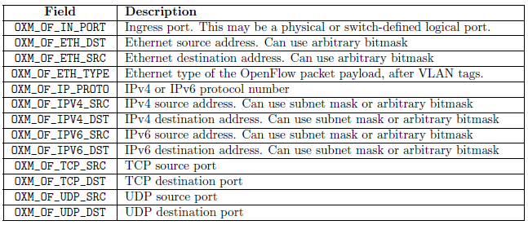
Where it’s going
OF v1.1: Extensions for WAN
multiple tables: leverage additional tables
tags and tunnels
multipath forwarding
OF v1.2: Extensible Match structure
Required fields includes IPv6

Slide 37
Where it’s going
OF v2+
generalized matching and actions: an “instruction set” for networking
Several other working groups have been created:
Hybrid group: Specifies how OpenFlow can be included into legacy switches without assuming clean-slate
Config group: Will specify an independent protocol that will help configure OpenFlow parameters out-of-band
.... And more

Slide 38

Topology discovery
OpenFlow controller view is not always complete. For instance, what does the controller see here?
OF switch
OF switch
Non-OF switch
X
Y
Host A
Host B
Non-OF switch
Internet
Host C

Slide 39

OpenFlow Implementations (Switch and Controller)
39

Slide 40
OpenFlow building blocks
oftrace
oflops
openseer
Monitoring/ debugging tools
Stanford Provided
Controller Applications
ENVI (GUI)
LAVI
n-Casting
Aggregation
NOX
Beacon
Helios
Maestro
SNAC
Controller
Slicing
Software
Expedient
FlowVisor
Commercial Switches
Stanford Provided
Software
Ref. Switch
NetFPGA
Broadcom
Ref. Switch
HP, NEC, Pronto, Juniper.. and many more
OpenFlow
Switches
OpenWRT
PCEngine WiFi AP
OpenVSwitch
40
Notes:
There are components at different levels that work together in making it work
The commercial switch details will follow in next slide
There are a plethora of applications possible. I only list those available at Stanford

Slide 41
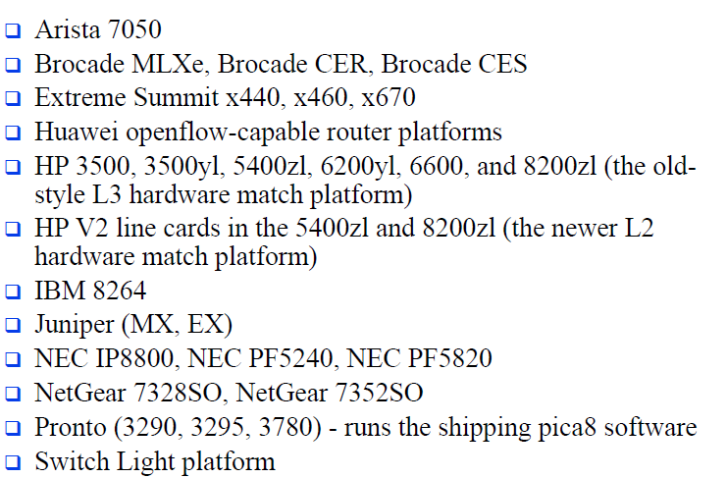
Hardware Switches from Vendors

Slide 42
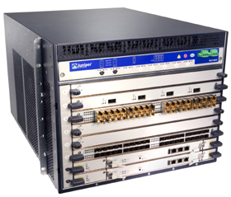
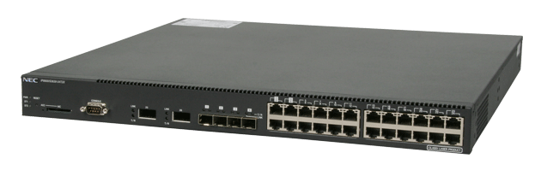
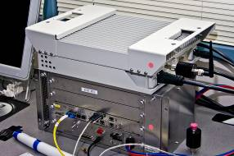
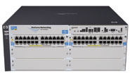
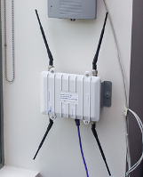

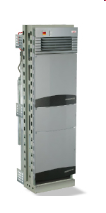

Current SDN hardware
Juniper MX-series
NEC IP8800
WiMax (NEC)
HP Procurve 5400
Netgear 7324
PC Engines
Pronto 3240/3290
Ciena Coredirector
More coming soon...
42

Slide 43
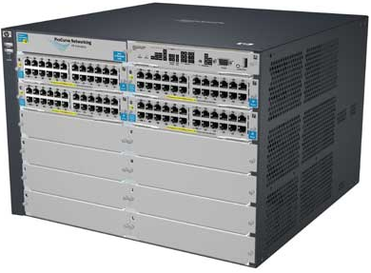

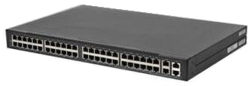
Commercial Switch Vendors
Model | Virtualize | Notes
HP Procurve 5400zl or 6600 | 1 OF instance per VLAN | LACP, VLAN and STP processing before OpenFlow Wildcard rules or non-IP pkts processed in s/w Header rewriting in s/w CPU protects mgmt during loop
NEC IP8800 | 1 OF instance per VLAN | OpenFlow takes precedence Most actions processed in hardware MAC header rewriting in h/w
Pronto 3290 or 3780 with Pica8 or Indigo firmware | 1 OF instance per switch | No legacy protocols (like VLAN and STP) Most actions processed in hardware MAC header rewriting in h/w
43
Notes:
All support ver 1.0
All have approx 1500 flow table entry limit

Slide 44
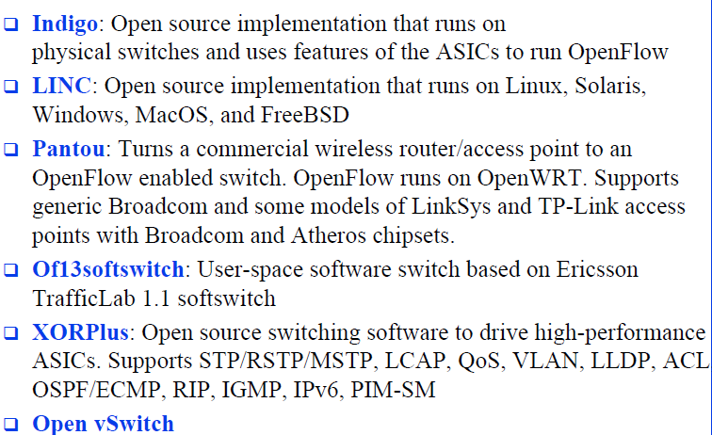
Software Switches from Vendors

Slide 45
Open-source controllers
Vendor | Notes
Nicira’s NOX | GPL C++ and Python
SNAC | GPL Code based on NOX0.4 Enterprise network C++, Python and Javascript Currently used by campuses
Vendor | Notes
Stanford’s Beacon | BSD-like license Java-based
Maestro (from Rice Univ) | GPL Based on Java
NEC’s Trema | Open-source Written in C and Ruby Included test harness
45

Slide 46
Current SDN hardware
Juniper MX-series
NEC IP8800
WiMax (NEC)
HP Procurve 5400
Netgear 7324
PC Engines
Pronto 3240/3290
Ciena Coredirector
More coming soon...
46

Slide 47
Commercial Switch Vendors
Model | Virtualize | Notes
HP Procurve 5400zl or 6600 | 1 OF instance per VLAN | LACP, VLAN and STP processing before OpenFlow Wildcard rules or non-IP pkts processed in s/w Header rewriting in s/w CPU protects mgmt during loop
NEC IP8800 | 1 OF instance per VLAN | OpenFlow takes precedence Most actions processed in hardware MAC header rewriting in h/w
Pronto 3240 or 3290 with Pica8 or Indigo firmware | 1 OF instance per switch | No legacy protocols (like VLAN and STP) Most actions processed in hardware MAC header rewriting in h/w
47
Notes:
All support ver 1.0
All have approx 1500 flow table entry limit

Slide 48
Controller Vendors
Vendor | Notes
Nicira’s NOX | Open-source GPL C++ and Python Researcher friendly
Nicira’s ONIX | Closed-source Datacenter networks
SNAC | Open-source GPL Code based on NOX0.4 Enterprise network C++, Python and Javascript Currently used by campuses
Vendor | Notes
Stanford’s Beacon | Open-source Researcher friendly Java-based
BigSwitch controller | Closed source Based on Beacon Enterprise network
Maestro (from Rice Univ) | Open-source Based on Java
NEC’s Helios | Open-source Written in C
48

