Slide 1
Team 8: Project 4

Slide 2
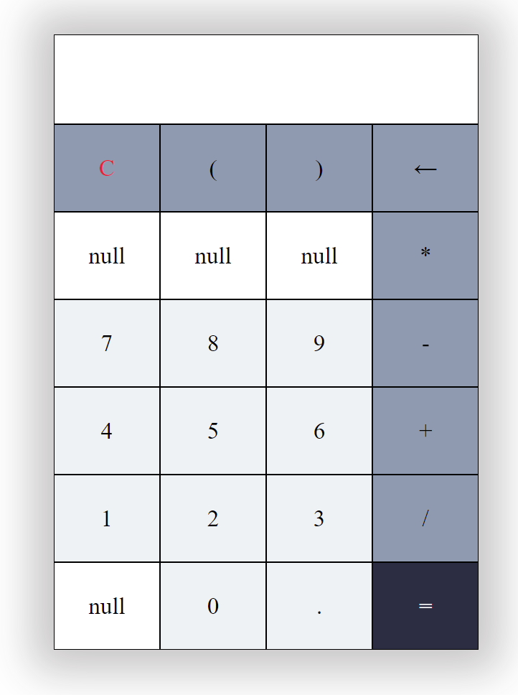
Project 3:
Basic Arithmetic Operations
Blank buttons for project 4

Slide 3
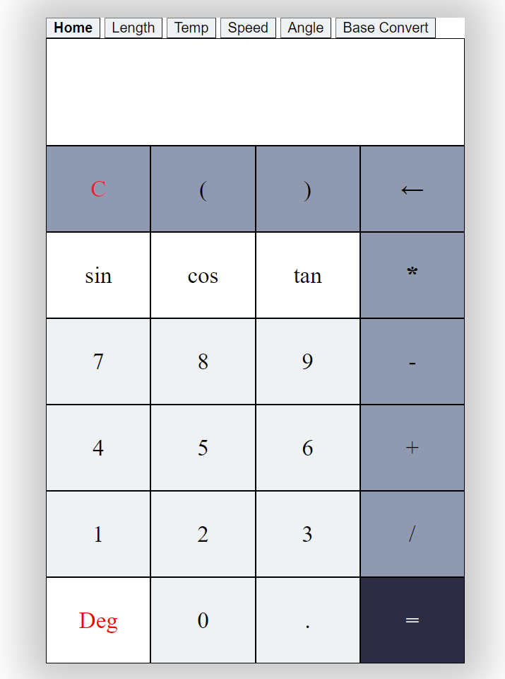
Main Calculator:
Basic Arithmetic Operations
Trigonometric Operations in deg & rad
Error displayed if syntactical error

Slide 4
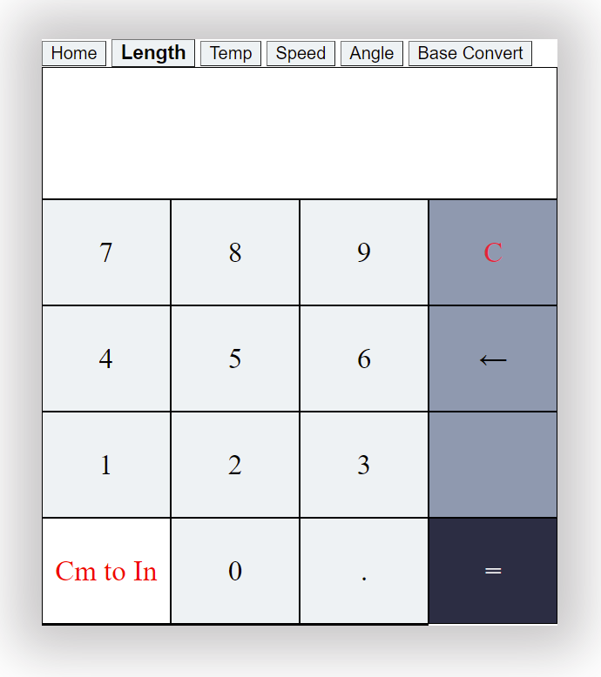
Length Converter:
Converts Cm to Inches
Converts Inches to Cm

Slide 5
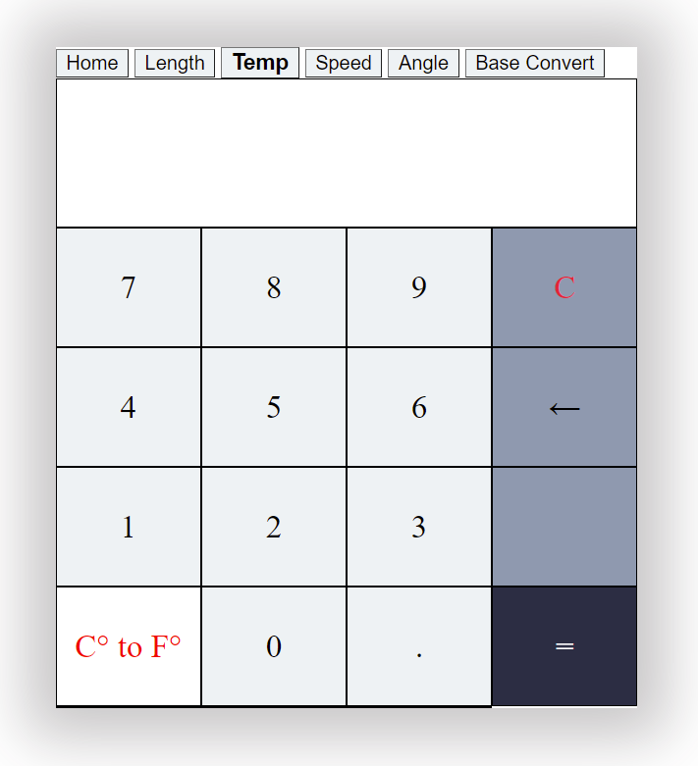
Temperature Converter:
Converts Celsius to Fahrenheit
Converts Fahrenheit to Celsius

Slide 6

Speed Converter:
Converts to Km/h to Mph
Converts Mph to Km/h

Slide 7
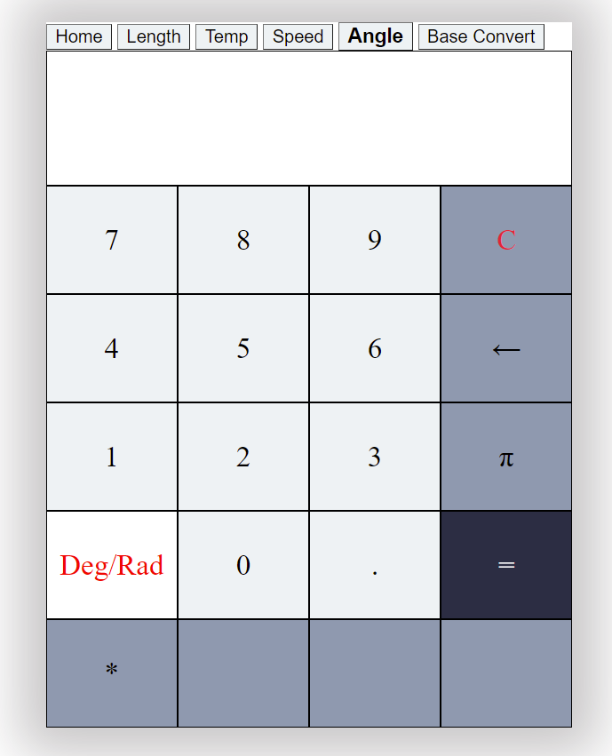
Angle Converter:
Converts degree to radians
Converts radians to degrees

Slide 8

Base Converter:
Converts Binary to Decimal
Converts Decimal to Binary

