Slide 1
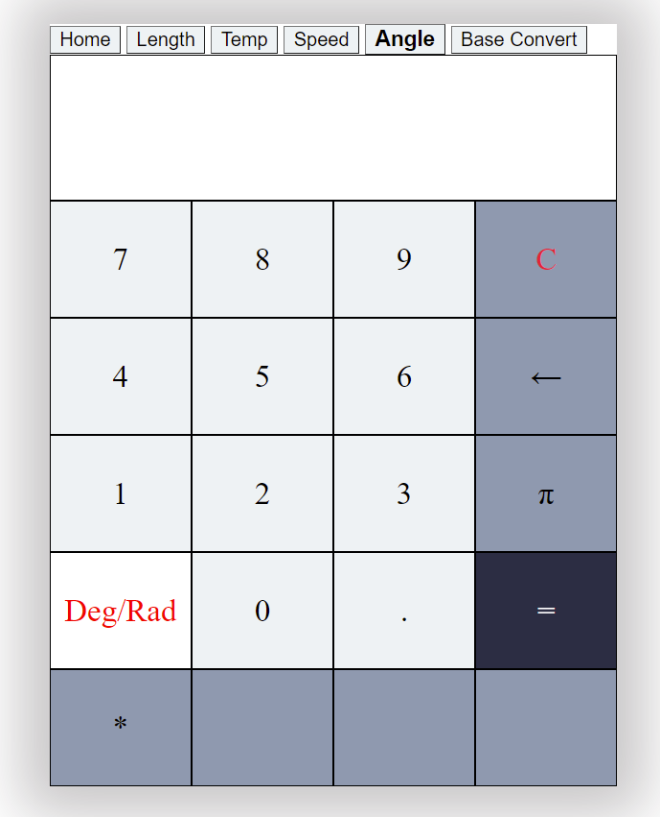
Angle Converter:
Converts degree to radians
Converts radians to degrees

Slide 2

Angle Converter:
Degree to Radians:
180 = $π=\text{3.141592653589793}$
90 = $\frac{π}{2}=$1.5707963267948966

Slide 3
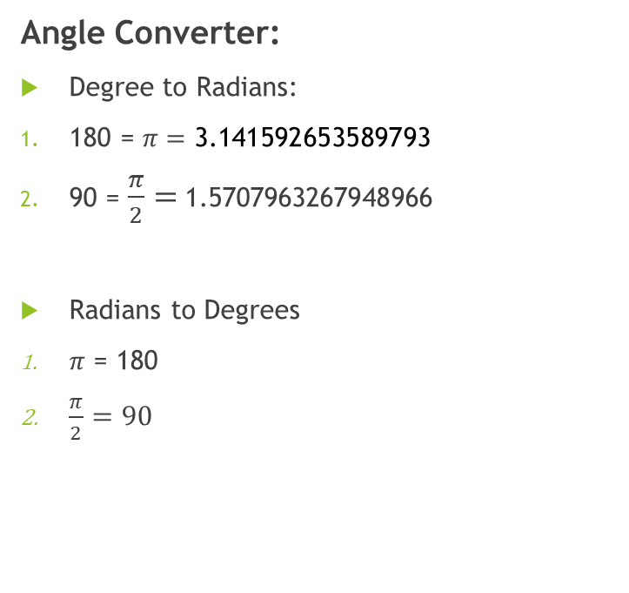
Angle Converter:
Degree to Radians:
180 = $π=\text{3.141592653589793}$
90 = $\frac{π}{2}=$1.5707963267948966
Radians to Degrees
$π$ = 180
$\frac{π}{2}=90$

Slide 4
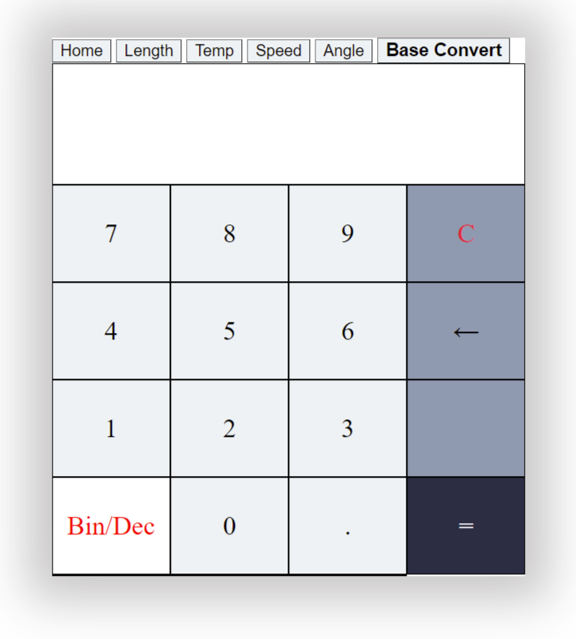
Base Converter:
Converts Binary to Decimal
Converts Decimal to Binary

Slide 5

Base Converter:
Binary to Decimal:
11101 = $2^{4}+$ $2^{3}$ + $2^{2}$ + $2^{0}=29$
1010 = $2^{3}$ + $2^{1}=10$

Slide 6
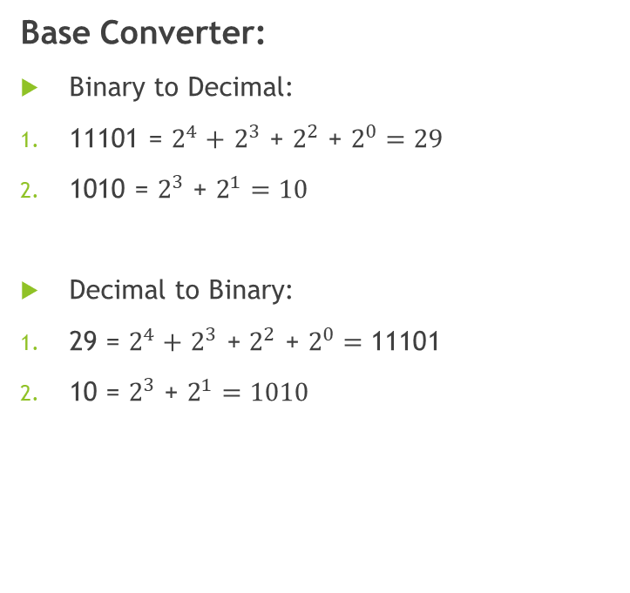
Base Converter:
Binary to Decimal:
11101 = $2^{4}+$ $2^{3}$ + $2^{2}$ + $2^{0}=29$
1010 = $2^{3}$ + $2^{1}=10$
Decimal to Binary:
29 = $2^{4}+$ $2^{3}$ + $2^{2}$ + $2^{0}=\text{11101}$
10 = $2^{3}$ + $2^{1}=1010$

Slide 7
Thank you!
Any question?

