Slide 1
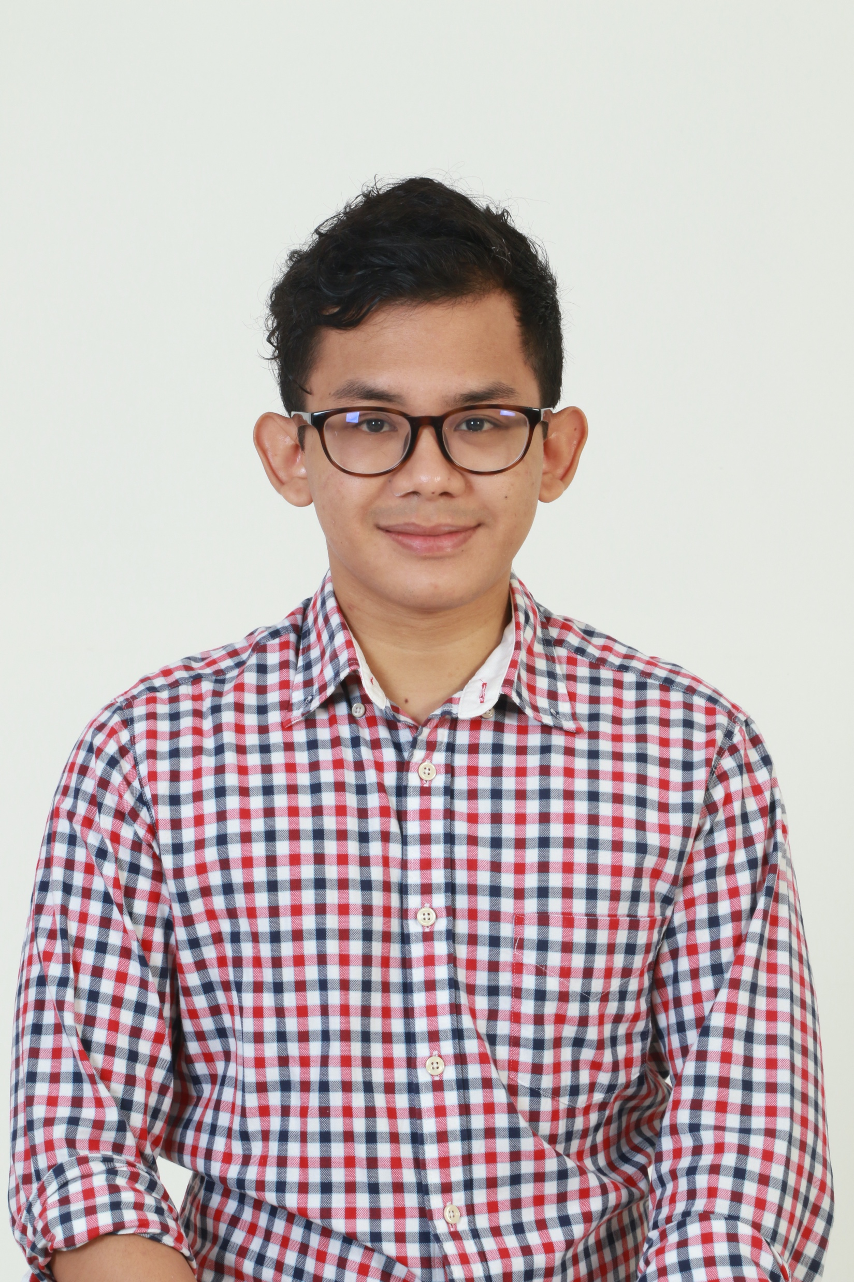
Muhammad Haziq Faiz
Hi my name is Haziq and I am a first year computer science student at Xiamen University Malaysia Campus

Slide 2

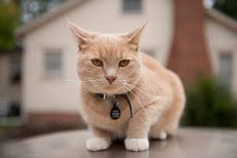
About Me
I was born and raised in Kuala Lumpur
But currently I live in Bandar Baru Bangi
My favourite animals is cats and I have three of them.
I am 22 years old

Slide 3
Contact Info
CST1909542@xmu.edu.my
+60132061817
No 11, Jalan 4/9C
B. B. Bangi,
43650,
Selangor, Malaysia
github.com/hzaiqfaiz

Slide 4
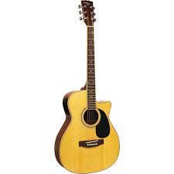

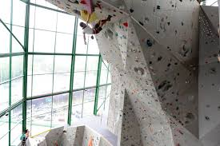
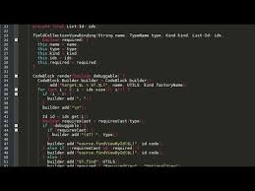
Interest
Running
Wall Climbing
Programming
Playing Guitar

Slide 5
Dreams and Ambitions
Insert the title of your subtitle Here
2019
2022
2023
202?
Start a Business
I always dreamed of starting my own business.
Post Graduate??
Maybe I can pursue a master or phD in CS
Graduate from XMUM
Hopefully with a good result
XMUM
Enrolled in a Computer Science Undergraduate Program

Slide 6
Thank you

