Slide 1
C
CryptoCopilot
An intelligent assistant for the world of crypto
ML direction signals · technical analysis · cited AI chat · safe paper trading
Presented by Kamran Zajkani
Demo Day · June 2026
Decision-support, not financial advice
A polyglot system: Python (data + ML) · Java/Spring Boot · React — five containers, one shared database.

Slide 2
WHY THIS PROJECT
Money, Control — and a Different Idea
Traditional money
🏦 Controlled by central banks — central control.
💸 You pay fees to hold and move your own money.
🔒 Someone else is always in charge of your account.
Cryptocurrency
🌐 Decentralized — no central authority in control.
🔑 You hold your own money, directly.
➕ Pros: open, global, fewer gatekeepers.
➖ Cons: complex, volatile, confusing for newcomers.
CryptoCopilot helps newcomers: it turns scattered market data + news into clear information and signals about coins.
Decision-support, not financial advice · Paper trading only
2 / 12

Slide 3
HOW IT IS BUILT
One System, Two Languages, Five Containers
frontend
React + nginx — the browser app
REST / JSON (same origin)
HTTP /api/ml/*
backend — Spring Boot
Modular monolith: ta4j · Spring AI · trading · analyst · REST API
ml-api — Python
FastAPI: on-demand ingest / train / predict
JDBC — reads ml's tables; writes orders + vectors
ml — Python
Batch worker: ingestion · XGBoost · SHAP
db — Postgres 16 + pgvector
The single shared database
writes predictions + raw data
The database is the polyglot boundary: Python writes → Java reads. No RPC, no shared model files.
Decision-support, not financial advice · Paper trading only
3 / 12

Slide 4
THE FUEL
Real Data: 10 Coins, 5 Free Sources
BTC · ETH · SOL · BNB · XRP · ADA · AVAX · DOT · LINK · MATIC
Where it comes from
📈 Binance — price candles (1h / 4h / 1d, ~2 years)
🦎 CoinGecko — market cap, supply, community & dev data
📰 RSS ×5 — CoinDesk, Cointelegraph, Decrypt, The Block…
⛓️ Blockchain.com + Etherscan — on-chain activity
📚 Curated knowledge base — how each coin works
How we treat it
🗃️ ~231,000 rows loaded into one Postgres database
🛡️ Multi-source by design — no single point of failure
🔁 If any source fails: log and skip, never crash
👤 One writer per table — clean, auditable data
💶 All sources are public and free
Decision-support, not financial advice · Paper trading only
4 / 12

Slide 5
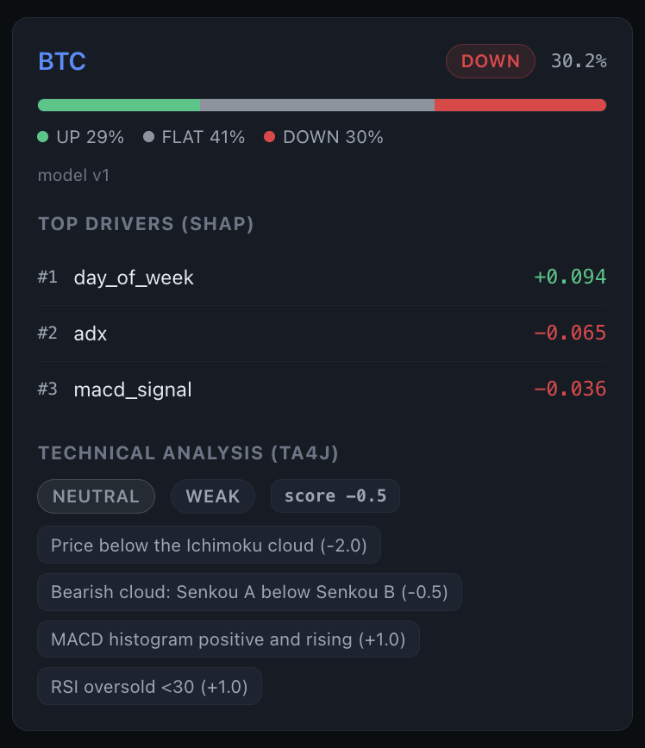
THE MACHINE LEARNING
An Honest Edge, Not a Crystal Ball
Raw candles
46 features
XGBoost
Calibration
SHAP
Probabilities
▸ Predicts UP / FLAT / DOWN over the next 24 hours (a ±2% move).
▸ ROC-AUC = 0.578 — a small but real edge above luck (0.5 = a coin flip).
▸ Calibrated probabilities: “70%” really means about 70%.
▸ SHAP explains the top-3 reasons behind every single prediction.
▸ Trained on ~2 years of history — the score is reported honestly.
Decision-support, not financial advice · Paper trading only
5 / 12

Slide 6
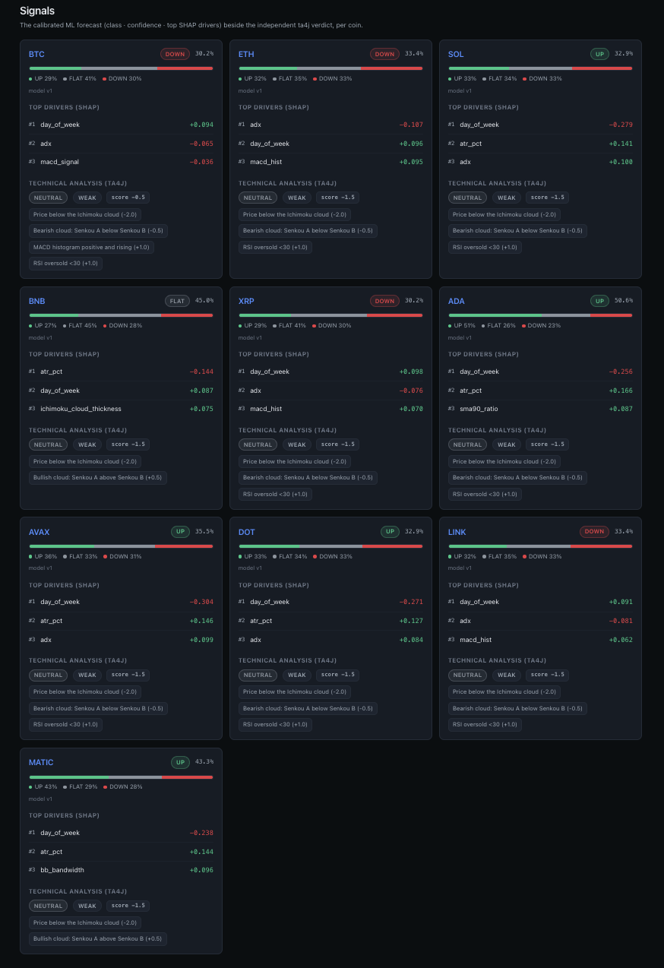
TECHNICAL ANALYSIS
Chart Signals You Can Audit
▸ Computed in Java with ta4j, straight from the price candles.
▸ Indicators: Ichimoku · RSI · MACD · Bollinger · ATR.
▸ Deterministic rules → BULLISH / NEUTRAL / BEARISH + a confidence.
▸ It shows the exact rules that fired — fully transparent.
▸ Independent of the ML model — a real second opinion.
Backend = one modular monolith (Spring Boot), not microservices.
Decision-support, not financial advice · Paper trading only
6 / 12

Slide 7
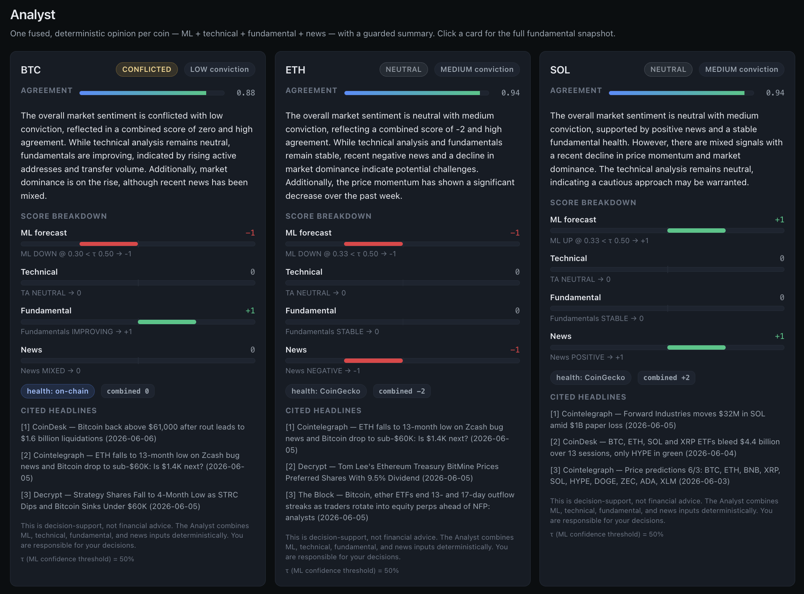
THE RESEARCHER
AI Chat That Cites Its Sources
▸ Embeddings turn text into numbers that capture meaning.
▸ pgvector stores them inside the same Postgres database.
▸ RAG = retrieve real sources, then answer using only them.
▸ Every answer is cited [1][2]; it refuses if the answer isn’t there.
▸ Gives cited, signal-based views — flagged ‘educational, not financial advice’.
▸ recall@8 = 0.90 · 100% of answers cited.
Runs free & local (Ollama llama3.2:3b) — or switch to OpenAI gpt-4o-mini with one click.
Decision-support, not financial advice · Paper trading only
7 / 12

Slide 8
PUTTING IT TOGETHER
Four Views → One Clear Opinion
🤖 ML signal
📊 Technical
🏥 Fundamentals
📰 News
Analyst → Direction · Conviction · Agreement
▸ A simple, deterministic score from −2…+2 per view.
▸ Same inputs always give the same verdict — auditable.
▸ A hallucination guard keeps the summary truthful.
▸ Works even with the AI switched off (plain template).
Decision-support, not financial advice · Paper trading only
8 / 12

Slide 9
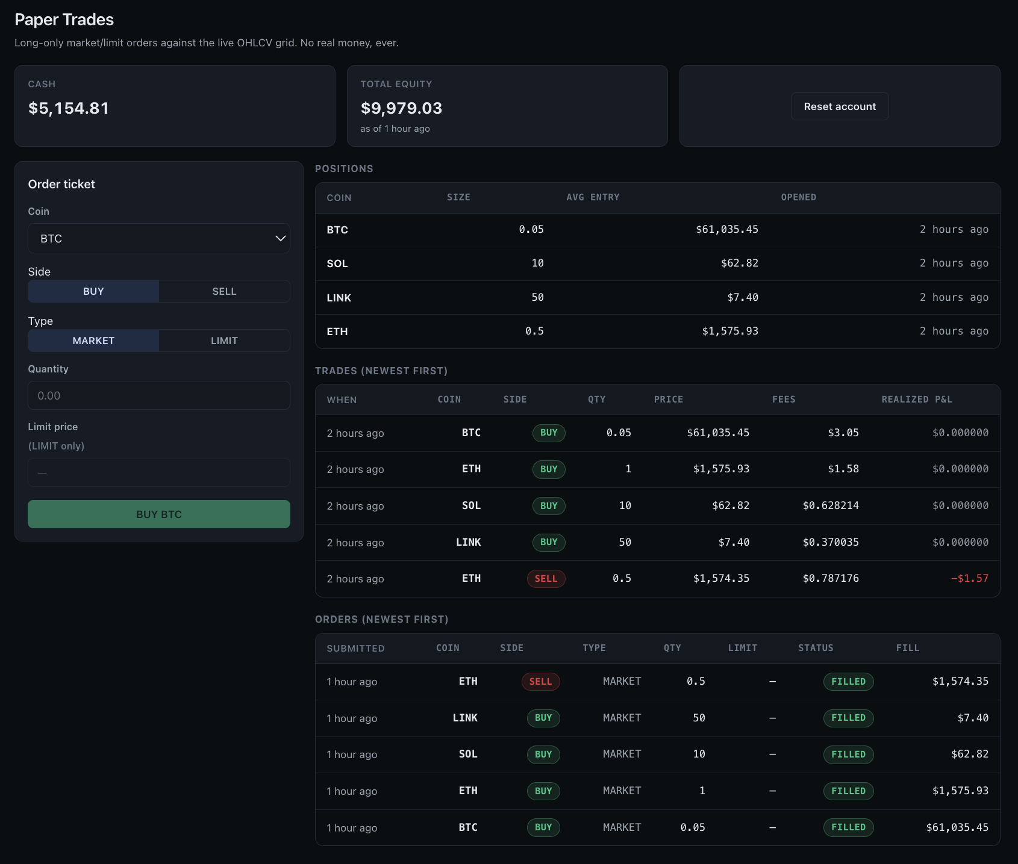
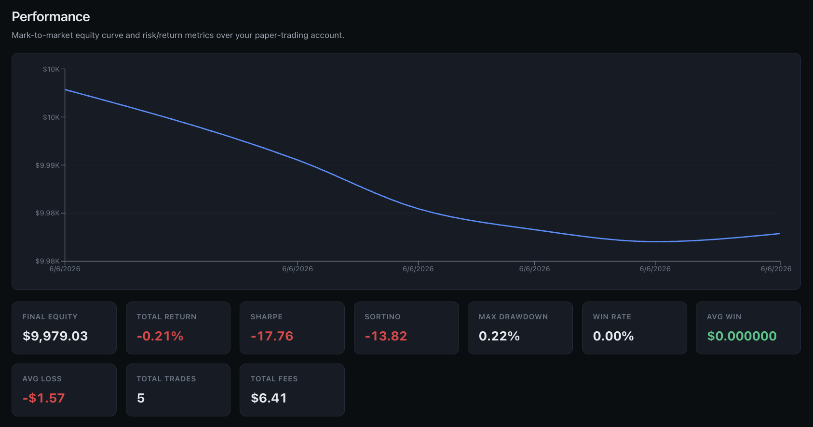
ACTING ON IT — SAFELY
Practice Trading, No Real Money
▸ Paper trading = real mechanics, fake money.
▸ Long-only; realistic fills with slippage + a 0.1% fee.
▸ Market & limit orders; positions, trades, account tracked.
▸ Performance: equity curve + Sharpe, Sortino, drawdown.
▸ Honest backtest result — the engine is correct, not magic.
Decision-support, not financial advice · Paper trading only
9 / 12

Slide 10
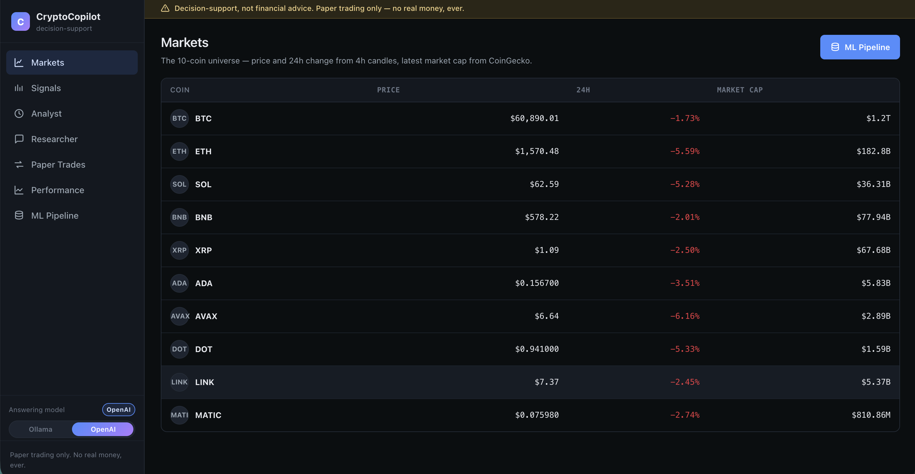
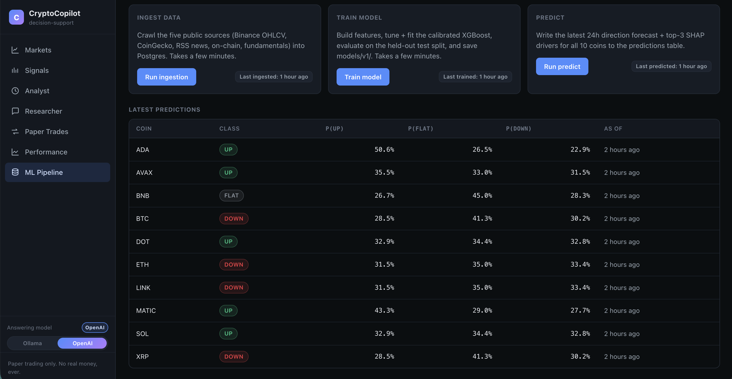
THE PRODUCT
A Clean, Typed Web App
▸ React · Vite · TypeScript · nginx.
▸ Candlestick charts with klinecharts; equity with Recharts.
▸ 7 pages: Markets, Signals, Analyst, Chat, Trades, Performance…
▸ …plus an ML Pipeline page — run the whole pipeline in-browser.
▸ A disclaimer is on every page.
Decision-support, not financial advice · Paper trading only
10 / 12

Slide 11
THE HONEST SCORECARD
What It Achieves — Reported Honestly
Machine learning
ROC-AUC 0.578
A small, real edge above luck.
AUC + Brier pass; F1 limited by ~2y data.
RAG retrieval
recall@8 0.90
100% of answers cited.
Refuses the unknown; ≈ €0, local.
Engineering
5 containers · 1 DB
Tests + CI across 3 languages.
Backtest honest, engine correct.
The goal was production-grade polyglot engineering — built end-to-end and reported honestly.
▸ Hard rules, never broken: paper only · crypto only · no shorts/leverage · decision-support, not advice.
Decision-support, not financial advice · Paper trading only
11 / 12

Slide 12
Thank you!
Questions?
CryptoCopilot — four views on every coin, fused into one explainable opinion.
app · localhost:3000
API docs · :8080/swagger-ui.html
ML API · :8000/docs
Decision-support, not financial advice. Paper trading only — no real money, ever.

