Slide 1
Apache Camel Advanced Techniques
Hadrian Zbarcea
hzbarcea@talend.com

Slide 2
Agenda
from(“introduction”)
.to(“camel:overview”)
.wireTap(usecases())
.enrich(understanding(concepts()))
.to(“camel:examples”).pipeline(
“split”, “dynamic routing”,“expressions”)
.end();

Slide 3
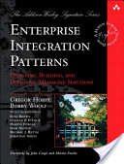
What?
Robust, mature integration framework
Modular and extensible
Based on known standards
Based on Enterprise Integration Patterns
Embraces diversity

Slide 4
Why?
Make you more productive!
Simplify integration
Help meet challenges:
  Cost (time and money)
  Constant change (cost)
  Too much middleware
  No “one size fits all solution”
  Long feedback loop for architectural decisions

Slide 5
How?
Plugin based architecture
Lightweight
Integration API
Payload and deployment model agnostic
DRY – the framework should handle repetitive tasks that can be automated
Heavy use of convention over configuration

Slide 6
When/Who?
Project started in 2007 as an ActiveMQ subproject
TLP since Dec 2008
Large, diverse, growing user and developer communities across the globe
Commercial support and services from a number of companies

Slide 7
Use cases
Lightweight Business Processes
Value added router (e.g. validation)
Topology adapter (sync/async, eai/p2p)
Protocol adapter
Web service proxy for legacy apps
Test framework (mock services, data generator)
… many more

Slide 8
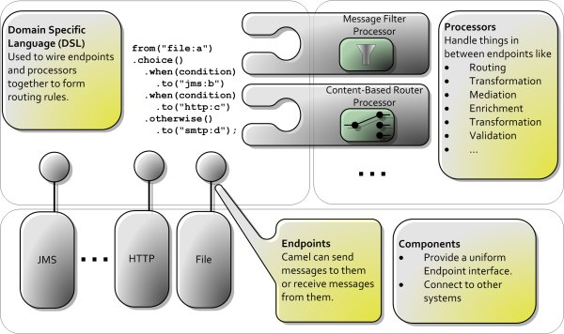
Architecture

Slide 9




Concepts (basic)
Message
  headers
  body
Exchange
Processor
Route
CamelContext
Producer
Consumer
  event based
  polling
Endpoint
Component

Slide 10
Concepts (advanced)
Type Converter
Data Format
Language
Expression
Predicate
DSL
DLC
Error Handling
Test framework

Slide 11
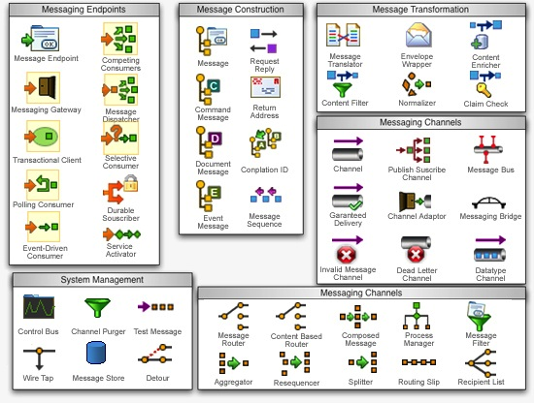
Enterprise Integration Patterns

Slide 12
Recipient List
allows routing messages to a number of dynamically specified recipients
recipients will receive a copy of the same Exchange, and Camel will execute them sequentially
the recipient address is determined by evaluating an Expression

Slide 13
Routing Slip
route a message consecutively through a series of processing steps where the sequence of steps is not known at design time and can vary for each message.
the endpoint addresses are determined by evaluating an Expression

Slide 14
Splitter
“allows splitting a message into a number of pieces and process them individually”
actually it's not really a message, but the result of evaluating an Expression against the message (so it could be a part of the message, or something else)
… but it has to be Iterable

Slide 15
Expressions
A String (script) that gets evaluated against an Exchange, sometimes in the context of a Language, to return a value of certain Type.
… language usually means an expression language (xpath, juel, simple), but could be a scripting/programming language too.

Slide 16
Expressions
Used by a number of EIPs (the more interesting ones) to:
  configure behavior based on message content
  generate content
Camel provides out of the box a large number of expressions
… but Camel is extensible, you can implement your own...

Slide 17
Expressions
… which is quite easy, you only need to implement one interface with one method.
public interface Expression {
<T> T evaluate(Exchange exchange, Class<T> type);
}

Slide 18
and Predicates
Many Predicates provided out of the box by Camel as well.
… you can implement your own too, they only return a boolean.
public interface Predicate {
boolean matches(Exchange exchange);
}

Slide 19
Exceptions and Predicates
Sometimes used together
… and could be chained!
...choice()
.when(header("foo").isEqualTo("bar"))
.process(myProcessor)

Slide 20
Q & A
… but let's see some code first (not a lot though)
“Answer only important when ask the right question”
  Mr Miyagi

Slide 21
Thanks

