Slide 1
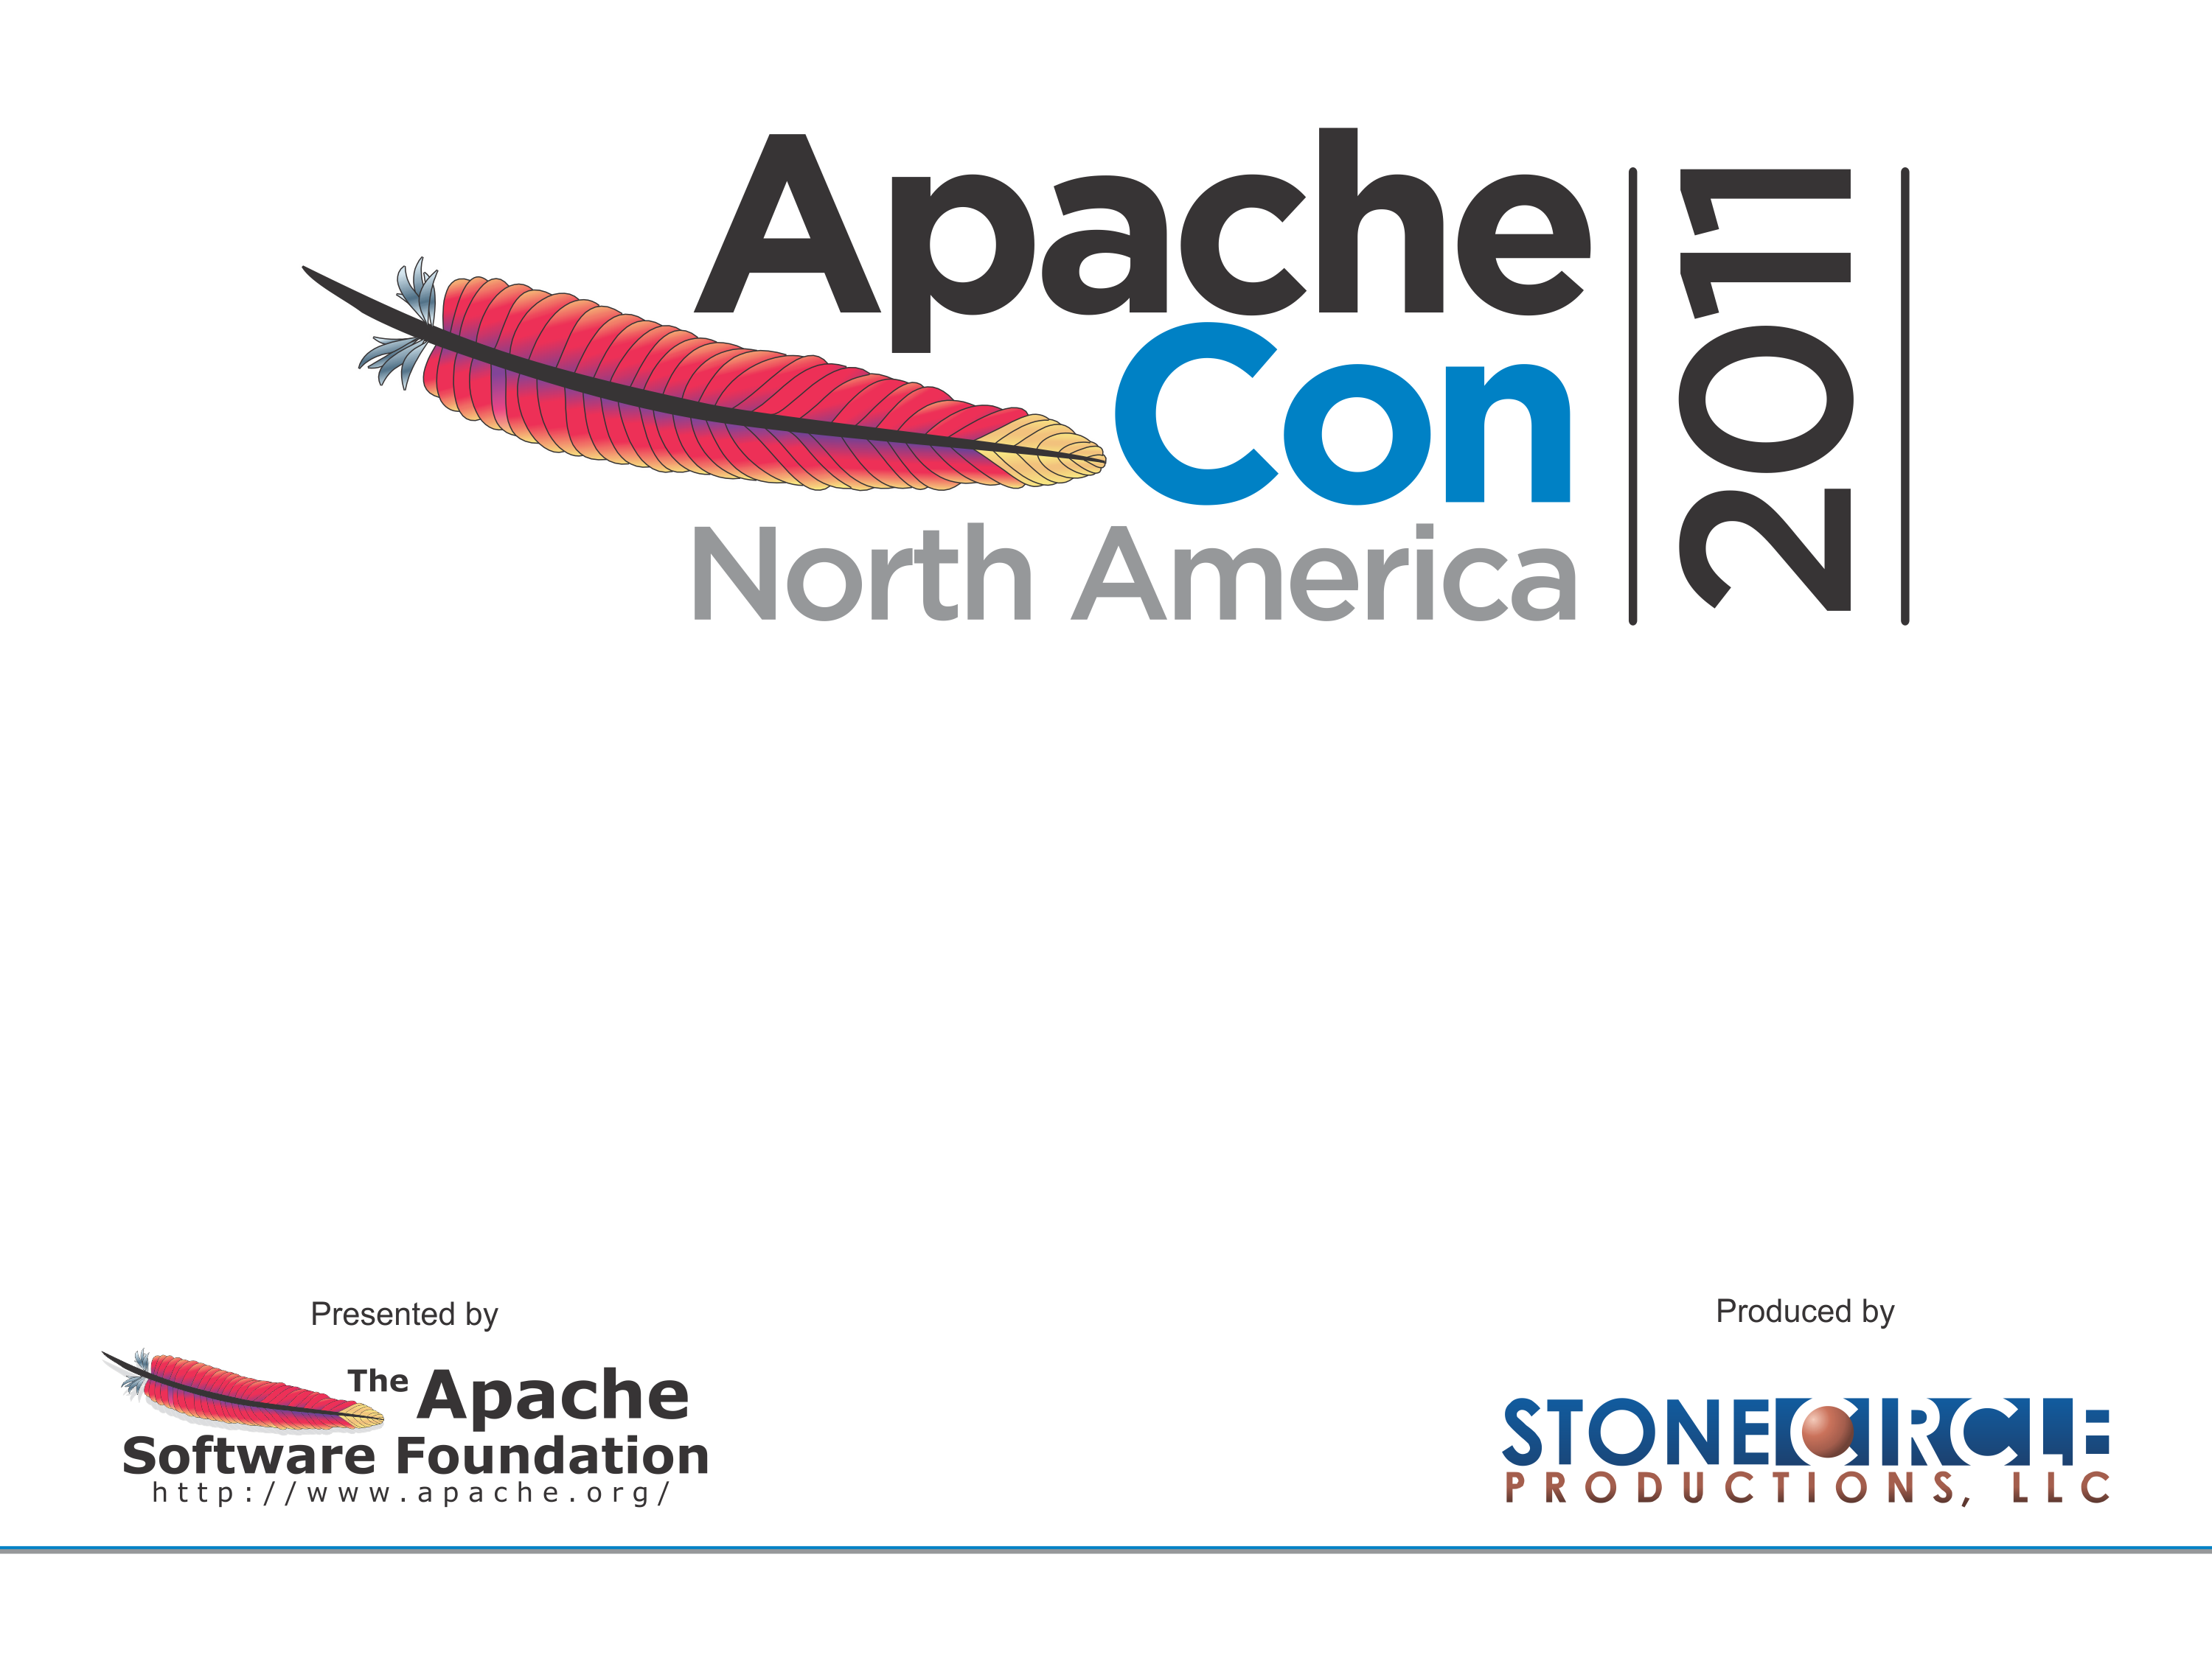
Enterprise SOA, Apache Style
Hadrian Zbarcea (Talend) - hadrian@apache.org
Daniel Kulp (Talend) – dkulp@apache.org
2011-11-10

Slide 2
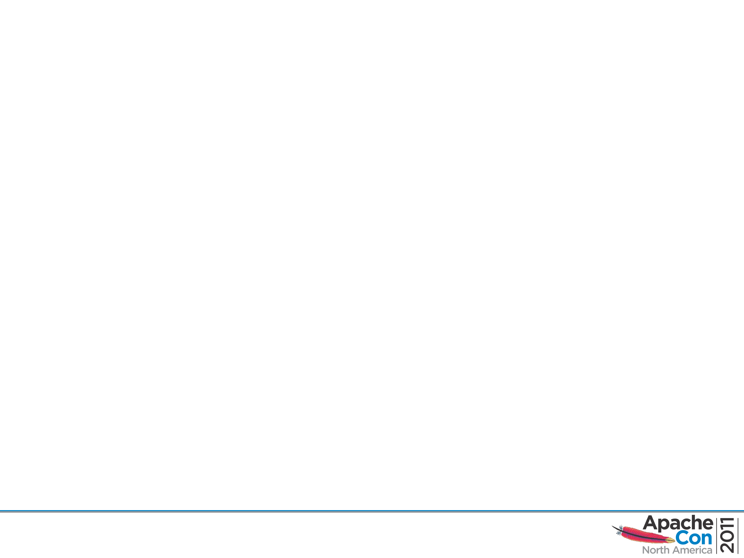
Speakers' Background
Dan Kulp
VP, Open Source Development at Talend
ASF Member
Committer on CXF, Camel, Aries, ServiceMix
Hadrian Zbarcea
Principal Architect at Talend
ASF member
Committer on Camel, ActiveMQ and Rave

Slide 3
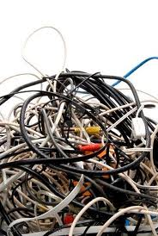
What is SOA?

Slide 4
Challenges
Cost (time and money)
Constant change (cost)
No 'one size fits all solution'
Long feedback loop for architectural decisions
Too much middleware

Slide 5
Taming Complexity
Finer grained, independent, autonomous (Web) Services
Partitioning (avoid sharing state)
Loose coupling
Asynchronous Messaging
Solid Integration Framework

Slide 6
Apache 'infrastructure'
CXF (web services)
ActiveMQ (pub/sub broker)
Camel (integration framework)
Karaf (OSGi on steroids)
Aries (OSGi blueprint)

Slide 7
Apache CXF
Services Framework
  WS-* (JAX-WS)
  REST (JAX-RS)
Supports several security options
Flexible deployment options
  OSGi/Karaf ready

Slide 8
Apache Karaf
Enterprise ready OSGi based runtime
  Hot deployment
  Dynamic configuration
  Shell console for remote access
  Support for deploying Web Applications

Slide 9
Apache Camel
Robust, mature integration framework
Standards based (support for 100+ technologies – protocols, data formats...)
Based on Enterprise Integration Patterns
Convention over Configuration simplifies work
Payload agnostic
Lightweight
Modular and extensible
Embraces diversity

Slide 10
Camel Features
Integration API
DSL based on EIPs
Lightweight, modular runtime
Large number of Components
Mature, stable production ready
Clever use of URIs for Endpoint configuration

Slide 11
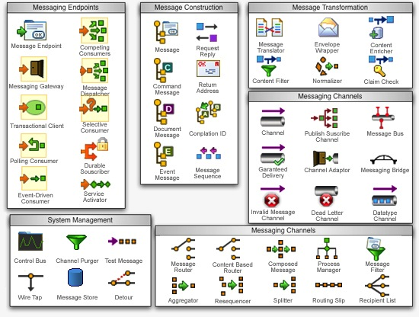
EIPs

Slide 12
Best Practices
Design your functionality as a set of small and autonomous tasks. Let the framework connect them together.
It's all about the data! The interface between functional units should be based on data formats. Formats and protocols are important, but the framework should take care of that.
Use open standards as much as possible. WS are your friend, REST scales very well. Asynchronous messaging scales well too.
Use Open Source Software
Deploy in robust containers like OSGi (Apache Felix/Equinox + Apache Karaf/Camel/CXF/ActiveMQ...)
… and have fun and remember to contribute back!

Slide 13
Demo time
Enterprise SOA?
Interactive?
Apache Style?

Slide 14
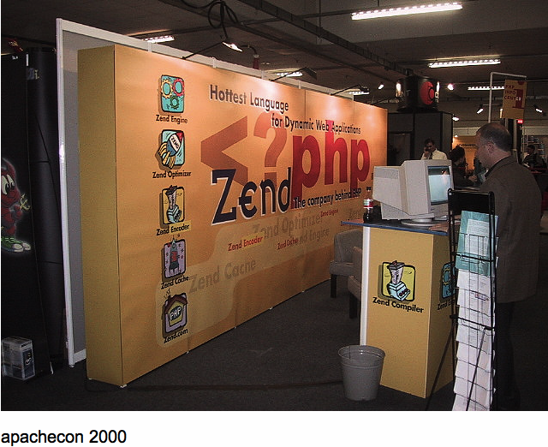
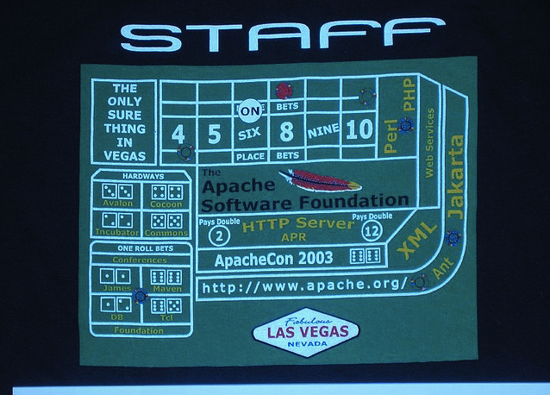
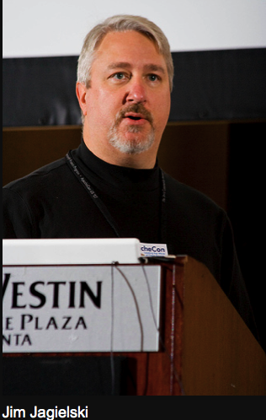

Memories

Slide 15
The Application
Hippocampus
Part of the cortex “essential for initial storing of long-term memory for a period of days to weeks before the memory trace is consolidated elsewhere”
http://www.biology-online.org/dictionary/Hippocampus
SpeechBubble
Scrapbook
Emporium
A place where various [messages] are [exchanged]; a marketplace.
(adapted from) http://www.thefreedictionary.com/emporia
https://github.com/hzbarcea/memories

Slide 16
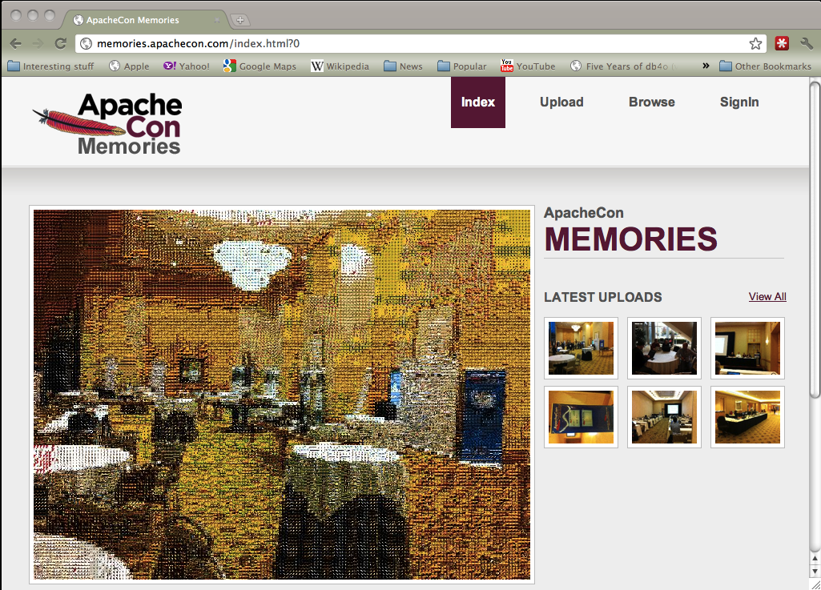
Memories

Slide 17
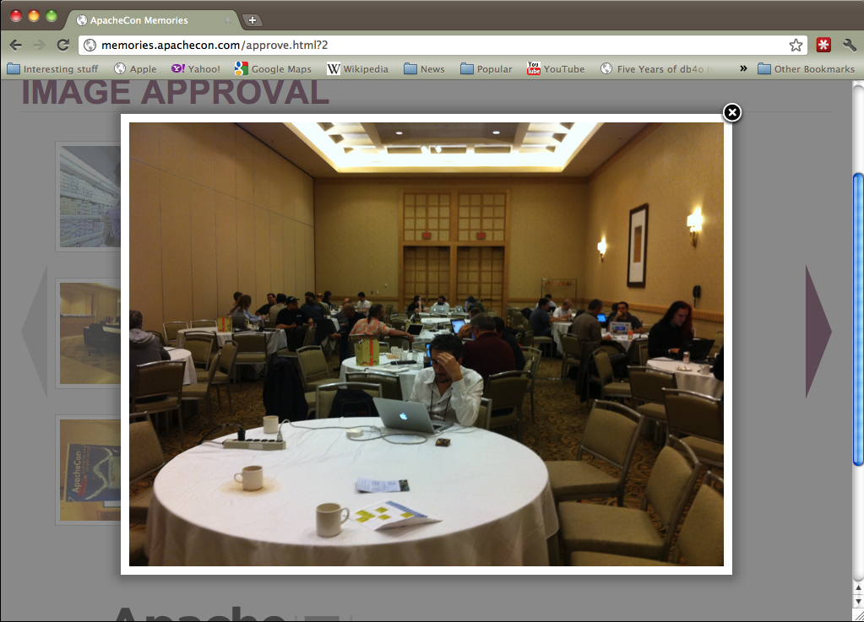
Memories

Slide 18
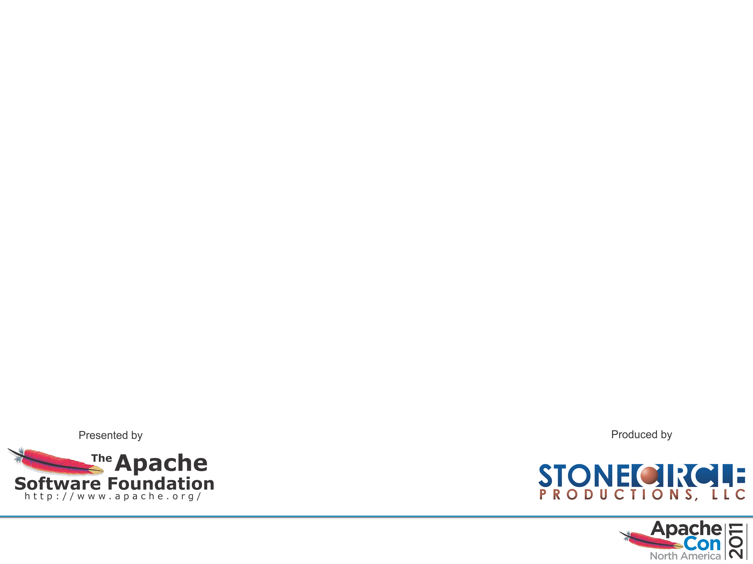
Thanks
Alex Zbarcea, Eugen Stan (html/css)
Łukasz Dywicki (Wicket/OSGi)
Dan Kulp (WS)
Hadrian Zbarcea (Camel)
The ASF infra@ (Gavin, Daniel, Joe)
Sally & Shane (concom@)

Slide 19
Q&A

